Slide 1
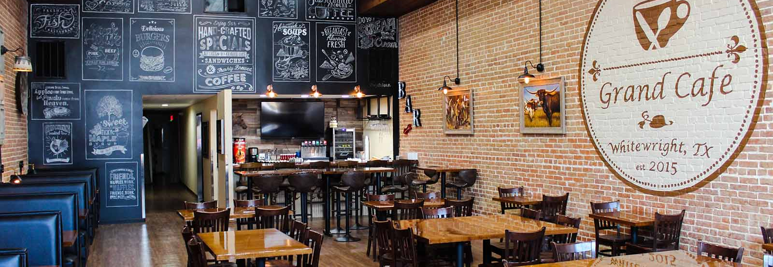
Café Great Chain
MRA Project
Deepti Lobo
January, 2020

Slide 2
Assignment Snapshot
Background
Exploratory Analysis
Exploratory Analysis of data & an executive summary of your top findings, supported by graphs.
What kind of trends do you notice in terms of consumer behavior over different times of the day and different days of the week? Can you give concrete recommendations based on the same?
Are there certain menu items that can be taken off the menu?
Are there trends across months that you are able to notice?
Menu Analysis
Identify the most popular combos that can be suggested to the restaurant chain after a thorough analysis of the most commonly occurring sets of menu items in the customer orders. The restaurant doesn’t have any combo meals. Can you suggest the best combo meals?
The data set provided constitutes the data of a Café Chain for one of its restaurants. We need to do a thorough analysis of the data and come up with the following analysis
Menu Analysis
Exploratory Analysis

Slide 3

Exploratory Analysis

Slide 4
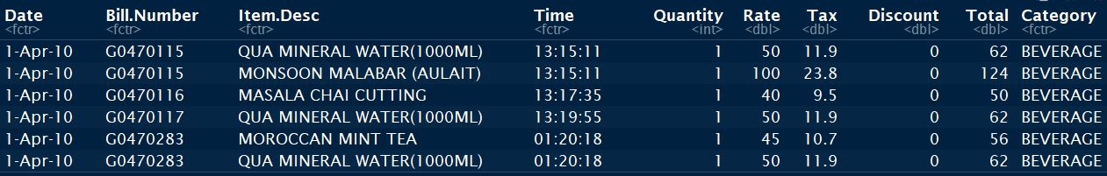
Data
Size
145830 rows
Column Names
Date Rate
Bill Number Tax
Item Desc Discount
Time Total
Quantity Category
10 columns

Slide 5
Data Types
Interval Variables
Date - The date on which the transaction happened. Date ranges from April, 2010 to Mar, 2011.
Time - The time of he day when the transaction happened
Quantity - no of items bought in each transaction
Rate - The rate of each item
Tax - Tax to be collected on each item
Discount - Discount given on each time
Total - Total price of the item, sum of rate, tax and discount.
Nominal Variables
Bill Number - The transaction ID
Item Desc - Item description
Category - It is divided into 8 categories. Beverages(30%), Food(39%), Liquor(4%), Liquor & Tobacco(0.03%), Merchandise(0.33%), Misc(0.81%), Tobacco(25%), Wines(0.55%)

Slide 6
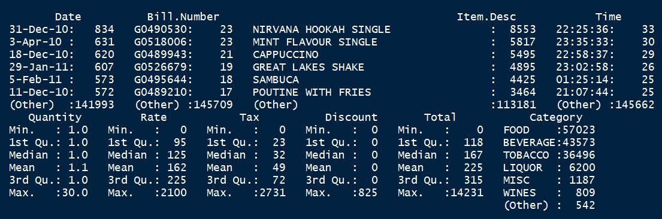
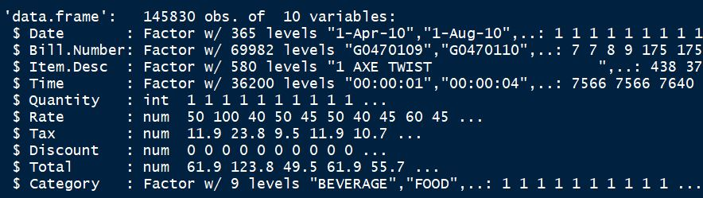
Data Summary

Slide 7
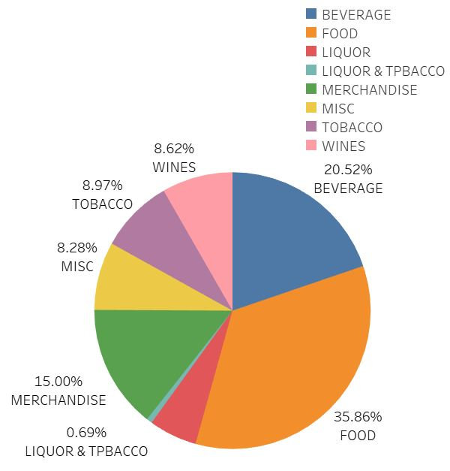
Menu Category
Food is the biggest category.
Liquor & Tobacco is the smallest category.

Slide 8
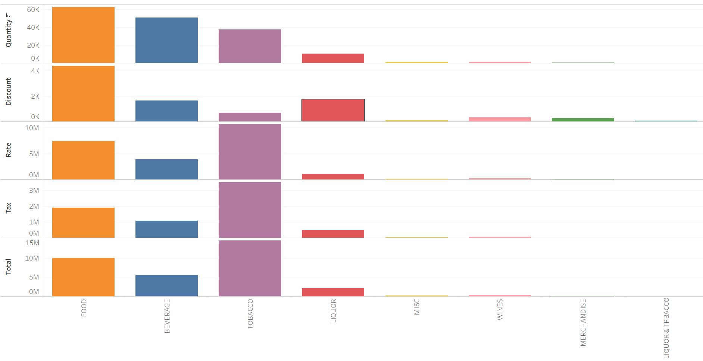
Sales Mix
Food is sold & discounted the most.
Tobacco has the highest rate and tax collected.
Even though Liquor has been highly discounted, the sales are not good.
Beverages quantity sold is high but revenue earned is low.

Slide 9
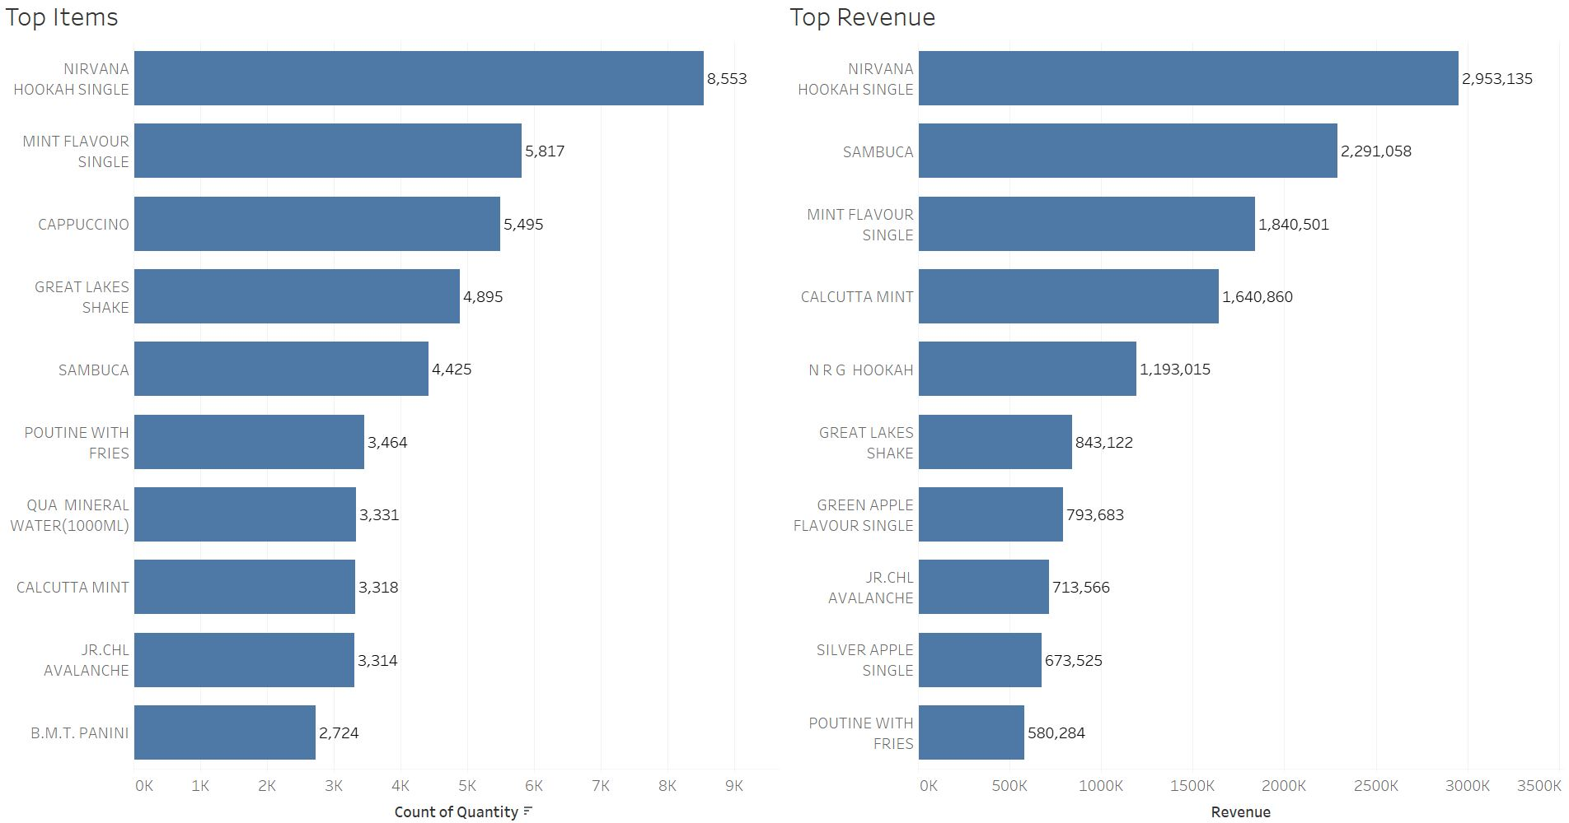
Top Items List
Nirvana Hookah Single is Top seller & grosser.
Qua Mineral Water, Cappuccino and B.M.T. Panini sales are high but revenue generated is low.
Tobacco products are most preferred.

Slide 10
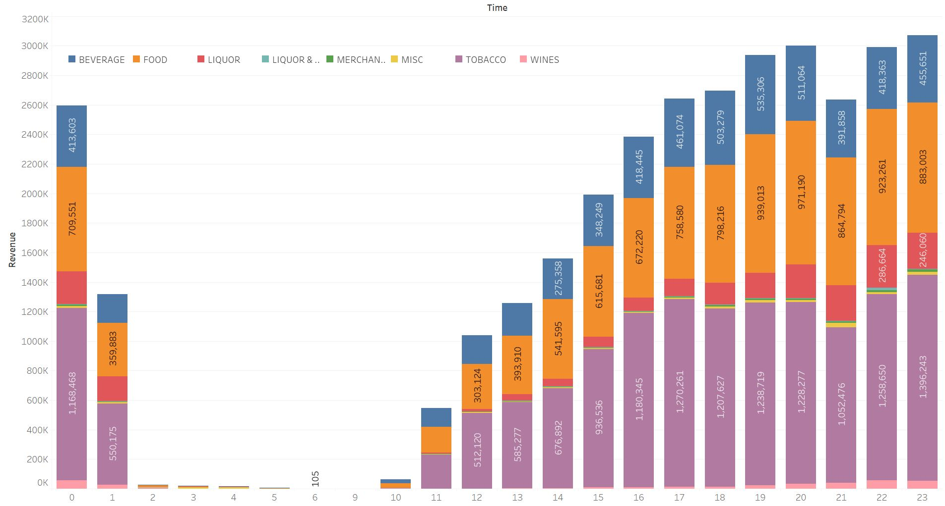
Hourly Sales trend
Sales show an increase from 1100 hrs onwards.
Max sales happen in the evening from 1900 – 2300 hrs with a dip at 2100 hrs.
Peak hours are 1900 – 2000 hrs.
Tobacco & Food sales increase as the day progresses.

Slide 11
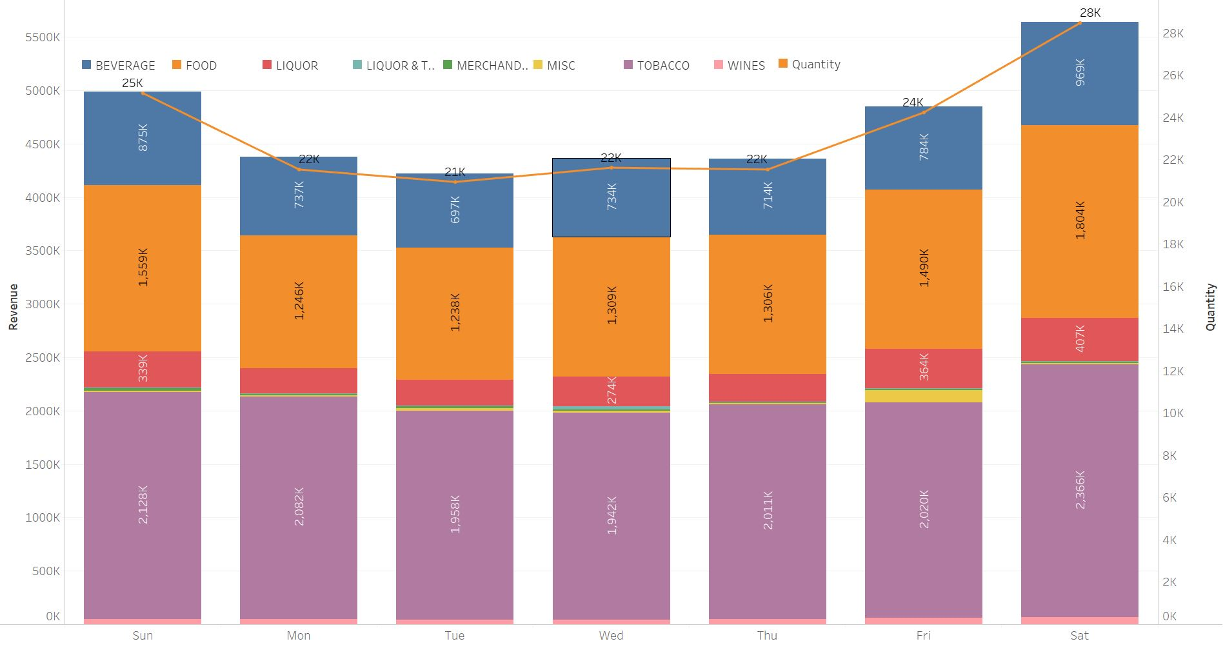
Daily Sales Trend
Sales increase towards the weekend, from Friday – Sunday.
Sales peak on Saturday.
Tobacco sales is almost steady throughout the week.
Food & Beverages sales increases on the weekends.

Slide 12
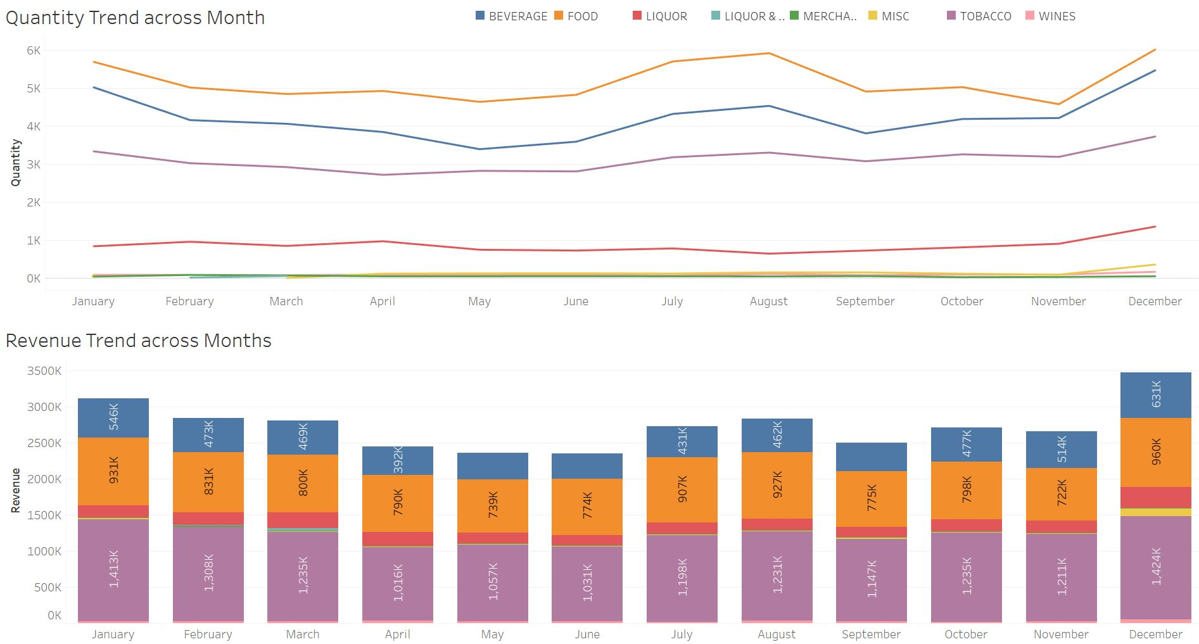
Trend across Months
Sales increases from July and peaks in December. From January there is a dip in sales.
There is s rise in Food, Beverages and Tobacco sales in July and August.
Revenue For Tobacco is high throughout the year.
The Quantity of Food & Beverages is higher.

Slide 13
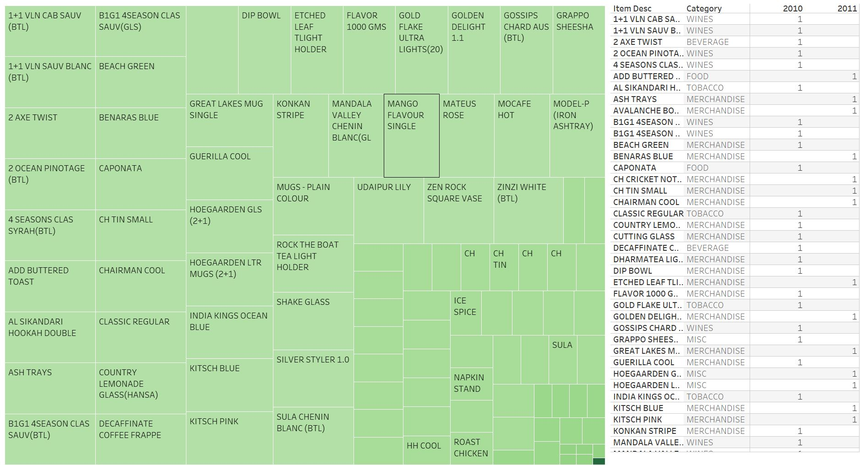
Items to be removed
List of items sold less then 100 quantities in the entire year.
There are 73 items in 2010 and 35 items in 2011
Items can be taken off after a discussion with business.

Slide 14
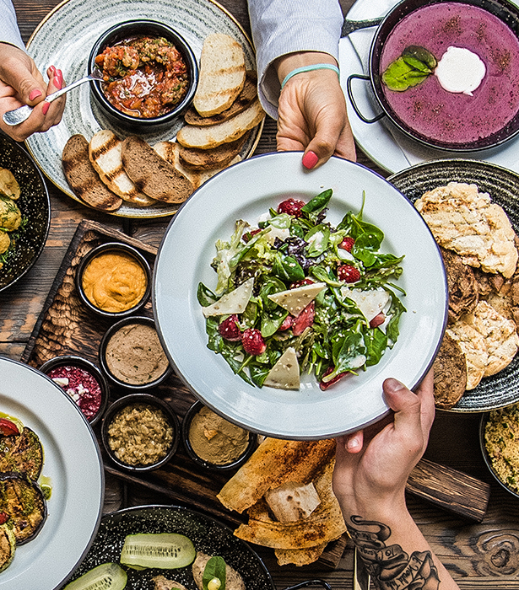
Menu Analysis

Slide 15
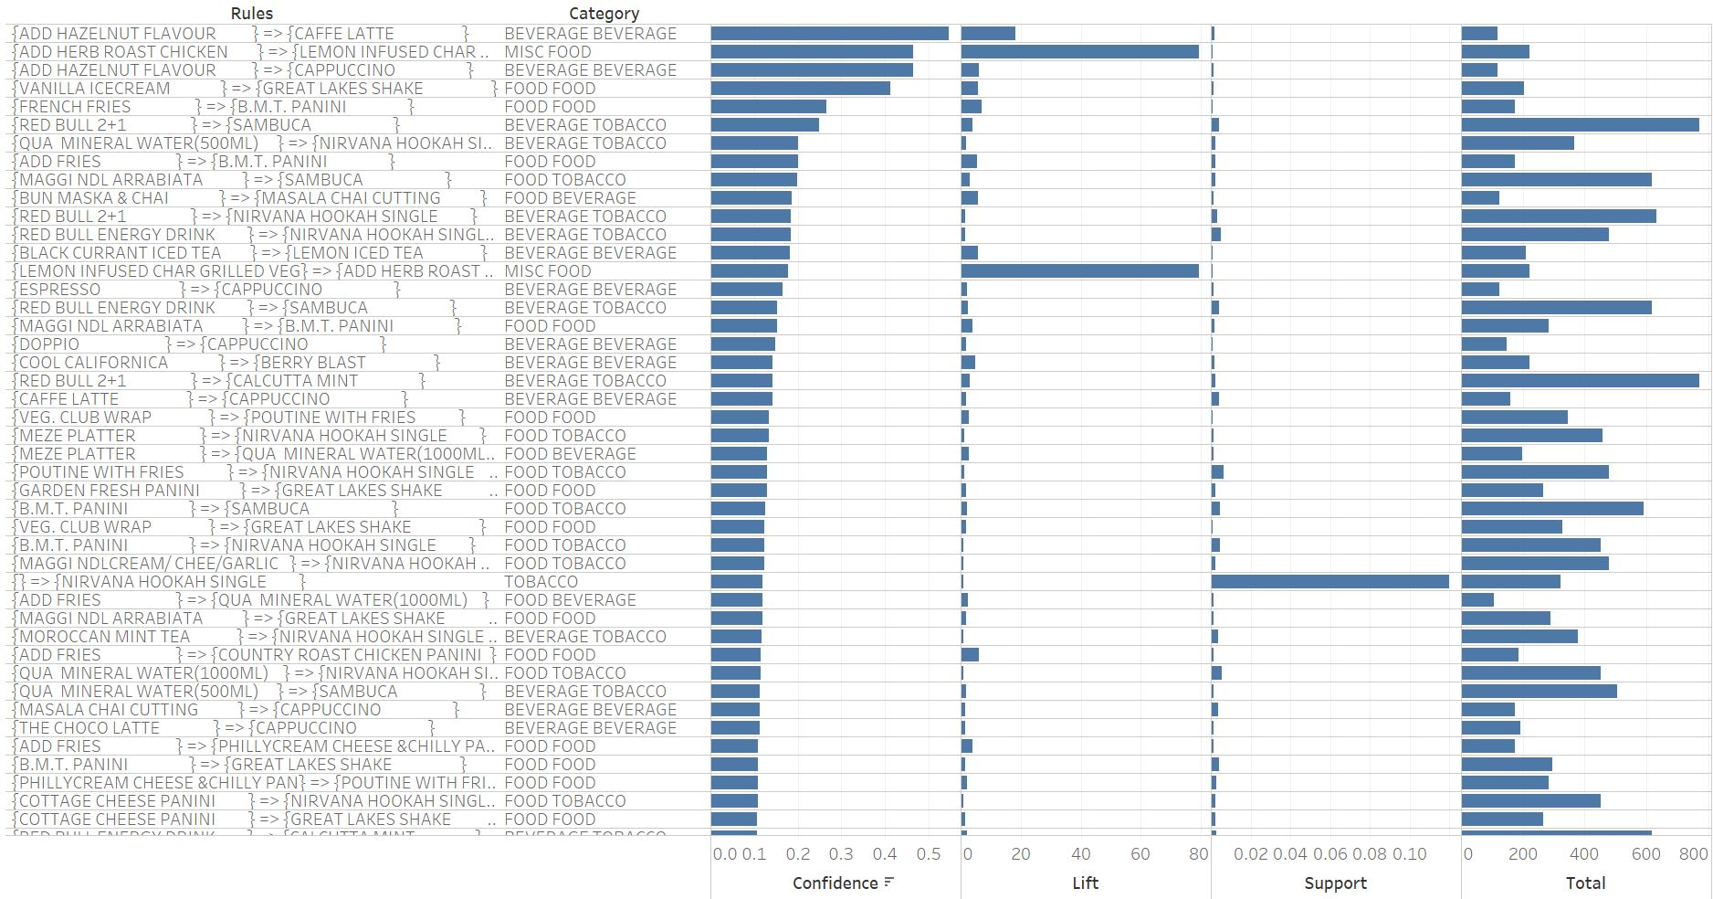
Popular Combos
Based on popular products, 54 combos have been created and attached in the file.
The combos have been sorted based on Confidence.

Slide 16
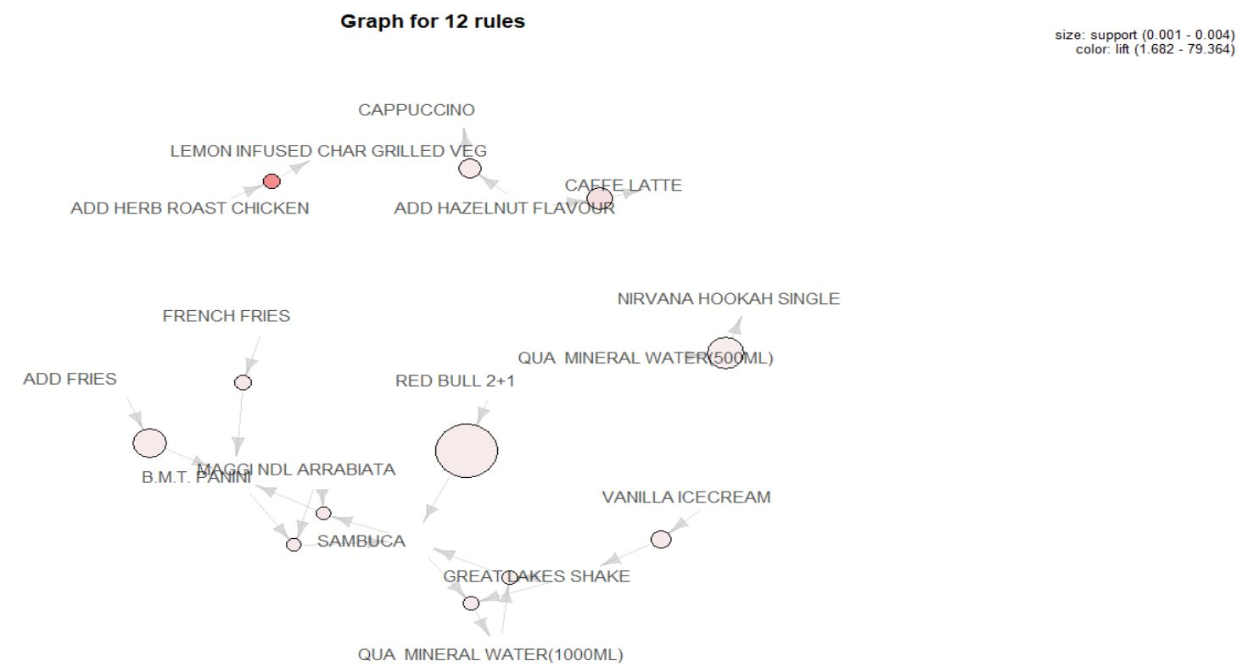
Popular Items
Red Bull 2+1 and Qua Mineral Water (500 ML) have high support.
Add Herb Roast Chicken has the highest lift.

Slide 17
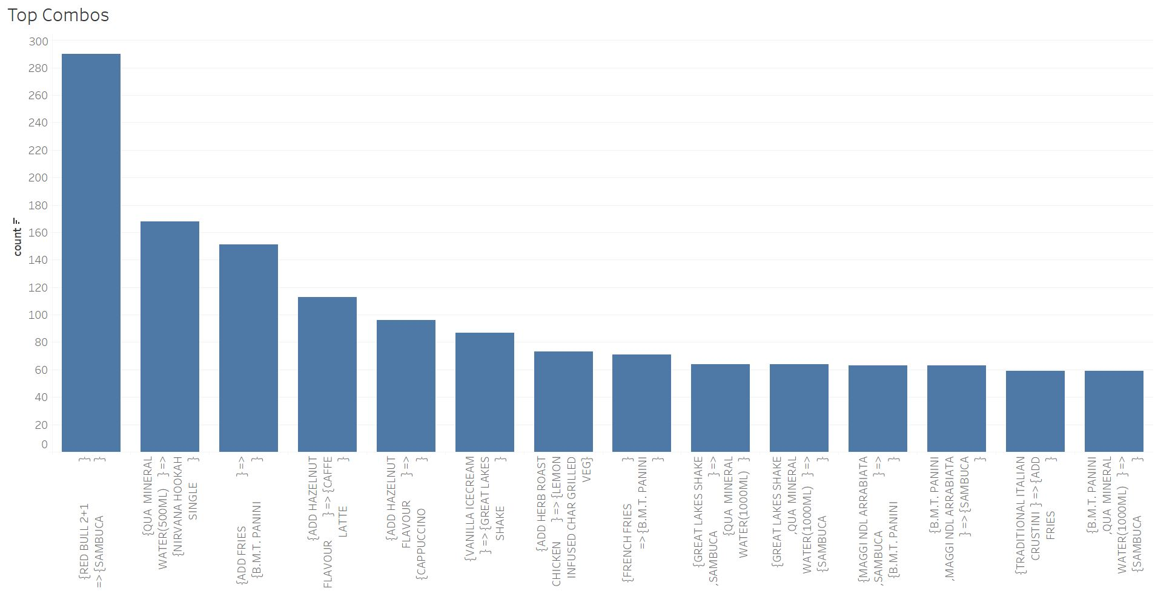
Combo Meals
12 combo meals have been created and attached in the file.
The combos have been sorted based on count.

Slide 18

Recommendation

Slide 19
Analysis
Recommendation
Top selling Categories are Tobacco, Food and Beverage.
Sufficient resources, inventory and staff should be available to cater at the peak of different times of the day and different days of the week. The findings from the analysis of the monthly trends can be used as a basis to compute forecasted quantities for the next fiscal year .
Sales tend to from Friday and reaches a peak on Saturday. Sales peak during December - January.
Sales show steady progress from 1100 hours onwards. Restaurant makes max sales in the evenings between 1900-2300 hours. Peak time is 1900-2000 hours.
During the winter months the sales of Tobacco has a higher consumption pattern than most of the other categories . Hence, the promotion of Tobacco can be increased to tap into this trend.
Food is sold & discounted the most.
Inclusion of combo meals will help in boosting the revenue during the lean and overall periods, as Food is a versatile category here .
Nirvana Hookah Single is Top seller & grosser.
Qua Mineral Water, Cappuccino and B.M.T. Panini sales are high but revenue generated is low.
There are a couple of items which constitute for a small portion of the revenue, hence these should be discontinued.

