Slide 1
09.08.2019
Digital Image Processing (CSE/ECE 478)
Lecture 4 : Histogram Processing & Intro. to Spatial Filters
 | Ravi | Kiran

Slide 2
Recap …

Slide 3
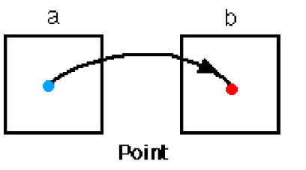
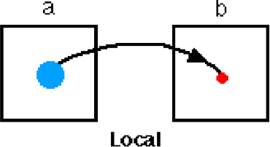
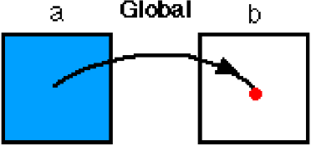
Spatial Domain Processing
 Manipulating Pixels Directly in Spatial Domain
 Point to Point
 Neighborhood to Point
 Global Attribute to Point

Slide 4


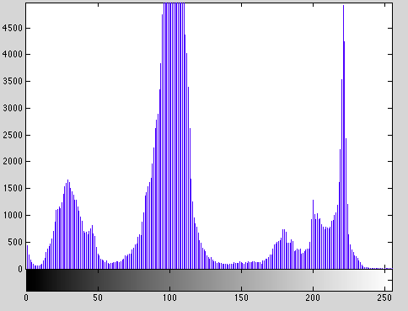
Histogram
i → intensity value, range [0 L-1]
n_{i} → number of pixels with intensity i

Slide 5
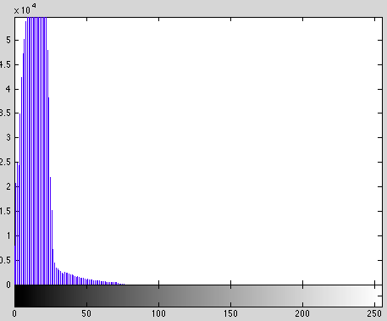

Histograms
 Histograms and brightness
Under exposure

Slide 6
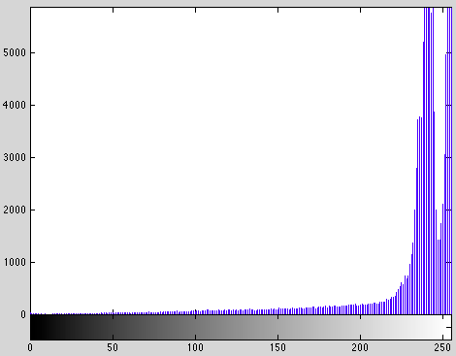
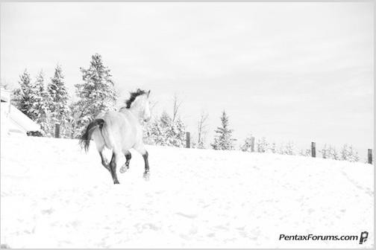
Histograms
 Histograms and brightness
Over exposure

Slide 7
Spatial Domain Processing
 Manipulating Pixels Directly in Spatial Domain
 Point to Point
 Neighborhood to Point
 Global Attribute to Point

Slide 8
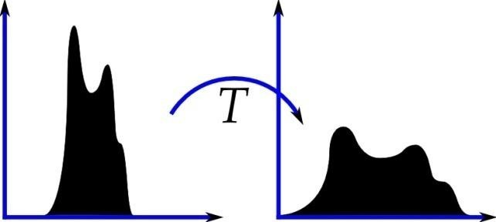
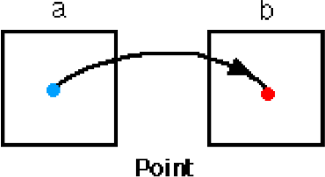
Spatial Domain Processing
 Manipulating Pixels Directly
 Point to Point
 Neighborhood to Point
in Spatial Domain
Histogram Processing
 Global Attribute to Point

Slide 9
Histogram Processing
 Histogram Stretching/ Contrast Stretching
 Histogram Equalization
 Histogram Specification
 Local Histogram Equalization

Slide 10

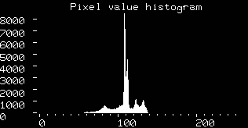
Contrast Stretching

Slide 11
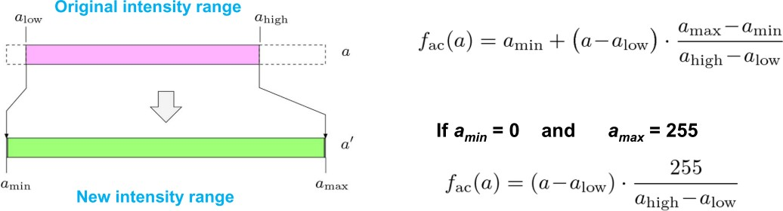
Contrast Stretching

Slide 12

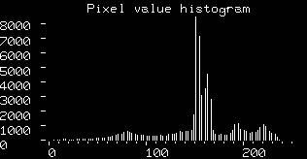
Contrast Stretching

Slide 14
Contrast Stretching
Single pixel with intensity 0 or 255. What happens ?

Slide 15
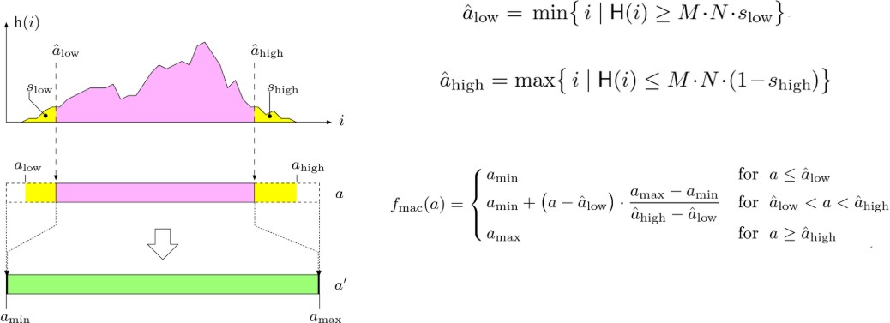
Contrast Stretching ver. 2

Slide 16
Ver. 2

Slide 18
Contrast Stretching – Enough?
 Do all intensities have equal distribution ?

Slide 19

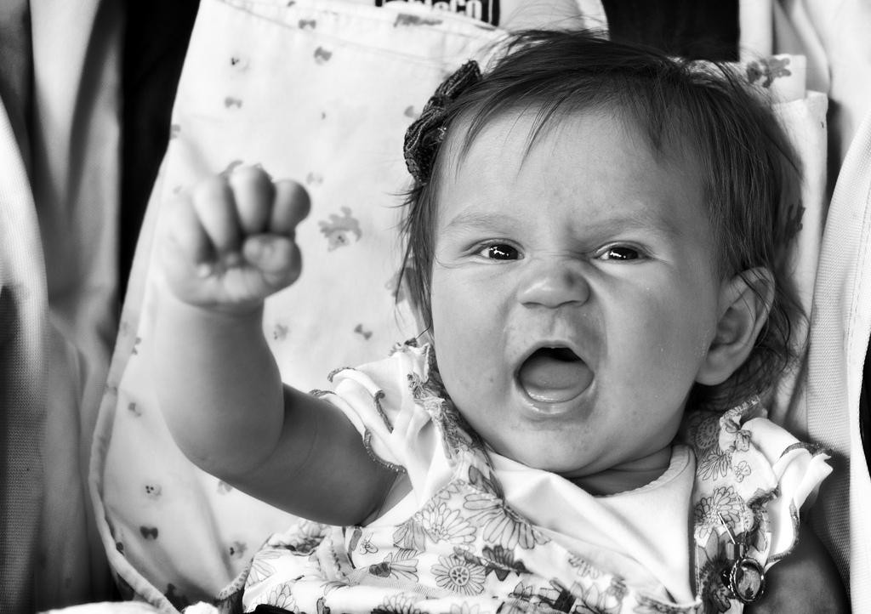
Histogram Equalization

Slide 20
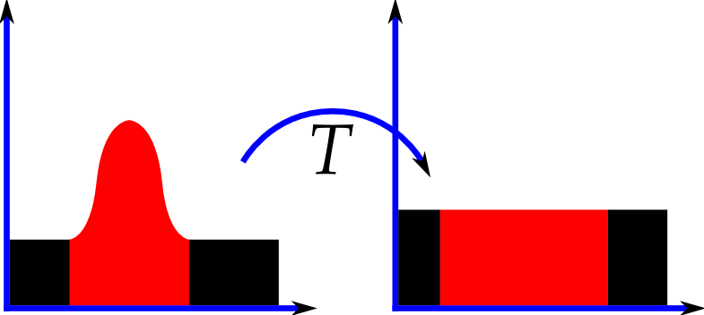
Histogram Equalization

Slide 21
Histogram Equalization
Assumptions
 S = T( r ) is a monotonically increasing function in 0 <= r <= L -1
 0 <= T( r ) <= L - 1

Slide 22
Histogram Equalization
 Histogram as PDF
 r and s as continuous random variables
 p_{r} (r) and p_{s} (s) as probability distribution functions of r and s
 p_{r} (r) . dr = p_{s} (s) . ds

Slide 23
Histogram Equalization
Derivation (on blackboard) [Section 3.3.1 in GW]

Slide 24



Histogram Equalization
Intensity
transformation
Histogram
Equalization

Slide 25

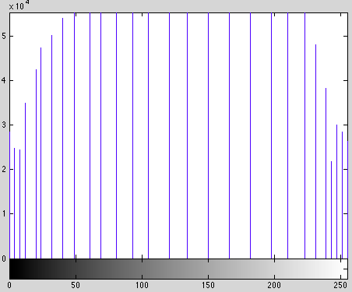
Histogram Equalization

Slide 26
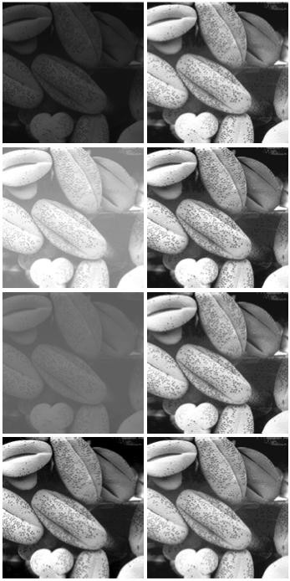
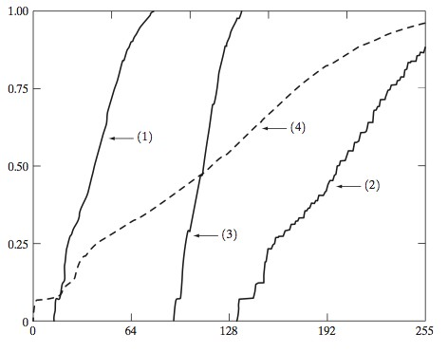
Histogram Equalization
1 through 4 : top to bottom
Image Courtesy: Gonzalez and Woods

Slide 27

Histogram Equalization

Slide 28
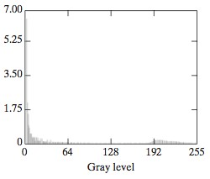
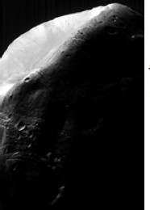
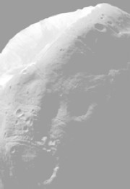
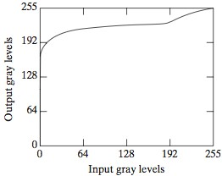

Histogram Equalization
Image Courtesy: Gonzalez and Woods

Slide 29
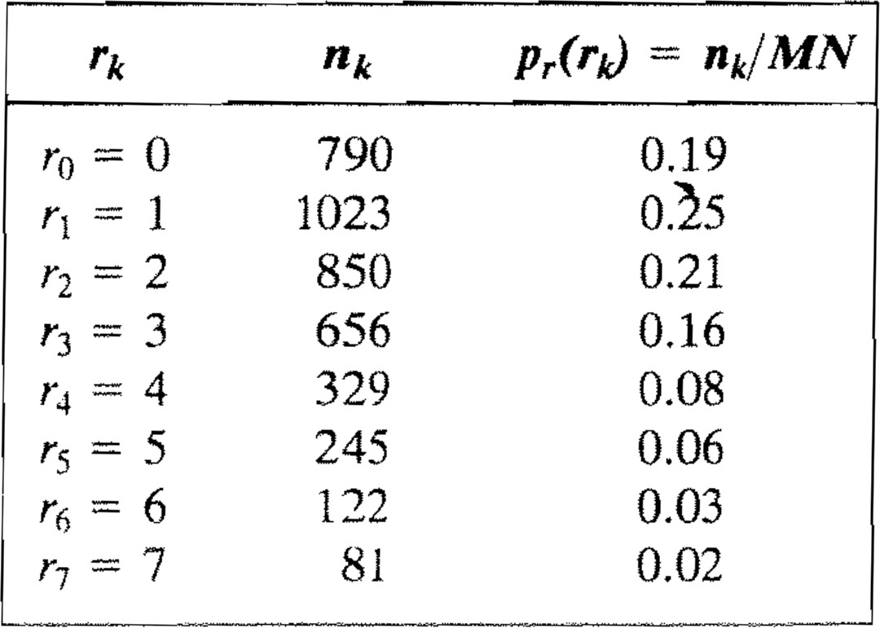
Histogram Equalization - Example
64 x 64 image
3-bits / pixel

Slide 30
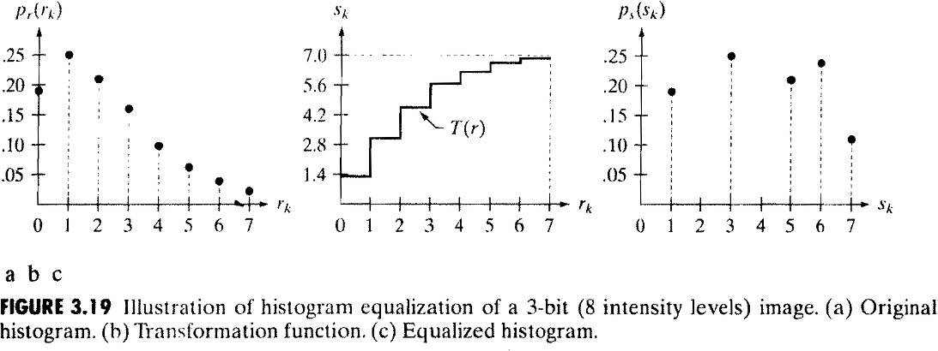
Histogram Equalization - Example

Slide 31
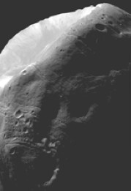
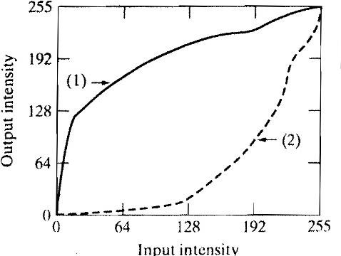
Histogram Specification / Matching [Section 3.3.2]
Compare with the curves we saw for
contrast enhancement. What’s the difference ?
Image Courtesy: Gonzalez and Woods

Slide 32
Spatial Domain Processing
 Manipulating Pixels Directly in Spatial Domain
 Point to Point
 Neighborhood to Point
 Global Attribute to Point

Slide 33
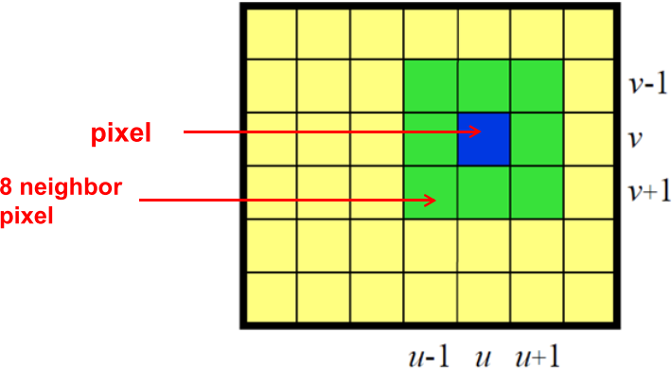
Neighborhood

Slide 34
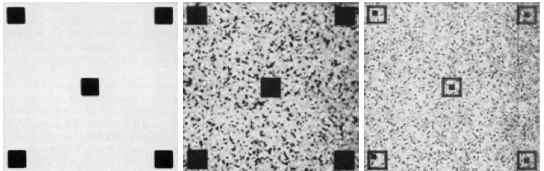
Local Histogram Processing
Image Courtesy: Gonzalez and Woods

Slide 35
References
 GW Chapter – 3.3.1 to 3.3.3
Transformations of Random Variables
  http://www.randomservices.org/random/dist/Transformations.html
  Section 1 of http://www.cs.cmu.edu/~minx/transform.pdf
  Leibnitz Integration Rule : https://en.wikipedia.org/wiki/Leibniz_integral_rule#Alternative_derivation

Slide 36
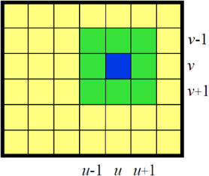

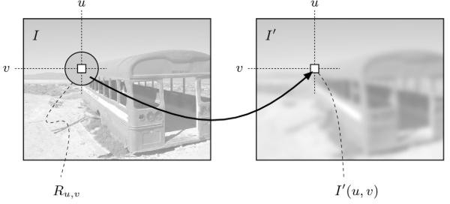

Smoothing Operation

Slide 37
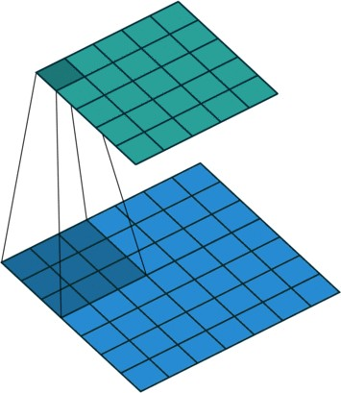
Smoothing Operation

Slide 38
Spatial Domain Filtering
 What is a filter?
 What is filtering operation?

Slide 39
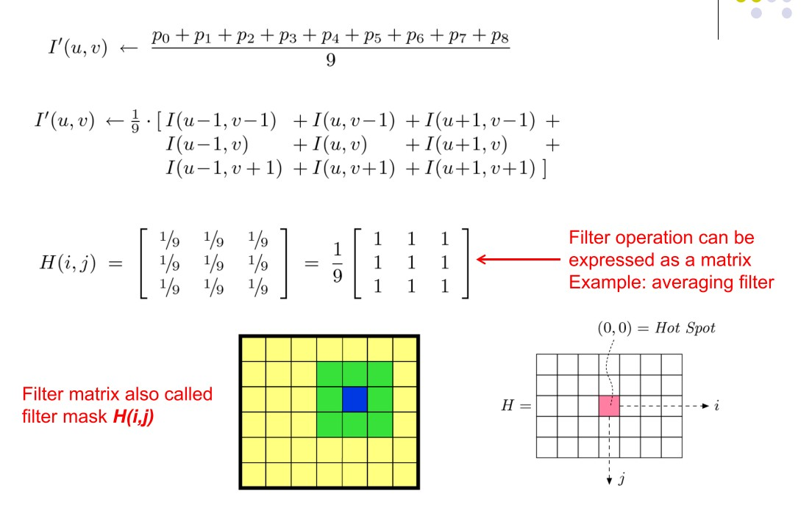
Smoothing Filter

