Slide 1

Digital Image Processing (CSE/ECE 478)
Lecture-8: Image Enhancement in Frequency Domain – FT of sampled functions, DFT
23.08.2019
Ravi Kiran
Center for Visual Information Technology (CVIT), IIIT Hyderabad

Slide 2
Announcements
Tutorial : Fourier Series and Transforms
Quiz-1 : Wednesday, 9.00 am – 9.45 am, Room: H-205
  Syllabus: Up to today’s lecture
  Format: Derivations and Numericals

Slide 3
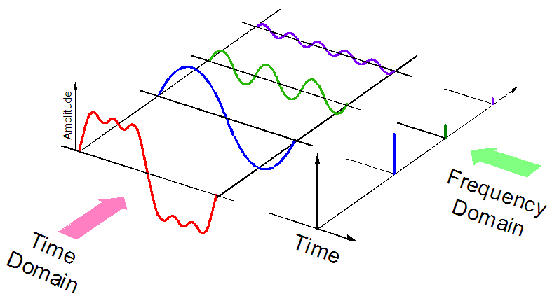


Fourier Series

Slide 4
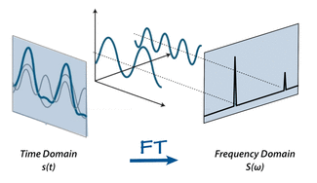
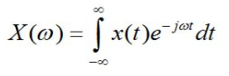

Fourier Transform vs Series
Fourier Transform
Fourier Series
$$f(t)$$

Slide 5
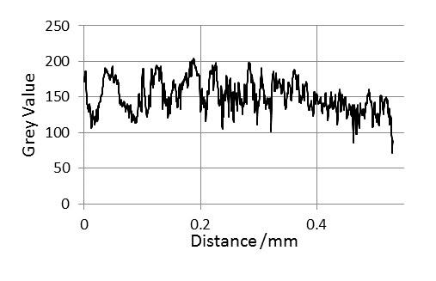
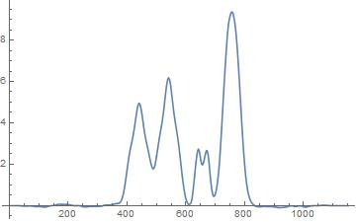

What if x(t) is non-periodic ?
$$f(t)$$
https://i.stack.imgur.com/fKznF.jpg

Slide 6

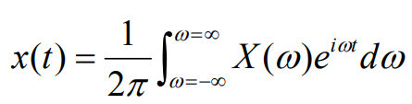
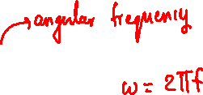
Fourier Transform
Fourier Transform
Inverse Fourier Transform

Slide 7

Fourier Transform (G&W version)
Fourier Transform
Inverse Fourier Transform
https://i.stack.imgur.com/wutf4.jpg

Slide 8
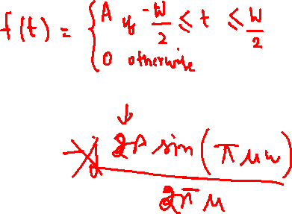
FT of box function

Slide 9

FT of box function

Slide 10
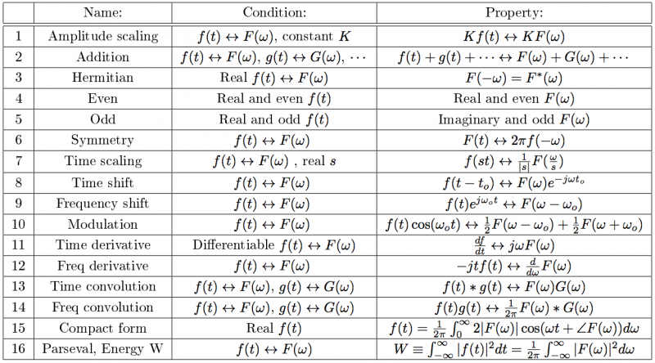
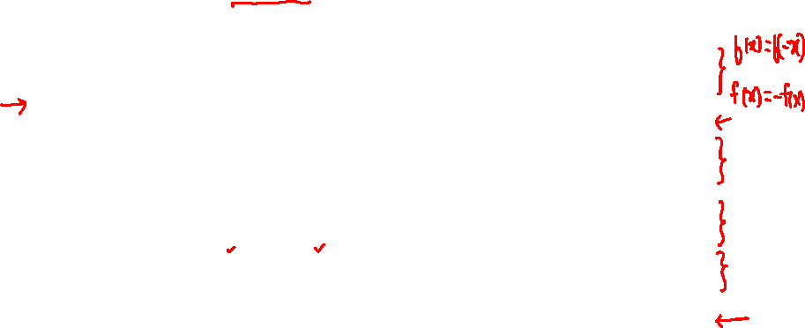
(Some) Properties of FT
https://hkn.illinois.edu/wiki/_media/sidebar:screen_shot_2016-04-11_at_12.35.36_pm.png?w=800&tok=1f0b2e

Slide 11
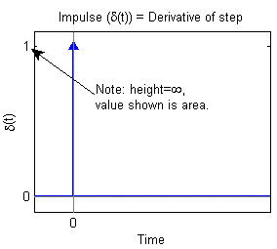
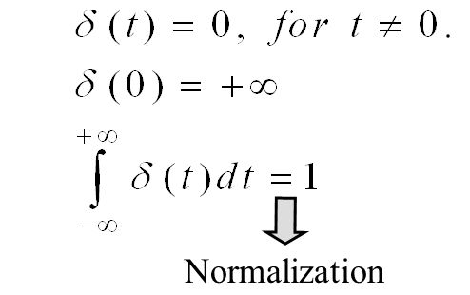

Unit Impulse Function
http://lpsa.swarthmore.edu/BackGround/ImpulseFunc/ImpFunc.html

Slide 12
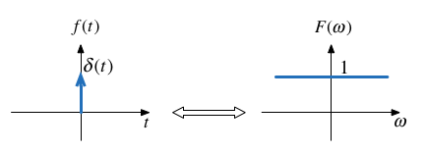
FT of impulse function

Slide 13

Impulse: Sifting Property
?
http://lpsa.swarthmore.edu/BackGround/ImpulseFunc/ImpFunc.html

Slide 14
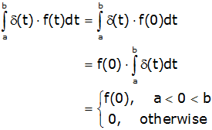
Impulse: Sifting Property
?
http://lpsa.swarthmore.edu/BackGround/ImpulseFunc/ImpFunc.html

Slide 15
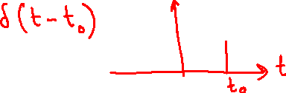
Time-shifted Impulse: Sifting Property
Time-shifted impulse
http://lpsa.swarthmore.edu/BackGround/ImpulseFunc/ImpFunc.html

Slide 16

Time-shifted Impulse: Sifting Property
Time-shifted impulse
?
http://lpsa.swarthmore.edu/BackGround/ImpulseFunc/ImpFunc.html

Slide 17
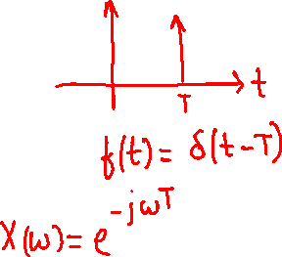
FT of impulse function

Slide 18
FT of impulse function

Slide 19
Time-shifted Impulse
Time-shifted impulse
Sifting Property
http://lpsa.swarthmore.edu/BackGround/ImpulseFunc/ImpFunc.html

Slide 20


FT of time-shifted impulse
t
$$a$$

Slide 21
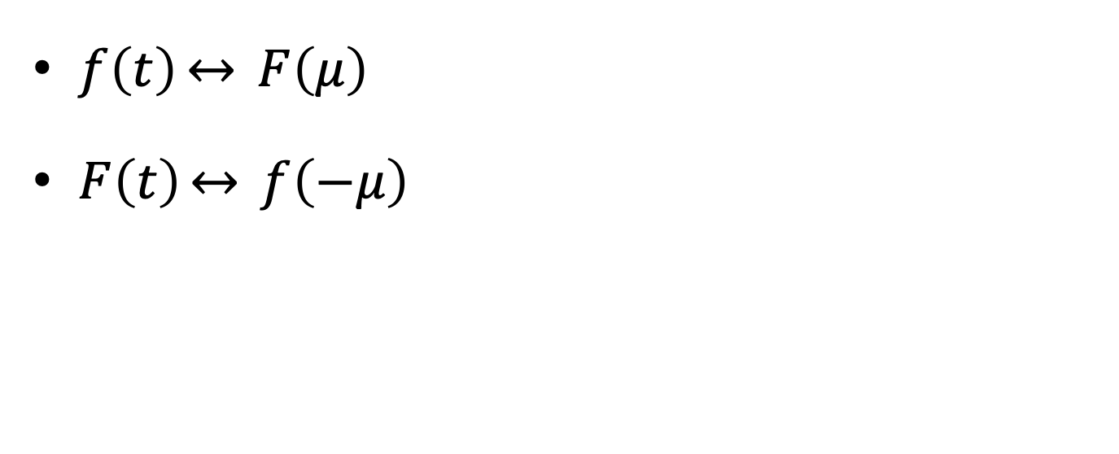
Symmetry property of FT
$f\left(t\right)\underset{↔}{} F\left(μ\right)$
$F\left(t\right)\underset{↔}{} f\left(−μ\right)$

Slide 22
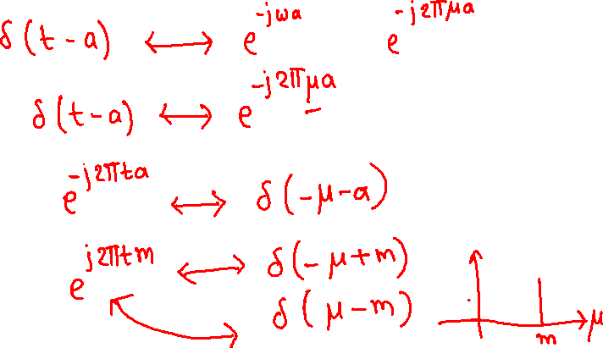
FT of complex exponential

Slide 23
FT of a periodic function
http://lpsa.swarthmore.edu/Fourier/Xforms/FXPeriodic.html
http://devonbryant.github.io/blog/2013/03/02/fourier-transforms/

Slide 24
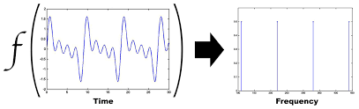

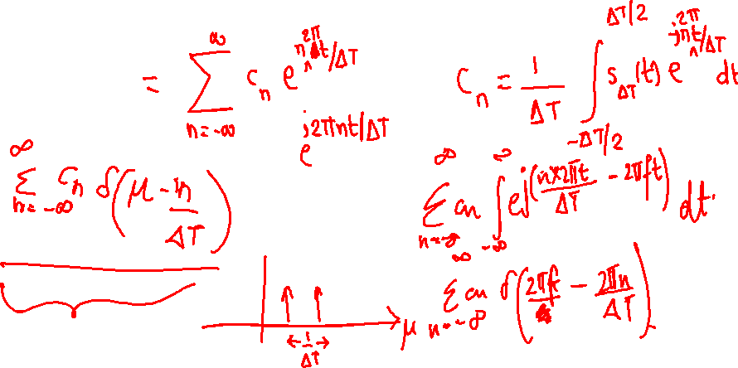
FT of a periodic function
$$F$$
http://lpsa.swarthmore.edu/Fourier/Xforms/FXPeriodic.html
http://devonbryant.github.io/blog/2013/03/02/fourier-transforms/

Slide 25
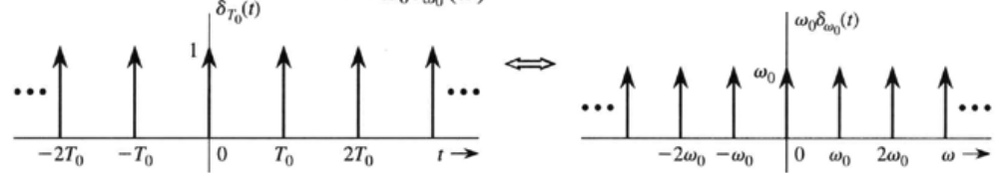
FT of impulse train

Slide 26
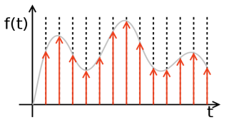
Sampling

Slide 27
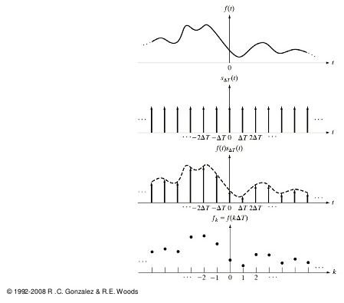
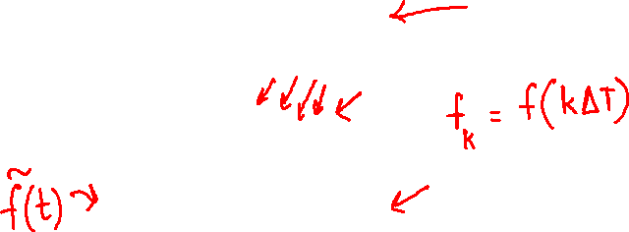
Sampling = f(t) x Impulse Train

Slide 28
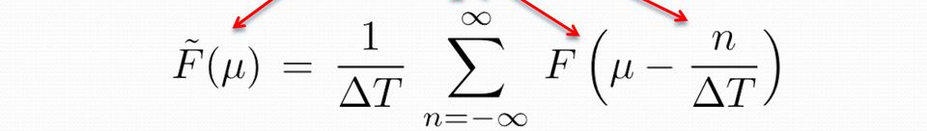
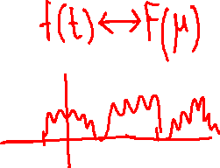
FT of sampled function

Slide 29
FT of sampled function : properties
Continuous
Periodic (copies of f(t)’s FT)
NOTE: FT is continuous

Slide 30
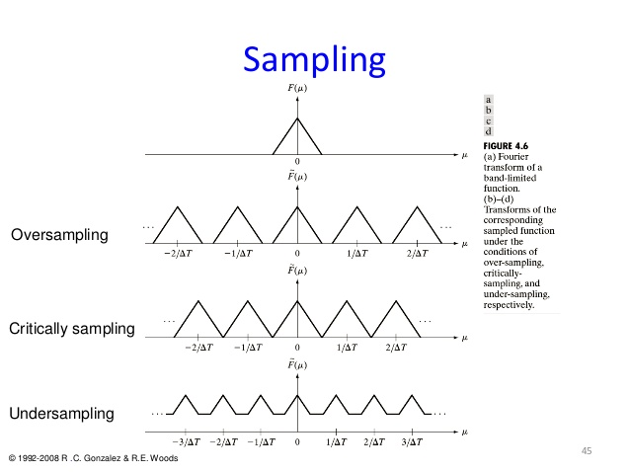
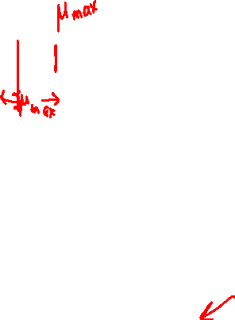

Slide 31
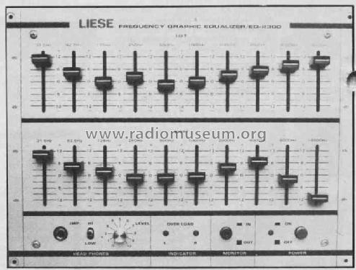

Digital processing of frequencies
Need discrete frequency samples, but FT of sampled function is

Slide 32
Observation
Characterizing one period is enough
How do we actually get the frequency ‘samples’ ?

Slide 33
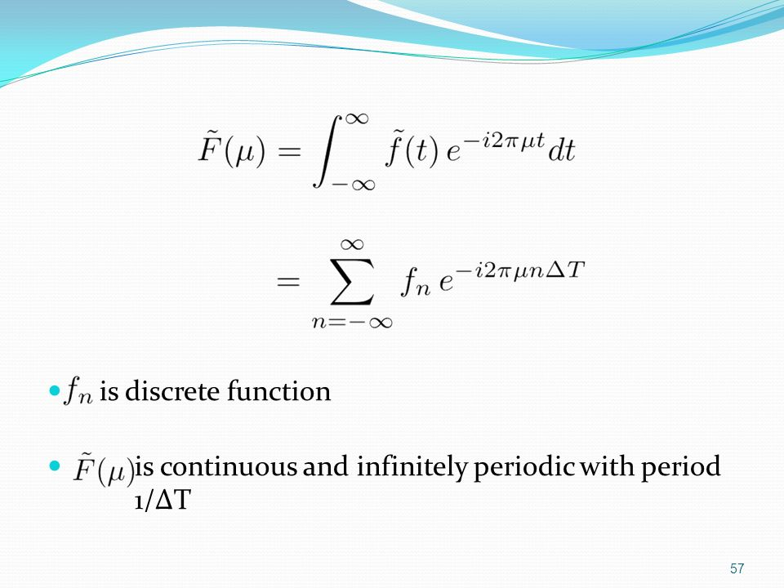
Discrete Fourier Transform
FT of sampled function .. In terms of sampled function
https://slideplayer.com/slide/10719747/

Slide 34
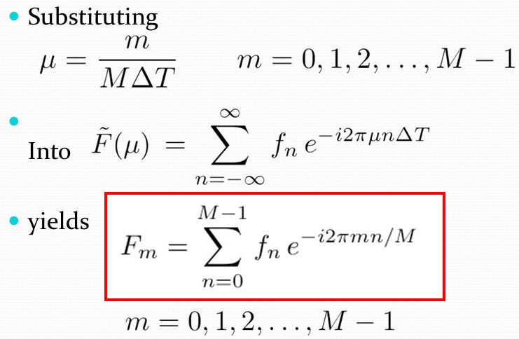
https://slideplayer.com/slide/10719747/

Slide 35
DFT and IDFT

Slide 36
Relationship between Sampling and Frequency Intervals

Slide 37
References & Fun Reading/Viewing
GW DIP textbook, 3rd Ed.,
  4.2.4
  4.2.5
  4.3.1
  4.3.2 (FT of sampled functions)
http://www.thefouriertransform.com/
A visual introduction to Fourier Transform: https://www.youtube.com/watch?v=spUNpyF58BY
Fourier Transform, Fourier Series and Frequency Spectrum: https://www.youtube.com/watch?v=r18Gi8lSkfM

Slide 38
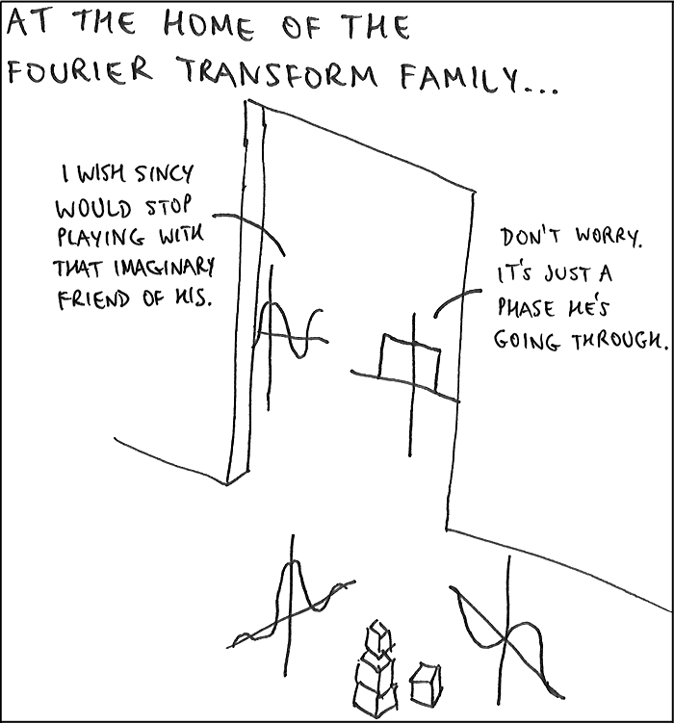
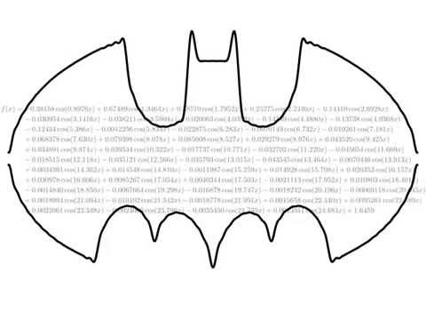
sinc(ax) = sin(ax)/ax
https://www.youtube.com/watch?v=IhAiINH7pBU
The Dark Knight Rises
.. As a Fourier Series ☺
https://i.stack.imgur.com/wKrSc.png

