Slide 1
COLPITTS
Oscillator

Slide 2
TEAM ndns
SAI CHARAN
NIKHILESH
DEEPAK
NIKHIL

Slide 3
MICRO-CAP CIRCUIT
Simulation

Slide 4
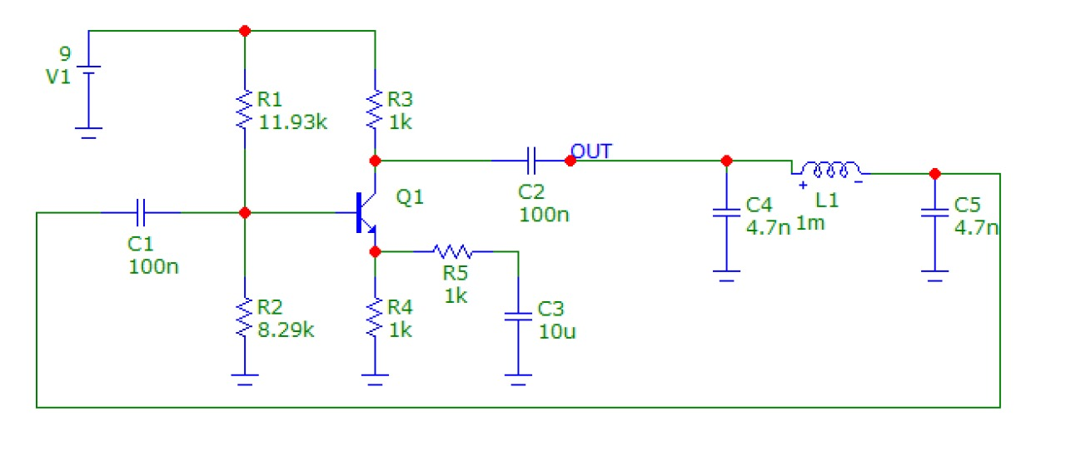
simulation
Targetted frequency-100khz
L=1m henry;
Both capisitors C1,C2 are
4.7n .

Slide 5
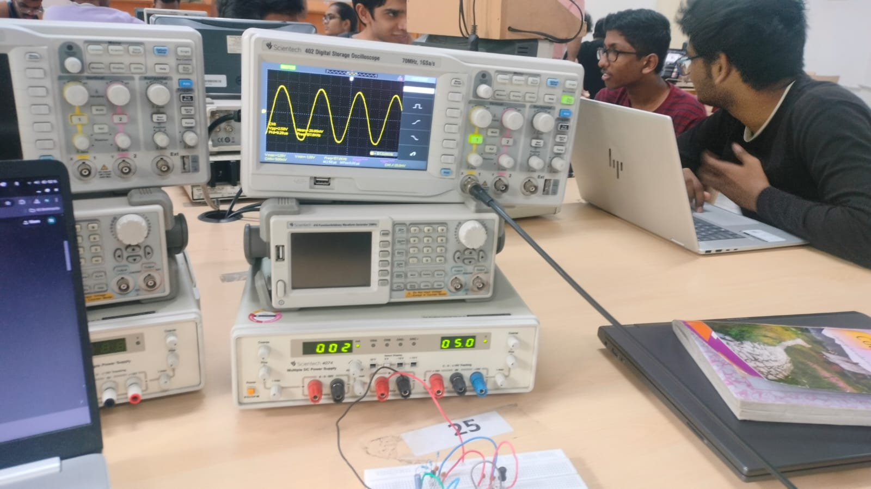
HARDWARE IMAGES

Slide 6
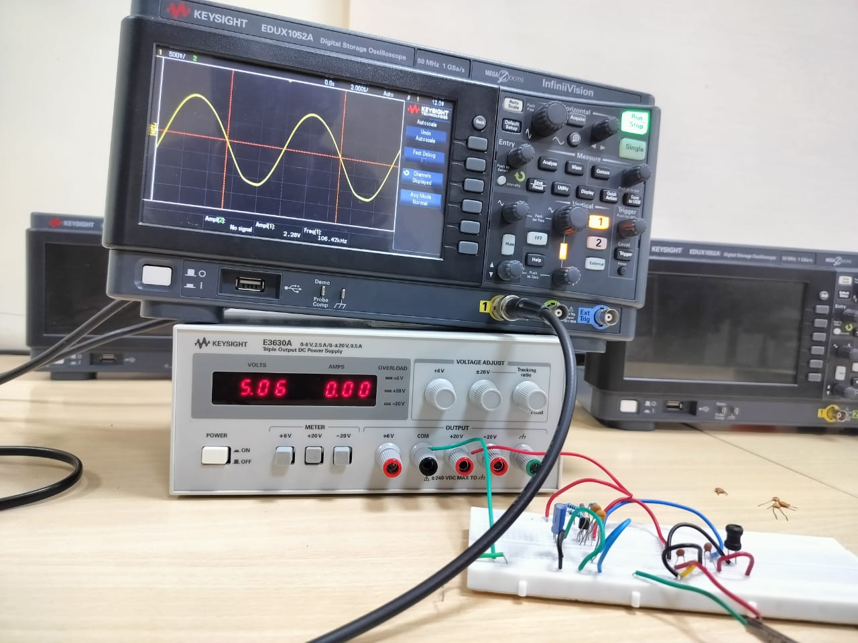
HARDWARE IMAGES

Slide 7
About colpitts
oscillator

Slide 8
About
A Colpitts oscillator is an electronic oscillator that generates high-frequency sinusoidal signals
It uses a combination of inductors and capacitors in a resonant LC circuit to determine the oscillation frequency.
The capacitors in the circuit form a capacitive divider, which provides the necessary feedback to sustain oscillations.
It's widely used in RF circuits due to its stability and ease of tuning.

Slide 9
Components required
1. Inductor (L) – For the resonant LC circuit.
2. Capacitors (C1 and C2) – Form the capacitive divider for feedback.
3. Transistor (e.g., BJT or FET) – Acts as the active amplifying device.
4. Resistors – For biasing the transistor and stabilizing the circuit.
5.Power supply – To provide the necessary operating voltage.
6. Optional bypass capacitor – To stabilize the power supply.
These components are connected to form the LC tank circuit and feedback loop essential for oscillation.

Slide 10

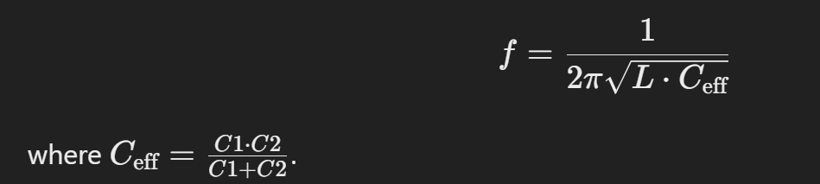
SPEAKING IMPACT
FREQUENCY OF OSCLLITOR IS GIVEN BY

Slide 11
advantages
Maintaining composure during the Q&A session is essential for projecting confidence and authority. Consider the following tips for staying composed:
Stay calm
Actively listen
Pause and reflect
Maintain eye contact

Slide 12
uses and Appilcations
Signal Generators:Acts as a source of high-frequency sinusoidal signals in testing and instrumentation.
Frequency Modulation (FM) Circuits: Provides the carrier signal in FM transmitters.
Clock Generation: Used in digital circuits to produce precise timing signals.
Wireless Communication: Forms the basis of oscillators in Wi-Fi, Bluetooth, and other wireless technologies.
Radio Transmitters and Receivers: Generates stable RF signals for communication systems.

Slide 13
conclusion
It is a simple and reliable high-frequency oscillator based on an LC tank circuit.
The capacitive feedback ensures stable and sustained oscillations.
It is widely used in RF communication, signal generation, and timing applications.
The oscillator's frequency can be easily adjusted by tuning the inductor or capacitors.

Slide 14
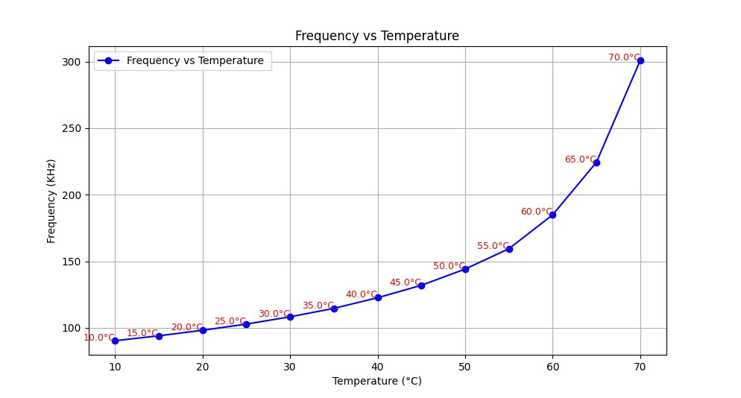
Freq vs temp predicted by our ml model

Slide 15
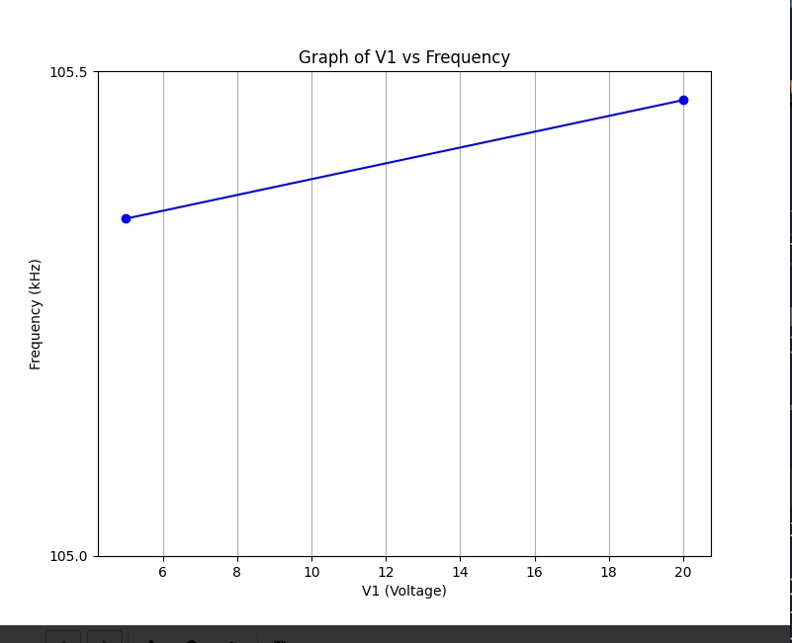
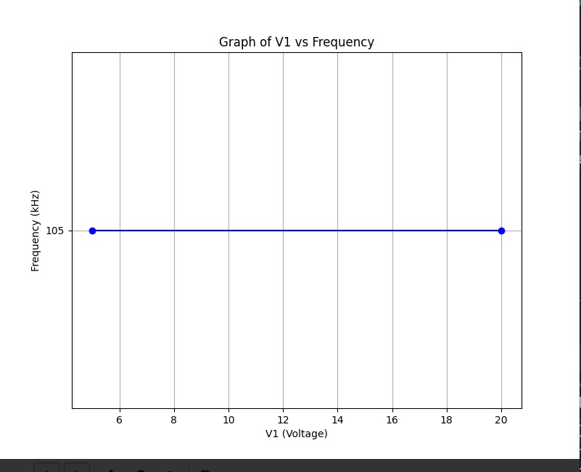
Freq vs Voltage predicted by our ml model

Slide 16
RESULTS and observations
FREQUENCY | INDUCTANCE(L) | CAPASITENCE(C) | TEMP(IN C)
104.763kHz | 1mH | 4.7nF | 27
121.624kHz | 1mH | 4.7nF | 39
105kHz | 1mH | 5.7nF | 39
141kHz | 1mH | 4.7nF | 49
104kHz | 1mH | 11.4nF | 49

Slide 17
THANK YOU
FROM
TEAM NDNS-
SAI CHARAN(2023101044)
NIKHILESH(2023101037)
NIKHIL(2023101110)
DEEPAK(2023101109)

