Slide 1
Project presentation

Slide 2


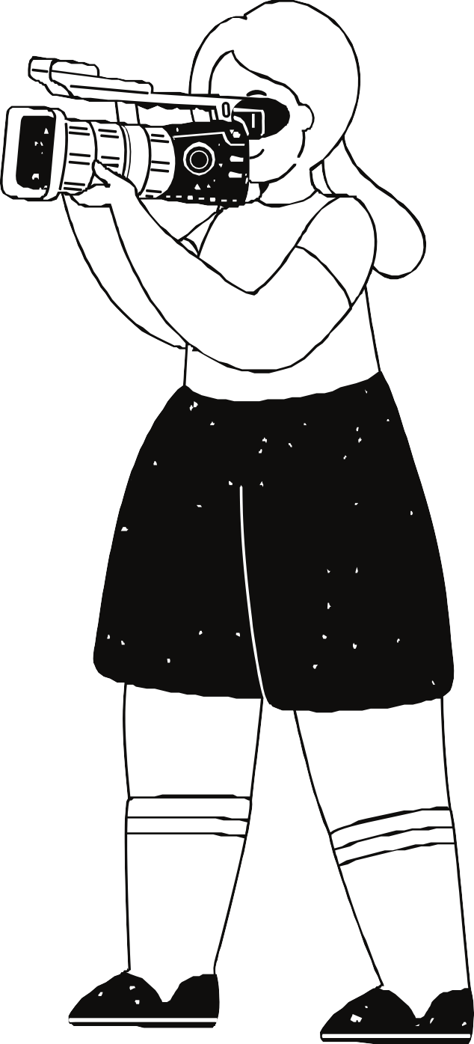

Effective crowd
monitoring is crucial for ensuring public safety, managing events, and
optimizing the use of shared spaces.
Understanding crowd dynamics in real-time can help prevent
accidents, reduce
congestion, and enhance the overall experience for everyone involved
Traditional crowd
monitoring systems often rely on centralized
processing, which can lead to latency,
bandwidth constraints, and potential privacy concerns.
By processing data
locally, edge computing reduces the need for
constant data
transmission to the cloud, leading to faster
response times and
greater system resilience.

Slide 3




Project Mid Goals:
Present a working model that can detect the objects present on the camera frame.
Ensure our working model can detect the number of people on the camera frame.

Slide 4
Objectives
Compile information about the modules which help in the endeavour of object
detection.
Determine the differences between the modules.
Understand the working of each module.

Slide 5

Yolo Nas
The architecture is designed on the principles of speed and efficiency. It automatically optimize its model architecture for further improvements in performance.
Key Features:
Speed: YOLO NAS is optimized for real-time object detection and presents a good balance between speed and accuracy.
Light-weighted: Normally, YOLO NAS requires fewer computational resources
Real-time performance: YOLO NAS is very efficient and thus can be easily deployed on every device that has limited computational capability while ensuring high-speed detection.

Slide 6
Yolo Nas
Weaknesses:
Accuracy vs. Complexity: While YOLO NAS is fast, it does leave out some accuracy in case of small object detection or somewhat cluttered scenes.
Rotated Objects: YOLO NAS relies on axis-aligned bounding boxes, which means it might struggle with detecting rotated objects.

Slide 7
DETR
DETR stands for Detection Transformers. It achieves object detection using transformers. Unlike the classic models on object detection, DETR frames the problem of detection as a direct set prediction problem and hence avoids anchor boxes.
Key Features:
Set-Based Detection: DETR treats object detection as a set prediction problem.
It just simply pipelines it and eases object detection.
Transformers: Transformers encode an image, by converting an image first into a matrix and then convolutes it to a featured map. Then using previous stored data of featured maps of different objects, it identifies the object.
End-to-End Training: It simplifies opject detection by removing anchor boxes.

Slide 8
DETR
Weaknesses:
Inference Speed: DETR is slower compared to YOLO because of the computational costs associated with the use of transformers.
Training Complexity: DETR is more challenging to train since even more data and computational resources become necessary for its best performance. DETR is more resource-consuming during training and inference, hence makes it less
suitable for real-time applications on limited hardware.

Slide 9
We chose DETR to go through with our working model as, it can guarantee higher accuracy.
Objectives
Use DETR model to create a semi-working model which can detect objects and identify them.
Understand the the calculation of accuracy and precision of DETR model.

Slide 10
01.
QIDK git repo is used as a reference for our model.
QIDK
02.
Code for the DETR object
taken
detection model is
from the solutions folder of the DETR section.

Slide 11
When we run the code it detects the
objects present in images in two different ways CPU FP32 and DSP INT8 .

Slide 12
EfficientDET-Lite
MobileNet-SSD (Single Shot Multibox Detector) is a lightweight and efficient object detection framework designed for mobile and embedded vision applications. It combines MobileNet, a streamlined deep neural network optimized for mobile devices, with SSD, an object detection algorithm that detects objects in a single forward pass.

Slide 13
MobileNet SSD
MobileNet: Uses depthwise separable convolutions, which reduces computational complexity, making it ideal for resource-constrained environments like mobile devices.
SSD: Detects objects by generating multiple bounding boxes (or "anchors")and predicting their class scores in one pass, without the need for a
separate region proposal stage.

Slide 14



Project End Goals
We wish to integrate direction analysis into our model, along with the number of people that are present in the camera detection range.
We also wish to further enhance our model to accommodate crowd density calculation and monitoring into our model along with a wireless communication protocol which sends post processed data to a server(our monitor in this case.)
We wish to integrate prediction models which can judge the upcoming results based on the previous accumulated data.

Slide 15
Direction Analysis
This can be achieved by using the following methods
SORT(Simple online Real-Time Tracking)
Image Subtraction

Slide 16
Direction Analysis
1) SORT(Simple online Real-Time Tracking):
SORT is used to assign unique IDs to each tracked object. When an object is detected in the video for the first time, SORT assigns it a new ID. As the object moves across frames, SORT tracks it and maintains the same ID as long as it can associate the object's new position with its previous one. If an object disappears (e.g., moves out of the frame) and is not detected for a certain number of frames, its ID is removed. Similarly, new objects entering the frame get new IDs. This makes SORT effective for tracking multiple objects in real-time while keeping track of their identities.

Slide 17
Direction Analysis
2) Image subtraction:
Image subtraction is a technique used in computer vision to highlight differences between two images, usually by subtracting the pixel values of one image from another.
It's commonly used for motion detection or background subtraction.
It works by subtracting each pixel in the first image with the corresponding pixel in the second image. The result is a binary or grayscale image showing the areas of change (e.g., moving objects). This can be used to directly infer the directional changes of different objects on the image.

Slide 18
Direction Analysis
We implemented directional analysis in a way similar to image subtraction. We store the co-ordinates of each person of each frame. Then for each frame, we compare the co- ordinates of each object in the previous frame, subtract them and obtain the data corresponding to the number of people going right or left.
While this method does not provide the description of the directional changes of each object, we will have the aggregate changes in direction of all objects.

Slide 19
Cloud Storage
The end goal of such projects is always to accommodate the scalability of the model.
While the provided kit doesn’t really allow industrial use, it can be used as a prototype for a much larger use case while using much better camera modules that provide much larger range of detection.
Such increase in scalability is only possible by accommodating cloud storage.
Because while letting edge devices do the significant work reduce latency it demands much higher computational costs and memory devices if we intended to store the data in the edge device itself which is not acceptable, as edge devices are meant to be used in a large quantity.

Slide 20
Cloud Storage
To allow this, we use firebase which is a tool provided by android studio, to send data over from edge device(the kit) to the running laptop which is working as cloud storage and then using the data to make predictions about the upcoming outcomes.
It also alerts on the real-time dashboard in case any of the fixed thresholds have been breached. Such as when the crowd density has exceeded the limit that has been set.
The final data after computing is stored in an online database. This can ensure a huge amount of data can be processed as compared to letting an edge device do the storage.

Slide 21
Applications
This current model can be used in places like,
Parking lots, where we can prematurely inform if an area in a parking lot is empty or can accommodate more vehicles.
Streets, in order to estimate the traffic on each path at a junction and offer ways which has least traffic.
Malls, exhibitions can also use the model to find out the the sections which are more popular and those which are least popular.
Hospitals, to find out the floors which are empty and can allow influx of patients and also in many public areas.

Slide 22
Team
Billuri Srinivasu
Bheema Siddartha
Amudala Jagadeesh
Tulasi Rushwik

Slide 23
Thank you very much!

