Slide 1
BLUESTOCK FINTECH • CAPSTONE PROJECT
Mutual Fund
Analytics Platform
End-to-end ETL, star-schema database, and interactive Power BI dashboard for Indian mutual fund analytics.
Deepu B
Data Analyst Intern

Slide 2
The Problem
1
Fragmented Data
AMFI
Codes
Scheme
Master
Mutual fund data lives scattered across AMFI and multiple sources, with no single unified view.
2
No Unified Analytics
Retail investors lack a consolidated platform to track scheme performance and trends together.
NAV
History
3
No Risk Comparison
Comparing risk-adjusted returns across schemes is difficult without a dedicated analytical tool.
Disconnected sources, no single source of truth
Mutual Fund Analytics Platform | Bluestock Fintech Capstone
2

Slide 3
Objective
Build an end-to-end ETL pipeline and interactive Power BI dashboard to track mutual fund performance, investor behavior, and risk — at scale.
40+
5
6
Schemes Tracked
Star-Schema Tables
Risk & Return Metrics
Mutual Fund Analytics Platform | Bluestock Fintech Capstone
3

Slide 4
Architecture
Python (Pandas)
SQLite
Power BI Desktop
→
→
ETL — extract, clean, transform raw datasets
Star-schema database — organized, query-ready
Interactive dashboards & visual analytics
Raw CSVs from AMFI → cleaned, standardized tables → live, filterable dashboards for stakeholders.
Mutual Fund Analytics Platform | Bluestock Fintech Capstone
4

Slide 5
ETL & Database
Built scripts to ingest 10 raw datasets, clean missing values, standardize AMFI codes, and load into a 5-table star schema.
dim_fund
Fund master — category, benchmark, AMFI code
fact_nav
Historical NAV by scheme and date
fact_transactions
Investor-level SIP / lumpsum / redemption records
fact_aum
AUM aggregated by fund house over time
fact_performance
CAGR, Beta, and other computed metrics
Mutual Fund Analytics Platform | Bluestock Fintech Capstone
5

Slide 6
EDA Insights
SIP Growth Peak
Category Inflows
Demographic Spread
December 2025
Equity-led
State-wise
Systematic Investment Plan contributions hit their highest monthly volume.
Category-wise inflow patterns show clear investor preference shifts over time.
Investment patterns vary meaningfully across states and age groups.
Mutual Fund Analytics Platform | Bluestock Fintech Capstone
6

Slide 7
Performance Metrics
Computed for all 40 schemes using historical NAV data.
Sharpe
Ratio
Sortino
Ratio
Beta
Alpha
CAGR
Max
Drawdown
Mutual Fund Analytics Platform | Bluestock Fintech Capstone
7

Slide 8
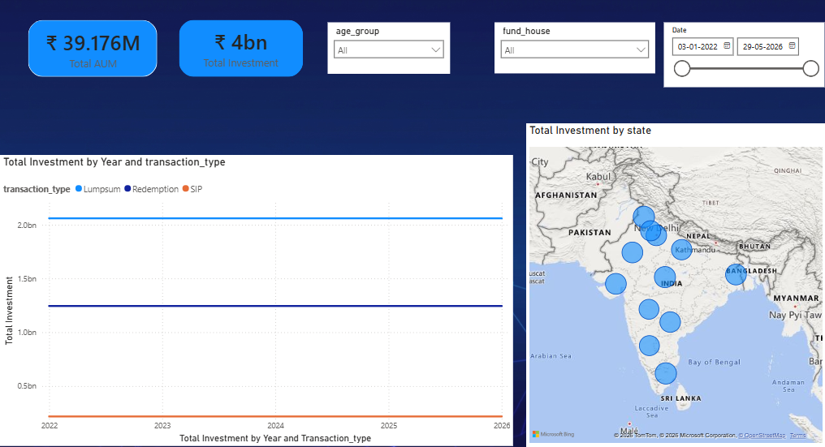
Interactive Dashboard — Page 1
Industry Overview & KPI Cards
Mutual Fund Analytics Platform | Bluestock Fintech Capstone
8

Slide 9
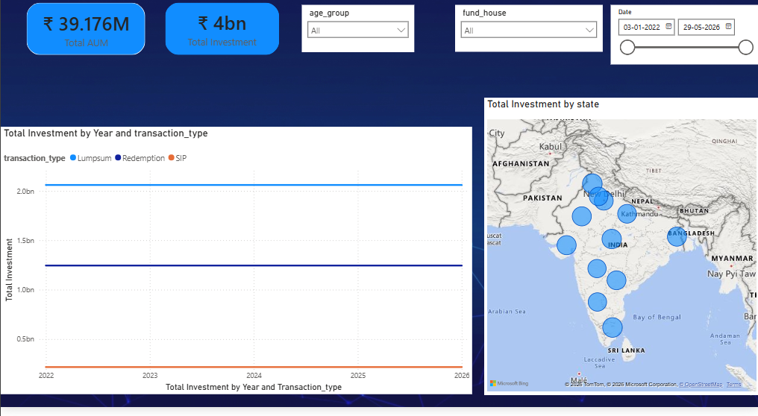
Dashboard — Page 2
AUM Trends and Geographic Distribution
Mutual Fund Analytics Platform | Bluestock Fintech Capstone
9

Slide 10
Advanced Analytics
★
95% VaR
Value-at-Risk calculated to quantify potential downside across schemes.
★
Rolling 90-Day Sharpe
Rolling risk-adjusted return windows to track performance stability over time.
★
Investor Cohort Analysis
Grouped investor behavior by demographic and transaction patterns.
★
Risk-Based Fund Recommender
A simple rules-based engine matching investor risk appetite to suitable schemes.
Mutual Fund Analytics Platform | Bluestock Fintech Capstone
10

Slide 11
Key Findings
01
02
03
SBI Fund House Dominates
SIP Amount Correlates with Age
Nifty 50 Benchmarks Alpha
Leads the industry in total Assets Under Management (AUM) among all tracked fund houses.
SIP contribution size shows a strong relationship with investor age group.
Comparing scheme returns against the Nifty 50 helps quantify true fund manager outperformance.
Mutual Fund Analytics Platform | Bluestock Fintech Capstone
11

Slide 12
Thank You
GitHub repository and live dashboard accessible via the Drive link below.
Deepu B • Data Analyst Intern, Bluestock Fintech
github.com/deepub144-creative

