Slide 1

Agenda
Jenkins REST APIs
  To Fetch Data
  To Trigger Build
Yowsup – WhatsApp API (PYTHON)
  Methods and signals
  Yowsup Add-ons
Build Messenger
  Intro and Functionality
  Architecture
  Demo

Slide 2
Jenkins
provides continuous integration services for software development
a server-based system running in a servlet container such as Apache Tomcat
Builds can be started by various means:
  including being triggered by commit in a version
  control system,
  building when other builds have completed, and
  by requesting a specific build URL

Slide 3
Jenkins REST APIs
machine-consumable remote access API
Comes in three flavours:
XML
JSON
Python
What can you do with it?
retrieve information from Jenkins for programmatic consumption.
trigger a new build
create/copy jobs

Slide 4
Fetch Data From Jenkins
In XML
  – Hit GET request to http://{jenkins.url}/api/xml
  – Limit the amount of data by XPATH
  http://{jenkins.hostAddress}/api/xml?XPATH=hudson/job[name=”Job Name”]
In JSON
  – Hit GET request to http://{jenkins.url}/api/json
  – Limit the amount of data by Tree
  http://{jenkins.hostAddress}/api/json?tree=jobs[name,color]

Slide 5
Trigger a Job
– Job can be triggered by just POSTing a request to following URL:
http://{jenkins.hostAddress}/job/{job.name}/build
– If the Job contains parameters, they should be sent as form parameters while POSTING to following URL:
http://{jenkins.hostAddress}/job/{job.name}/buildWithParameters?param1=value1&param2=value2

Slide 6
DEMO

Slide 7
WhatsApp
a cross-platform mobile messaging app which allows you to exchange messages without having to pay for SMS
According to a recent survey:
67 percent of users reported using WhatsApp, with Facebook Inc. finishing second with 63-percent use.

Slide 8
Yowsup
a cross platform python library
Yowsup makes all WhatsApp features available at your hands like:
Registration
Text send/ receive
Media send/receive (images, videos, audio, location, contact
cards)
Groups(create, leave, join, update picture, updating subject)
Fetch user profile picture
Fetch user status
Set profile picture
Set group icon
Set status and others

Slide 9
Methods and Signals
– Yowsup is Event driven
– provides set of methods that you can invoke in order to send different commands to Whatsapp server.
– provides set of Signals that you can register callbacks to, to receive data/notifications from WhatsApp server
– Yowsup connection manager handles the triggering of callbacks registered with Signals.

Slide 10
Example
def onAuthSuccess(username):
print "Logged in with %s" % s
y = YowsupConnectionManager()
signalsInterface = y.getSignalsInterface()
methodsInterface = y.getMethodsInterface()
signalsInterface.registerListener("auth_success", onAuthSuccess)
methodsInterface.call("auth_login", ("username", "password"))

Slide 11
List of Methods & Signals
Signals:-
auth_success()
auth_fail()
message_received()
group_messageReceived()
profile_setStatusSuccess()
profile_setPictureSuccess()
receipt_messageSent()
receipt_messageDelivered()
Ping()
Pong()
disconnected()
Methods:-
auth_login()
message_send()
typing_send()
message_imageSend()
profile_getPicture()
profile_setStatus()
contact_getProfilePicture()
group_create()
Ping()
Pong()
disconnect()

Slide 12
Yowsup Add-ons
Yowsup Examples:
  – EchoClient
  – ListenerClient
Yowsup CLI
– a command line interface to Yowsup library.
– It provides you with the options of
  – registration,
  – reading messages
  – sending messages

Slide 13
DEMO

Slide 14
Build Messenger
Receive Failure/Success alerts from Jenkins for a Job
Get current status
Trigger build of a Job
Track status of triggered Job
Administrator can configure URLs, refresh time, Users and Jobs they want to listen to etc.
Fault tolerance against network failures.

Slide 15





Application Scenario
Version Control Systems
Commits
WA messages
Jenkins Server
REST Calls
Yowsup API
WhatsApp Server
Build Messenger

Slide 16
Application Architecture
Job
Jobs
Job
Poller
Events
Customized
Yowsup
Python
Library
H
T
T
P
/
S
Executor
Message
Handlers
Message
Listener
Events
Build
Listeners
Job Event
Handlers
Message
Sender
Logging
Configurations
(URLs, Refresh Interval)
Configurations
(Jobs, Users)
Jobs API
Controller
Messaging API

Slide 17
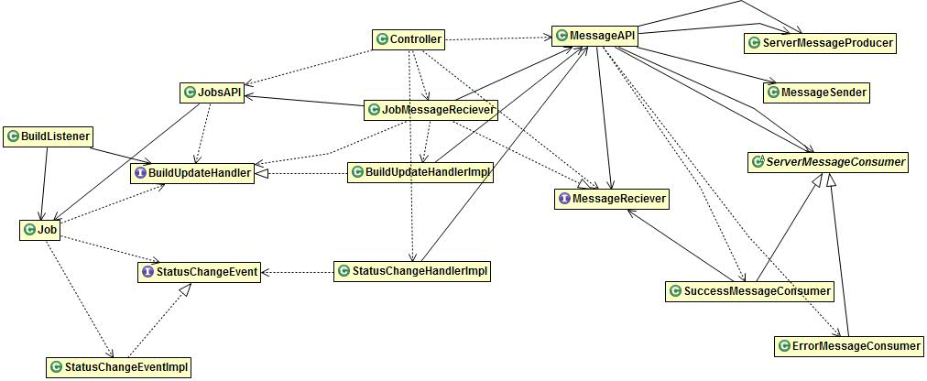
Class Diagram

Slide 18
DEMO

Slide 19
References
https://wiki.jenkins-ci.org/display/JENKINS/Remote+access+API
https://github.com/tgalal/yowsup
https://github.com/deepubansal/BuildMessenger
http://xebee.xebia.in/index.php/2013/11/25/yowsup-the-whatsapp-api/

