Slide 1

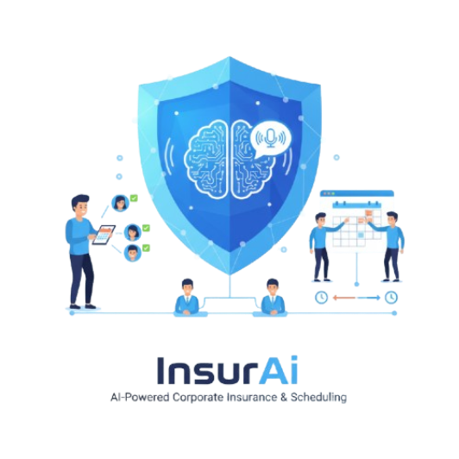
InsurAI: Corporate Policy Automation & Intelligence System Infosys Springboard Virtual Internship 6.0
Presented by:
Sangoji Pranav
Rakesh Kummari
Mithunraj M
M. Harshini Priya
Project Mentor:
Niti Dwivedi

Slide 2
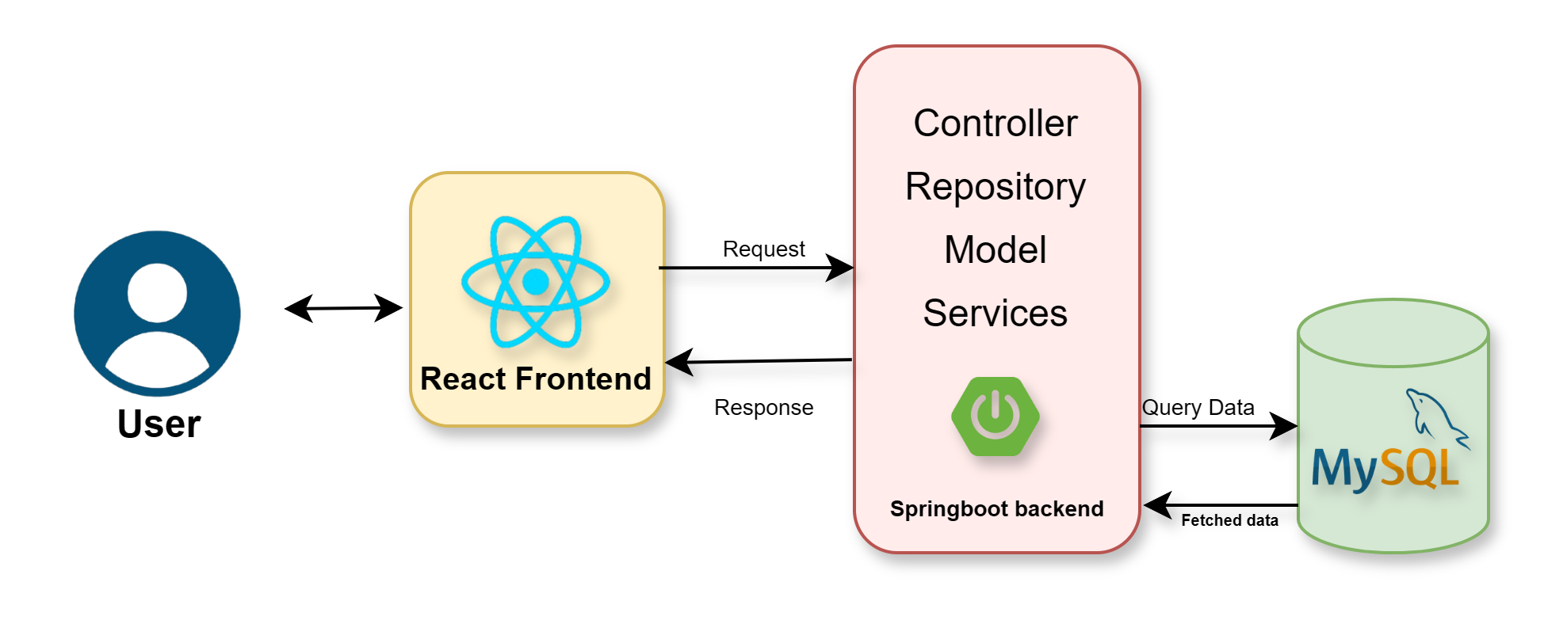
Introduction
InsurAI: Corporate Policy Automation & Intelligence System Infosys Springboard Virtual Internship 6.0
The project “Online Corporate Insurance using AI” is developed with the primary goal of creating a smart, interactive, and user-friendly web-based platform that bridges the gap between customers and insurance agents. In the traditional insurance sector, scheduling appointments and managing customer queries often involve manual communication, leading to delays, confusion, and inefficiency. This project addresses these challenges by automating the entire process through a well-structured and responsive web application.
The system allows customers to easily view available agents, schedule appointments, and manage bookings based on their convenience and preferences. It also provides agents with tools to update their availability, manage appointment requests, and maintain customer interaction records effectively.
To further enhance usability, the application integrates Artificial Intelligence (AI) features such as voice recognition, which enables customers to interact with the system using natural speech. This AI integration not only improves accessibility but also adds a modern and intelligent touch to the user experience.
Project Mentor:
Niti Dwivedi
Presented by:
Sangoji Pranav
Rakesh Kummari
M. Harshini Priya
Mithunraj M

Slide 3
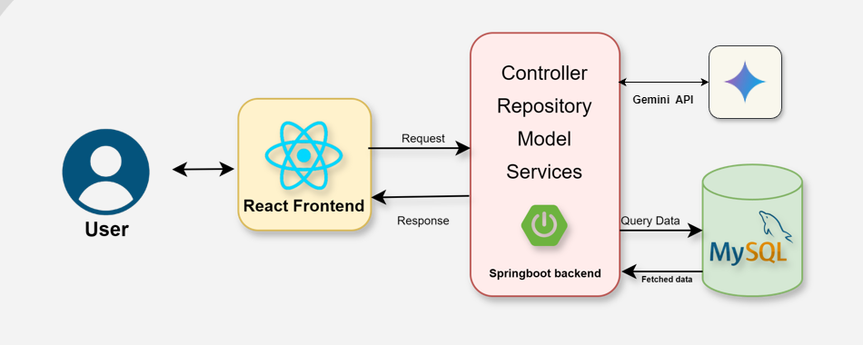
System architecture
The project “Online Corporate Insurance using AI” is developed with the primary goal of creating a smart, interactive, and user-friendly web-based platform that bridges the gap between customers and insurance agents. In the traditional insurance sector, scheduling appointments and managing customer queries often involve manual communication, leading to delays, confusion, and inefficiency. This project addresses these challenges by automating the entire process through a well-structured and responsive web application.
The system allows customers to easily view available agents, schedule appointments, and manage bookings based on their convenience and preferences. It also provides agents with tools to update their availability, manage appointment requests, and maintain customer interaction records effectively.
To further enhance usability, the application integrates Artificial Intelligence (AI) features such as voice recognition, which enables customers to interact with the system using natural speech. This AI integration not only improves accessibility but also adds a modern and intelligent touch to the user experience.
Controller
Agent controller
User controller
PlanController
Appt.controller
Repository
we are extending JpaRepository, so we can perform not only Crud Operations and other methods
Create → save()
Read → findById(), findAll()
Update → save() again (it updates if ID exists)
Delete → deleteById()
Model
user
Agent
Plan
Appointments
Services:
UserService:Handles registration, password encryption, login, JWT token generation
AgentService: Manages agent CRUD operations (get, create, update, delete agents)
AppointmentService: Handles appointment creation, linking to users/agents, availability updates

Slide 4
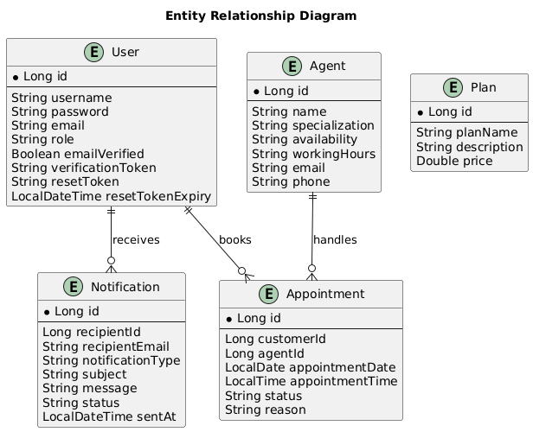
Backend Logic
Database Schema(class diagram)
User (Admin/Agent/Customer) authenticates using JWT (JSON Web Token) through SecurityConfig and JwtAuthenticationFilter
Once authenticated, users can manage appointments through AppointmentController - customers can book, agents can view/manage their appointments
The AI assistant integration (ChatController) handles insurance-related queries and provides automated assistance
Agents can manage customer policies and claims through respective controllers
Email notifications (EmailConfig) are sent for appointment confirmations and important updates

Slide 5
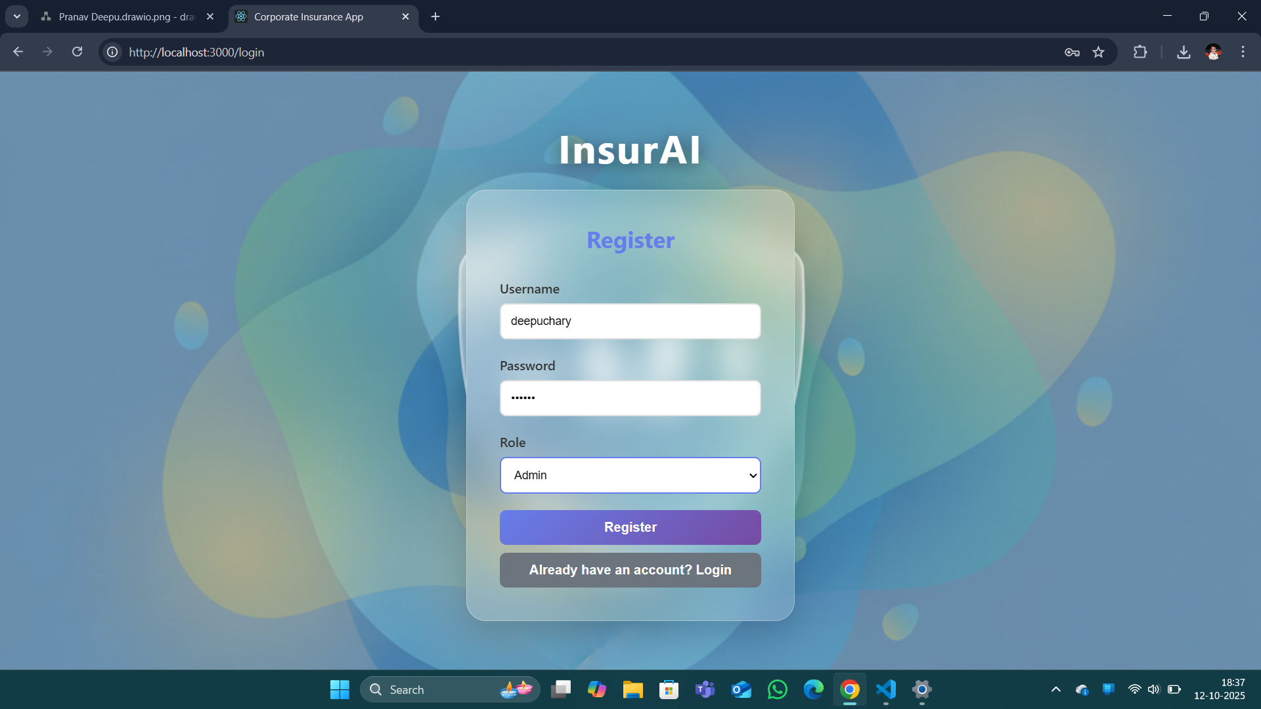
Database Schema(class diagram)

Slide 6
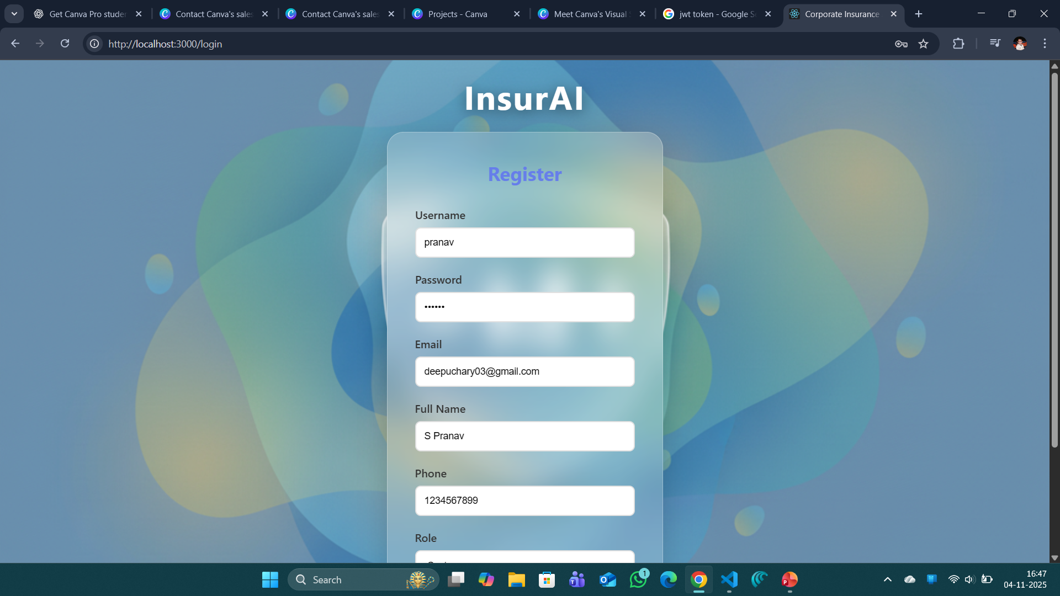
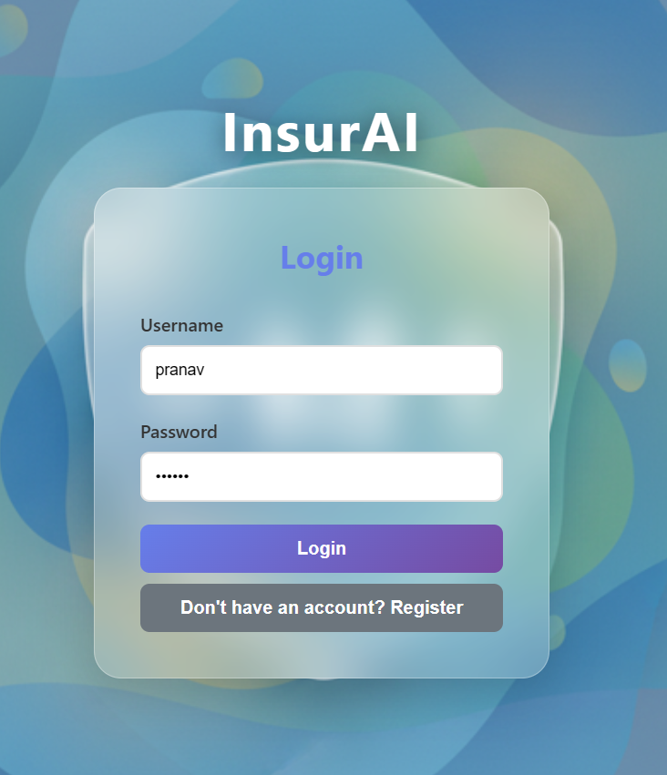
Output Screens:
Login
Register form with username, password, email and role details…

Slide 7
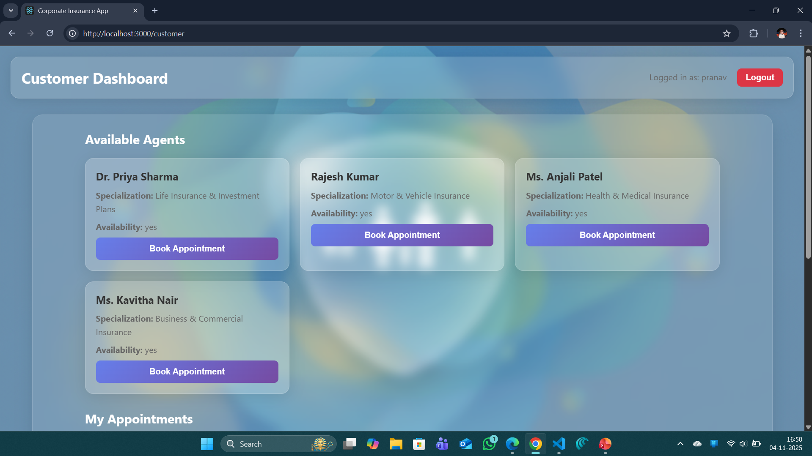
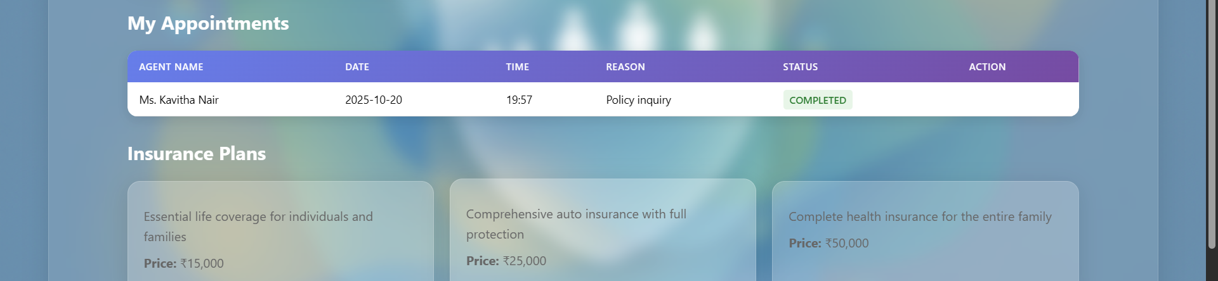
Output Screens:
Customer Dashboard:
User can see available agents
He can book the appointments
Can see his appointments
And insurance plans

Slide 8
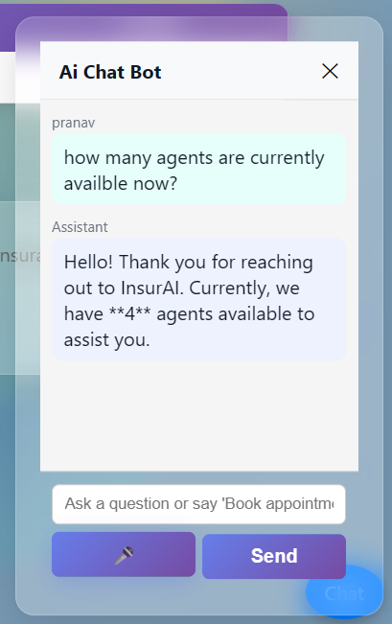
Output Screens:
Customer Dashboard(Ai chatbot with gemini API)
Uses the Web Speech API (SpeechRecognition) to capture voice input in “en-US” when the mic button is clicked.
Converts detected speech to text via the browser’s speech engine and stores it in the input field.
Sends the text to the backend using the Gemini-2.0-flash-001 model (Google GenerativeLanguage API) to generate and return a JSON-parsed response.

Slide 9
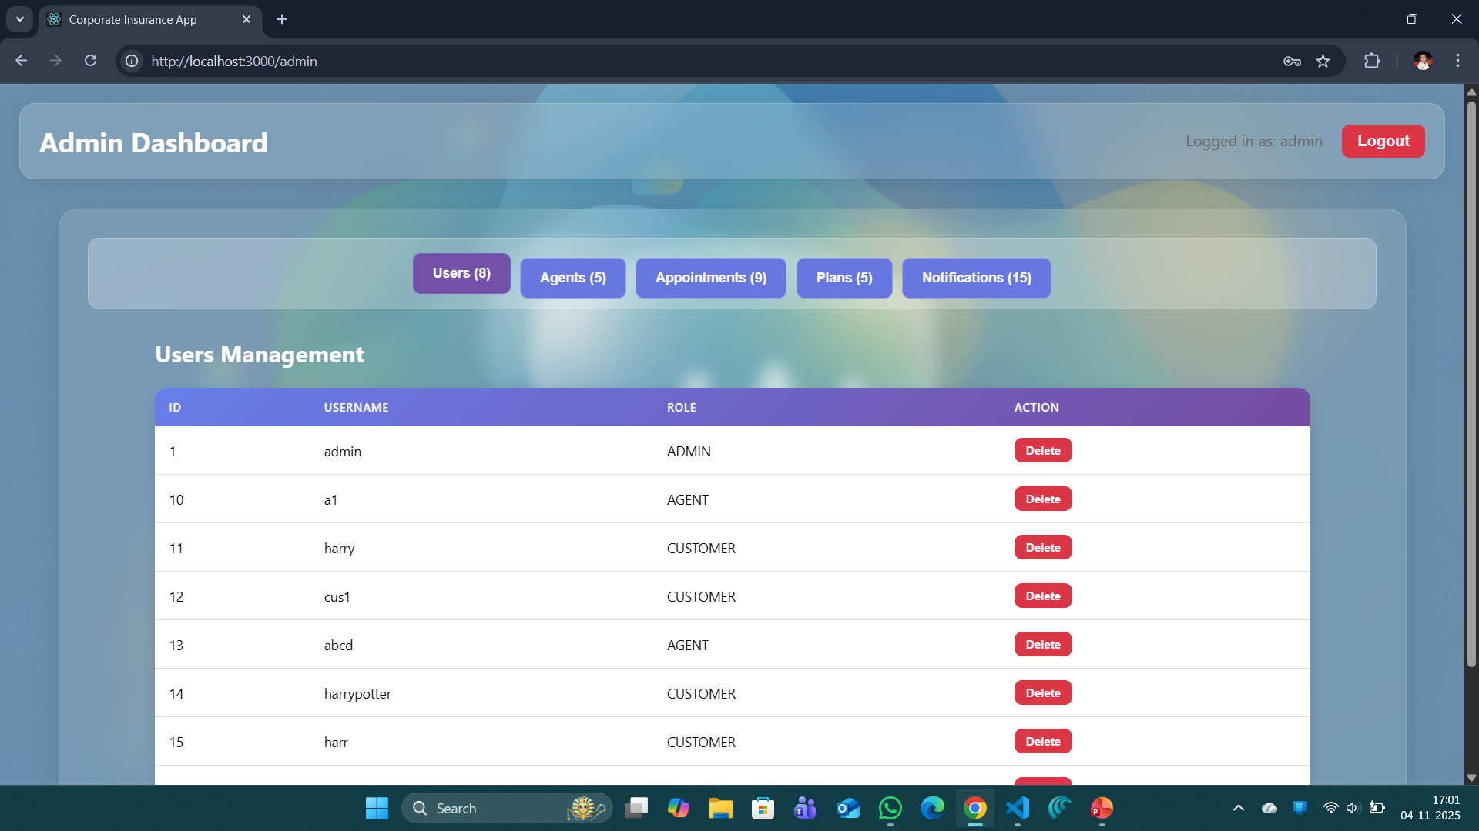
Output Screens:
Admin Dashboard
Can manage users, agents, plans.
Can look into notification tracking
Can able to see the appointments scheduled .

Slide 10
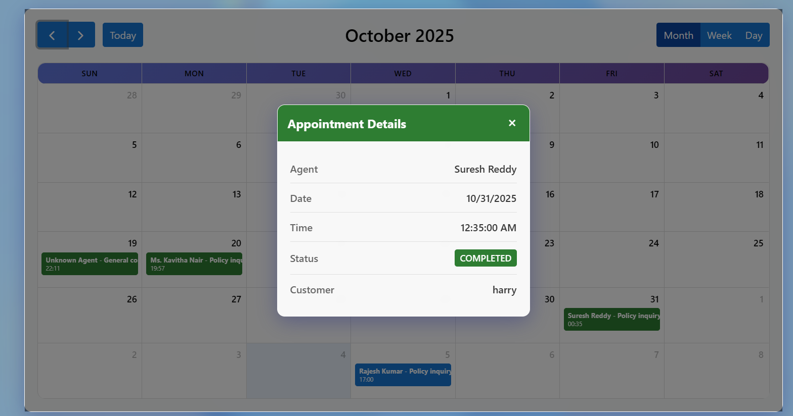
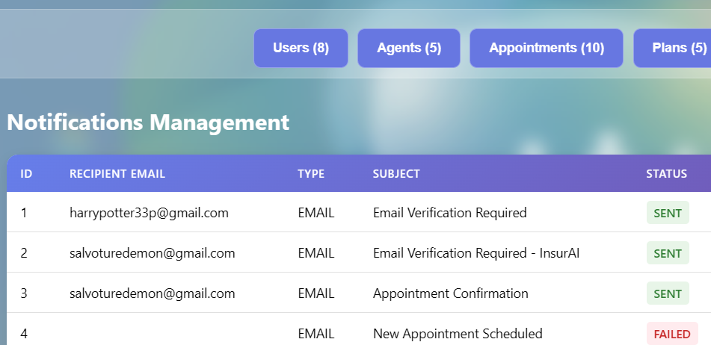
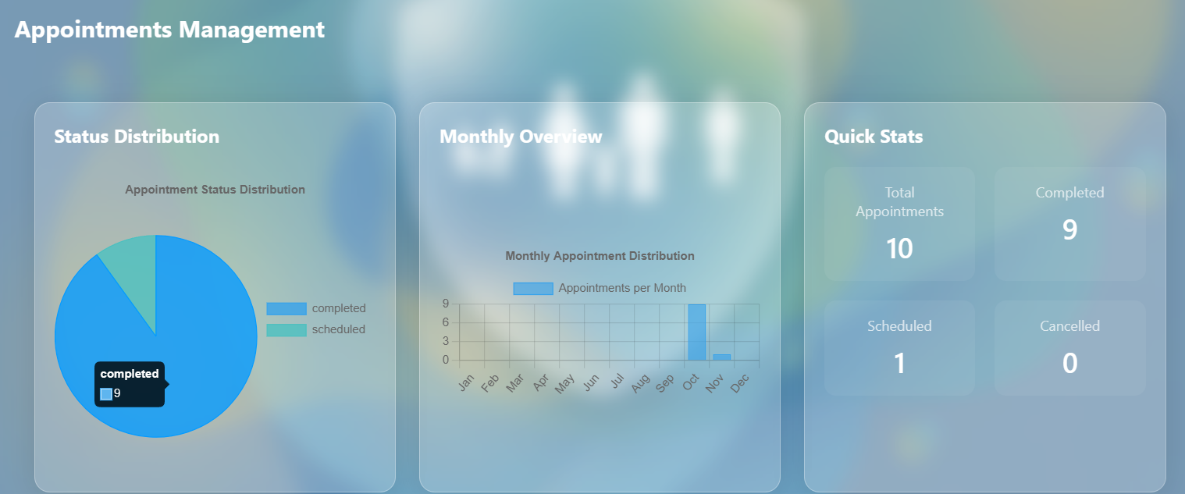
Output Screens:
Admin Dashboard
Visual dashboards are available in the appointments section in the admin dashboard

Slide 11
THANK YOU
Output Screens:

