Slide 1

HOUSE RENT PREDICTION USING LINEAR REGRESSION
PROJECT SUPERVISOR : Ms.Madhumitha
Name of the Student : Deepika.Dirisala
Register Number : 39110279

Slide 2

Introduction
Objectives
Scope
Ideation Map / System Architecture
Algorithms and Methods
Results
Conclusion
References

Slide 3
INTRODUCTION
Our goal for this project was to use regression and classification techniques in order to estimate the sale price of a house in Hyderabad, Telangana State given the feature and pricing data for around 25,000 houses sold within one year.
It can help the developer to determine the selling price of a house and can help the customer to arrange the right time to purchase a house.
There are 3 factors that influence the price of a house which include physical conditions ,concept and location.

Slide 4
OBJECTIVES
Major aim of the study to develop and compare several ML models namely Gradient Boosting Regressor, Decision Tree Regressor, Random Forest Regressor.
Secondly objective is to develop a rental house management system that allows the user to view customers data as well as house record.
The prediction can help the developer determine the selling and purchasing the house at the right time.

Slide 5
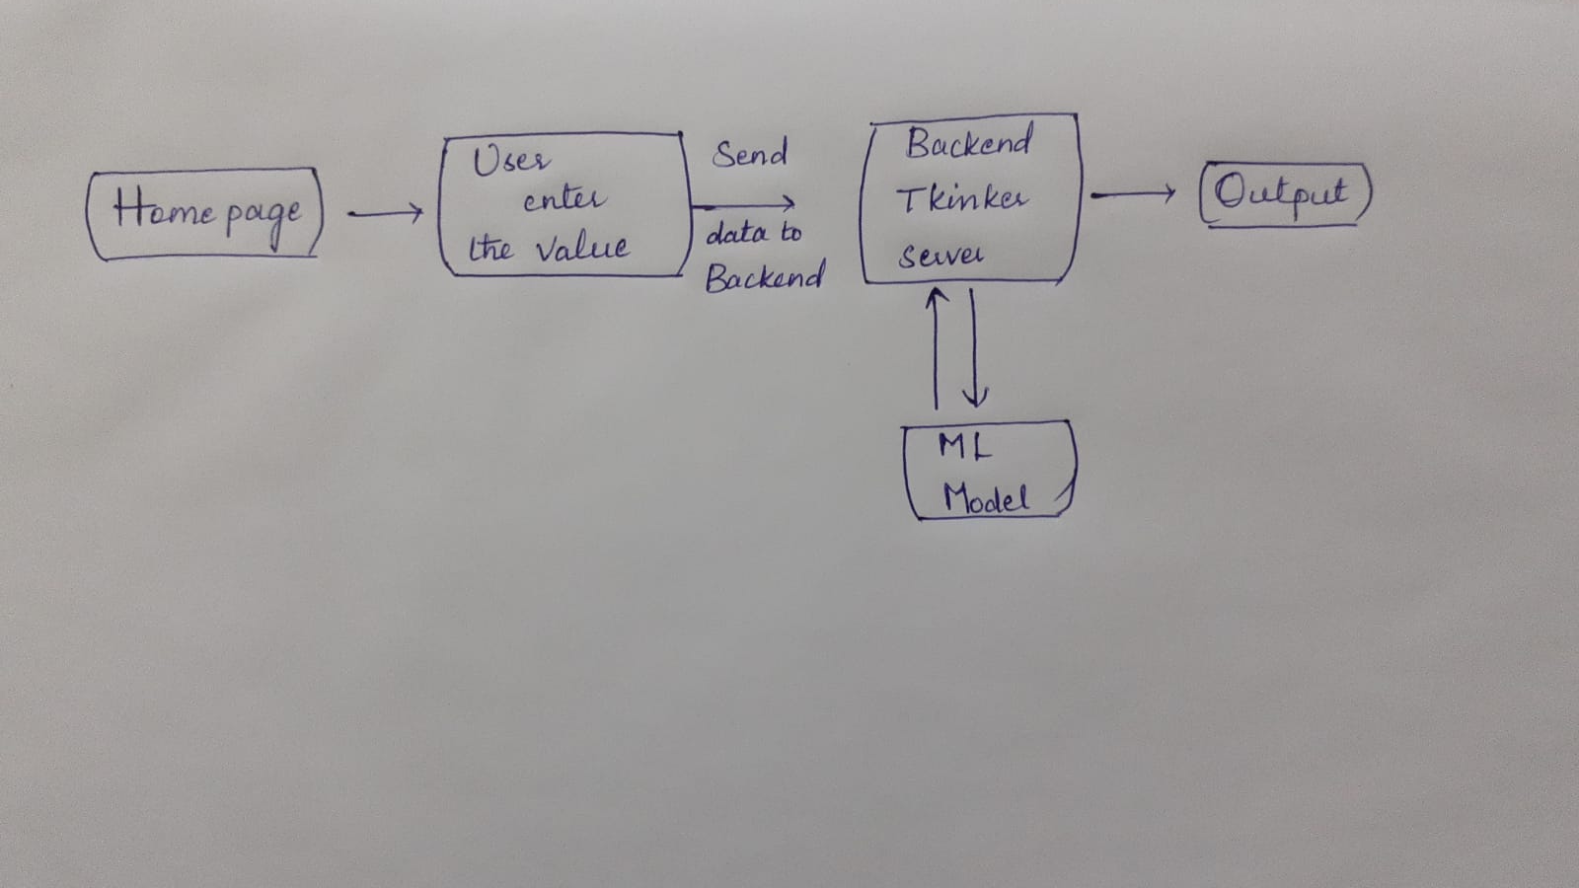
SYSYEM ARCHITECTURE

Slide 6
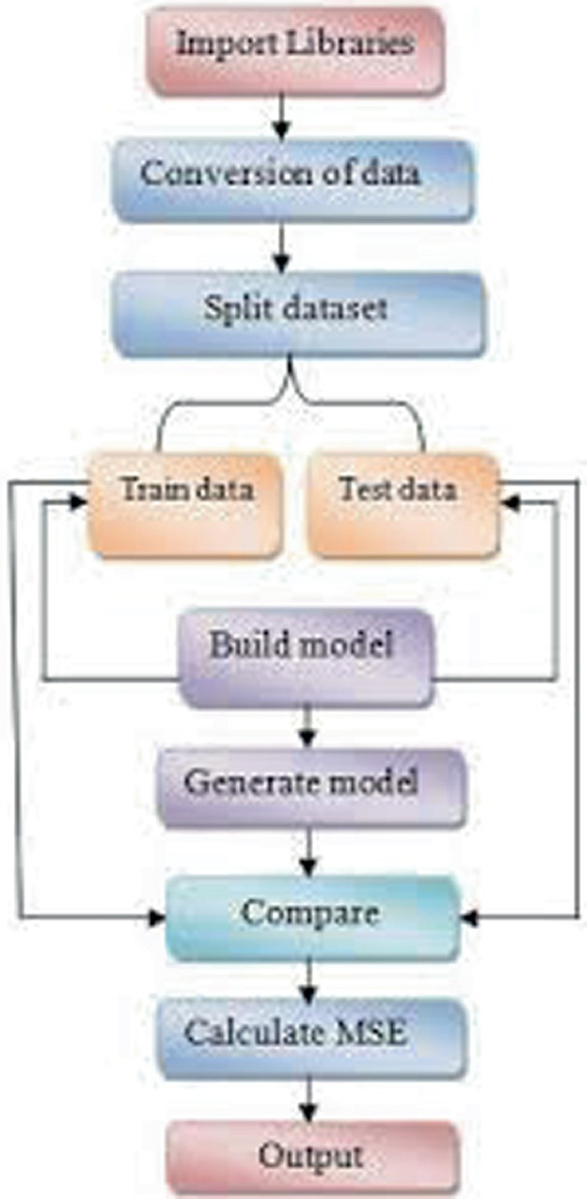
PROJECT DESIGN

Slide 7



HARDWARE AND SOFTWARE REQUIREMNTS
HARDWARE REQUIREMENTS: A laptop with a good internet connection.
SOFTWARE REQUIREMENTS : Anaconda software and jupyter notebook.

Slide 8
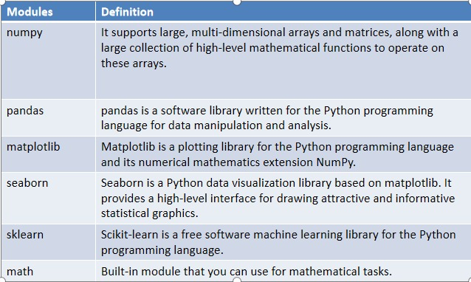
MODULE IMPLEMENTATION

Slide 9
METHODOLOGY ( cont..)
Gradient Boosting Regressor:
"Boosting" in machine learning is a way of combining multiple simplemodels into a single composite model.
This is also why boosting is known as an additive model, since simple models (also known as weak learners) are added one at a time, while keeping existing trees in the model unchanged. As we combine more and more simple models, the complete final model becomes a stronger predictor.
The term "gradient" in"gradient boosting" comes from the fact that the algorithm uses gradient descent to minimize the loss.

Slide 10
RANDOM FOREST REGRESSOR
Random forest is a bagging technique and not a boosting technique. The trees in random forests are run in parallel.
There is no interaction between these the trees.It operates by constructing a multitude of decision trees at training time and outputting the class that is the mode of the classes (classification) or mean prediction (regression) of the individual trees.
A random forest is a meta-estimator (i.e. it combines the result of multiple predictions) which aggregates many decision trees.

Slide 11
Decision Tree Regressor
Decision Tree is a decision-making tool that uses a flowchart-like tree structure or is a model of decisions and all of their possible results, including outcomes, input costs and utility.
Decision-tree algorithm falls under the category of supervised learning algorithms. It works for both continuous as well as categorical output variables.
Decision tree regression observes features of an object and trains a model in the structure of a tree to predict data in the future to produce meaningful continuous output.
Continuous output means that the output/result is not discrete, i.e., it is not represented just by a discrete,known set of numbers or values.

Slide 12
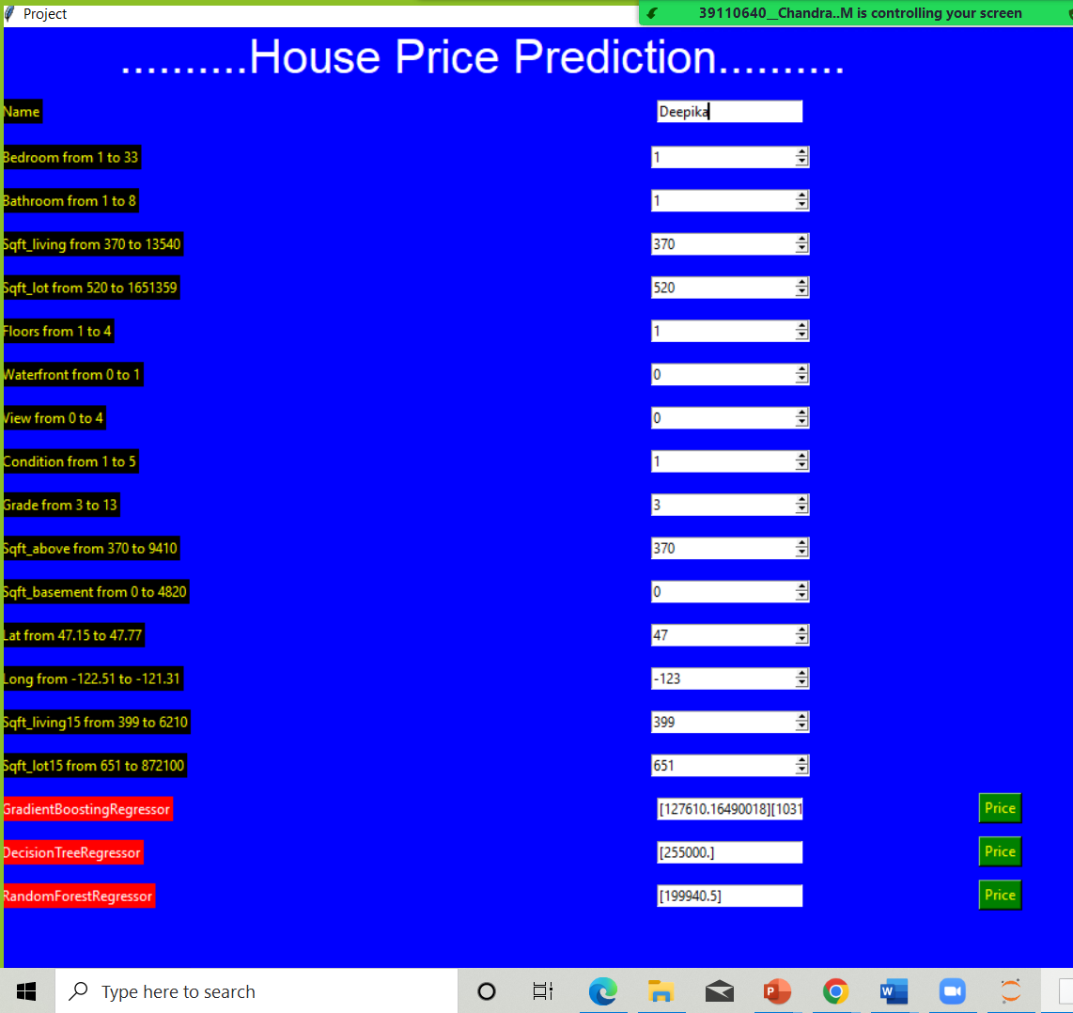
SNAPSHOT OF THE MODEL

Slide 13
RESULTS
Decision Tree
Accuracy : Approx 76.2%
Gradient Boosting:
Accuracy : Approx 89.4%
Random forest
Accuracy : Approx 88.4%

Slide 14
CONCLUSION
The study shows a comparison between the regression algorithms and artificial neural network when predicting house prices in Hyderabad.
The results were promising for the public data due to it being rich with features and having strong Regression, whereas the local data gave a worse outcome when the same pre-processing strategy was implemented due to it being in a different shape compared with the public data in terms of the number of features and the regression strength.

Slide 15
REFERENCES
https://www.slideshare.net/radiantgroup/renting-vs-owning-ppt
https://www.academia.edu/9498812/Rental_House_Management_System

