Slide 1
NEXORA
NEXORA - AI-Powered Startup Generation Platform

Slide 2
Problem - Startup Success Rate
90% of startups fail due to lack of validation and planning
Insufficient market research and business planning
Inadequate resources and support for early-stage entrepreneurs
2

Slide 3
Solution - NEXORA Platform
AI-powered idea validation and business planning tools
Advanced market research and analysis capabilities
Automated pitch deck generation and MVP development
3

Slide 4
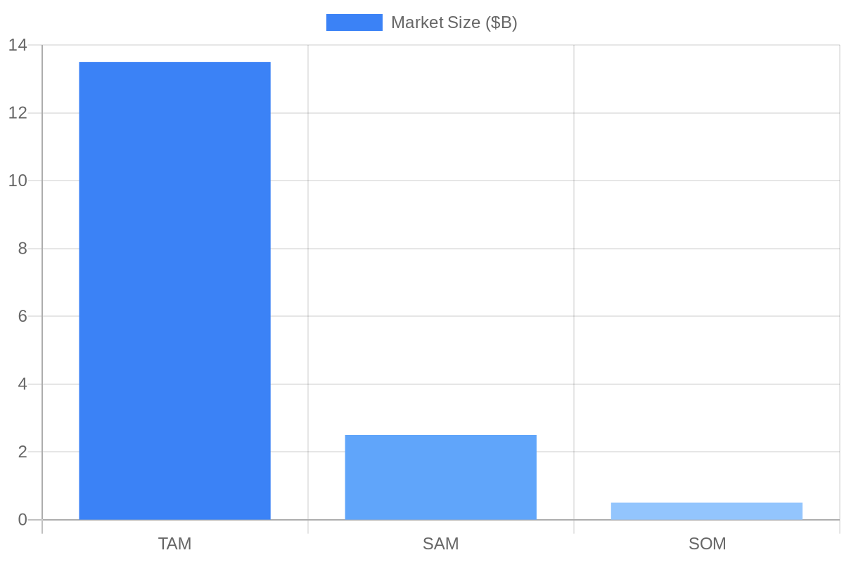
Market Opportunity
TAM: $10B - Global startup ecosystem
SAM: $1B - Targeting early-stage entrepreneurs
SOM: $100M - Initial focus on AI-powered startup tools
4

Slide 5
Product - Key Features and Demo
Idea validation and business planning tools
Market research and analysis capabilities
Pitch deck generation and MVP development
Integration with popular startup platforms
5

Slide 6
Business Model
Freemium model with premium features and support
Revenue streams: subscription fees, advertising, and partnerships
Scalable and flexible pricing plans for entrepreneurs
6

Slide 7
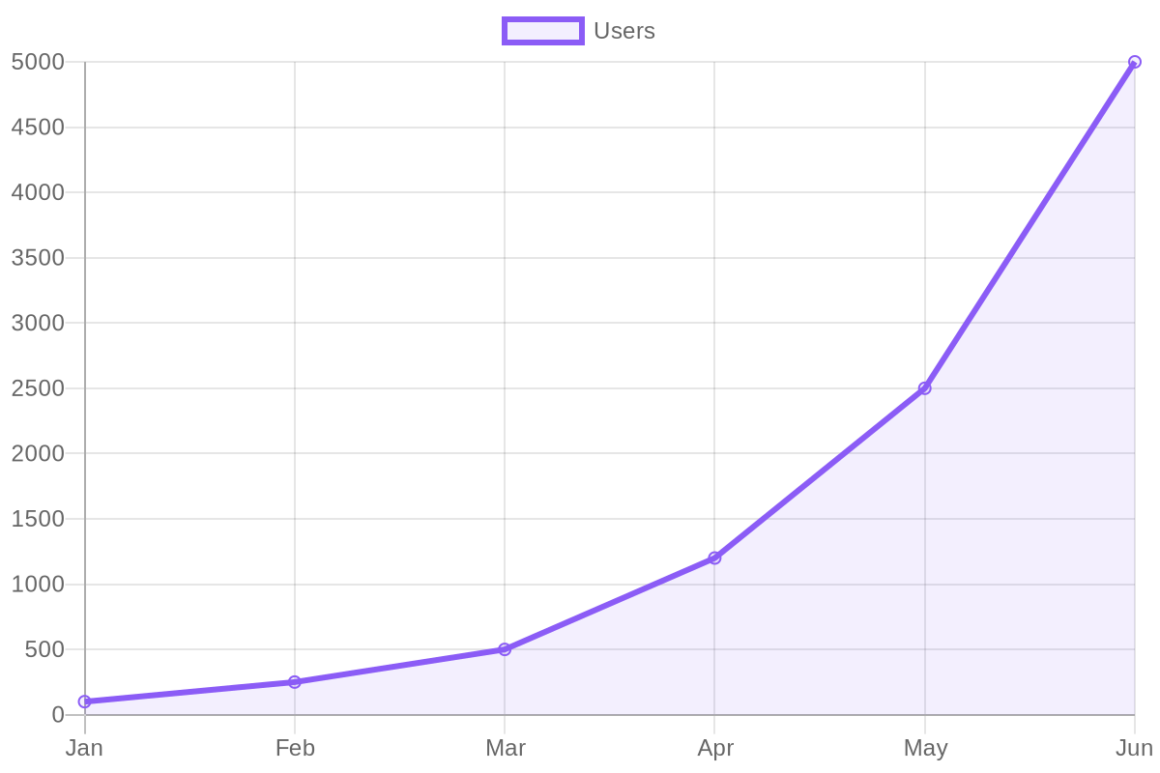
Traction - Metrics and Milestones
1000+ registered users and 500+ startup ideas validated
Partnerships with 5 leading startup accelerators and incubators
Average user engagement: 2 hours/week, 20% weekly retention
7

Slide 8
Competition - Landscape and Advantage
Competitors: startup accelerators, incubators, and consulting firms
NEXORA's advantage: AI-powered tools, automated processes, and scalability
Unique value proposition: comprehensive startup generation platform
8

Slide 9
Team - Founders and Key Members
Founders: [Your Name], [Co-Founder's Name]
Key team members: AI engineers, startup experts, and marketing professionals
Advisory board: experienced entrepreneurs and industry experts
9

Slide 10
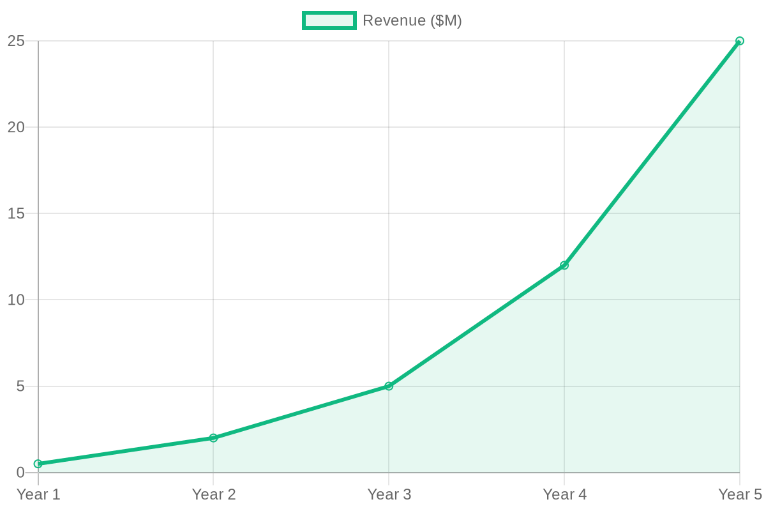
Financials - Revenue Projections and Unit Economics
Revenue projections: $250,000 (year 1), $1M (year 2), $5M (year 3)
User acquisition cost: $50, lifetime value: $200
Gross margin: 70%, operating expenses: $150,000 (year 1)
10

Slide 11
The Ask - Funding and Use of Funds
Funding ask: $100,000
Use of funds: platform development, marketing, and hiring key talent
Milestones and metrics for funding release
11

Slide 12
Closing - Vision and Call to Action
Transforming the startup ecosystem with AI-powered tools
Join us in empowering entrepreneurs and shaping the future of innovation
Let's partner to make NEXORA a leading startup generation platform
12

