Slide 1
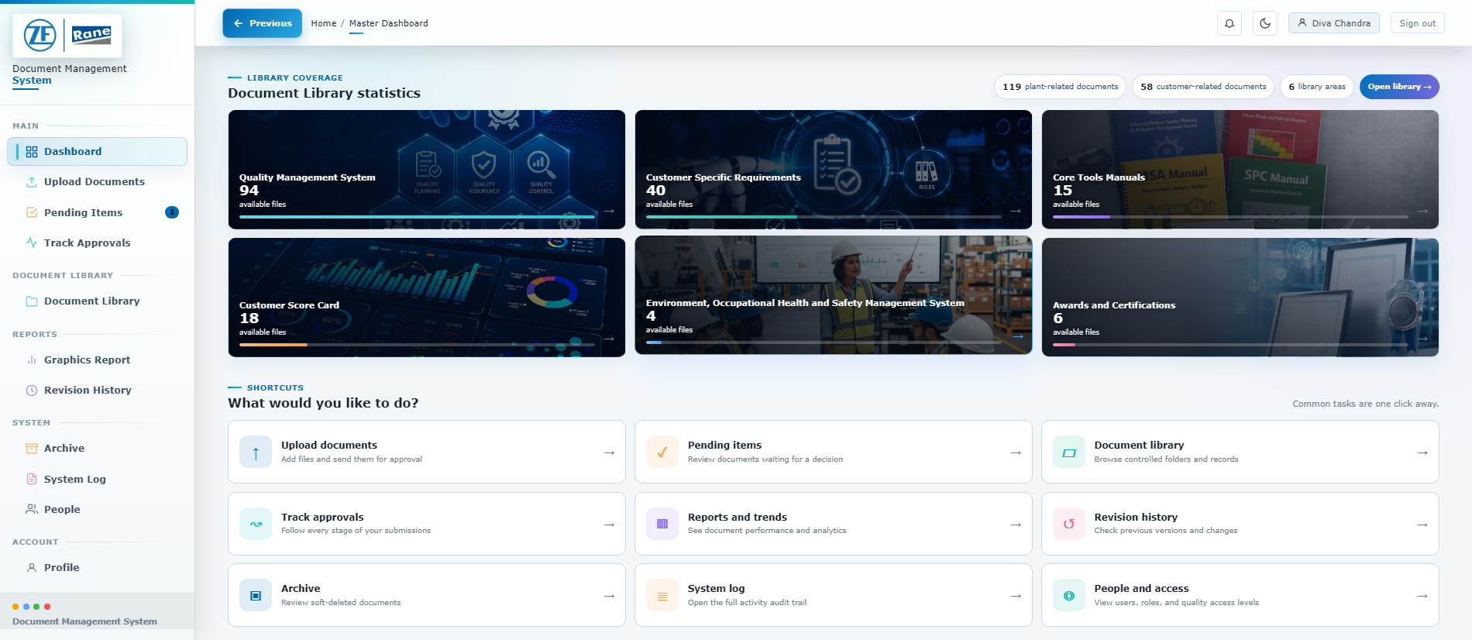
SMART DMS PORTAL
CONTROLLED DOCUMENT
USER MANUAL
Document submission, approval, access, reporting and audit
DOCUMENT NUMBER | REVISION | EFFECTIVE | OWNER
DMS-UM-001 | 1.4 | 10-Aug-2026 | DMS Team
ZF Rane Automotive India PVT LTD - SGD
Internal use only

Slide 2
ZF Rane Automotive India PVT LTD - SGD Smart DMS Portal User Manual
Document: DMS-UM-001 | Revision: 1.4
Effective: 10-Aug-2026 | Page: 2 of 27
1.2
Document Control and Contents
Use the latest controlled copy available in the portal.
Field | Value | Field | Value
Document title | Smart DMS Portal User Manual | Document number | DMS-UM-001
Revision | 1.4 | Effective | 10-Aug-2026
Prepared for | ZF Rane Automotive India PVT LTD - SGD | Classification | Internal user guide
System | Smart DMS v2.0.0 | Source | Portal UI, current Flask code, local database and supplied workflow screenshots
Contents
1
Document control and contents
2
6
Approvals and status tracking
10-16
2
Purpose, scope and access levels
3
7
Document library and repositories
17-19
3
End-to-end process overview
4
8
Reports and revision control
20-21
4
Login and account access
5-6
9
Archive, audit and people administration
22-24
5
Dashboard and document submission
7-9
10
Notifications, profile, logout and troubleshooting
25-27
Controlled-copy rule
Screenshots are representative of the current portal. Field availability and administrative actions may vary by role, QMS level and configured library category.

Slide 3
ZF Rane Automotive India PVT LTD - SGD Smart DMS Portal User Manual
Document: DMS-UM-001 | Revision: 1.4
Effective: 10-Aug-2026 | Page: 3 of 27
2.0
Purpose, Scope and Access Levels
This manual enables users to complete routine DMS work safely and consistently.
Purpose
To digitally centralize, control, and secure organizational documents through a standardized approval and version management system.
Scope
Covers the complete document lifecycle—including creation, approval, storage, retrieval, revision, archival, and audit traceability—for all quality and organizational documents across the enterprise.
Level / role | Primary access | Approval responsibility
L1 - HOD / final approver | All QMS files; final review; edit/delete rights where configured. | Approve or reject after L2 review. Admin is treated as L1.
L2 - Assistant Manager / Manager | All QMS files and first-stage review workspace. | Review, select recipients and send to L1; or reject with comments.
L3 - Procedure viewer | SOPs, IATF audit plans, Records and IATF Standards. | No approval decision.
L4 - Checksheet viewer | Records only. | No approval decision.
High-level roles | Admin, Manager, Supervisor and Approver can access Archive and System Log. | Decision rights still follow QMS level.
Admin | Full system access including People directory. | Final approval capability and user oversight.
Key distinction
Role controls administrative pages. QMS level controls document visibility and who can complete each approval stage.

Slide 4

ZF Rane Automotive India PVT LTD - SGD Smart DMS Portal User Manual
Document: DMS-UM-001 | Revision: 1.4
Effective: 10-Aug-2026 | Page: 4 of 27
3.0
End-to-End Process Overview
The workflow below reflects the current two-stage approval design.
1
Sign in Choose upload
Select files
2
3
Email or GENID
Open Upload Documents
Approved Office/PDF formats
4
Add metadata
5
Submit
6
L2 review
Number, revision, plant, path
Status becomes Pending
Select recipients and first approve
7
L1 review
8
Use and report
9
Retain and audit
Final approve or reject
View, download, track, analyze
Revise, archive, restore/log
Status path
Pending -> Pending Final Approval -> Approved. A rejection can occur at either approval stage and must include comments so the uploader knows what to correct.

Slide 5
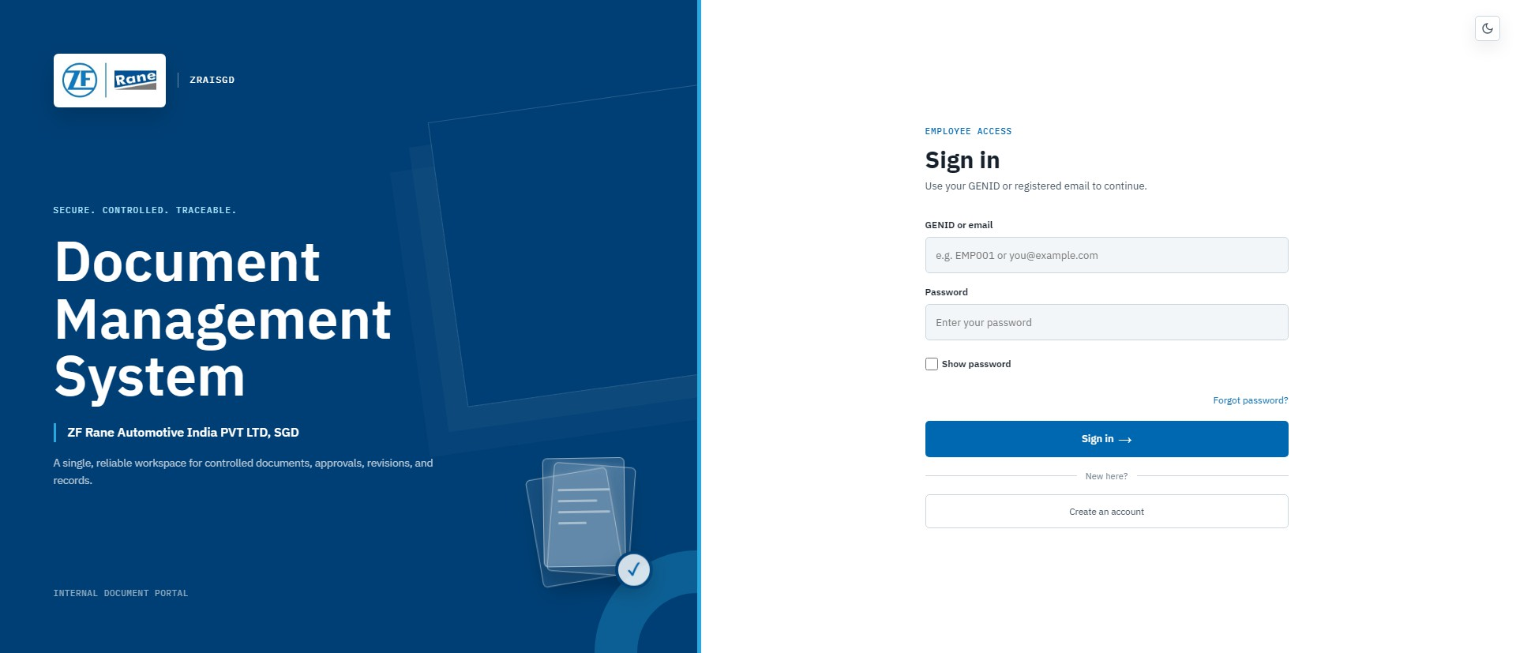

ZF Rane Automotive India PVT LTD - SGD Smart DMS Portal User Manual
Document: DMS-UM-001 | Revision: 1.4
Effective: 10-Aug-2026 | Page: 5 of 27
4.1
Login to the Portal
Use the portal URL supplied by your DMS administrator.
Figure 1 - Current Smart DMS login page
1
Open the Smart DMS portal
Use a supported browser and the approved internal URL.
2
Enter your identity
Use your registered email address or employee GENID.
3
Enter your password
Passwords are case-sensitive. Do not share credentials.
4
Select Sign in
Successful login opens the Master Dashboard. An audit event is recorded.
Access problem?
Use Forgot password for a registered email address or contact the DMS administrator if the account is not active.

Slide 6
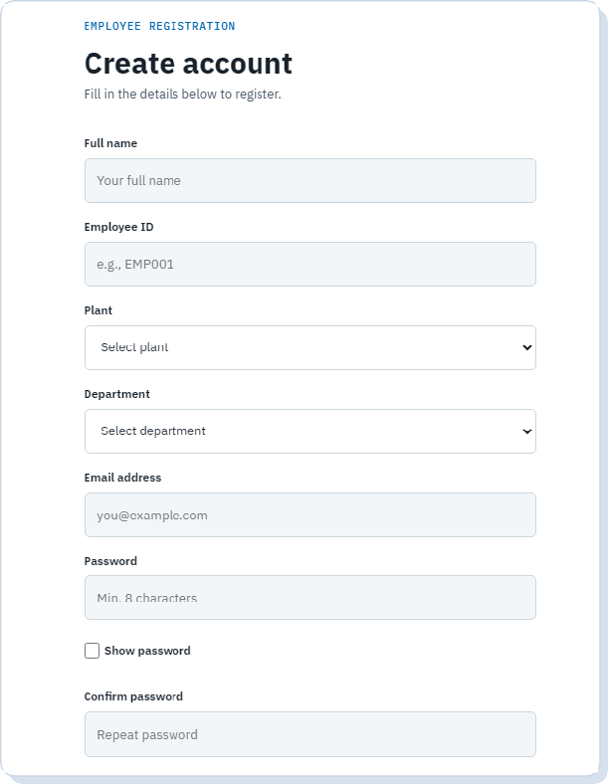
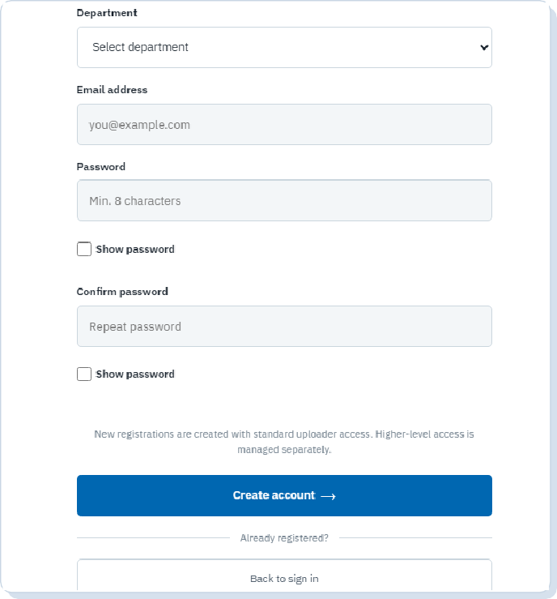

ZF Rane Automotive India PVT LTD - SGD Smart DMS Portal User Manual
Document: DMS-UM-001 | Revision: 1.4
Effective: 10-Aug-2026 | Page: 6 of 27
4.2
Register and Reset Password
New accounts start with the User role and standard QMS access.
Password confirmation and submission controls
Create account: identity and organization fields
1
Open Create account
From the login page, select Create account.
2
Complete identity fields
Enter full name, optional employee ID, plant, official department and a unique email.
3
Create a password
Use at least 8 characters and enter the same value in Confirm password.
4
Submit the registration
Return to the login page after the success message. An administrator manages any elevated role or QMS-level assignment.
Forgot password
Select Forgot password on the login page, submit the registered email and follow the time-limited reset link. Reset links expire after 1 hour.

Slide 7
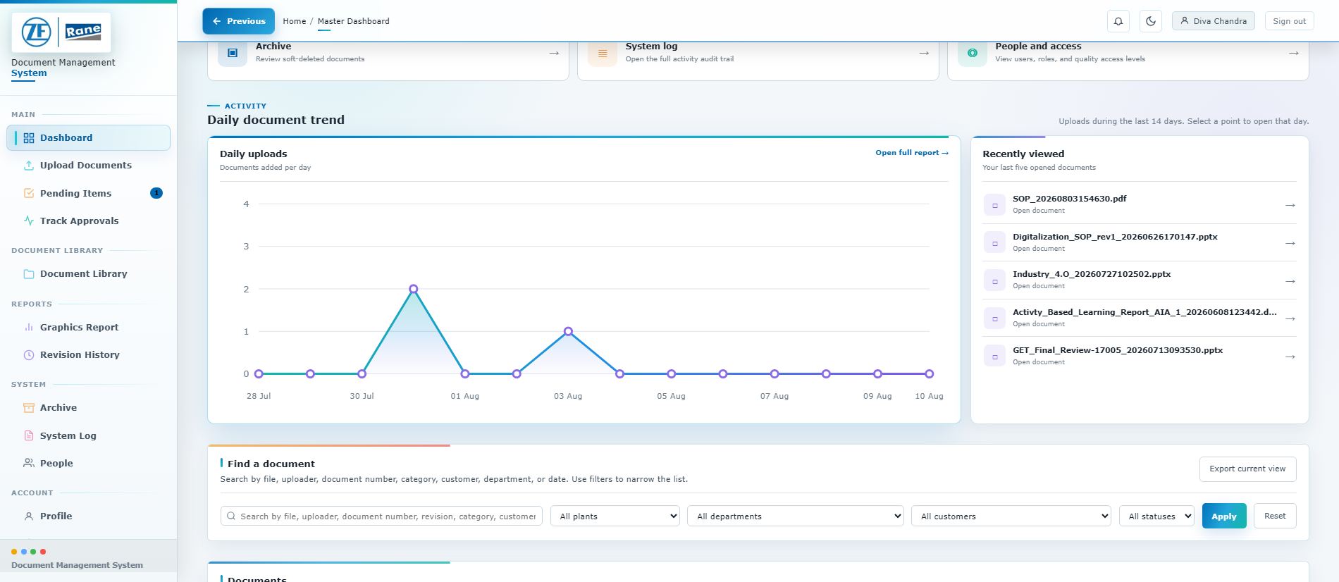

ZF Rane Automotive India PVT LTD - SGD Smart DMS Portal User Manual
Document: DMS-UM-001 | Revision: 1.4
Effective: 10-Aug-2026 | Page: 7 of 27
5.1
Use the Master Dashboard
The dashboard is shown in two complete views: library shortcuts first, then activity and search.
Figure 3 - Dashboard overview (top) and activity/search (bottom)
1
Review library coverage
Review 119 plant and 58 customer documents across six library areas.
2
Use quick actions
Open Uploads, Pending, Library, Approvals, Reports or Revision History.
3
Review activity
Use the 14-day trend and Recently viewed list to reopen work.
4
Search and filter
Search metadata; filter by plant, department, customer and status.
5
Manage the current view
Set page size, use authorized row actions, or export the filtered CSV.
Good practice
Reset filters before concluding that a document is missing. Counts and visibility are access-aware and reflect the current database.

Slide 8
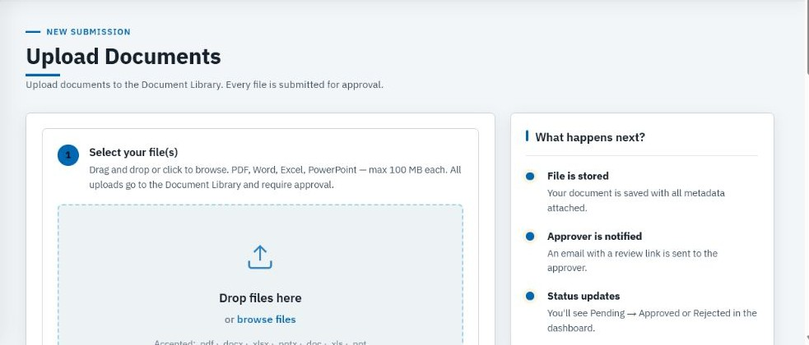

ZF Rane Automotive India PVT LTD - SGD Smart DMS Portal User Manual
Document: DMS-UM-001 | Revision: 1.4
Effective: 10-Aug-2026 | Page: 8 of 27
5.2
Upload Files and Enter Metadata
Every upload is routed into the Document Library and sent for approval.
Figure 4 - File selection and the start of the upload form
1
Select one or more files
Drag files into the drop zone or choose Browse files.
2
Check format and size
Accepted formats: PDF, DOC/DOCX, XLS/XLSX and PPT/PPTX. Maximum size is 100 MB per file.
3
Enter the document number
Use the approved numbering convention, for example DOC-2026-001.
4
Confirm revision
Enter the revision value. If left blank, the system uses Rev.00.
5
Select ownership
Confirm plant and department. Choose a customer or enable Internal Document.
Before upload
Remove passwords from files intended for browser preview and confirm the file name does not expose confidential personal data.

Slide 9
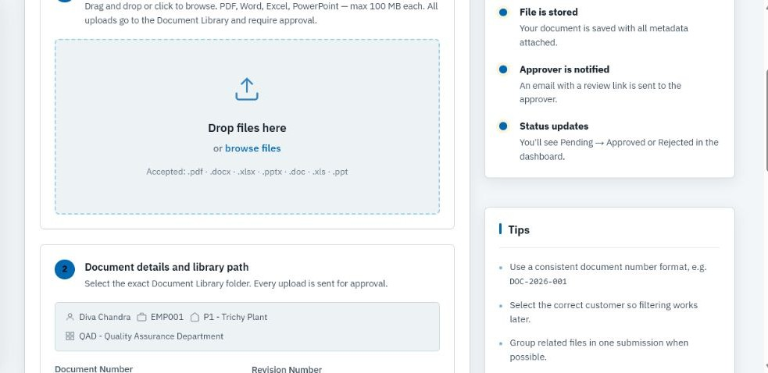

ZF Rane Automotive India PVT LTD - SGD Smart DMS Portal User Manual
Document: DMS-UM-001 | Revision: 1.4
Effective: 10-Aug-2026 | Page: 9 of 27
5.3
Choose the Library Path and Submit
The selected category and folder determine where users find the approved document.
Figure 5 - Current upload workflow; continue down the form to set the library path and submit
1
Select the category
Choose the correct library category, such as QMS.
2
Choose document type and folder
Complete every path field until the path indicator shows the exact destination.
3
Add a revision summary when needed
Enable the summary option when replacing or revising an existing controlled document.
4
Review all details
Verify file, document number, revision, plant, department, customer and library path.
5
Submit for approval
The document is stored with status Pending, the L2 reviewer is notified and the action is logged.
Required path
Do not submit against a broad category when a lower-level folder is required. Incorrect placement makes controlled documents difficult to retrieve.

Slide 10
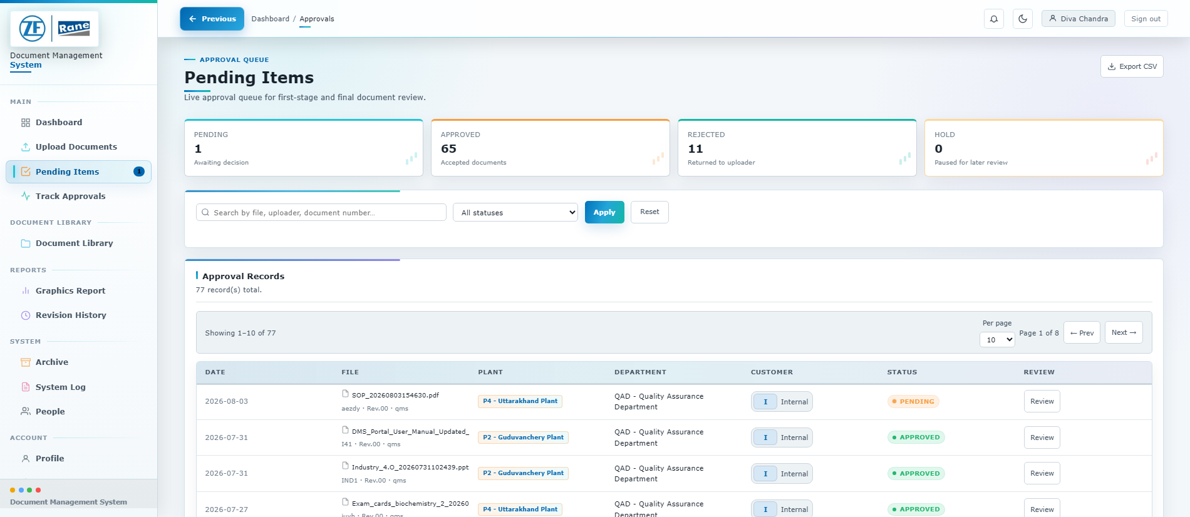

ZF Rane Automotive India PVT LTD - SGD Smart DMS Portal User Manual
Document: DMS-UM-001 | Revision: 1.4
Effective: 10-Aug-2026 | Page: 10 of 27
6.1
Find Documents in Pending Items
All logged-in users can view the approval list; decision rights depend on QMS level.
Figure 6 - Pending Items list with status filters and review actions
1
Choose a status tab
View All, Pending, Pending Final Approval, Approved or Rejected items.
2
Search the list
Search by file name, document number or uploader.
3
Open Review
Inspect the file preview, metadata and current approval stage.
4
Export when required
Download the filtered list as CSV for controlled reporting.
No bulk decisions
Approvals must be reviewed individually because the workflow requires stage-specific review, recipient selection and comments.

Slide 11
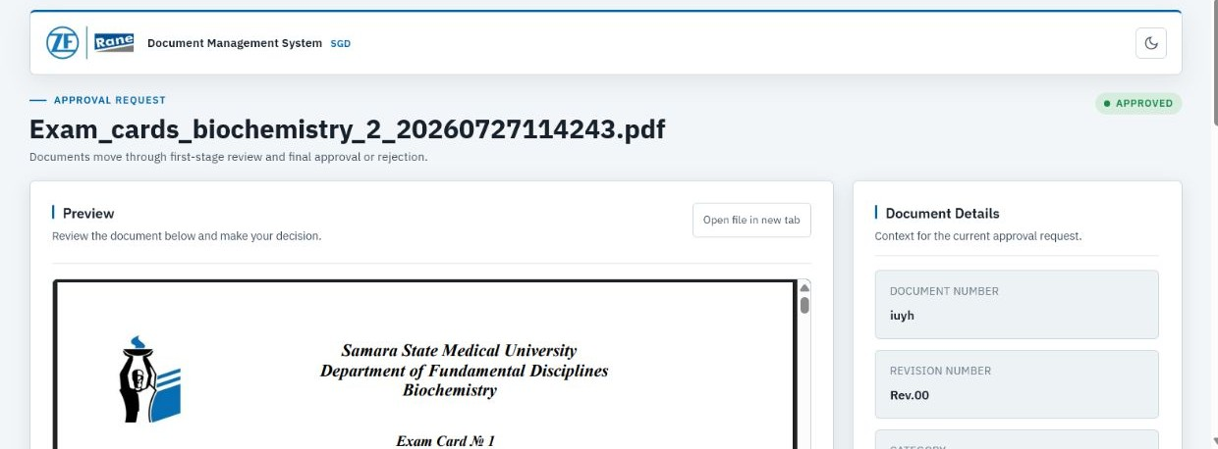
ZF Rane Automotive India PVT LTD - SGD Smart DMS Portal User Manual
Document: DMS-UM-001 | Revision: 1.4
Effective: 10-Aug-2026 | Page: 11 of 27
6.2
Review the Document Before Deciding
Review the file and metadata together before completing an approval action.
Figure 7 - Approval review workspace with preview and document details
1
Confirm document identity
Check file name, document number, revision, plant, department, customer and category.
2
Inspect the preview
Office documents use a generated PDF viewing copy. Use Open file in new tab when a larger view is required.
3
Check revision context
Read the revision summary and compare with the previous approved version when applicable.
4
Confirm the current stage
Pending requires L2 action. Pending Final Approval requires L1 or Admin action.
5
Record a clear decision
Follow the correct stage procedure on the next page.
Review standard
Never approve from the list view alone. Open the review page and verify the actual file content.

Slide 12
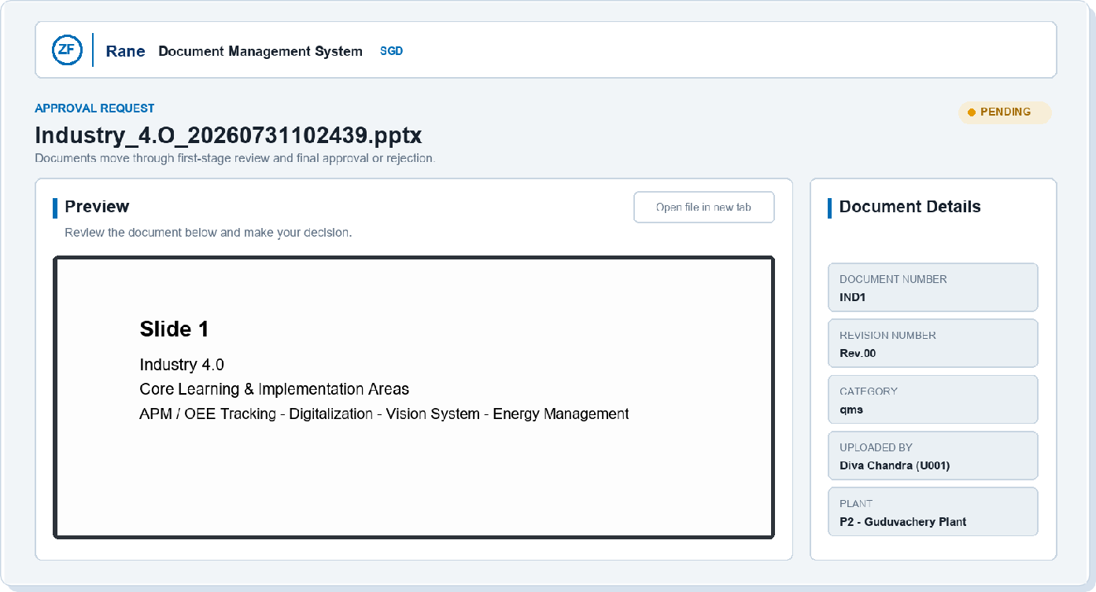
ZF Rane Automotive India PVT LTD - SGD Smart DMS Portal User Manual
Document: DMS-UM-001 | Revision: 1.4
Effective: 10-Aug-2026 | Page: 12 of 27
6.3
Open the Approval Request
The approval email and review page provide the same document context.
Approval request example - preview, status and document details
1
Open the email action
Select Review document only from an expected approval request.
2
Confirm the status
The first reviewer acts while the status is Pending.
3
Verify the converted preview
Office files are shown through their generated PDF viewing copy.
4
Cross-check metadata
Confirm document number, revision, category, uploader, plant, department and customer.
Email safety
Confirm the sender and document context before opening a review link. Report unexpected or duplicate requests.

Slide 13
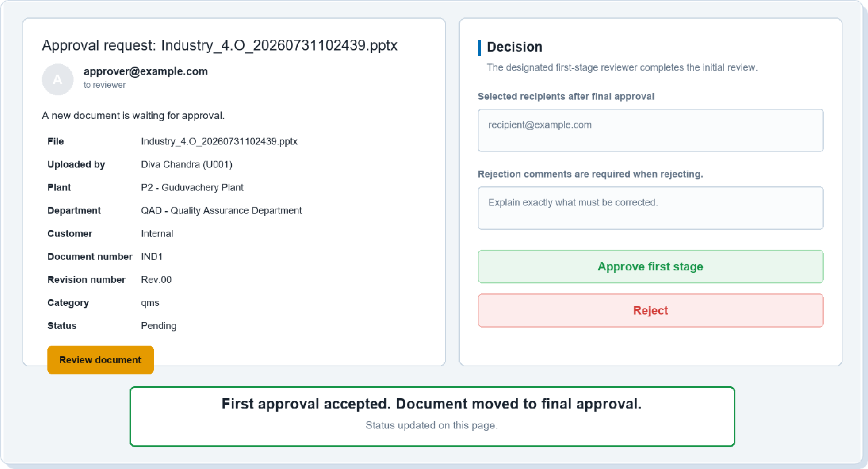
ZF Rane Automotive India PVT LTD - SGD Smart DMS Portal User Manual
Document: DMS-UM-001 | Revision: 1.4
Effective: 10-Aug-2026 | Page: 13 of 27
6.4
Complete First-Stage Approval
The designated L2 reviewer verifies the document and selects final recipients.
First-stage request, decision controls and successful handoff
1
Review the initial email
Check that the request status is Pending and open the review page.
2
Select final recipients
Enter the approved people or department heads who should receive the final document.
3
Approve or reject
Choose Approve first stage, or add specific correction comments before rejecting.
4
Confirm the handoff
A successful first approval changes the item to Pending Final Approval.
Recipient check
Verify recipient addresses before approval. Final sharing uses the recipients selected at this stage.

Slide 14
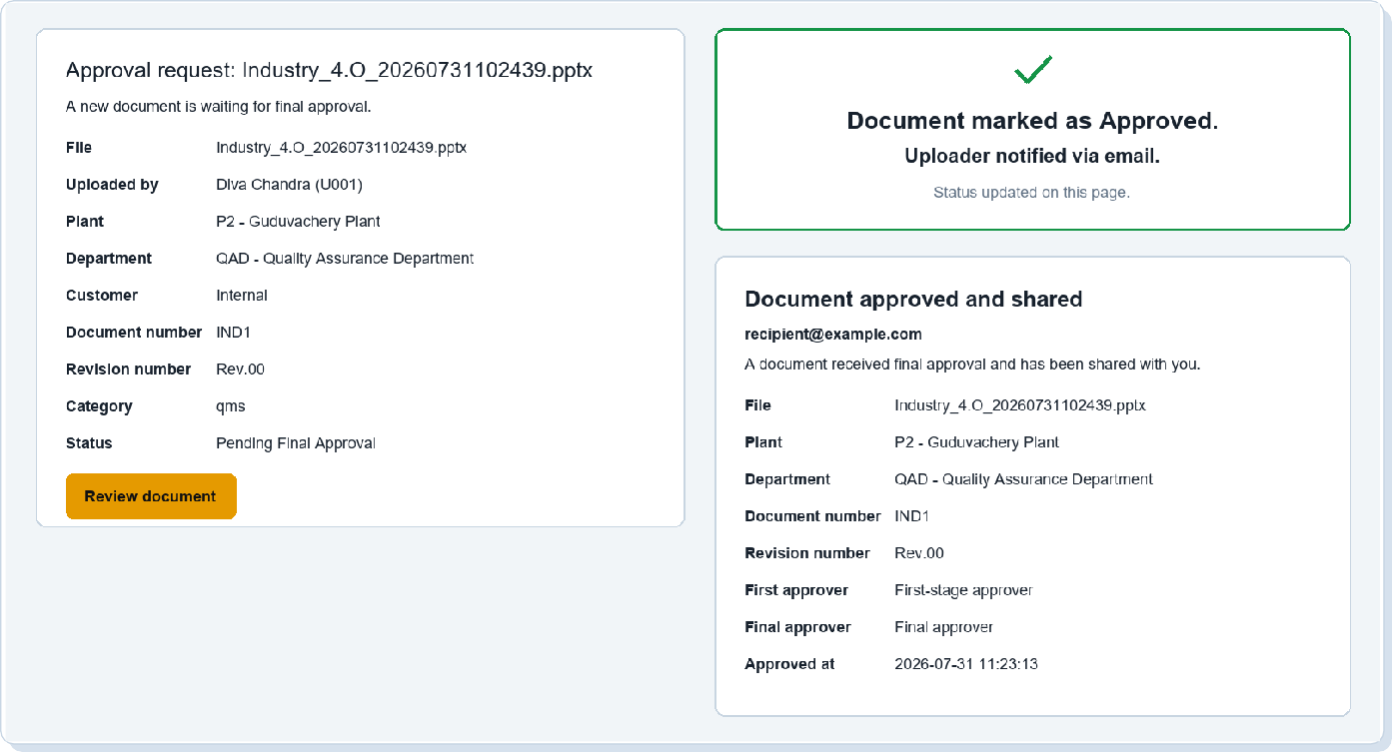
ZF Rane Automotive India PVT LTD - SGD Smart DMS Portal User Manual
Document: DMS-UM-001 | Revision: 1.4
Effective: 10-Aug-2026 | Page: 14 of 27
6.5
Complete Final Approval and Sharing
The L1 or Admin reviewer makes the final controlled-document decision.
Final approval request, confirmation and shared-document notification
1
Open the final request
Confirm the status is Pending Final Approval.
2
Perform the final review
Recheck the file, metadata, revision, first-stage decision and selected recipients.
3
Approve or reject
Approve to publish and notify, or reject with mandatory correction comments.
4
Confirm communication
The uploader is notified and approved recipients receive the final sharing email.
Completion evidence
Use Track Approvals and System Log for workflow evidence; email is a notification and not the system of record.

Slide 15


ZF Rane Automotive India PVT LTD - SGD Smart DMS Portal User Manual
Document: DMS-UM-001 | Revision: 1.4
Effective: 10-Aug-2026 | Page: 15 of 27
6.6
Complete the Two-Stage Approval
Approval responsibility is assigned by QMS level, independent of general role.
L2 - First-stage review
L1 - Final review
1
Verify document accuracy and library placement.
1
Confirm the L2 review and selected recipients.
2
Choose the recipients or department heads who should receive the final approved document.
2
Verify the final content, revision and controlled-document location.
3
Select Approve first stage to move the item to Pending Final Approval.
3
Select Approve to publish the final status and notify stakeholders.
4
Or select Reject and enter a clear correction comment.
4
Or select Reject and enter a mandatory rejection comment.
Status | Meaning | Next action
Pending | Awaiting L2 first review. | L2 reviews and first approves or rejects.
Pending Final Approval | L2 review completed. | L1/Admin approves or rejects.
Approved | Final approval completed. | Document is available for controlled use.
Rejected | Correction is required. | Uploader corrects and resubmits as required.
Mandatory rejection comments
State what is wrong, where it occurs and what the uploader must change. Avoid comments such as 'incorrect' without detail.

Slide 16
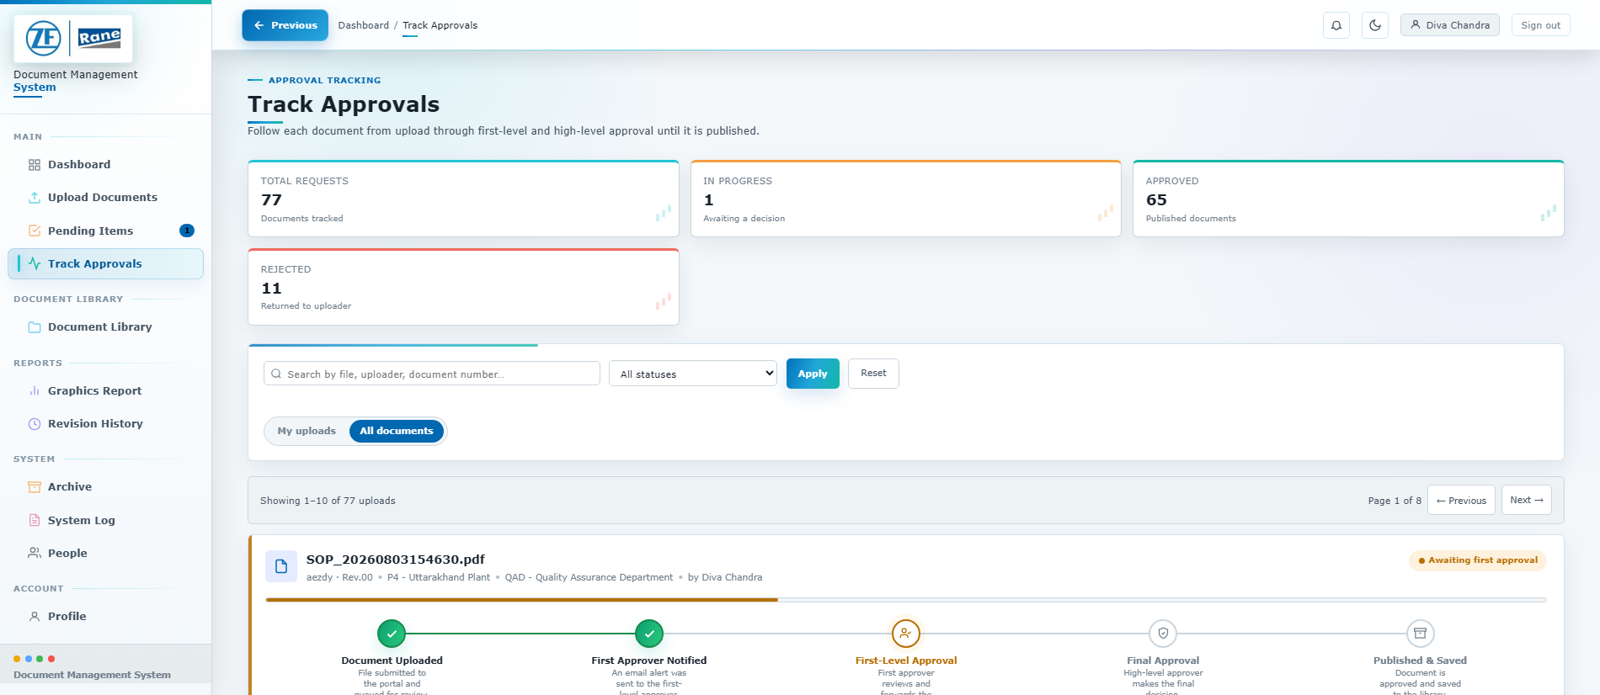
ZF Rane Automotive India PVT LTD - SGD Smart DMS Portal User Manual
Document: DMS-UM-001 | Revision: 1.4
Effective: 10-Aug-2026 | Page: 16 of 27
6.7
Track Approval Progress
The timeline shows the current stage and completed workflow events.
Figure 8 - Track Approvals summary and document timelines
1
Start with My submissions
Standard users see documents they uploaded.
2
Use All documents when authorized
High-level users can switch scope to review all records.
3
Filter by status or search
Narrow the list to pending, approved or rejected documents.
4
Read the timeline
Each marker shows submission, first approval, final approval or rejection.
5
Open the source record
Use the linked document or review action when follow-up is required.
Status interpretation
A green timeline is complete. A red marker identifies rejection. A neutral future marker means that stage has not yet occurred.

Slide 17
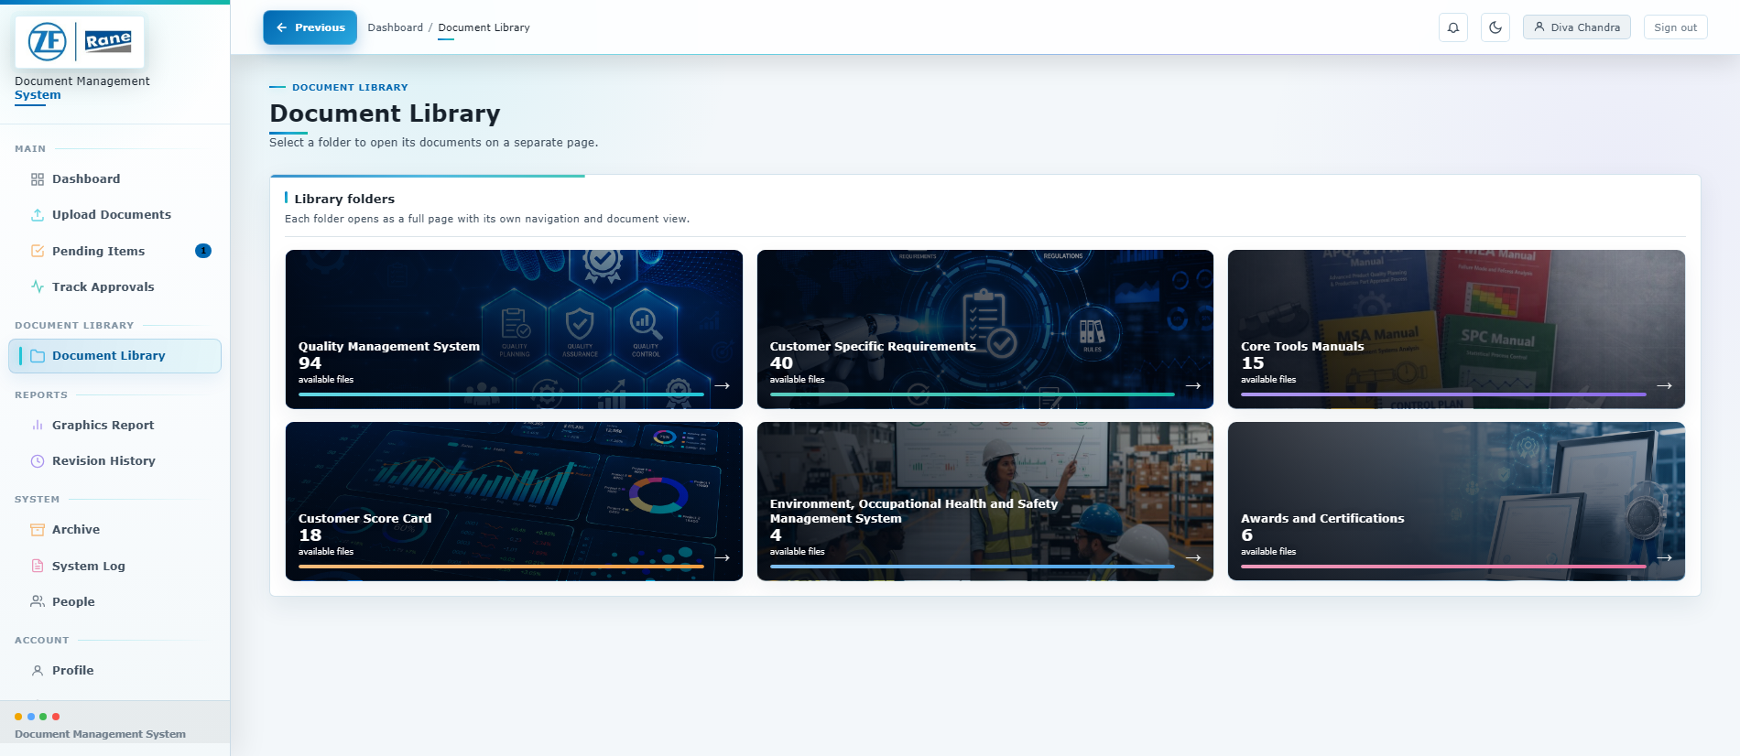
ZF Rane Automotive India PVT LTD - SGD Smart DMS Portal User Manual
Document: DMS-UM-001 | Revision: 1.4
Effective: 10-Aug-2026 | Page: 17 of 27
7.1
Browse the Document Library
The library landing page shows six access-aware folders; each folder opens on a dedicated page.
Figure 9 - Current Document Library folder landing page
1
Open Document Library
Use the left navigation menu.
2
Choose a category
Select QMS, CSR, Core Tools, Score Card, EOHMS, or Awards and Certifications.
3
Read access-aware counts
Counts show approved files visible to your access level and department.
4
Open the folder page
Open a card to enter its dedicated page and breadcrumb trail.
5
Follow the step bar
Select a type, customer or subfolder, then browse approved files.
Controlled use
Use the controlled library copy when the latest revision is required; folder counts and choices reflect your access.

Slide 18
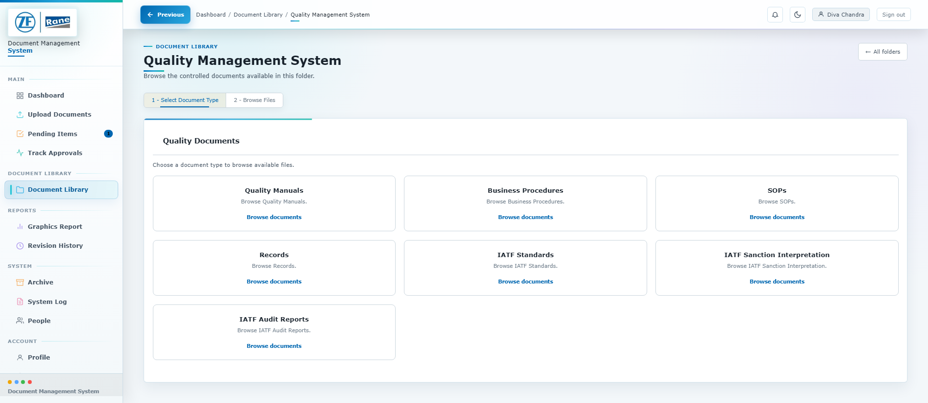
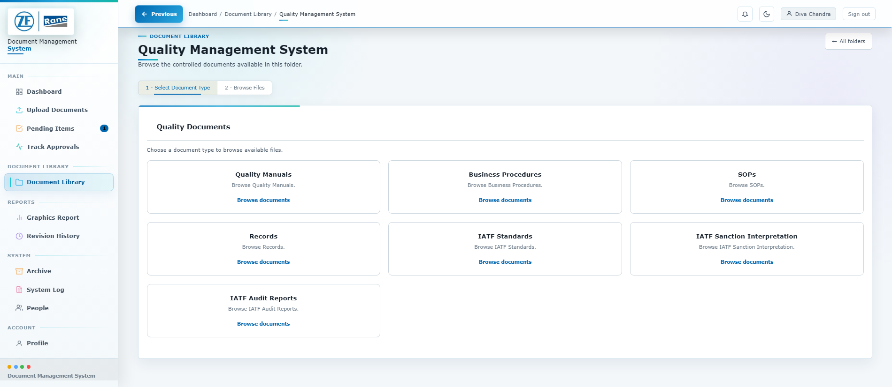
ZF Rane Automotive India PVT LTD - SGD Smart DMS Portal User Manual
Document: DMS-UM-001 | Revision: 1.4
Effective: 10-Aug-2026 | Page: 18 of 27
7.2
Browse QMS Document Types
QMS opens as a dedicated, access-aware folder page with seven document groups.
Figure 10 - QMS document type selection
Figure 11 - Complete QMS group list
1
Open the QMS folder
From Document Library, select Quality Management System.
2
Select one of seven groups
Choose Manuals, Procedures, SOPs, Records or an IATF reference/report group.
3
Follow the required hierarchy
SOPs and Records use plant/department; audits use audit folders and plant.
4
Browse approved files
Confirm document number, revision and location before opening the file.
Access-aware navigation
L1/L2 see all QMS groups; L3 sees SOPs, audit plans, Records and IATF Standards; L4 sees Records only.

Slide 19
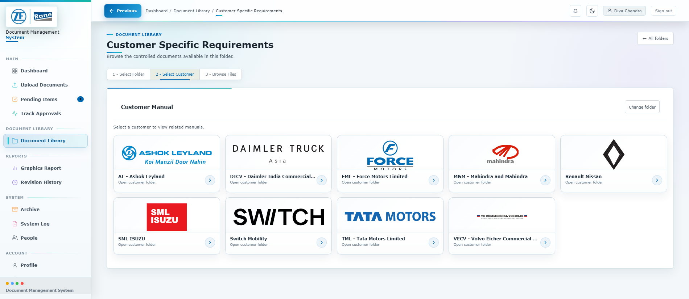
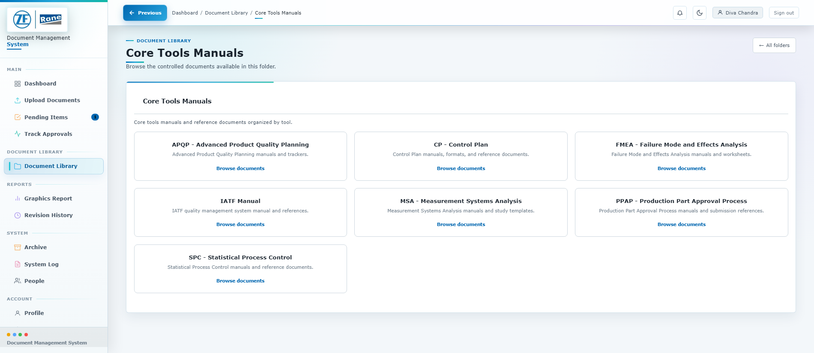
ZF Rane Automotive India PVT LTD - SGD Smart DMS Portal User Manual
Document: DMS-UM-001 | Revision: 1.4
Effective: 10-Aug-2026 | Page: 19 of 27
7.3
Browse Customer and Core Tools
Customer requirements and core-tool references now open as dedicated library pages.
Figure 12 - Customer Manual folders by customer
Figure 13 - Core Tools Manual cards
1
Customer Specific Requirements
Choose CSR Matrix, Customer Manual or Customer Initiatives; customer folders use logo cards.
2
Customer Score Card
Use the separate Score Card area and choose the required customer folder.
3
Core Tools Manuals
Choose APQP, Control Plan, FMEA, IATF Manual, MSA, PPAP or SPC.
4
Return through breadcrumbs
Use the breadcrumb or All folders button to return without losing library context.
Folder navigation
Use the dashboard for broad metadata search and Document Library for controlled, structured browsing.

Slide 20
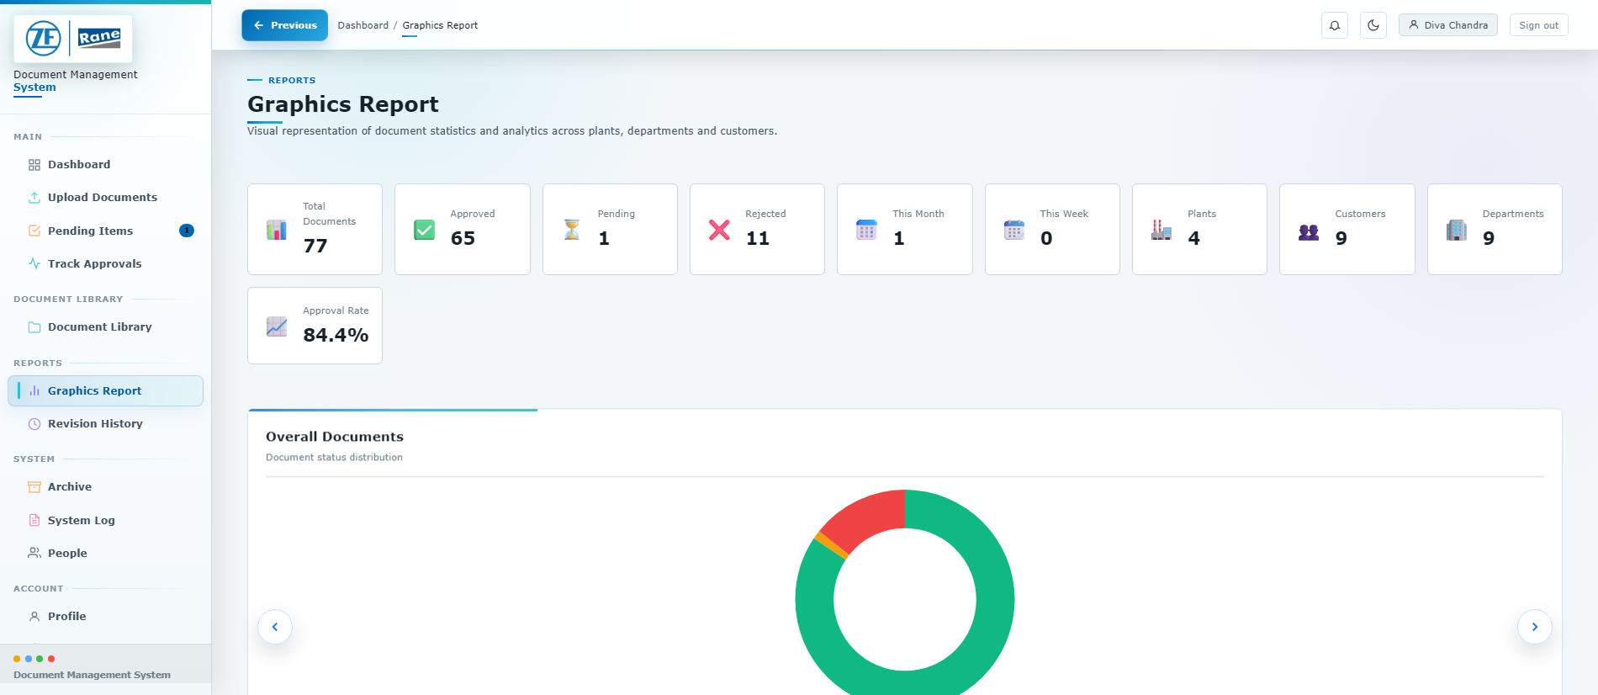

ZF Rane Automotive India PVT LTD - SGD Smart DMS Portal User Manual
Document: DMS-UM-001 | Revision: 1.4
Effective: 10-Aug-2026 | Page: 20 of 27
8.1
Read the Graphics Report
Charts summarize approval health, ownership and upload activity.
Figure 14 - Graphics Report summary cards and charts
1
Review KPI cards
Check total, approved, pending, rejected and recent upload counts.
2
Read status distribution
Use the doughnut chart to identify approval backlog and rejection volume.
3
Compare ownership
Use plant, customer and department charts to locate concentration or imbalance.
4
Review upload trend
Use the time-series chart to identify peaks and changes in submission volume.
Reporting caution
Charts reflect the current database and active filters. Use exported lists or System Log for record-level audit evidence.

Slide 21
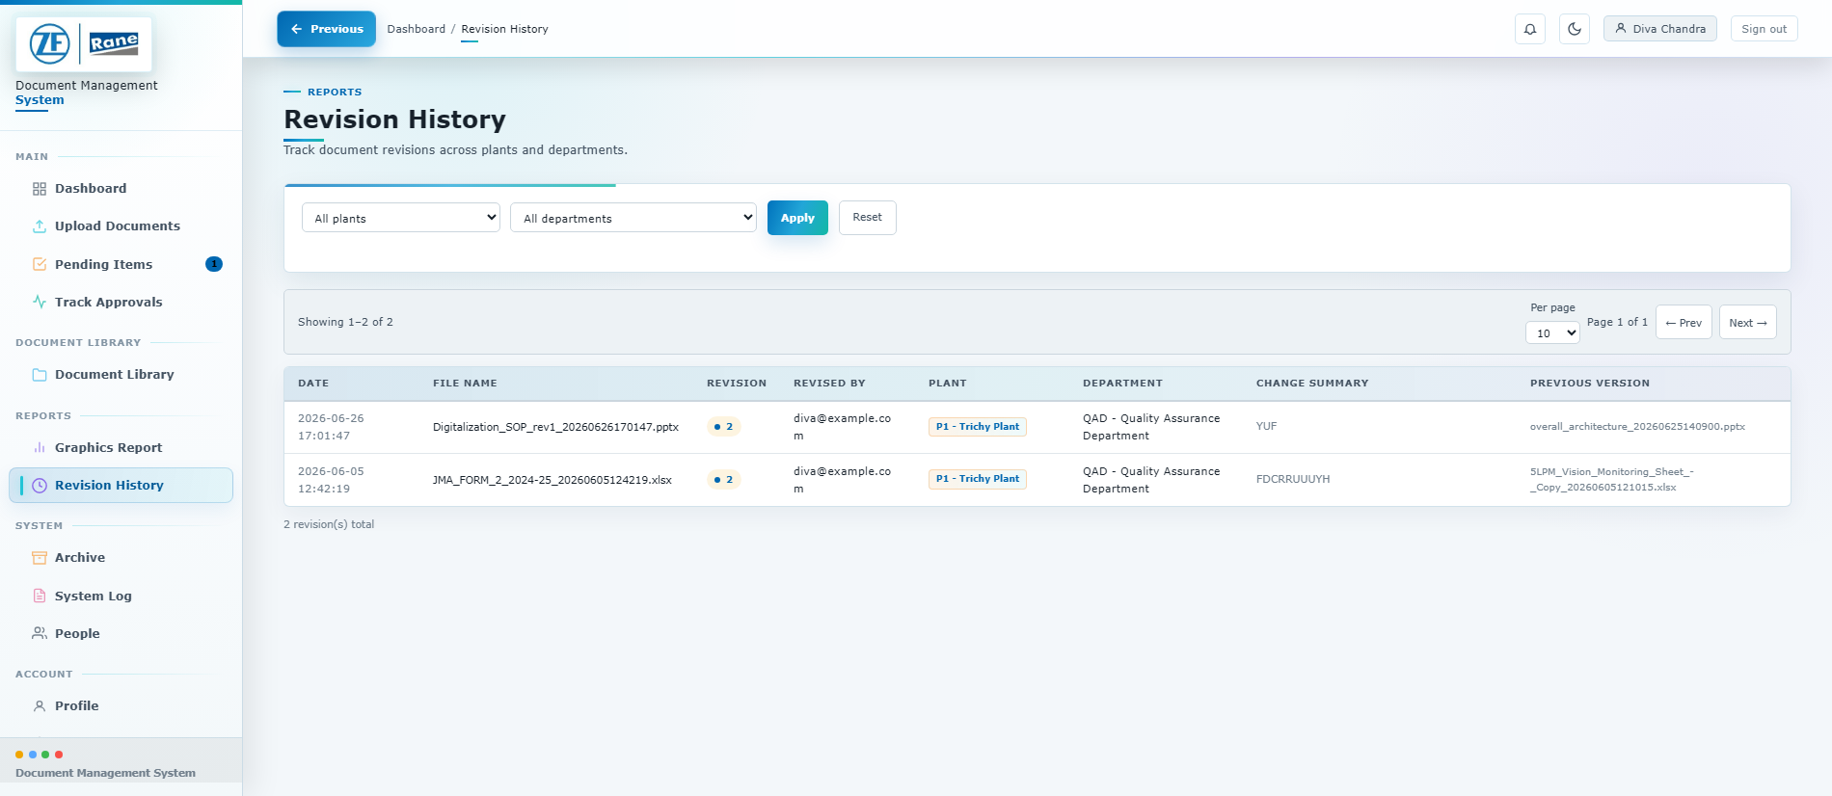
ZF Rane Automotive India PVT LTD - SGD Smart DMS Portal User Manual
Document: DMS-UM-001 | Revision: 1.4
Effective: 10-Aug-2026 | Page: 21 of 27
8.2
Review Revision History
Revision History records what changed, who changed it and where the document belongs.
Figure 15 - Revision History list and filters
1
Filter the history
Select plant and department, then apply the filter.
2
Identify the document
Use file name, document number and revision number.
3
Review ownership
Confirm the person, plant, department and revision date.
4
Read the change summary
Use the recorded summary to understand what changed between revisions.
5
Open the current approved file
Use the Document Library for the controlled version currently in force.
Revision discipline
Use a meaningful summary such as 'Updated torque specification in Section 4' rather than 'new version'.

Slide 22
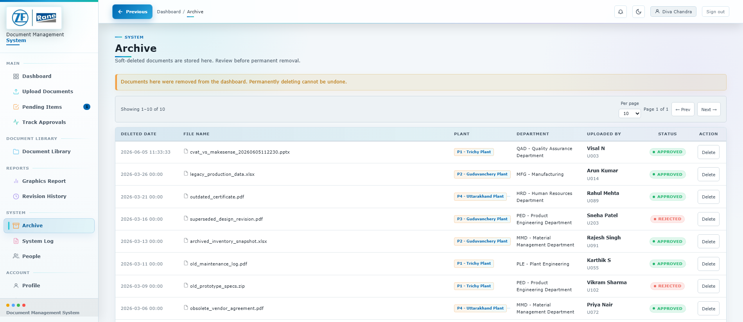
ZF Rane Automotive India PVT LTD - SGD Smart DMS Portal User Manual
Document: DMS-UM-001 | Revision: 1.4
Effective: 10-Aug-2026 | Page: 22 of 27
9.1
Manage Archived Documents
Archive is restricted to Admin, Manager, Supervisor and Approver roles.
Figure 16 - Archive list with retained document metadata
1
Understand soft delete
Removing a document from the dashboard moves its record to Archive instead of immediately erasing it.
2
Locate the archived item
Use the list, pagination and record metadata.
3
Retain for audit
Keep archived records when the retention period or investigation is still active.
4
Permanently delete only when authorized
Permanent deletion removes the archived record and is logged.
Destructive action
Confirm retention requirements and the exact document before permanent deletion. This action cannot be reversed through the portal.

Slide 23
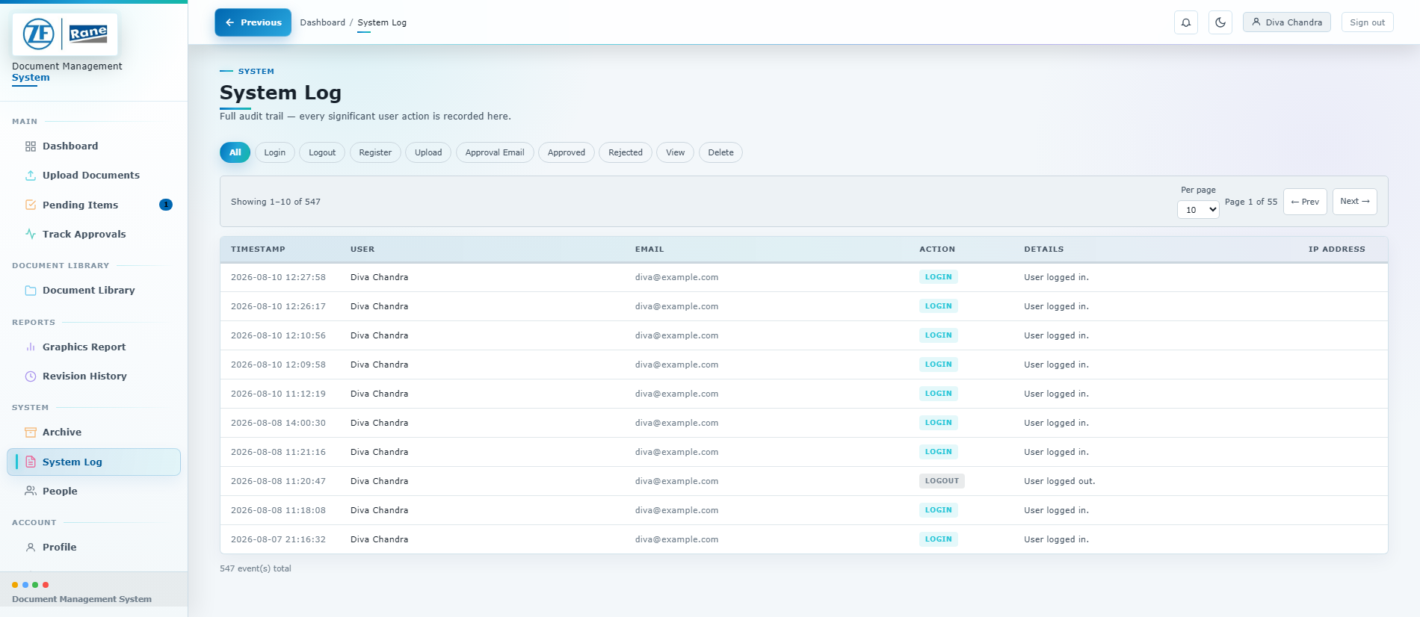
ZF Rane Automotive India PVT LTD - SGD Smart DMS Portal User Manual
Document: DMS-UM-001 | Revision: 1.4
Effective: 10-Aug-2026 | Page: 23 of 27
9.2
Use the System Log for Audit
System Log is available to high-level roles and records significant user actions.
Figure 17 - System Log with action filters
1
Choose an action filter
Filter login, logout, upload, view, delete, approval, rejection, email and password events.
2
Review who and when
Confirm timestamp, user name, employee ID or email and action type.
3
Read the details
Use the details field to identify the affected document or activity.
4
Preserve audit context
Capture the filtered result or export supporting records according to local audit practice.
Audit principle
Use System Log as the activity trail; use Revision History for version changes and Track Approvals for workflow progress.

Slide 24
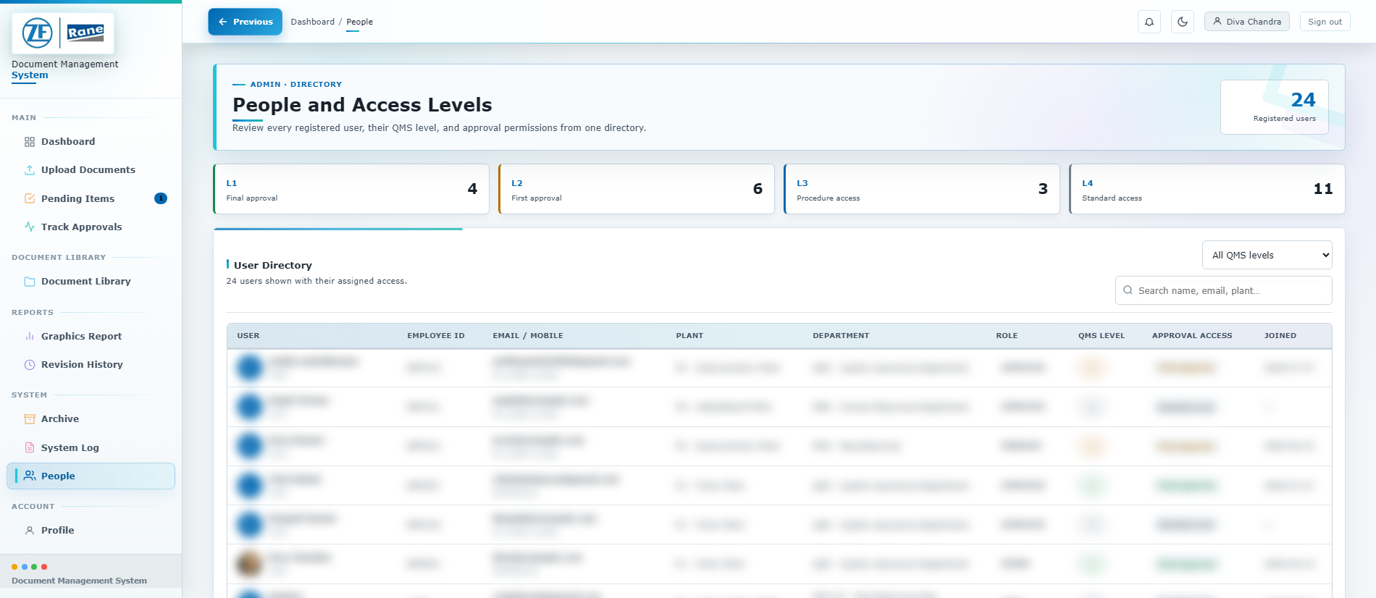
ZF Rane Automotive India PVT LTD - SGD Smart DMS Portal User Manual
Document: DMS-UM-001 | Revision: 1.4
Effective: 10-Aug-2026 | Page: 24 of 27
9.3
Review People and Access Assignments
The People page is restricted to Admin users.
Figure 18 - People directory; sample personal details obscured
1
Review level counts
Confirm the number of L1, L2, L3 and L4 users.
2
Search or filter
Filter by name, email, employee ID, department, role or QMS level.
3
Verify assignments
Ensure L1 and L2 approvers are current and aligned with the approved responsibility matrix.
4
Correct access through the approved admin process
Do not share accounts or use another user's approval privileges.
Least privilege
Assign only the role and QMS level required for the user's current responsibility. Review access when a person changes role or department.

Slide 25
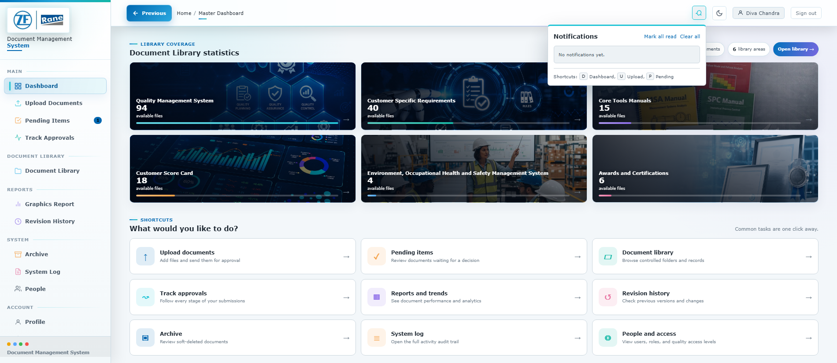
ZF Rane Automotive India PVT LTD - SGD Smart DMS Portal User Manual
Document: DMS-UM-001 | Revision: 1.4
Effective: 10-Aug-2026 | Page: 25 of 27
10.1
Use In-Portal Notifications
Notifications highlight uploads, required approvals, decisions and other events.
Figure 19 - Notification panel opened from the top bar
1
Open the bell icon
The badge shows unread notifications.
2
Select a notification
Use the linked item to open the related document or approval.
3
Mark items as read
Clear individual notifications or use Mark all read.
4
Use email as a secondary channel
Approval and decision emails supplement the in-portal notification; the portal remains the source of truth.
If email is delayed
Check the notification panel and Track Approvals. Report repeated email failures to the DMS administrator.

Slide 26
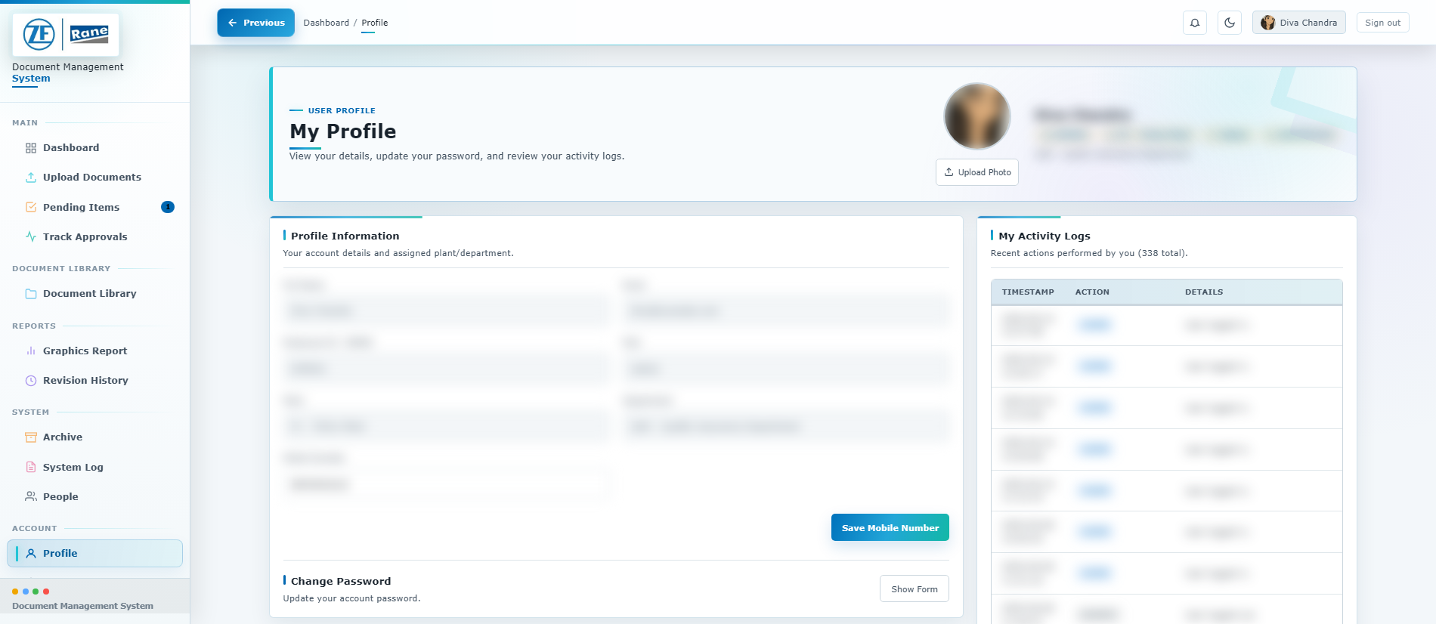
ZF Rane Automotive India PVT LTD - SGD Smart DMS Portal User Manual
Document: DMS-UM-001 | Revision: 1.4
Effective: 10-Aug-2026 | Page: 26 of 27
10.2
Maintain Your Profile and Sign Out
Keep personal details secure and end the session when work is complete.
Figure 20 - Profile and activity page; sample personal details obscured
1
Review account details
Confirm name, employee ID, plant, department, role and QMS level.
2
Update the profile image if required
Use an approved JPG, PNG, GIF or WebP image.
3
Change password securely
Enter the current password, then a new password of at least 8 characters.
4
Review My Activity
Use the personal activity list to identify unexpected access or actions.
5
Sign out
Select Sign out in the top-right corner. The session is cleared and the login page reopens.
Shared workstation rule
Always sign out before leaving the workstation. Closing only the browser tab may not be sufficient on a shared device.

Slide 27
ZF Rane Automotive India PVT LTD - SGD Smart DMS Portal User Manual
Document: DMS-UM-001 | Revision: 1.4
Effective: 10-Aug-2026 | Page: 27 of 27
10.3
Best Practices and Troubleshooting
Use this page as a quick operating checklist.
Before submission
Before approval
Use the approved document-number format.
Verify revision, plant, department and customer. Choose the exact library path.
Add a specific revision summary. Open the final file before upload.
Review the actual file and metadata.
Confirm the current approval stage. L2 selects final recipients.
L1 completes the final decision. Rejection comments must be actionable.
Issue | Check | Action
Cannot sign in | Email/GENID, password case and account status. | Use Forgot password or contact Admin.
Upload blocked | File type/size and all required metadata/path fields. | Correct the field marked in the form and retry.
Cannot approve | Document stage and your QMS level. | L2 handles Pending; L1/Admin handles Pending Final Approval.
Document not found | Filters, QMS access and library path. | Reset filters, browse the correct category, then contact owner.
Preview unavailable | Generated viewing copy and browser support. | Use Open file in new tab; report repeated conversion failures.
Email not received | Notification panel and Track Approvals. | Continue in portal and report repeated email failures.
Support information to provide
Share the page name, document number, time of issue, your role/QMS level and the exact error message. Do not send passwords or confidential file content in support messages.
End of controlled user manual

