Slide 1


Market Analysis
for
New Restaurant
Opening
By: Team D
Shruti Udagire
Sandeep Kumar
Siddhartha Kumar
Sathish Saminathan
Deepu Ranjan Nahak
© Futurense. All Rights Reserved.

Slide 2

Contents:
Problem Statement
Architecture for on-premise Analysis
Architecture for Cloud Based Analysis
Snapshots of Operations and Transformations
Challenges faced initially and in between
© Futurense. All Rights Reserved.

Slide 3
Problem Statement:
“Analysis of present restaurants’ business and operations to provide an insight of the restaurant market. The key factors that can boost the business growth and that are to be taken care of while opening a new restaurant.”
Dataset used : Zomato Bangalore Restaurant Dataset
(Source: Kaggle Datasets)
© Futurense. All Rights Reserved.

Slide 4





Architecture for on-premise Analysis:
Local System Architecture:
(PreProcessing /Transformation)
( HDFS Storage )
( Visualization )
{ Local System
(Transformed
output files)}
(Dataset .CSV)
© Futurense. All Rights Reserved.

Slide 5
Architecture for on-premise Analysis:
The process flow would be as follows:
Dataset -> HDFS(Storage) -> PySpark (Pre-processing and Transformation) -> Local System(Transformed output files) -> Tableau(Visualization)
To start with, we have downloaded the dataset from Kaggle’s Dataset repository i.e., in (.CSV) format.
Then this dataset is transferred and stored into the HDFS location of the Hadoop cluster.
For pre-processing/Transformations, we will create a dataframe using PySpark terminal via loading the Zomato dataset from the HDFS location.
The processed/transformed data is then written to the output file i.e.; (.csv) file and then stored into the storage of the local/on-premise system.
Tableau has been used for story-telling and providing the market insights using the processed data.
© Futurense. All Rights Reserved.

Slide 6

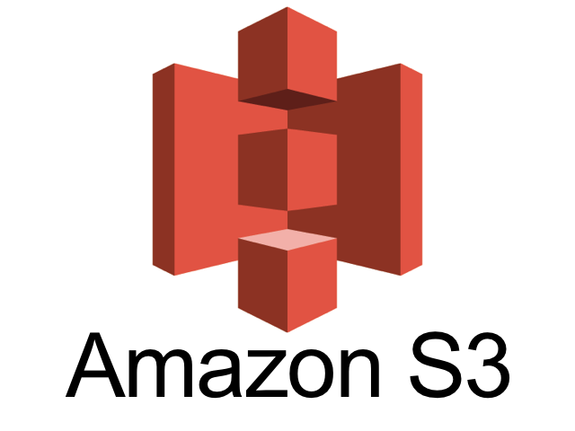
Architecture for Cloud Based Analysis:
Cloud Based Architecture(AWS):
EMR
(Processing /Transformation)
Athena(Query and to connect Tableau)
( Visualization )
( Transformed output files)
(Dataset – CSV)
© Futurense. All Rights Reserved.

Slide 7
Architecture for Cloud Based Analysis:
The process flow would be as follows:
Dataset -> S3(Storage) -> EMR(Pre-processing /Transformation) -> S3(Transformed output files) -> Athena(Query and to connect Tableau) -> Tableau(Visualization)
Zomato Bangalore Dataset (.CSV format) is transferred and stored into S3 bucket named ‘projectbktforsourcedataset’.
Launched EMR with PySpark 3.2.1 and having 1 Master Node and 1 Core Node (both m5.xlarge). All the profile, roles are taken in the default mode but user are maintained according to the AWS best practices of providing least privileges to the users. In the EMR EC2 instance, we would do the pre-processing/transformations.
The processed/transformed data is then written to the output file i.e.; (.csv) file and then stored into S3 bucket named ‘projectbkforstoretransformedoutput’ .
Create an external table in Athena from transformed output data i.e., stored in S3 bucket (projectbkforstoretransformedoutput).
Athena query logs will be stored in the S3 bucket (projectbkforathenaquerylog).
Tableau has been connected to the ‘Athena Server’ in order to be used for story-telling and providing the market insights.
© Futurense. All Rights Reserved.

Slide 8
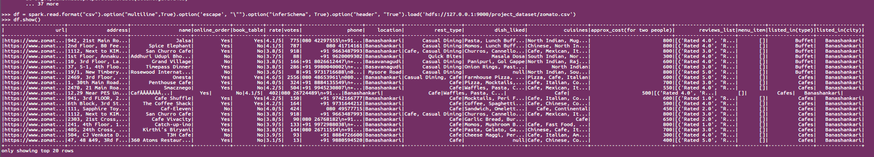
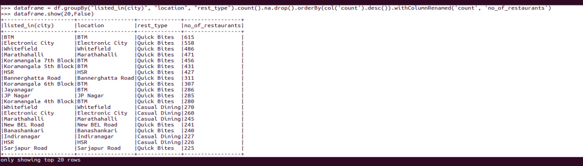
Snapshots of Operations and Transformation:
(Dataframe obtained after loading the dataset)
(Transformation to get the themed restaurant in a particular area)
© Futurense. All Rights Reserved.

Slide 9
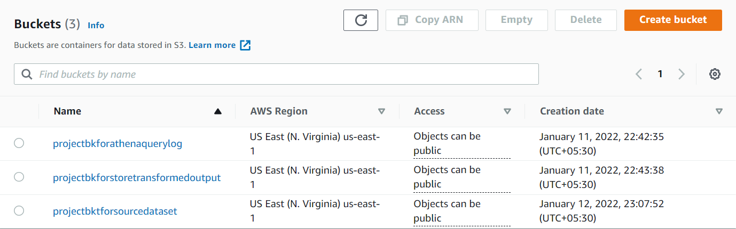
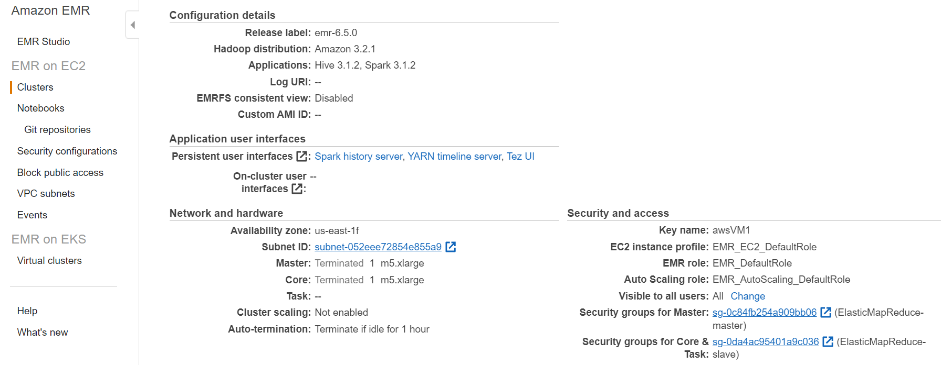
Snapshots of Operations and Transformation:
(Amazon S3 Buckets)
Amazon
EMR_EC2
instance
© Futurense. All Rights Reserved.

Slide 10
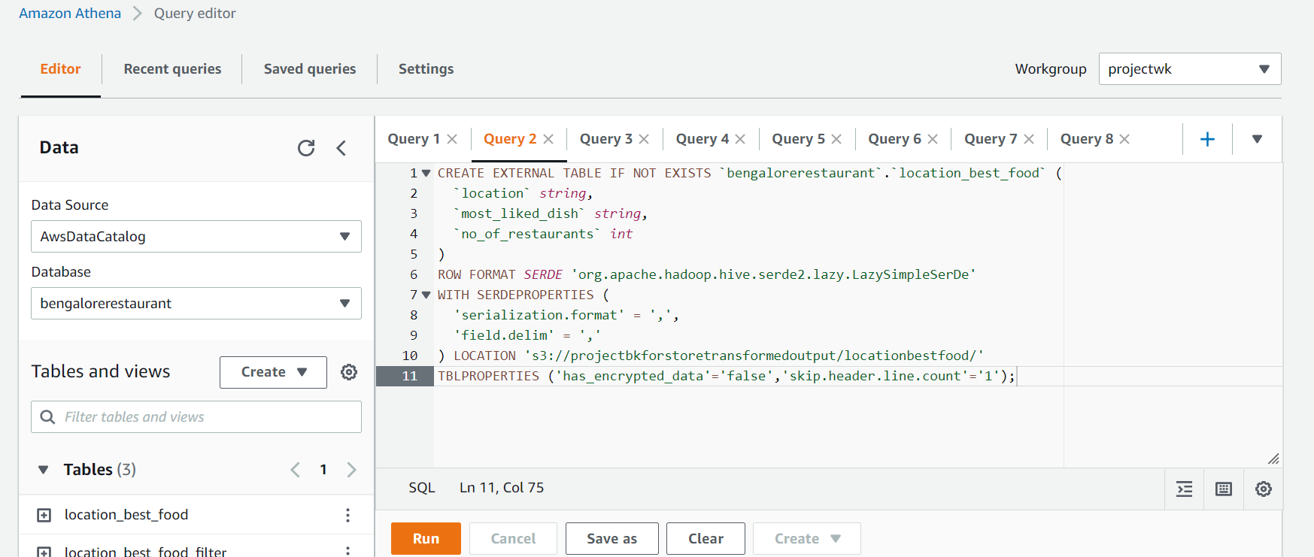
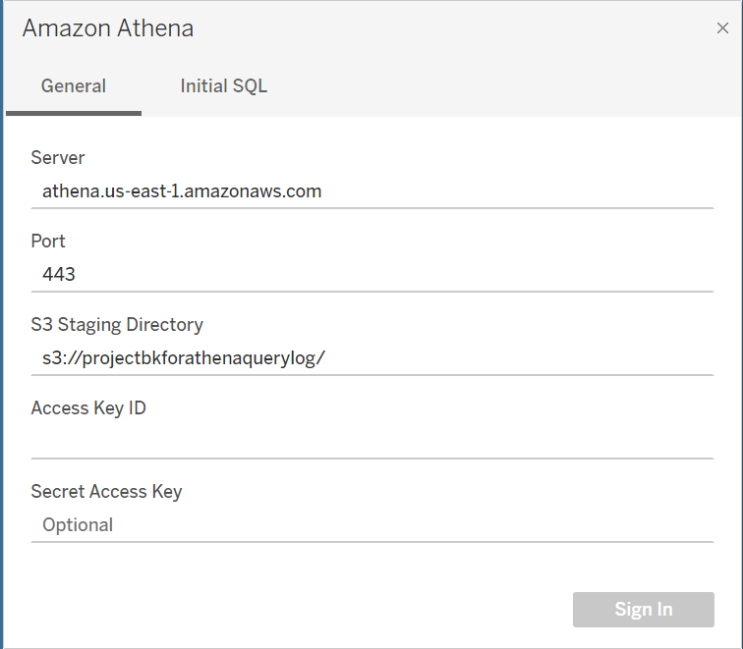
Snapshots of Operations and Transformation:
(1) Athena Querying Interface
(2) Athena Server connectivity Setup for Tableau
© Futurense. All Rights Reserved.

Slide 11
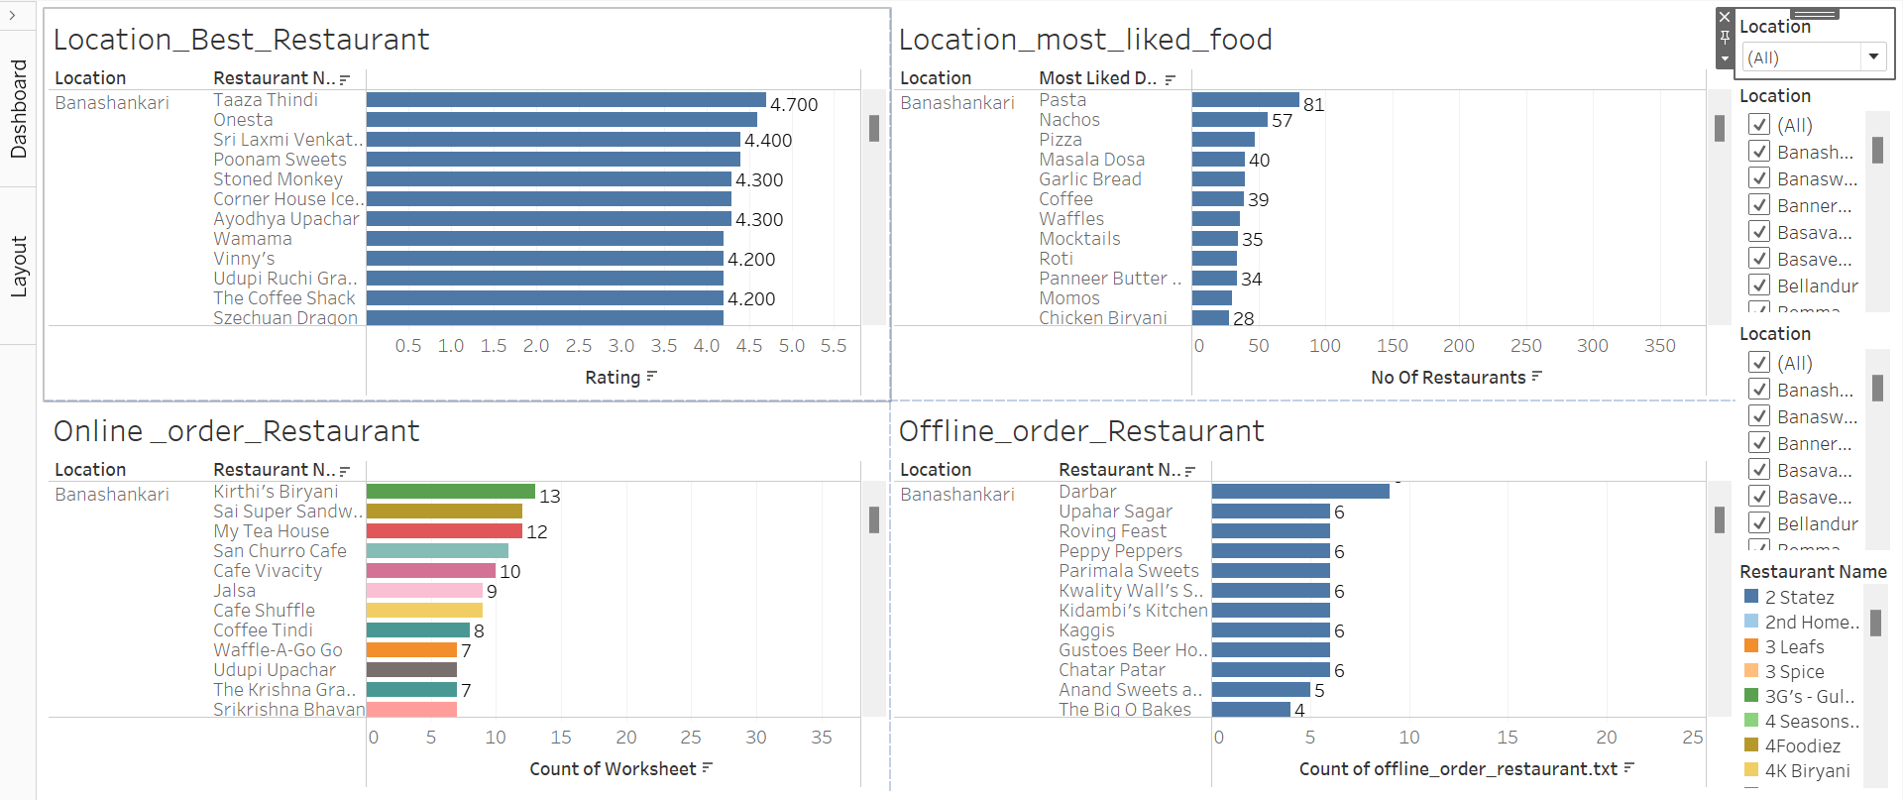
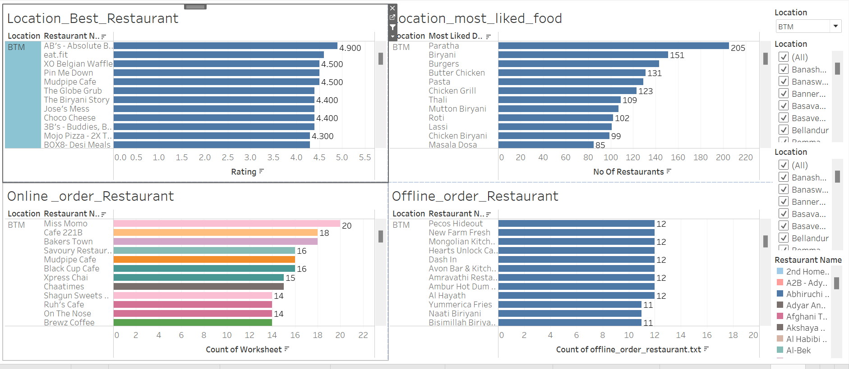
Snapshots of Operations and Transformation:
(Tableau output for the transformed data)
© Futurense. All Rights Reserved.

Slide 12
Challenges faced initially and in between:
Challenges we faced and approach for their solution:
Configuring Hadoop and PySpark together on Ubuntu (for on-premise analysis) platform. We faced the ‘namenode’ and ‘datanode’ shutdown problem. Solution we just reconfigured the ‘core-site.xml’ file of the Hadoop config file by the help of online resources.
During the transformation of the data we were having null values in our data. So, taking all the factors in consideration for our analysis we dropped the null values from ‘location’ and ‘Online/Offline Order’ columns.
In case of cloud based analysis, we faced the issue with the Tableau connectivity. This we sorted out through the online resources like StackoverFlow etc.
© Futurense. All Rights Reserved.

Slide 13


© Futurense. All Rights Reserved.

