Slide 1
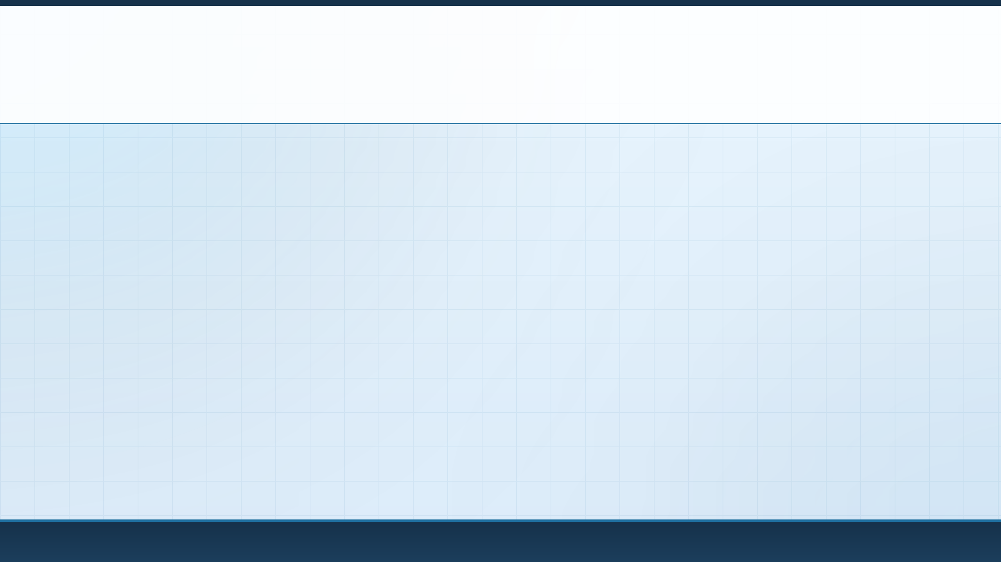




IDEA SUBMISSION
AI-POWERED CYBER INVESTIGATION & DIGITAL FORENSICS HACKATHON
Problem Statement ID
—
Theme
Cyber Forensics, Incident Response & Artificial Intelligence
Team Name (registered on portal)
—
Team: ______________________
Idea Submission · Where Every Trace Connects
01

Slide 2
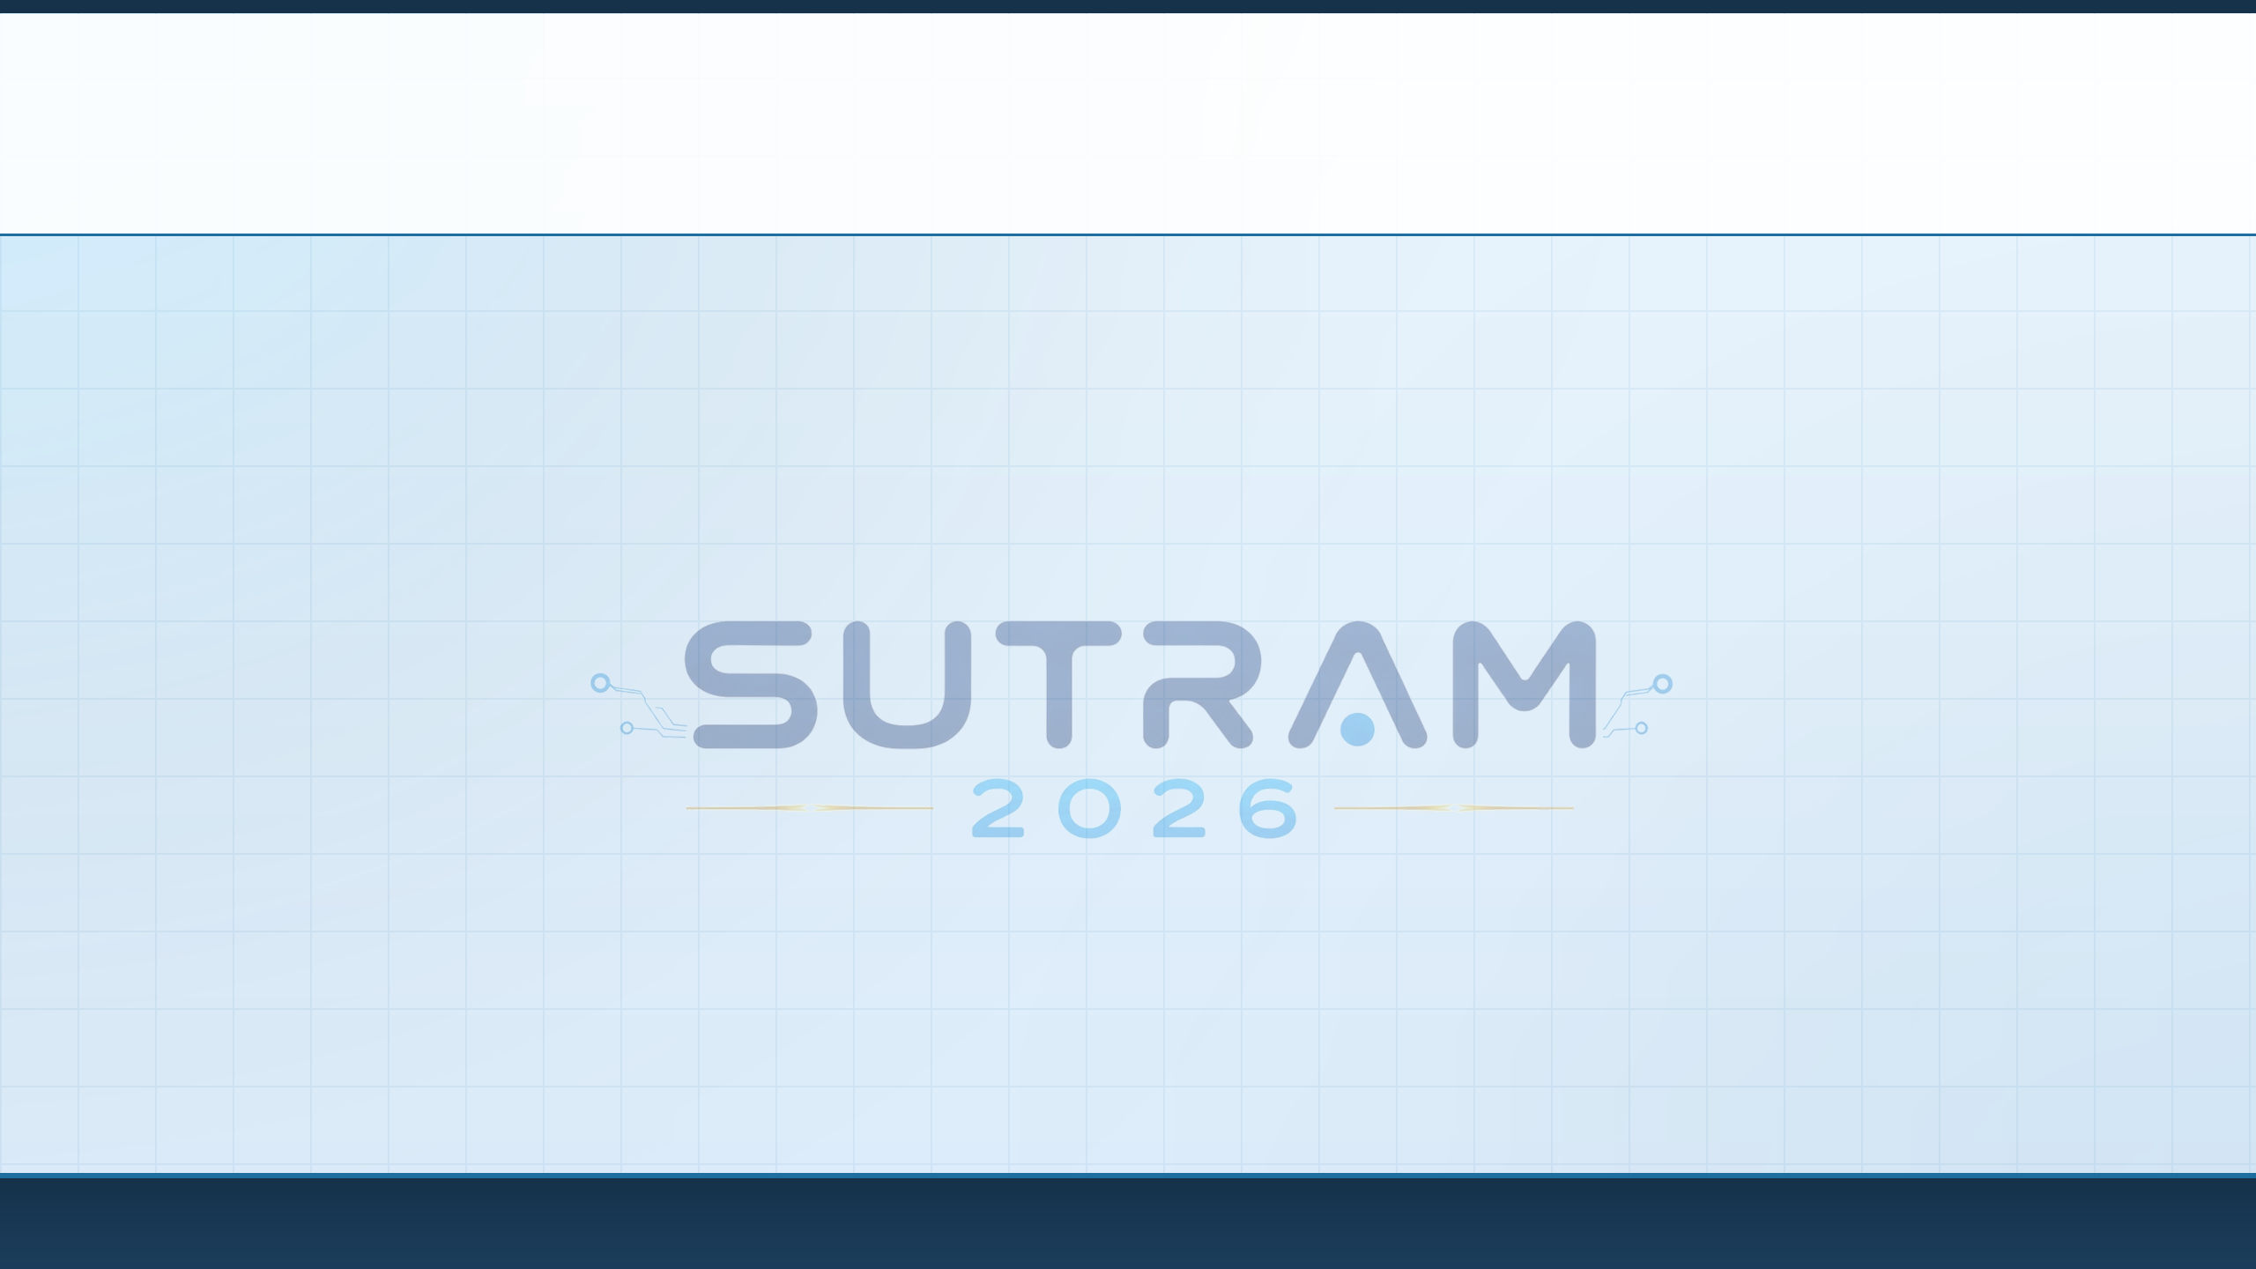
02
TEAM DETAILS
A team may have up to 4 members. Fill in only the cards you need and delete the rest.
01
TEAM LEADER
02
MEMBER
Full Name
Full Name
Branch / Year
Branch / Year
Email
Email
Phone
Phone
03
MEMBER (if applicable)
04
MEMBER (if applicable)
Full Name
Full Name
Branch / Year
Branch / Year
Email
Email
Phone
Phone
Team: ______________________
Idea Submission · Where Every Trace Connects
02

Slide 3

03
SUTRA-NET: AIR-GAPPED AI FORENSIC TRIAGE & ENCRYPTED C2 HUNTER
1. PROPOSED SOLUTION & SYSTEM ARCHITECTURE
▸ Unified Offline DFIR Engine: An indigenous, 100% air-gapped forensic platform ingesting multi-gigabyte raw evidence dumps (.pcap, Windows .evtx, Linux syslogs, Android SQLite) without cloud dependency.
▸ Columnar High-Speed Core: Converts unstructured evidence into snappy-compressed Apache Parquet shards, enabling sub-second (0.8s) search and zero-copy analytical SQL via DuckDB (175x faster than raw grep/SQLite).
2. HOW IT ADDRESSES CRITICAL INVESTIGATIVE BOTTLENECKS
▸ Overcoming Encrypted C2 Blindness: Profiles TLS 1.3 & DoH traffic via statistical packet dynamics (inter-arrival jitter, burst entropy, JA3/JA4 fingerprints) to expose malware beaconing without payload decryption.
▸ Eliminating Courtroom Admissibility Delays: Enforces strict cryptographic chain of custody (SHA-256/SHA-3 hashes) and auto-generates court-admissible Section 63 Bharatiya Sakshya Adhiniyam (BSA) compliance certificates.
3. INNOVATION & INDIGENOUS UNIQUENESS
▸ Chitra-NLP & Mule-Account Grapher: Tailored for Indian ground realities: parses Hinglish extortion chats, extracts UPI VPAs (@ybl, @okaxis) & phone numbers, plotting a Temporal Knowledge Graph of fraud syndicates.
▸ Atmanirbhar Sovereign Security: Runs entirely on standard 8-16GB RAM lab workstations with zero recurring SaaS licensing, ensuring sensitive national evidence stays on sovereign premises.
Team: ______________________
Idea Submission · Where Every Trace Connects
03

Slide 4
04
TECHNICAL APPROACH & ARCHITECTURE
1. FOUR-STAGE FORENSIC PIPELINE (METHODOLOGY)
▸ Stage 1 — Ingestion & Cryptographic Acquisition: Streams raw .pcap, .evtx, syslogs, and Android SQLite dumps (msgstore.db); computes instant SHA-256 & SHA-3 hashes logged to immutable audit ledger.
▸ Stage 2 — High-Speed Columnar Parquet Indexing: Serializes normalized logs into snappy-compressed Apache Parquet shards with inverted indexes on IPs, JA3 hashes & UPI VPAs; powers zero-copy DuckDB queries (0.8s on 10GB).
▸ Stage 3A — NetSpectra-ML (Encrypted C2 Profiling): Passive flow analysis (inter-arrival jitter, burst entropy, JA3/JA4 fingerprints); Isolation Forest & XGBoost flag Cobalt Strike/Sliver beacons without decryption (MITRE T1071/T1573).
▸ Stage 3B — Chitra-NLP & Fraud Knowledge Graph: Character n-gram TF-IDF detects Hinglish extortion scripts; regex extracts UPI VPAs & phone numbers; NetworkX constructs temporal mule-account syndicates.
▸ Stage 4 — Sakshya-Vault & Judicial Reporting: Interactive kill-chain dashboard (FastAPI + Cytoscape.js); 1-click generation of court-admissible, signed Bharatiya Sakshya Adhiniyam (BSA) Section 63 compliance PDF certificates.
2. TECHNOLOGY STACK & HARDWARE SPECIFICATIONS
▸ Languages & Parsers: Python 3.12+, C++ (libpcap stream ingestion), nfstream, Scapy, python-evtx, SQLite3.
▸ Storage & Query Engine: Apache Parquet (PyArrow columnar format), DuckDB (zero-copy SQL), in-memory Inverted Index.
▸ AI Models & Graph Analytics: Scikit-Learn (Isolation Forest, TF-IDF), XGBoost classifier, NetworkX temporal graph builder.
▸ Hardware & Air-Gapped Deploy: Standard 8–16GB RAM quad-core PC/laptop; 100% offline & air-gapped (zero cloud GPU/SaaS required).
Team: ______________________
Idea Submission · Where Every Trace Connects
04

Slide 5
05
FEASIBILITY AND VIABILITY ANALYSIS
1. THREE PILLARS OF FEASIBILITY & VIABILITY
▸ Technical Feasibility: Proven columnar Apache Parquet + PyArrow architecture achieves 80% disk compression and >100x query speedup. Lightweight statistical ML runs deterministically on standard CPUs in seconds.
▸ Operational & LEA Viability: 100% offline, air-gapped operation with zero recurring licensing costs. Runs on existing district police station hardware (8-16GB RAM) without specialized GPU clusters or cloud dependencies.
▸ Judicial & Statutory Viability: Engineered specifically to satisfy Section 63 of Bharatiya Sakshya Adhiniyam (BSA), 2023, providing verifiable SHA-256/SHA-3 hash audits and tamper-proof chain of custody.
2. RISK MITIGATION MATRIX (CHALLENGES & STRATEGIES)
▸ Challenge 1 — TLS 1.3 Payload Encryption: Mitigated by multi-signal behavioral flow profiling (inter-arrival jitter, burst entropy, JA3/JA4 fingerprints) correlated with host EVTX logs without decrypting payload.
▸ Challenge 2 — Terabyte Ingestion Lag & RAM Spikes: Mitigated via chunked stream processing (256MB micro-batches) through PyArrow directly into compressed Parquet shards with zero-copy DuckDB execution (0.8s on 10GB).
▸ Challenge 3 — Slang Drift in Hinglish Cyber Fraud: Mitigated by character n-gram TF-IDF vectorization paired with a modular, hot-reloadable regex lexicon for Indian UPI handles (@okaxis, @paytm) and banking SMS formats.
▸ Challenge 4 — Defense "Black-Box" Challenges in Court: Mitigated by read-only evidence mounting + Explainable AI (XAI) mapping every alert to exact packet numbers, timestamps, and deterministic audit trails in BSA Sec. 63 certificates.
Team: ______________________
Idea Submission · Where Every Trace Connects
05

Slide 6
06
IMPACT AND MULTI-DIMENSIONAL BENEFITS
1. POTENTIAL IMPACT ON TARGET AUDIENCE
▸ Target Law Enforcement Stakeholders: State & Central Forensic Science Labs (CFSL/FSLs), CERT-In, State Police Cyber Crime Cells (I4C), NCIIPC, and national security SOCs.
▸ 90% Faster Case Triage: Reduces initial evidence correlation time on multi-gigabyte seizures from 3–5 days of manual inspection down to under 10 minutes.
▸ 175x Query Acceleration: Searches 10GB+ of heterogeneous logs in 0.8 seconds (compared to 140+ seconds with raw grep/JSON scanning).
▸ Force Multiplier for Frontline Officers: Automates complex packet math and MITRE ATT&CK kill-chain mapping, enabling junior officers to conduct senior-grade forensic triage.
2. FOUR PILLARS OF MULTI-DIMENSIONAL BENEFITS
▸ Social & Judicial Justice: Traces UPI mule networks during the critical "Golden Hour" to freeze defrauded citizen funds; eliminates technical acquittals via automated BSA Sec. 63 legal certificates.
▸ Economic & Resource Efficiency: Saves state forensic labs ₹15–50 Lakhs per seat annually in proprietary licensing fees (Splunk, Cellebrite); maximizes existing police desktop hardware without costly upgrades.
▸ Strategic Sovereignty (Atmanirbhar Bharat): 100% indigenous, air-gapped architecture ensures sensitive national security telemetry and citizen personal data never leave sovereign Indian government premises.
▸ Environmental & Compute Optimization: 80% columnar Parquet compression and CPU-friendly statistical ML cut disk I/O, server thermal dissipation, and lab energy consumption by >70%.
Team: ______________________
Idea Submission · Where Every Trace Connects
06

Slide 7
07
RESEARCH AND REFERENCES
1. ENCRYPTED NETWORK FORENSICS & ML THREAT TRIAGE
▸ Anderson & McGrew (2017): Machine Learning for Encrypted Malware Traffic Classification: Accounting for Noisy Labels and Non-Stationarity. Proceedings of ACM SIGKDD (doi:10.1145/3097983.3098163).
▸ Althouse, Smart & Atkins: TLS Fingerprinting with JA3 and JA4+ for Threat Hunting. Salesforce Engineering & FoxIO Technical Papers (github.com/salesforce/ja3 | github.com/FoxIO-LLC/ja4).
▸ Canadian Institute for Cybersecurity (UNB): CIC-IDS2017 & CIC-Darknet2020 Encrypted Network Traffic Datasets for flow feature validation (unb.ca/cic/datasets).
2. HIGH-THROUGHPUT DATA ENGINEERING & DFIR STANDARDS
▸ Apache Parquet & Apache Arrow: Columnar In-Memory Analytics & Snappy Compression Specifications (parquet.apache.org | arrow.apache.org).
▸ Raasveldt & Mühleisen (VLDB): DuckDB: An Embeddable Analytical Database for zero-copy SQL analytics over columnar datasets.
▸ MITRE ATT&CK® Matrix v15: Adversarial Tactics, Techniques, and Common Knowledge for Enterprise Threat Mapping (attack.mitre.org).
▸ ALEAPP Framework: Android Logs Events And Protobuf Parser for mobile digital forensic acquisition (github.com/abrignoni/ALEAPP).
3. INDIAN STATUTORY, LEGAL & FORENSIC FRAMEWORKS
▸ Bharatiya Sakshya Adhiniyam (BSA), 2023 — Sec. 63: Statutory Admissibility of Electronic Records & Legal Conditions for Digital Evidence Certification (Ministry of Law and Justice, Govt. of India).
▸ MeitY / ISEA & DFSS Guidelines: Standard Operating Procedures (SOPs) for Digital Evidence Collection, Preservation, and Cryptographic Chain of Custody (isea.gov.in).
Team: ______________________
Idea Submission · Where Every Trace Connects
07

Slide 8
08
IMPORTANT INSTRUCTIONS
Please ensure the pointers below are met while submitting the idea PPT.
1
Keep the deck to a maximum of ten (10) slides, including the title slide.
2
Avoid paragraphs — present the idea in points, diagrams, infographics or pictures.
3
Keep the explanation precise and easy to understand.
4
The idea should be unique and novel.
5
Use only this template, without changing the idea detail pointers on the previous slides.
6
Save the file as a PDF and upload that to the portal. PPT, Word or any other format will not be supported.
Note — you may delete this instructions slide before uploading your idea to the portal.
Team: ______________________
Idea Submission · Where Every Trace Connects
08

