Slide 1

Parallelizing While Loops for Multi Processor Systems
Lawrence Rauchwerger and David Padua
Presentation by:
Dilip Kumar Kola

Slide 2
Introduction
Parallelize the WHILE loops to improve performance.
Difficulty
    Unknown iteration space

Slide 3
Types of While Loops
Single statically detectable recurrence and no Cross iteration dependencies.
Loops with Cross iteration dependencies.

Slide 4
Type 1 - Induction
Dispatcher is an Induction
while (condition(i)) {
work(i);
i++;
}
DOALL with condition(i) inside the loop.
Maintain a lowest iteration that executed the termination for each processor.
Undo for the overshot iterations.

Slide 5
Type 1 - General recurrence
Dispatcher is a General recurrence
while(list){
work(list.num);
list = list.next;
}

Slide 6
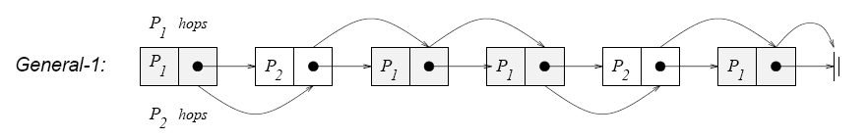
Type 1 – General recurrence I
Maintain a Global Linked List pointer.
List traversal is done in Critical section.
Distribute work dynamically.

Slide 7
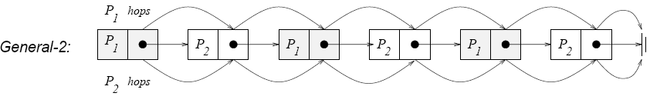
Type 1 – General recurrence II
Privatize Linked List pointer.
Distribute work statically.
k = i % NUM_PROCS
Complete List traversal is done for all the processors.

Slide 8
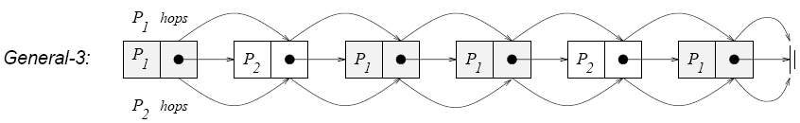
Type 1 – General recurrence III
Privatize Linked List pointer.
Distribute work dynamically.
Each processor maintains previous iteration number it executed.
Complete List traversal is done for all the processors.

Slide 9
Type 1 – Associative recurrence I
Dispatcher is an Associative recurrence
Remainder contains no Conditional Exit
while (condition1) {
work(r);
r = 2*r + 1;
}
First find prefixes and store
Execute work in parallel

Slide 10
Type 1 – Associative recurrence II
Dispatcher is an Associative recurrence
Remainder contains Conditional Exit
while (condition1) {
work(r);
if(condition2) break;
r = 2*r + 1;
}
First find prefixes and store
Overshooting can take place
Use strip mining to execute work in parallel

Slide 11
Type 2 - Cross iteration dependencies I
Cross iteration dependencies that are known at compile time
while(condition) {
A[i]=2*A[i]+10;
work(A[i-1]);
i++;
}
Dependence distance is known
Loop alignment can be used to parallelize the above code

Slide 12
Type 2 - Cross iteration dependencies II
Cross iteration dependencies that are unknown at compile time
while(condition) {
work(A[R[i]]);
A[W[i]]=2*i+10;
i++;
}
Use PD test (privatizing Do All) to check whether the above code can be executed in parallel or not

Slide 13
Performance
Type of While Loop | Speed Up
Induction | 1.952
General 1 | 1.679
General 2 | 1.811
General 3 | 1.719
Associative Recurrence - RI | 1.879
Associative Recurrence - RV | 1.823
Cross Iteration Dependence | 1.909
Unknown Cross Iteration Dependence | 1.467

Slide 14
Questions & Suggestions

