Slide 1
MAROPOST · DESIGN SANDBOX SHOWCASE
One design system.
Every screen.
A working copy of our product, where every screen follows one shared set of rules.
EVERYTHING SHOWN TODAY IS LIVE SOFTWARE — NOT MOCKUPS
Deepak · UX — July 2026 · 45 minutes
Notes:
Thanks for making the time — 45 minutes, and I will keep us on schedule. One sentence to remember: we built a full working copy of our product, where every screen follows one shared set of rules. Looks like our product, clicks like our product — runs on pretend data, so it is completely safe to play with. Promise: nothing today is a picture. Every screen is real, running software. If you think something is a mockup, say so and I will click on it.

Slide 2
AGENDA
What we’ll cover in 45 minutes.
1
Why we did this
The problem, in one image — and what it costs us.
2
A 75-second film
The whole story, compressed.
3
Five screens, live
The heart of the session — a real walkthrough, not slides.
4
How it works
Five layers, explained without jargon.
5
The plan + six decisions
What happens next, and what I need from this room.
Notes:
Here is the plan for our time. First, why we did this. Then a short film. Then the part that matters most — five real screens, live. Then how it works in plain terms, the plan from here, and your questions. Ask questions as they come up — this works better as a conversation.

Slide 3
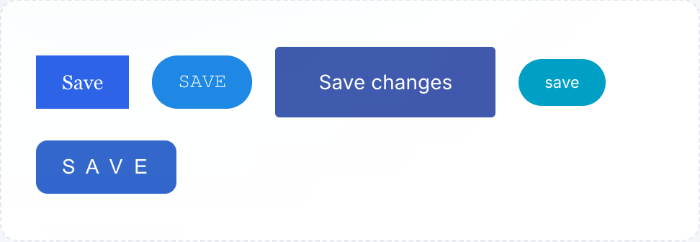
THE PROBLEM
Every screen does its own thing.
!
Built apart, without a rulebook
Screens came from different teams at different times, each making its own sensible — but different — decisions.
!
Ideas took weeks to try
So most design decisions were made from static pictures, which never show loading states, empty tables, or small screens.
Five Save buttons, recreated from patterns in our current product.
!
Customers feel it
They may not name it, but they notice: the product doesn’t feel like one product.
Notes:
These are five Save buttons, all from patterns in our current product. Five shapes, five blues, five fonts — for the same action. Nobody chose this. Screens were built at different times, by different teams, with no shared rulebook. Each team made sensible decisions — just different ones. Second problem: trying an idea took weeks, so decisions were made from static pictures — and pictures are always on their best behavior. Customers feel the result, even if they cannot name it: the product does not feel like one product.

Slide 4
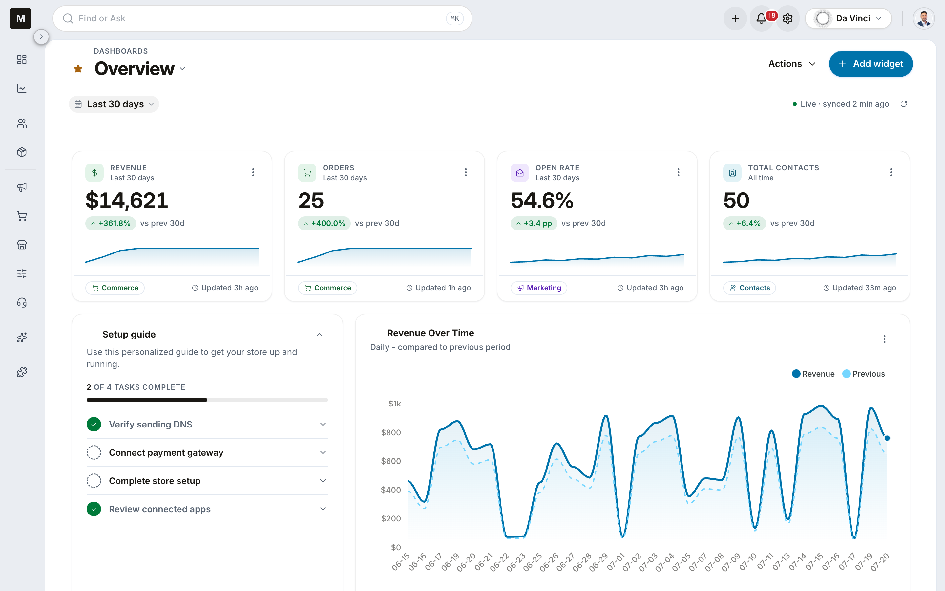
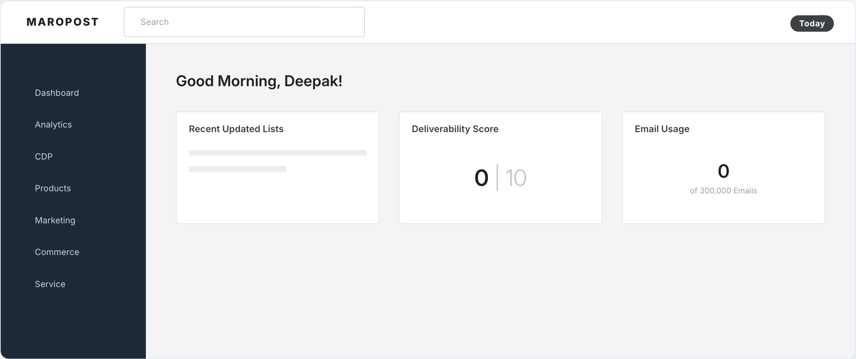
BEFORE / AFTER
Our dashboard today vs. the sandbox.
TODAY — RECREATED FROM UAT
THE SANDBOX — SAME ACCOUNT
Same account, same numbers. The right side is live, running software — every card comes from one shared kit of parts.
Notes:
Left: our dashboard as it looks today — a faithful recreation of my actual account. It works, but it is not telling me much, and every box looks a little different. Right: the same screen, same account, same numbers — rebuilt in the sandbox. Every card comes from one shared kit of parts. This is the only jargon today: a design system is a shared kit of parts plus a rulebook. Build every screen from the same kit and everything matches, automatically. DO: if the room leans in, Cmd-Tab to the logged-in UAT tab for ten seconds — "this is the real product, live, compare for yourself" — then back.

Slide 5
THE FILM
75 seconds.
The whole story, before we go hands-on.
Notes:
Before I start clicking around, here is the whole story in 75 seconds. DO: play the reel MP4 from the desktop, full-screen. When it ends, pause a beat before speaking. Fallback: the /reel tab shows the same cards live — arrow through them.

Slide 6
SCOPE
What this is — and what it isn’t.
IT IS
IT ISN’T
✓
A working prototype environment
✕
A rewrite of our product
171 real screens, on the same technology our product uses.
Nothing changes for customers tomorrow.
✓
One shared kit of parts
✕
Connected to real data
Every screen draws from the same components and rules.
Everything is pretend data — on purpose, so nothing can break.
✓
Live on the web, right now
✕
A second system to maintain
Every one of you can click through it after this call.
The good parts converge into LiquidSky, our shared foundation.
Notes:
IT IS: a working prototype environment — 171 real screens on the same technology our product uses. One shared kit of parts behind all of them. Live on the web right now — click it after this call. IT ISN’T: a rewrite — nothing changes for customers tomorrow. Not connected to real data — pretend data, on purpose, so nothing can break. Not a second system to maintain forever — the plan is to fold the good parts into LiquidSky, and I will show you how.

Slide 7
CURRENT STATE
What’s in the sandbox today.
89
84
171
297
2
shared components
documented parts
real screens
design decisions
complete themes
the parts in the kit
each with its own instruction page
built from the same kit
written down once, used everywhere
light and dark, from one switch
Counted from the project — not estimated. If the count changes, this slide changes.
Notes:
89 shared components — the parts in the kit. 84 fully documented. 171 screens built from those parts. 297 design decisions — every color, every spacing size — written down once, in one place. Two complete themes from one switch. These are not estimates; they are counted from the actual project. If the count changes, this slide changes.

Slide 8
LIVE DEMO
Five screens, all live.
Switching to the browser — everything real, pretend data.
1
2
3
4
5
Dashboard
Sales Orders
Contact detail
Journey builder
Da Vinci + the flip
→
→
→
→
The calm version of our busiest screen.
Learn one list screen, know half the product.
One way to edit things — not thirty.
Same family, different room.
One keypress: every screen changes its clothes.
Rules of the road: open and close anything — never save, never delete. Backup screenshots of every stop live in the appendix.
Notes:
Now the part I actually came here to do. Five screens, all live. Ten seconds on this map, then switch to the browser. Demo rules: open and close things freely — never save, never delete. If a screen misbehaves: "I’ll come back to that one," move on. Every stop has a backup screenshot in the appendix. Stop 1 Dashboard (3 min): drag a widget, change the date range. "Notice how calm it is — three hundred tiny decisions made once." Stop 2 Sales Orders (4 min): tabs, search, filter panel, tick a row for the bulk bar. "Learn this screen once and you know half the product." Stop 3 Contact detail (2 min): open Edit, close it. "One way to edit things, not thirty." Stop 4 Journey builder (3 min): click a node. "A canvas, not a table — same kit underneath. Same family, different room." Stop 5 Da Vinci (2 min), then THE FINALE: press D — the whole app flips dark. Pause. Press L. "297 written-down decisions flipping at once. One change, every screen updates."

Slide 9
HOW IT’S BUILT
Five layers, from decisions to screens.
5 · Product areas
Dashboards, builders — their own layouts, on the same foundations
4 · Page recipes
A list page, a detail page — assembled from the patterns
3 · Patterns
Page headers, search-and-filter bars — snapped together from parts
2 · Parts
89 components: buttons, fields, cards, tables
1 · Decisions
297 values: every color, size, and spacing — written down once
Change a decision at the bottom → it flows up through everything. That’s the dark-mode flip you just watched.
Notes:
Five layers, bottom to top. Decisions: every color and spacing size, written down once. Parts: buttons, fields, cards — built from those decisions. Patterns: bigger assemblies like page headers and toolbars. Page recipes: list pages, detail pages. Product areas: dashboards and builders — own layouts, same foundations. Change a decision at the bottom and it flows up through everything. That is what you saw in the dark-mode flip.

Slide 10
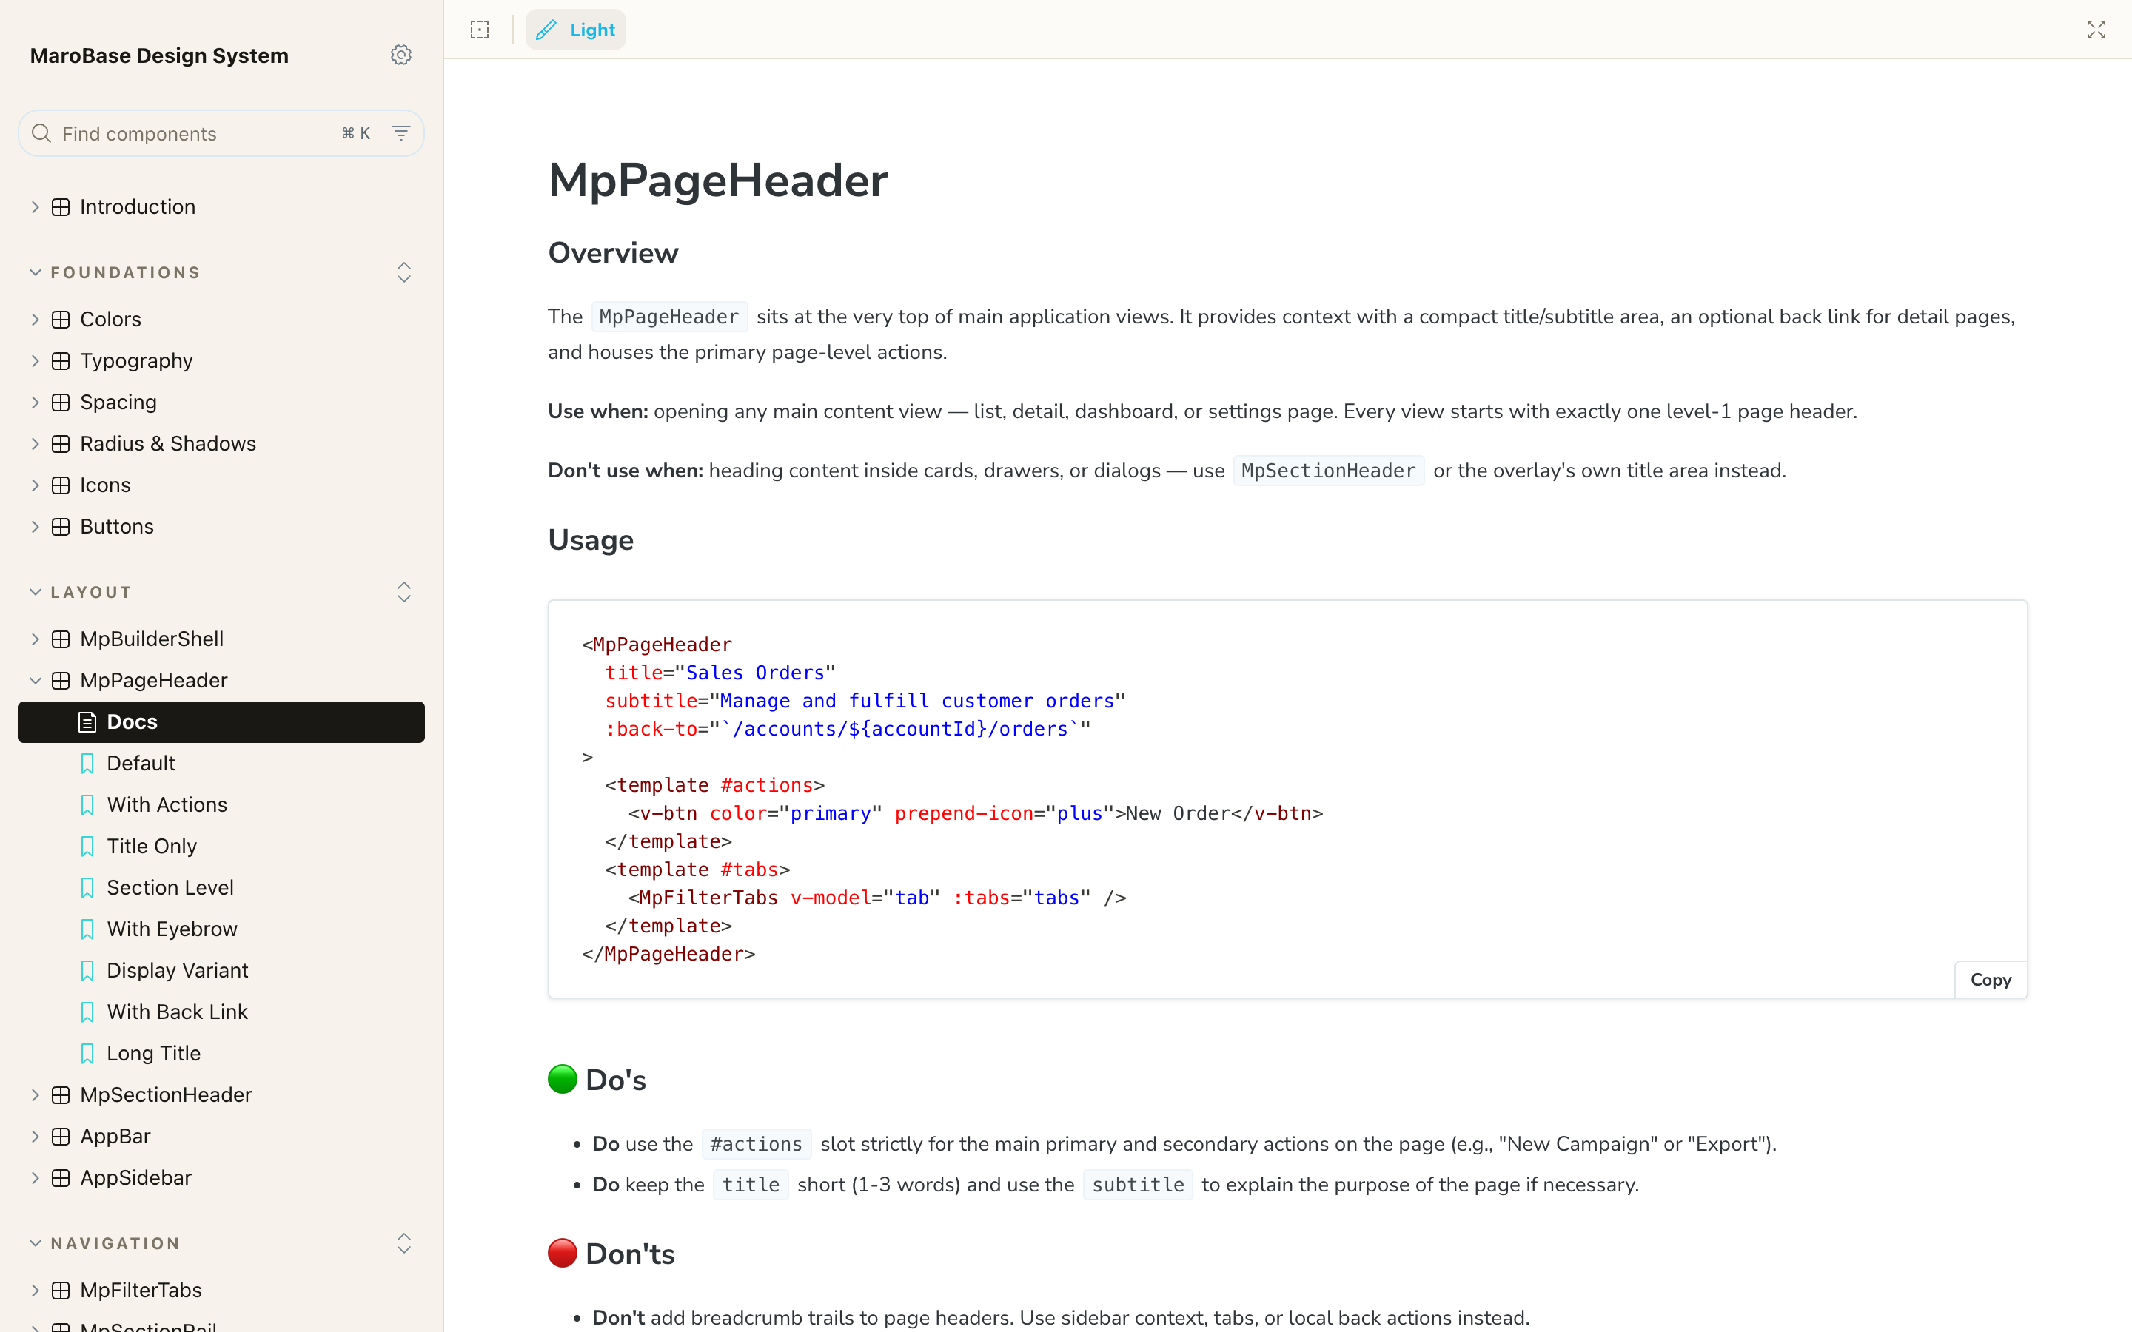
DOCUMENTATION
Every part comes with instructions.
A page per part
THE INSTRUCTION MANUAL
1
What it’s for, when to use it — and when not to.
2
It can’t go stale
The page renders the actual part, not a drawing of it. If the part changes, the page changes.
3
The house rule
No instruction page, no component. 84 of 89 parts are fully documented today.
Notes:
Every part in the kit has its own instruction page: what it is for, when to use it, when not to. The clever bit: the page renders the actual part — the same one the screens use — not a drawing of it. So the documentation physically cannot go out of date. House rule: if a part has no instruction page, it does not exist yet.

Slide 11
WHY THIS MATTERS
An idea becomes clickable in a day.
Try
Review
Build
A new screen is clickable in a day — the parts already exist, so building a prototype is assembly, not construction.
Every change gets a private web link. You click the real flow on your own laptop — not a picture in a meeting.
Engineers start from a working reference they can copy, instead of a mockup they have to interpret.
This sandbox — all 171 screens of it — was built exactly this way.
Notes:
What all of it buys you, whatever your role: an idea can become a clickable prototype in a day, because the parts already exist. Instead of debating a static picture in a meeting, you click a link on your own laptop and try the real flow. I can vouch for this personally — this sandbox was built exactly that way.

Slide 12
IMPLEMENTATION PLAN
Converge into LiquidSky — step by step.
01
02
03
04
Compatibility review
Pilot the safe parts
One full page
Area by area
Two named people sort every part: use as-is, wrap, contribute, or keep local. About two weeks.
→
Start with the simple, self-contained pieces — headers, dialogs, empty states.
→
Sales Orders, built the new way inside the real product.
→
Adopt at the pace the evidence supports. Shell last.
No dates on this slide — deliberately.
The two pilots turn guesses into numbers you can hold me to. I’d rather be accurate than fast.
Notes:
The plan is deliberately boring — that is a compliment. Step 1: compatibility review — two named people sort every part into four buckets: use LiquidSky’s version, wrap it, contribute ours, or keep it local. About two weeks. Step 2: pilot the low-risk parts. Step 3: one full page — Sales Orders — built the new way in the real product. Step 4: area by area, at the pace the evidence supports. No dates on this slide, deliberately. Anyone quoting a migration date before the pilots is guessing. The pilots turn my guesses into numbers you can hold me to.

Slide 13
DECISIONS I NEED TODAY
Six asks — none need budget this quarter.
1
Sign off on the direction
2
Make this the shared reference
3
Two names for the review
The look and behavior you saw today becomes our agreed direction.
When we discuss design, the sandbox and its docs are what we point at.
One LiquidSky maintainer + one product engineer, for the two-week review.
4
Access to LiquidSky
5
Approve the two pilots
6
No second library — ever
The repository and its normal contribution process.
The safe parts first, then the Sales Orders page.
Nothing ships from the sandbox as a separate package. One foundation.
Notes:
What I need from this room today — six decisions, none of which cost budget or headcount this quarter. Walk through them one by one. Number six is me volunteering a constraint: one shared foundation, no second one.

Slide 14
OVER TO YOU
Questions.
Ask me the hard ones — they’re the reason we’re all here.
Notes:
Keep the FAQ crib sheet within reach (docs/design-system/showcase-faq-crib-sheet.md). If the room is quiet, open with: "The question I’d be asking in your seats is: aren’t we building everything twice? Let me answer that one first, because it’s fair." (Crib sheet #21.) Parking-lot phrase: "Great question — I don’t want to hand-wave it. Let me take it into the compatibility review and come back with evidence instead of adjectives."

Slide 15
KEEP CLICKING
Everything you saw is live.
The sandbox
Link in the meeting chat — every screen from today’s demo.
The component wall
/showcase — all 89 parts on one page.
The instruction manual
Storybook — every part’s documentation, live.
Thank you.
Pretend data — you can’t break anything. Please try.
Notes:
Everything I showed you is live right now. The sandbox stays open — go click the things I did not get to. Try to break it: it is pretend data, you cannot hurt anything. DO: drop the sandbox link in the meeting chat, and leave this slide up while people drop off.

Slide 16
DEMO FALLBACK
Stop 1 · Dashboard
Captured live from the sandbox — July 20, 2026.
Notes:
Demo fallback: narrate over this screenshot if the live demo misbehaves. Captured from the running sandbox on 2026-07-20.

Slide 17
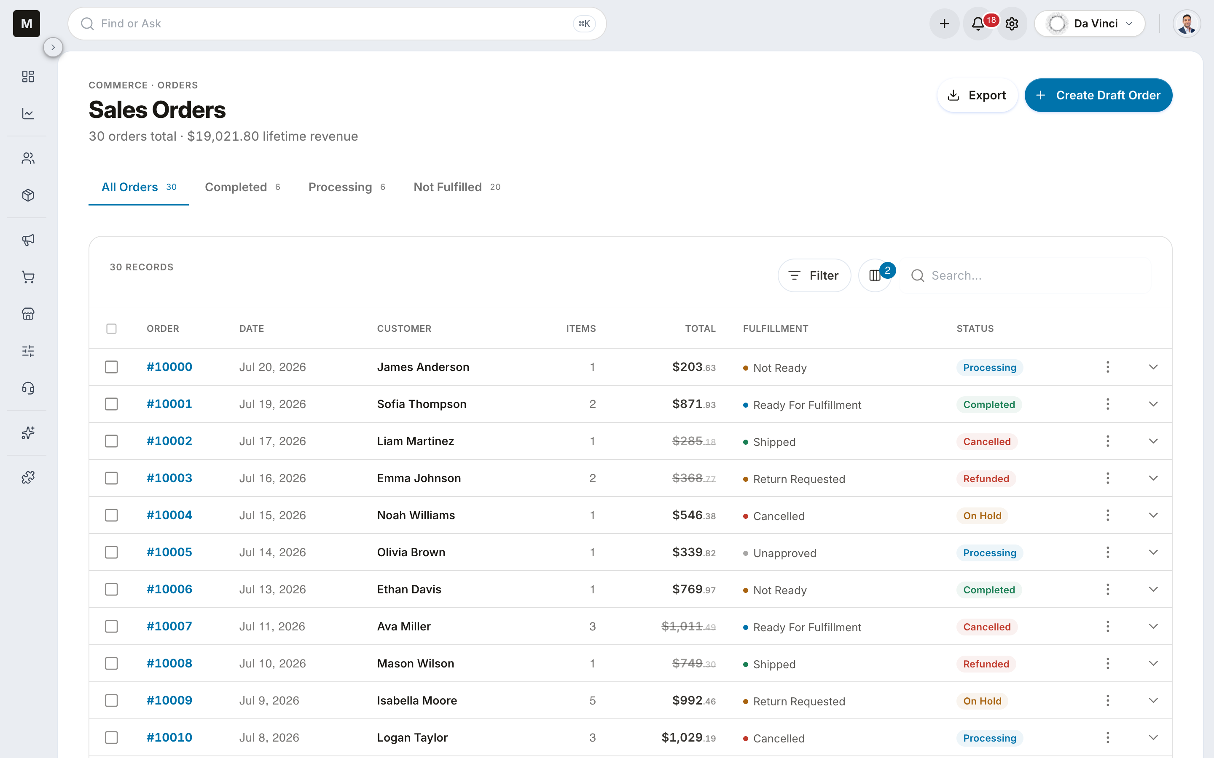
DEMO FALLBACK
Stop 2 · Sales Orders
Captured live from the sandbox — July 20, 2026.
Notes:
Demo fallback: narrate over this screenshot if the live demo misbehaves. Captured from the running sandbox on 2026-07-20.

Slide 18
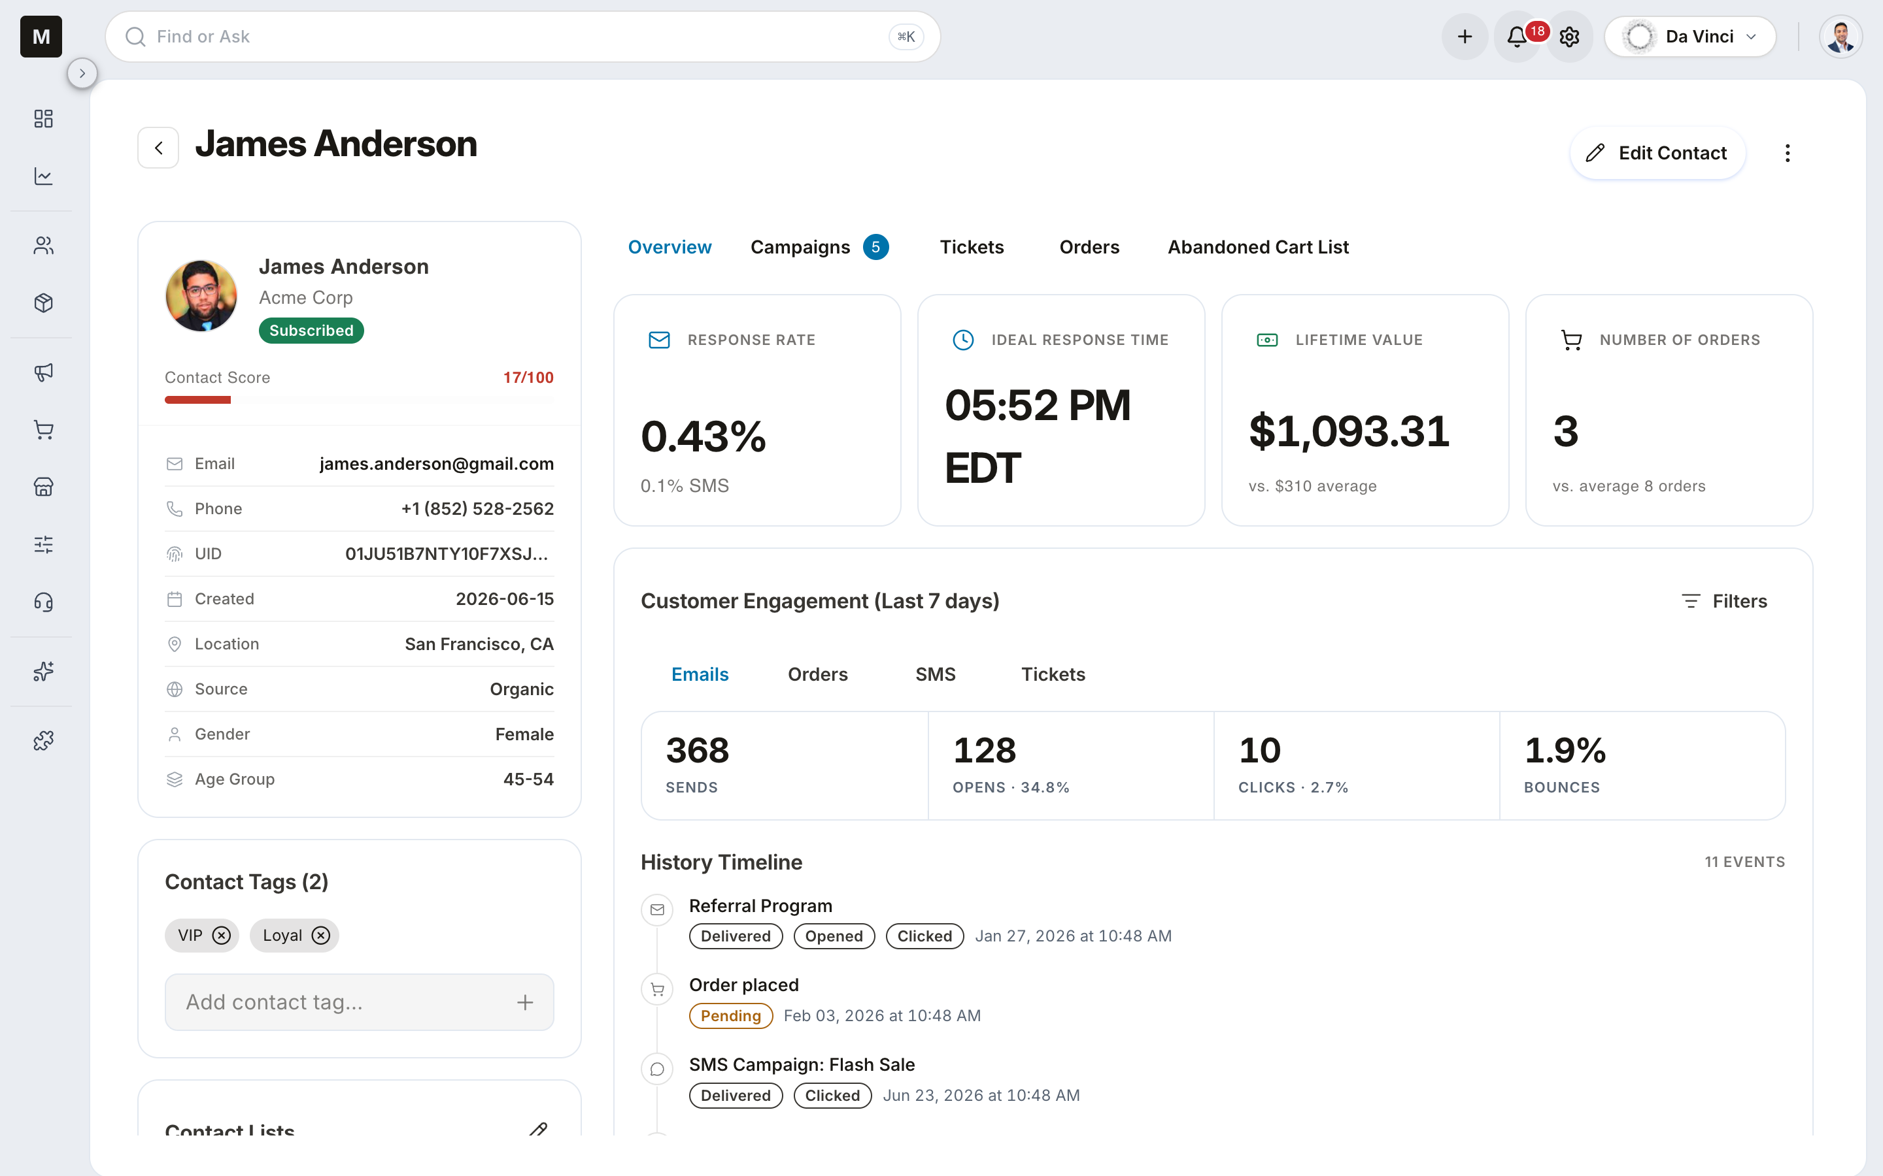
DEMO FALLBACK
Stop 3 · Contact detail
Captured live from the sandbox — July 20, 2026.
Notes:
Demo fallback: narrate over this screenshot if the live demo misbehaves. Captured from the running sandbox on 2026-07-20.

Slide 19
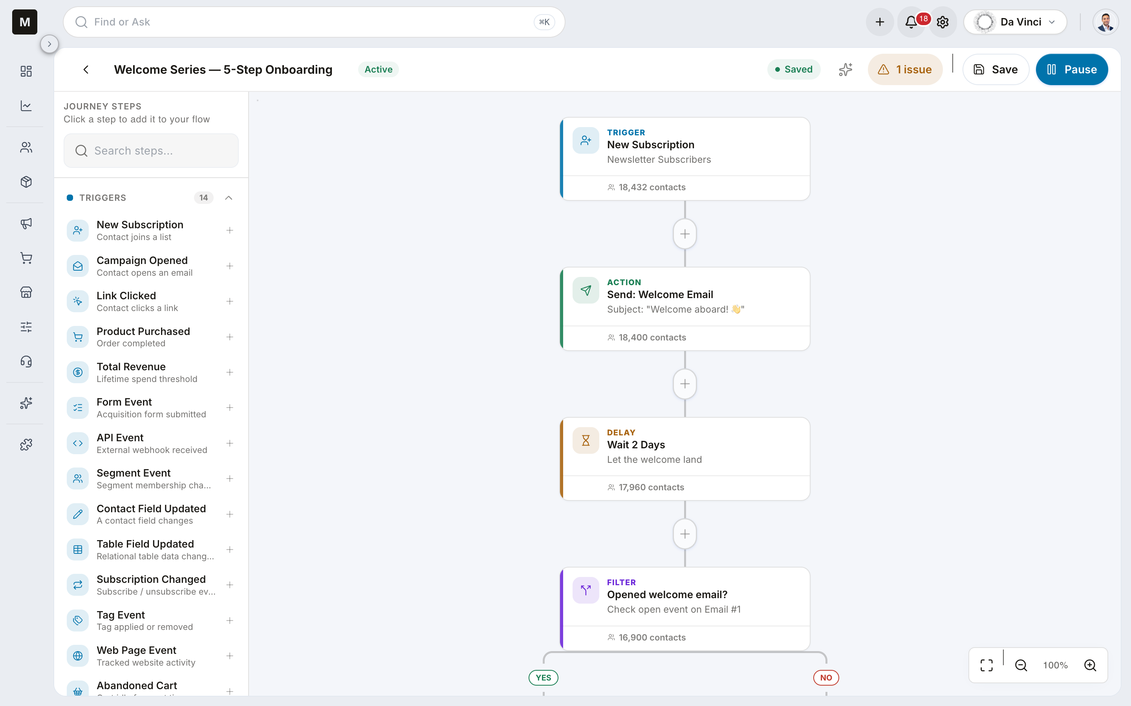
DEMO FALLBACK
Stop 4 · Journey builder
Captured live from the sandbox — July 20, 2026.
Notes:
Demo fallback: narrate over this screenshot if the live demo misbehaves. Captured from the running sandbox on 2026-07-20.

Slide 20
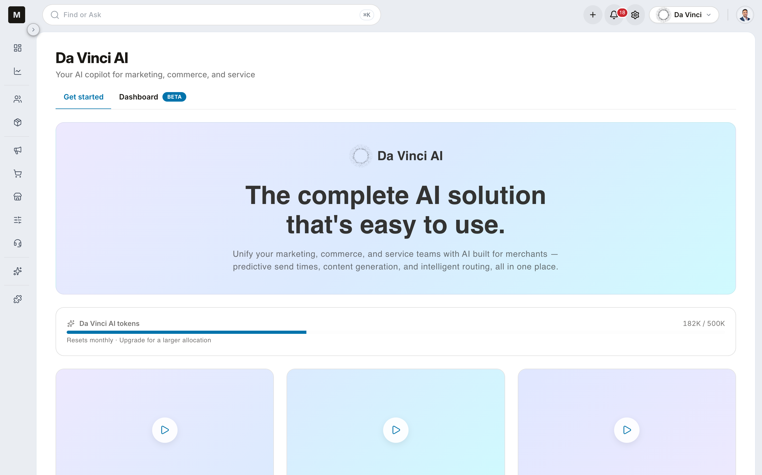
DEMO FALLBACK
Stop 5 · Da Vinci
Captured live from the sandbox — July 20, 2026.
Notes:
Demo fallback: narrate over this screenshot if the live demo misbehaves. Captured from the running sandbox on 2026-07-20.

Slide 21
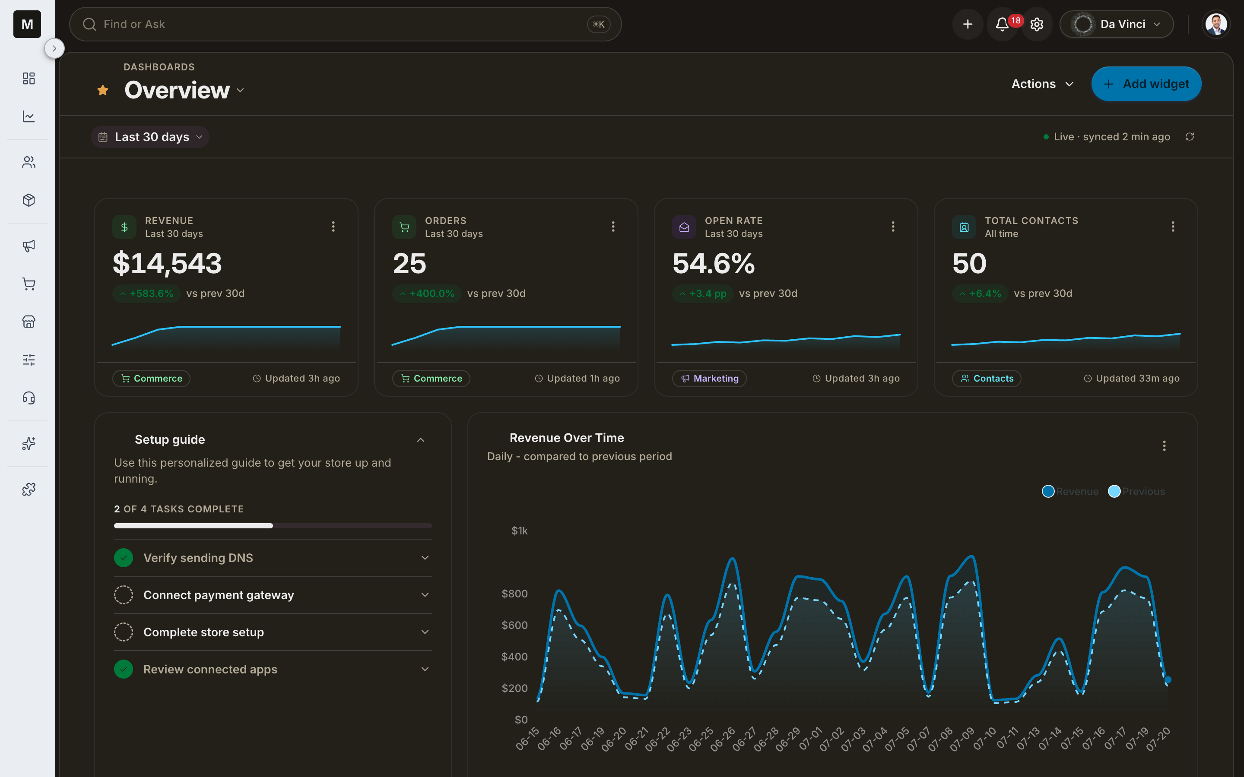
DEMO FALLBACK
The theme flip — one change, every screen.
Same screen, same data. 297 decisions flip to their dark values at once.
LIGHT
DARK
Notes:
Demo fallback for the finale: the same dashboard in light and dark. One keypress, 297 written-down decisions flip at once — no screen is special-cased.

