Slide 1
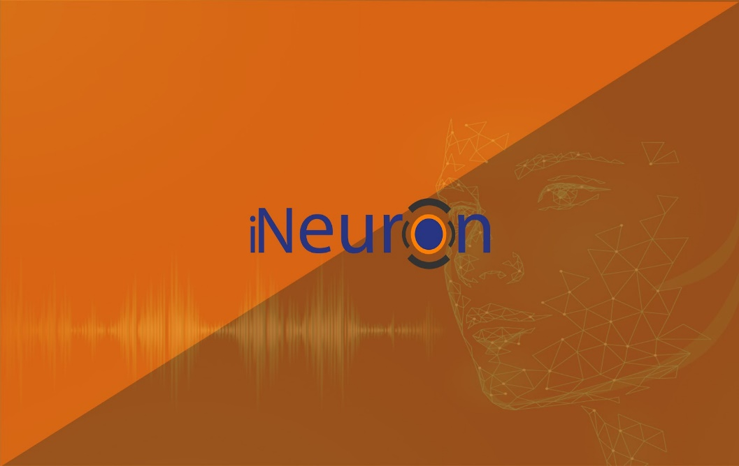
iNeuron.ai

Slide 2
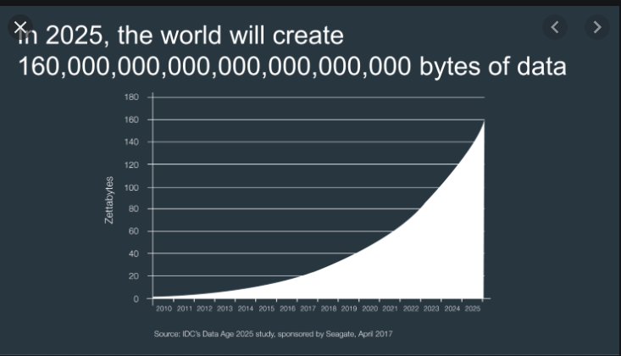
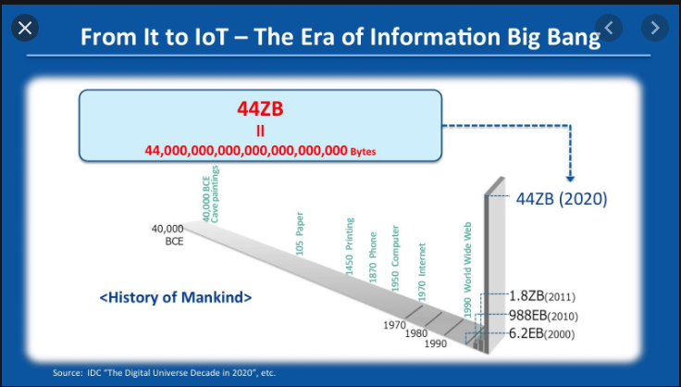

Why AI is gaining pace NOW?
What if I ask you since when do we have AI algorithms present in the world? The answer might be surprising for some of you.
AI has been around since almost 1950s.
Then why are we talking about this now? Why haven’t the field grown in past half of a century?
There are two answers to it:
Processing speed of the computers.
The Amount of data present to train those models.
Almost 98% of the data that we have generated has been in the last few years.
Courtesy: Google Images

Slide 3
The Importance of AI
Can be used for a lot of automations of the mundane tasks.
AI machines can adapt through progressive self learning.
Can find hidden patterns and insights which are oblivious to humans.
Can perform the predictions with incredible accuracy.
Can help organizations take data driven decisions.
Can be used in places where humans can’t go.
Can help in medicine and healthcare.
And Many Many More…

Slide 4
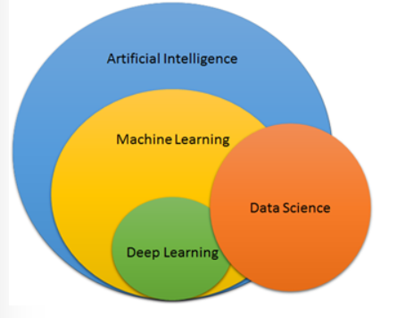
AI vs DS vs ML vs DL
01
02
03
04
Courtesy: Google Images

Slide 5
Use Cases
Banking and Finance
Insurance and Claims
.
Human Resource and workforce management
.
Domain Specific Use Cases
Optimization of operations and management
Retail, supply chain, inventory management etc.
.
Customer data-oriented marketing

Slide 6
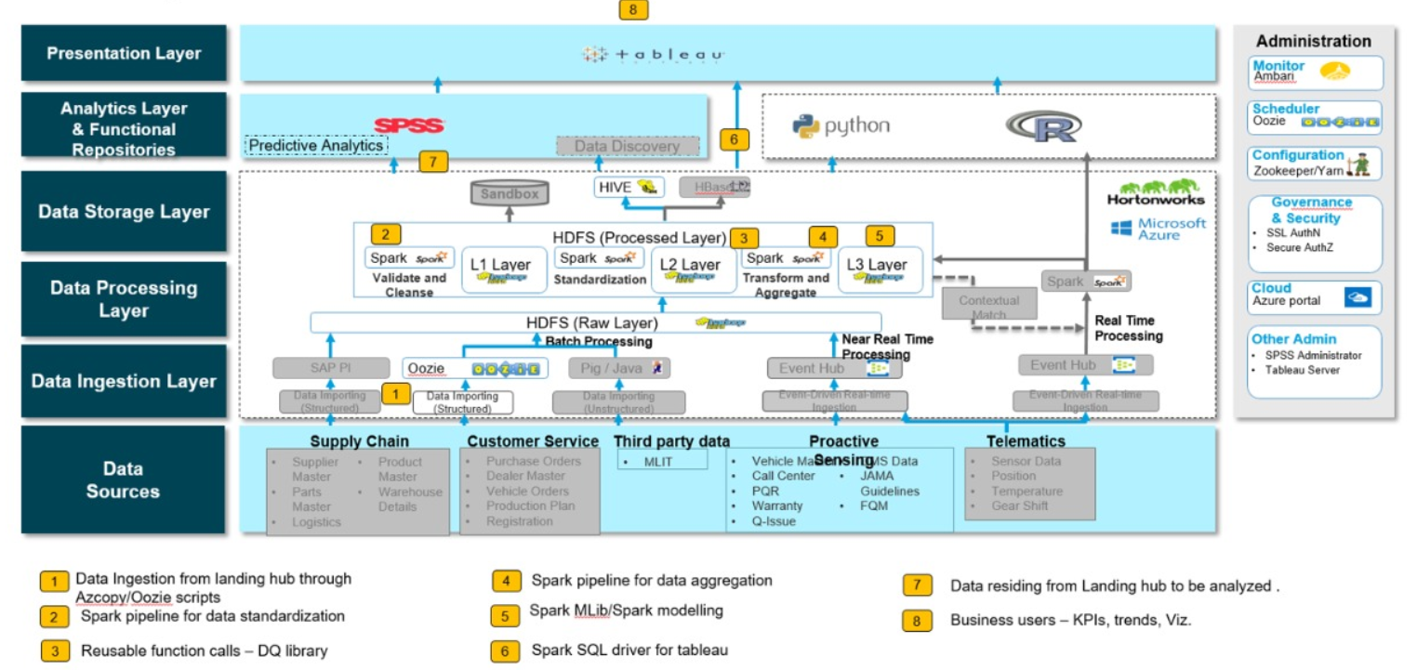
Conceptual Architecture

Slide 7
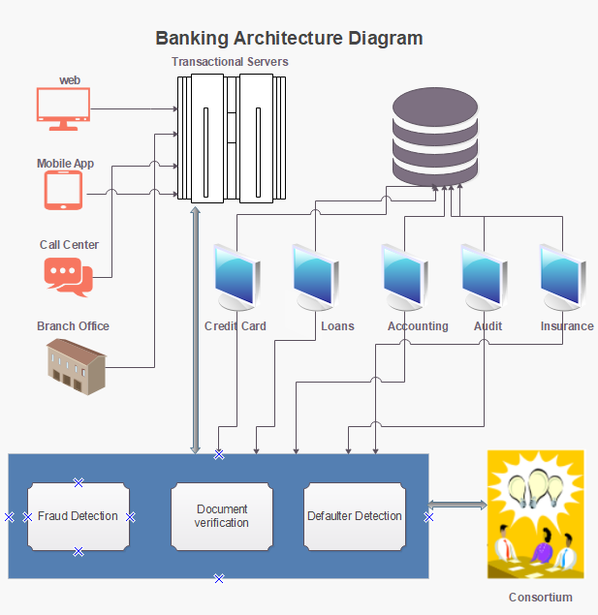
Banking System Architecture

Slide 8
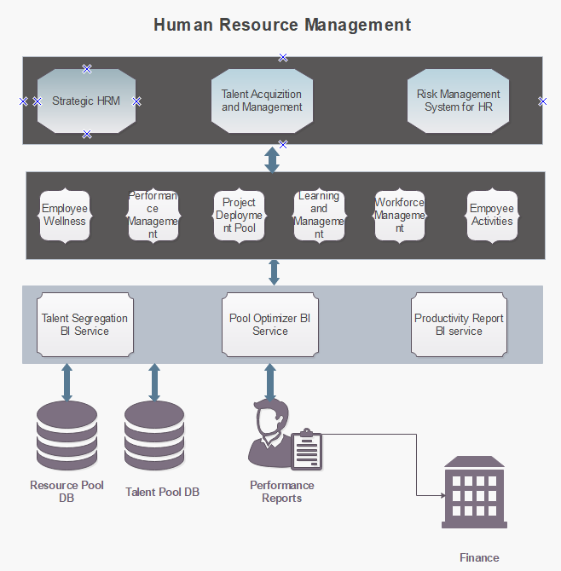
HR System Architecture

Slide 9
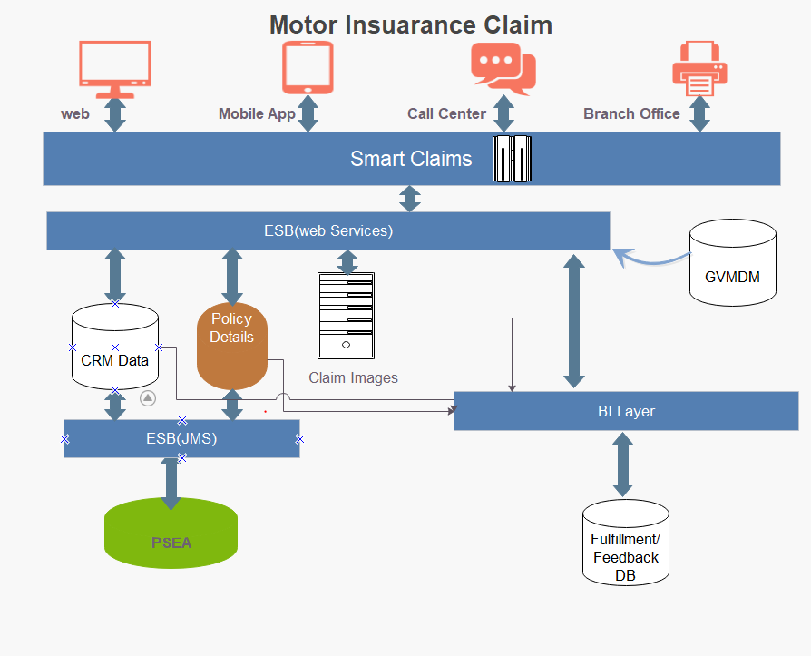
Insurance Claim Architecture

Slide 10
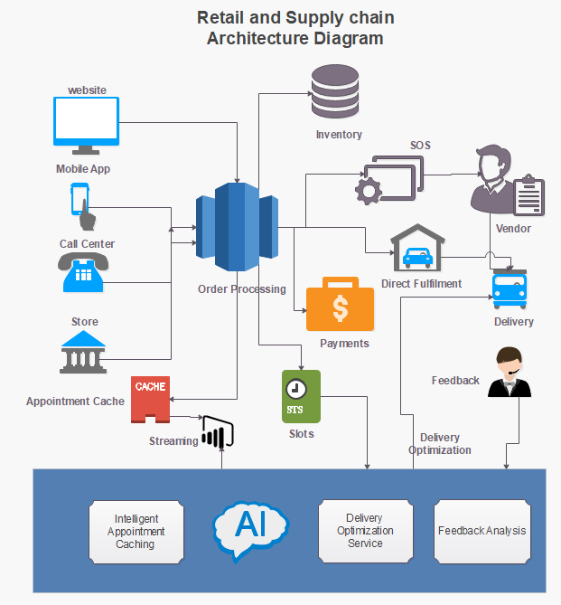
Retail System Architecture

Slide 11
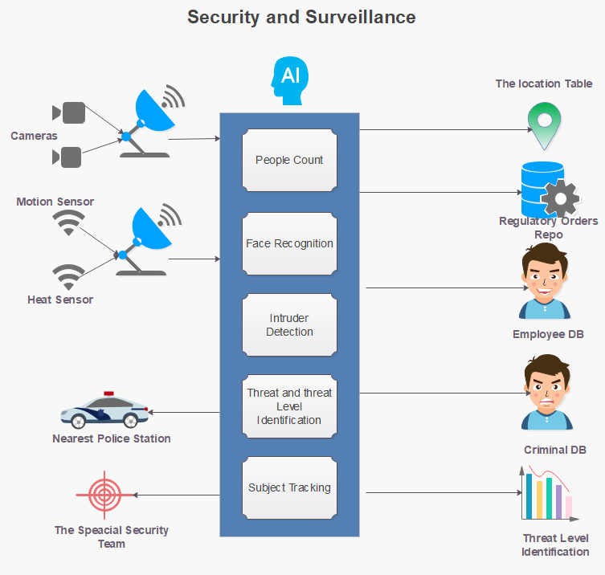
Security and Surveillance

Slide 12
Our Cool Stuff
Automated Attendance System
https://www.youtube.com/watch?v=7VDzO4PX96A&list=PLmQAMKHKeLZ_dmcPBxdiZ-1qN2iMexErg&index=3
Live Stream Face Recognition from Drone
https://www.youtube.com/watch?v=0tgaVavFXig&list=PLmQAMKHKeLZ_dmcPBxdiZ-1qN2iMexErg&index=6
Live Stream Object Detection from Drone
https://www.youtube.com/watch?v=0tgaVavFXig&list=PLmQAMKHKeLZ_dmcPBxdiZ-1qN2iMexErg&index=6
Automatic Number Plate detection System
https://www.youtube.com/watch?v=hBLdlx_U4L8&list=PLmQAMKHKeLZ_dmcPBxdiZ-1qN2iMexErg&index=5
And Many More…

Slide 13
Thank You

