Slide 1
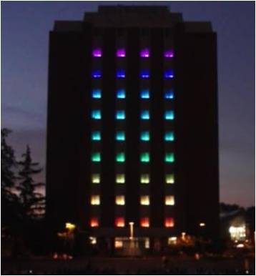
Tower Lights Animator
A Project by the Tower ILLuminati –
Ranger Adams
Paul Bailey
Matt Brown
Heyan Huang
Emeth Thompson

Slide 2
Goals
Link .tan file with corresponding audio file
Rewrite in C++
Make light shows “easier”
  Less clicks
  Automated movement
  Pre-generated shapes
  Pre-generated animations
  Import from other files

Slide 3
Background
Current program (v0.3) in C#
Every “window” change requires a click
v0.2 was black and white
UI CS Curriculum is C++ based

Slide 4
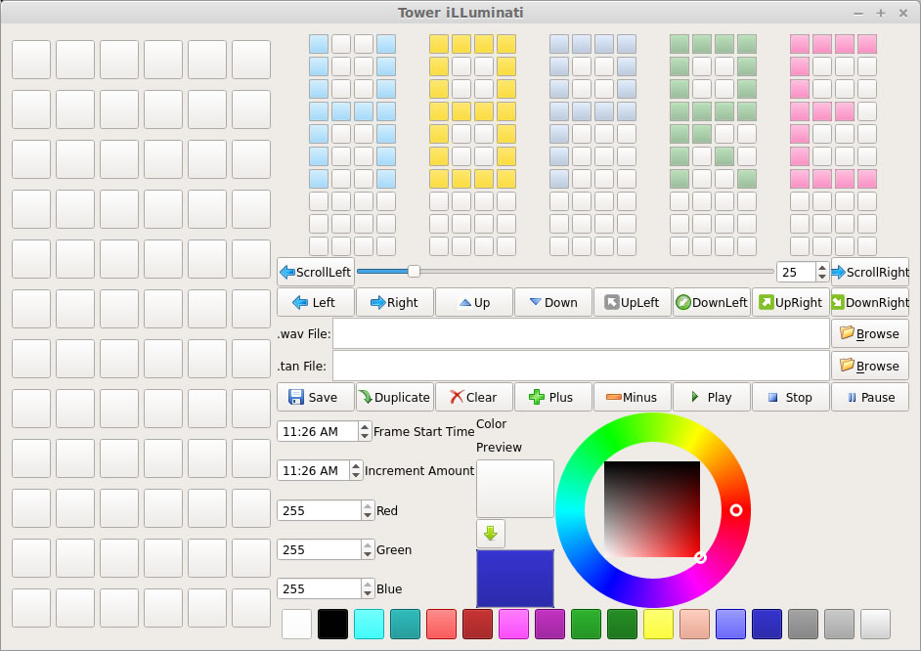
Status
GUI design
Design documents
Main division of work
Classes and Prototypes

Slide 5
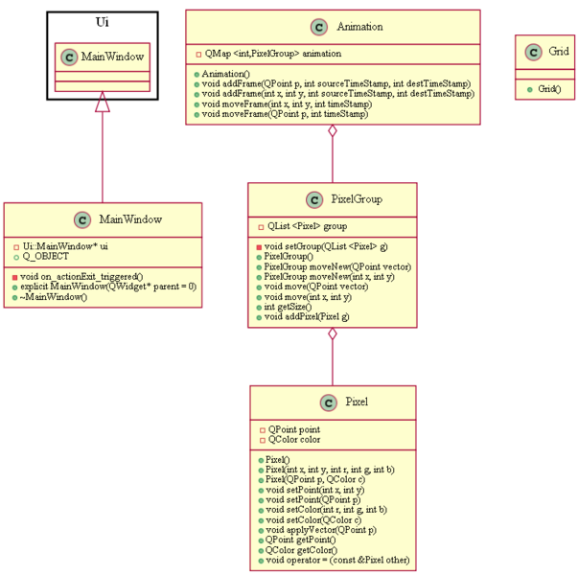
Future Work
Implement functionality to GUI
Implement multiple “pixel” movement
Figure out modifications to .tan file layout
Next Semester
  Implement more advanced animations/movements
  Add more GUI features

Slide 6
Preliminary Conclusions
Design
  Prototypes and Classes
  More to be Added
Coding
  Based on Design
  Testing

Slide 7
Questions?

