Slide 1
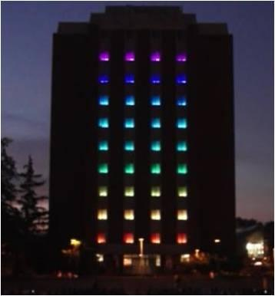
Tower Lights Animator
A PROJECT BY THE TOWER ILLUMINATI –
RANGER ADAMS
PAUL BAILEY
MATT BROWN
HEYAN HUANG
EMETH THOMPSON

Slide 2
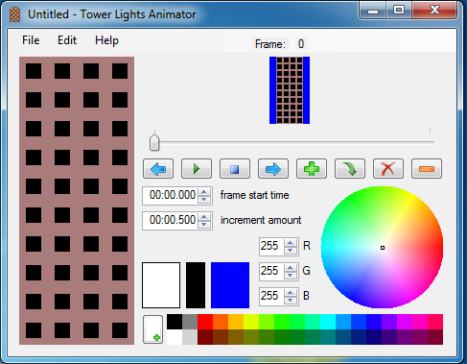
Background
Bob Rinker and ACM - 2009
v0.2 was black and white
Current program (v0.3) in C#
Every “window” color change requires a click
UI CS Curriculum is C++ based

Slide 3
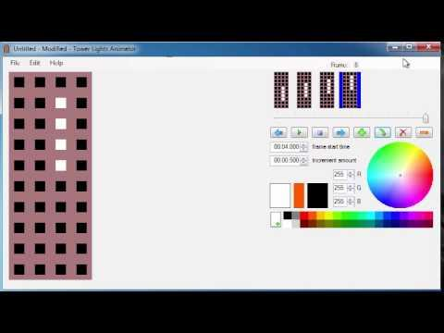
Goals
Link .tan file with corresponding audio file
Rewrite in C++
Cross Platorm (Linux, Mac)
Make light shows “easier”
  Less clicks
  Automated movement
  Pre-generated shapes
  Pre-generated animations
  Import from other files

Slide 4
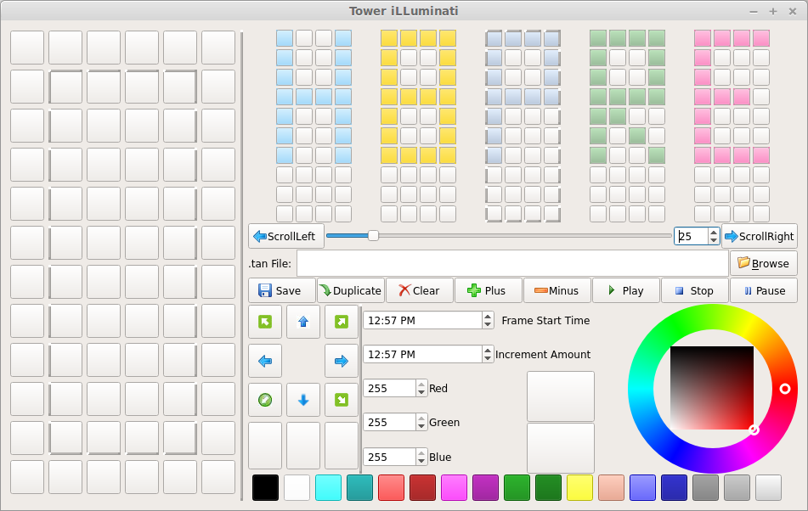
Status
GUI design
Design documents
Main division of work
Classes and Prototypes

Slide 5
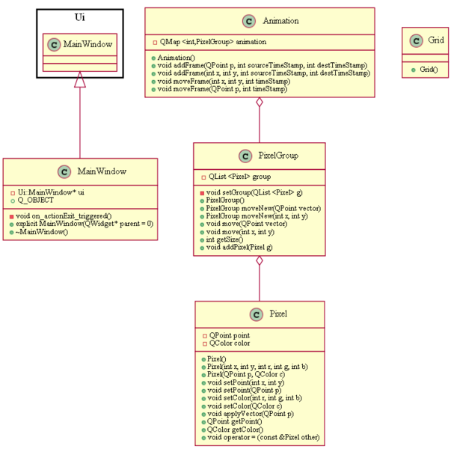
Future Work
Implement functionality to GUI
Implement multiple “pixel” movement
Figure out modifications to .tan file layout
Next Semester
  Implement more advanced animations/movements
  Add more GUI features

Slide 6
Preliminary Conclusions
Design
  Prototypes and Classes
  More to be Added
Coding
  Based on Design
  Testing

Slide 7
Questions?

