Slide 1

各位来宾
下午好

Slide 2
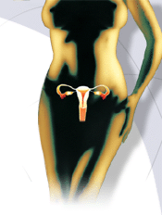
子宫内膜异位症
Endometriosis
Gynecological department of the first affiliated hospital of Xinjiang medical university
妇产科教研室 艾星子

Slide 3
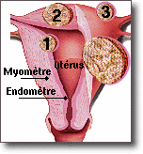

Slide 4
教学目的要求
了解子宫内膜异位症的定义病因及病理变化
熟悉子宫内膜异位症的临床特点诊断方法及治疗原则

Slide 5
定义 Definition
具有生长功能的子宫内膜组织出现在子宫以外身体其他部位时称子宫内膜异位症.
Presence of endometrial tissue outside the lining of the uterine cavity

Slide 6
Epidemiology
Age: common in reproductive period
True Incidence Unknown: ? 1-5% & 30 – 50 % infertility.
Does NOT Discriminate by Race.
Herdietary (↑↑ among sisters).

Slide 7
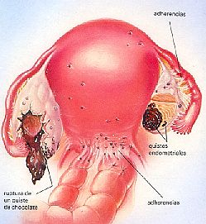
Sites
Pelvic
宫骶韧带及卵巢
- Extra pelvic
Umbilicus.
Scars (Lap.).
Lungs

Slide 8
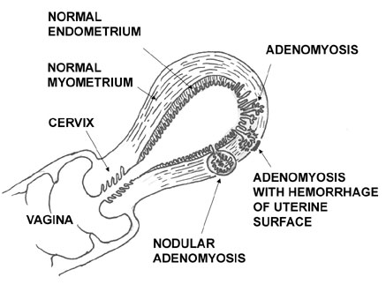
Pelvic Endometriosis
Uterine= Adenomyosis (50%).
Extraut:
- Ovary 30%
- Pelvic peritoneum 10%.
- F. tube.
- Vagina.
-Bladder & rectum.
- Ligaments.

Slide 9
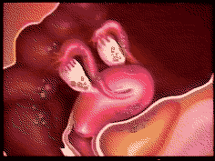

Slide 10
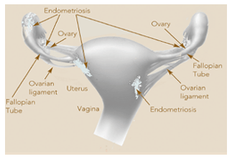

Slide 11
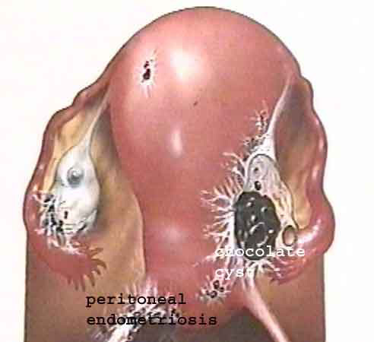

Slide 12
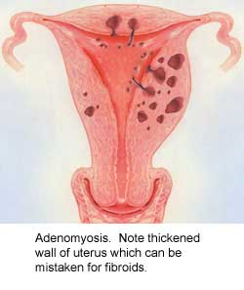

Slide 13
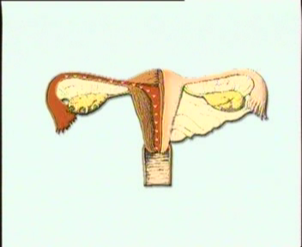
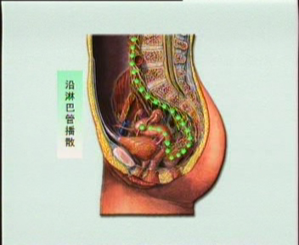
体腔上皮化生学说
Theories of histiogenesis
子宫内膜种植学说
淋巴静脉播散学说

Slide 14
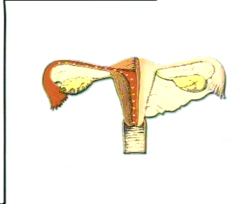

Slide 15
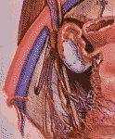

Slide 16
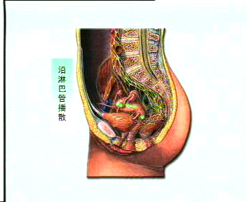

Slide 17
Theories of histiogenesis
continue
Motorras等报道有异位症家族史者的发病率为4~6%
遗传因素
自身免疫性疾病
免疫学说

Slide 18

Theories of histiogenesis
2008年前攻破创妇科史上的奥林匹克
OXEGENE------国际合作项目
http://www.endozone.org

Slide 19
Pathology 病理
宫骶韧带,直肠子宫陷凹
子宫后壁下段异位症
卵巢异位症
巨检
盆腔腹膜异位症
输卵管及宫颈异位症

Slide 20
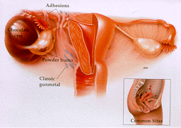

Slide 21
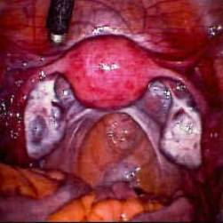

Slide 22
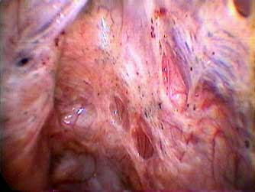

Slide 23
病理
Pathology 病理
continue
子宫内膜腺体
镜
检
子宫内膜间质
纤 维 素
出 血

Slide 24
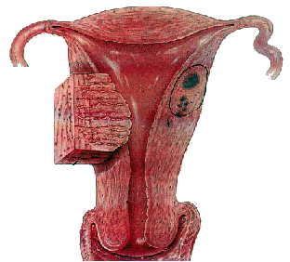

Slide 25
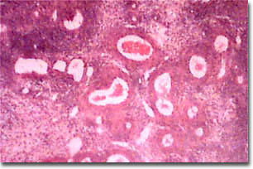

Slide 26
Diagnosis
Symptoms (history).
Signs (Exam).
Investigations.

Slide 27
Symptoms症状
疼痛: 继发性渐进性加重的痛经
不孕
月经失调
性交痛
卵巢子宫内膜异位囊肿破裂
盆腔以外异位症的临床表现

Slide 28
异位症引起不孕的原因
盆腔结构异常：卵巢、输卵管粘连----机械性障碍，影响排卵、受精和生殖细胞游走。
盆腔内微循环改变：补体系统、细胞因子
卵巢功能异常：未破裂卵泡黄素化综合征（luteinized unruptured follice syndrome,LUFS)

Slide 29
Signs 体征
1. Pelvic tenderness.
2. Fixed retroverted uterus.
3. Nodularity of the Douglas pouch and uterosacral ligaments.
4. Ovaries may be enlarged and tender . Ovarian cyst may be detected.

Slide 30
辅 助 检 查
1. Laparoscopy .腹腔镜------金标准
2. Imaging. B超
3. Serum CA - 125.
4. ? IL-8 & CEA.

Slide 31
Laparoscopy
Value:
It permits a “see and treat” approach, although its effectiveness may be limited by the nature of the disease and the surgeon's skill.

Slide 32
Laparoscopy cont….
Appearance:
Endometriosis May Appear
Brown
Black (“Powderburn”)
Clear (“Atypical”)

Slide 33
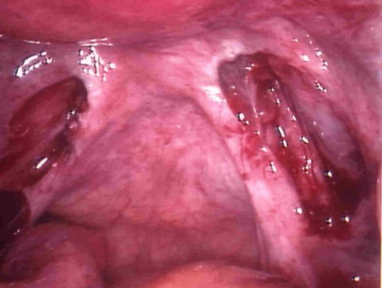

Slide 34
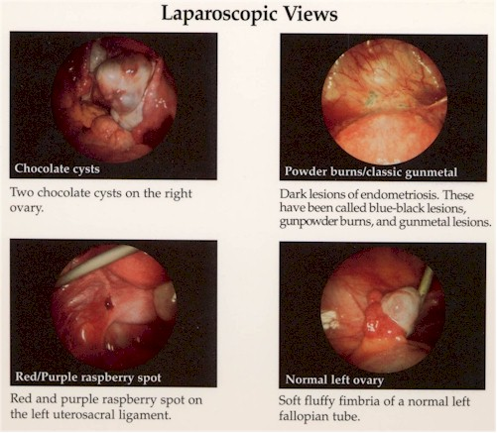

Slide 35
Differential diagnosis
1.Ovarian cysts.卵巢恶性肿瘤
2. Pelvic inflammatory disease .
盆腔炎性包块
3. Asymmetrical enlarged uterus.

Slide 36
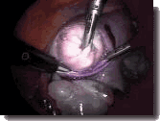

Slide 37
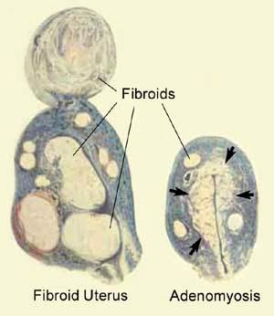

Slide 38
Ovarian Endometriosis
Formed by invagination of the ovarian cortex after accumulation of menstrual debris from bleeding of endometriotic implants.

Slide 39
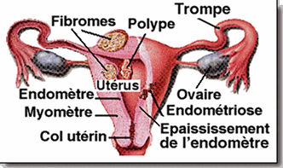

Slide 40
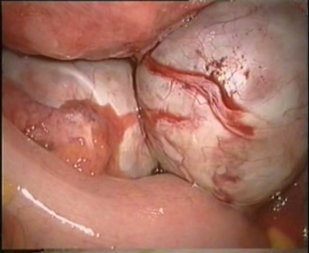

Slide 41
临床分期 Staging
Revised AFS System: Most Often Used.
Ranges from Stage I (Minimal) to Stage IV (Severe).
Staging Involves Location and Depth of Disease, Extent of Adhesions.

Slide 42
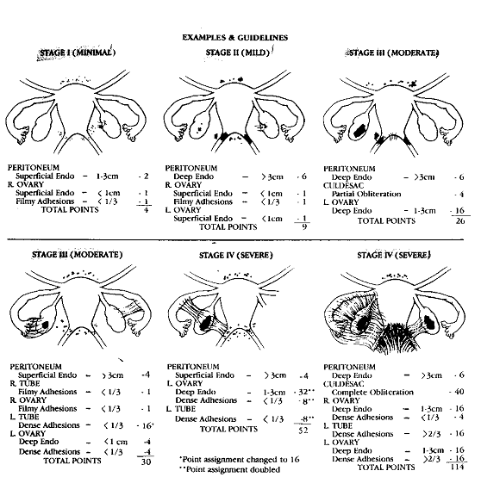

Slide 43
Revised AFS 1985
Stage I (minimal) 1 – 5.
Stage II (mild) 6 – 15.
Stage III (moderate) 16 – 40.
Stage IV (severe) > 40.

Slide 44
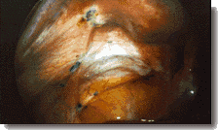
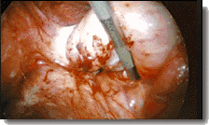
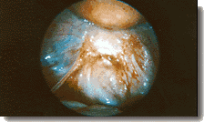
Stage

Slide 45
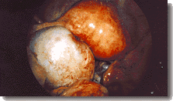
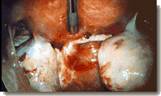
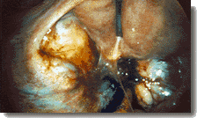
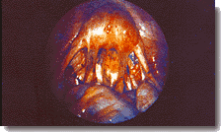
Stage

Slide 46
Treatment 治疗
Age.年龄
Symptoms. 症状
Stage. 分期
Infertility. 生育情况

Slide 47
Treatment (Rationale)
Recognize Goals:
– Pain Management
– Preservation / Restoration of Fertility
Discuss with Patient: 循证医学
– Disease may be Chronic and Not Curable
– Optimal Treatment Unproven or Nonexistent

Slide 48
Lines of ttt
Expectant .期待治疗
Medical. 药物治疗
Surgical. 手术治疗

Slide 49
Expectant treatment
Young , asymptomatic infertile patient with mild endometriosis.
If pregnancy does not achieved within 12 - 18 months of observation:

Slide 50
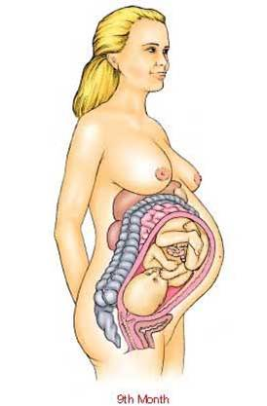
Endometriosis & IVF
The presence of endometriosis does not generally impair the results of IVF but it increases the risk of infection.
It is preferable not to cauterize ovarian endometrioma if IVF or ICSI is indicated for fear of destruction of ovarian tissues.

Slide 51
Medical Treatment
1.达那唑 danazol
2.孕三烯酮
3.米非司酮
4.促性腺激素释放激素激动剂
GnRH-a
5.假孕疗法 大剂量雌/孕激素，连服 9个月

Slide 52
Surgical Treatment
保留生育功能的手术
附件包块
盆腔疼痛
不孕
保留卵巢功能的手术
根 治 性 手 术

Slide 53
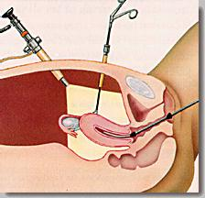

Slide 54
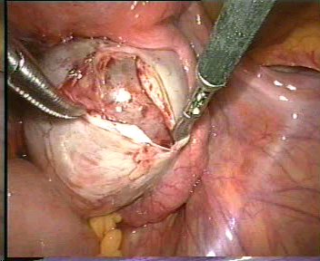

Notes:
卵巢巧克力囊肿

Slide 55
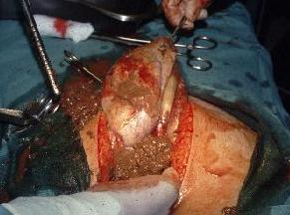

Slide 56
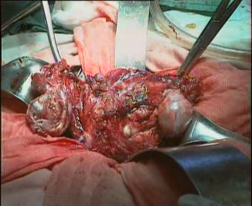

Slide 57
三 步 疗 法
手 术
药物
药 物
金标准
治疗
腹腔镜确诊+手术+药物

Slide 58
预 后
? Removal of Ovaries at Hysterectomy
? Adjuvant Treatment Postoperatively
? Is Endometriosis Best Treated Surgically, Medically or Both

Slide 59
预 防
防止经血逆流
2.药物避孕
3.防止医源性异位内膜种植

Slide 60
总结Conclusion
Endometriosis is a mystery tour as it requires decision making at every stage by the physician and the patient.
Endometriosis still stand as one of the most-investigated disorders in gynecology. SO is one of the highest priorities for research.

Slide 61
思 考 题
什么是子宫内膜异位(endometriosis)?
子宫内膜异位症典型症状是什么
内异症引起不孕的原因是什么

Slide 62
制 作 简 介
POWERPOINT 平台
FLASH动画
图片
超级截霸3000
手术片段
操作简便
便于修改

Slide 63


Thank you
Email. aixingzi@yahoo.com.cn

