Slide 1
Connect Four using Alpha-Beta Pruning
Billy Landowski
CptS 540
7 December 2010

Slide 2
Overview
Background
Connect Four as a search problem
Alpha-beta pruning
Details about winning
Heuristics
Implementation / Demo
Conclusion

Slide 3
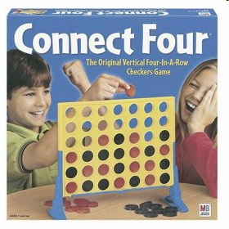
Background
Sold by Milton Bradley in February 1974
2 players
Alternate turns
Goal: Connect four tiles in a row horizontally, vertically, or diagonally

Slide 4
Connect Four as a Search Problem
≤7 possible moves per turn
Enumerate each move
Continue for each board configuration
Player 1
Player 2

Slide 5
Connect Four as a Search Problem
States: Any board configuration with at most one player’s tile in each location
Initial State: An empty game board with no tiles.
Actions: Place a tile of the current player’s color into any column that is not full.
Transition Model: Returns a board configuration with a tile added to the specified column.
Goal/Terminal Test: A player has four of her tiles in a line either horizontally, vertically, or diagonally, or the game board is full (indicating a tie).
Utility: +∞ if player has connected four, 0 if board is full, –∞ if opponent has connected four.

Slide 6
Alpha-beta pruning
O (b^{d/2}) time complexity
b = branching factor = 7
d = depth = 7 × 6 = 42
Computationally intensive
Need cut-off depth
Can also add heuristics

Slide 7
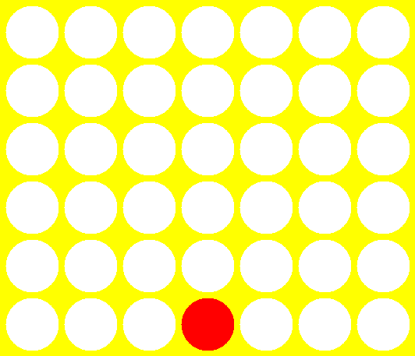
Winning Connect Four
To win, player needs a “winning line” of 4

Slide 8
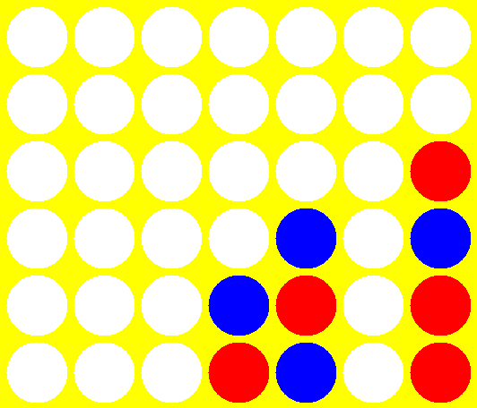
3-out-of-4 Heuristic
To win, player needs a “near” winning line of 3

Slide 9
3-out-of-4 Heuristic (cont.)
Count total 3-out-of-4 “unblocked” winning lines
Compare to opponent
Utility(p,G) = f(p,G) – f(opponent(p),G)
f(a,G) = # of 3-out-of-4 winning lines for player a on board G

Slide 10
Scoreboard Heuristic
Extend 3-out-of-4 heuristic to n-out-of-4 for n ≤ 3
Award weighted points based on the value of n
Score(p,G) = 100(n₃) + 10(n₂) + 1(n₁)
n_{i} is the number of i-out-of-4 winning lines for player p on game board G

Slide 11
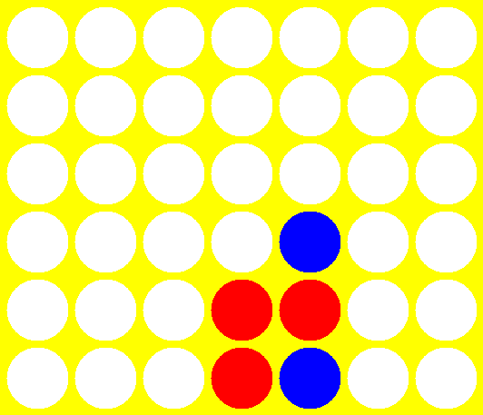
Scoreboard Heuristic (cont.)
Five 1-out-of-4 winning lines (n1 = 5)
Five 2-out-of-4 winning lines (n2 = 5)
Score = 100(0) + 10(5) + 1(5) = 55

Slide 12
Scoreboard Heuristic (cont.)
Compare players’ scores
Utility(p,G)
= Score(p,G) – Score(opponent(p),G)

Slide 13
Implementation
Written in C# under .NET Framework
Microsoft Visual Studio 2008
Windows Forms application

Slide 14
CPU Difficulties
4 difficulties
  Beginner – random
  Moderate – alpha-beta pruning with cutoff-depth 3 and simple utility function
  Hard – alpha-beta pruning with cutoff-depth 6 and 3-out-of-4 heuristic
  Expert – alpha-beta pruning with cutoff-depth 6 and scoreboard heuristic
Aspect of randomness

Slide 15
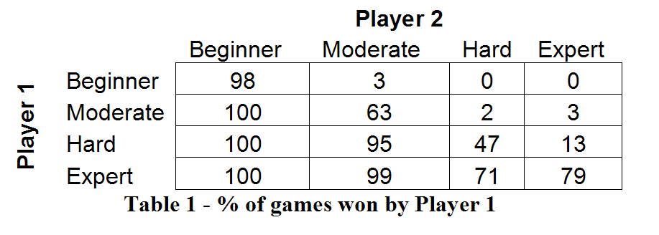
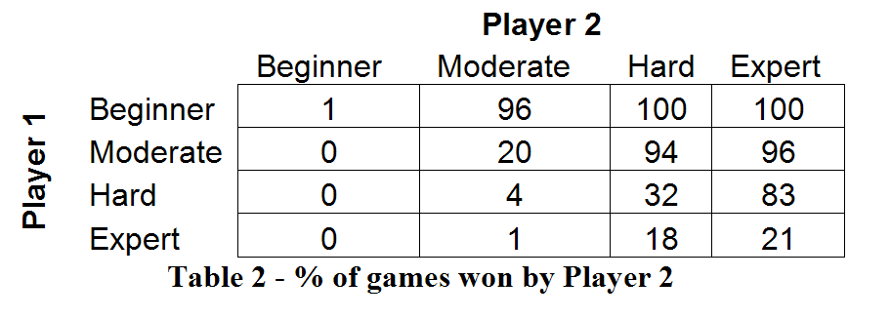
Comparison of CPU Difficulties

Slide 16
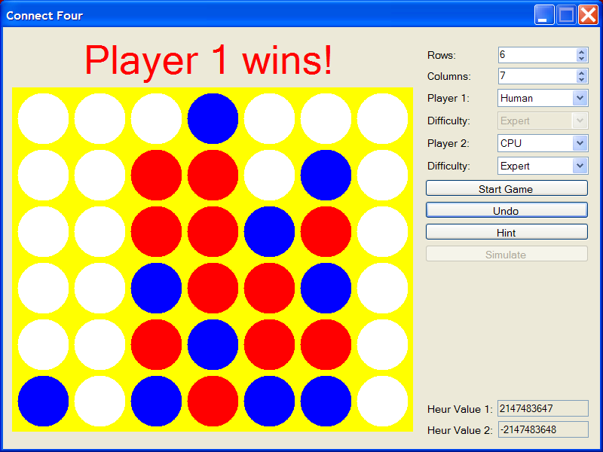
Demonstration

