Slide 1
Chapter 6: CPU Scheduling
CPU调度

Slide 2

Chapter 6: CPU Scheduling
6.1 Basic Concepts 基本概念
6.2 Scheduling Criteria 调度标准
6.3 Scheduling Algorithms 调度算法
Summary 小结

Slide 3
6.1 ■ Basic Concepts
CPU-I/O Burst Cycle CPU-I/O 区间循环
CPU Scheduler CPU调度程序
Preemptive Scheduling 剥夺式调度
Dispatcher 分派程序

Slide 4


CPU-I/O Burst Cycle
CPU-I/O 区间循环
Maximum CPU utilization obtained with multiprogramming
CPU–I/O Burst Cycle CPU-I/O 区间循环
  – Process execution consists of a cycle of CPU execution and I/O wait.
    进程执行过程由CPU执行和I/O等待循环组成

Slide 5

Alternating Sequence of CPU And I/O Bursts

Slide 6
CPU burst distribution CPU区间分布
  Although the durations CPU bursts vary greatly by process and by computer, they tend to have a frequency curve similar to that shown in Figure. The curve is generally with many short CPU bursts, and a few long CPU bursts.

Slide 7

< Histogram of CPU-burst Times
<

Slide 8
CPU Scheduler
CPU调度程序
Selects from among the processes in memory that are ready to execute, and allocates the CPU to one of them.
When we consider the various scheduling algorithms, a ready queue may be implemented as a FIFO queue, a priority queue, a tree, or simply an unordered linked list.
<

Slide 9




Preemptive Scheduling 剥夺式调度
CPU scheduling decisions may take place when a process:
    Switches from running to waiting state.
    Switches from running to ready state.
    Switches from waiting to ready.
    Terminates.
  Scheduling under 1 and 4 is nonpreemptive. All other scheduling is preemptive.

Slide 10

nonpreemptive scheduling
    once the CPU has been allocated to a process, the process keeps the CPU until it releases the CPU either by terminating or by switching to the waiting state.
preemptive scheduling incurs a cost.
    Consider the case of two process sharing data. New mechanisms are needed to coordinate access to shared data.
<

Slide 11
Dispatcher 分派程序
Dispatcher module gives control of the CPU to the process selected by the short-term scheduler; this involves:
  switching context 切换上下文
  switching to user mode 切换到用户模式
  jumping to the proper location in the user program to restart that program 跳转到用户程序的适当位置重启该程序
Dispatch latency 分派延迟
  – time it takes for the dispatcher to stop one process and start another running.

Slide 12
6.2 Scheduling Criteria 调度标准
Different CPU-scheduling algorithms have different properties and may favor one class of processes over another.
The criteria include the following:
  CPU utilization CPU利用率
    – keep the CPU as busy as possible.(In a real system, it should range from 40 percent to 90 percent.)
  Throughput 吞吐量
    – # of processes that complete their execution per time unit

Slide 13


  Turnaround time 周转时间
    – amount of time to execute a particular process.
      It is the sum of the periods spent waiting to get into memory, waiting in ready queue, executing on the CPU, and doing I/O.
  Waiting time 等待时间
    – amount of time a process has been waiting in the ready queue.
      The CPU-scheduling algorithm does not affect the amount of time during which a process executes or does I/O; it affects only the amount of time that a process spends waiting in the ready queue.
  Response time 响应时间
    – amount of time it takes from when a request was submitted until the first response is produced, not output (for time-sharing environment)

Slide 14
Optimization Criteria
  Max CPU utilization
  Max throughput
  Min turnaround time
  Min waiting time
  Min response time

Slide 15
6.3 ■ Scheduling Algorithms
First-Come, First-Served Scheduling
Shortest-Job-First Scheduling
Priority Scheduling
* Highest Response Ratio First
Round-Robin Scheduling
Multilevel Queue Scheduling
Multilevel Feedback Queue Scheduling

Slide 16
First-Come, First-Served (FCFS) Scheduling
Process Burst Time
P₁ 24
P₂ 3
P₃ 3
Suppose that the processes arrive in the order: P1 , P2 , P3
The Gantt Chart for the schedule is:
Waiting time for P₁ = 0; P₂ = 24; P₃ = 27
Average waiting time: (0 + 24 + 27)/3 = 17
P₁
P₂
P₃
0
24
27
30

Slide 17
Suppose that the processes arrive in the order
P₂ , P₃ , P₁ .
The Gantt chart for the schedule is:
Waiting time for P₁ = 6; P₂ = 0; P₃ = 3
Average waiting time: (6 + 0 + 3)/3 = 3
  Much better than previous case.
P₂
P₃
P₁
0
3
6
30

Slide 18
Convoy effect short process behind long process
The average waiting time under the FCFS policy is often quite long.
Preemptive?
<

Slide 19
Shortest-Job-First (SJF) Scheduling
Associate with each process the length of its next CPU burst. Use these lengths to schedule the process with the shortest time.
A more appropriate term would be the shortest next CPU burst.

Slide 20
Two schemes
  Nonpreemptive
    once CPU given to the process it cannot be preempted until completes its CPU burst.
  Preemptive
    if a new process arrives with CPU burst length less than remaining time of current executing process, preempt.
    This scheme is know as the Shortest-Remaining-Time-First (SRTF).
SJF is optimal
  gives minimum average waiting time for a given set of processes.

Slide 21
Example of Non-Preemptive SJF
Process Arrival Time Burst Time
P₁ 0.0 7
P₂ 2.0 4
P₃ 4.0 1
P₄ 5.0 4
SJF (non-preemptive)
Average waiting time = (0 + 6 + 3 + 7)/4 = 4
P₁
P₃
P₂
P₄
0
3
7
8
12
16

Slide 22
Example of Preemptive SJF
Process Arrival Time Burst Time
P₁ 0.0 7
P₂ 2.0 4
P₃ 4.0 1
P₄ 5.0 4
SJF (preemptive)
Average waiting time = (9 + 1 + 0 +2)/4 = 3
P₁
P₂
P₃
P₂
P₄
P₁
0
2
4
5
7
11
16

Slide 23

Determining Length of Next CPU Burst
The real difficulty with the SJF algorithm is knowing the length of the next CPU request.
  SJF scheduling is used frequently in long-term scheduling.
  Can only estimate the length.
    Can be done by using the length of previous CPU bursts, using exponential averaging.

Slide 24
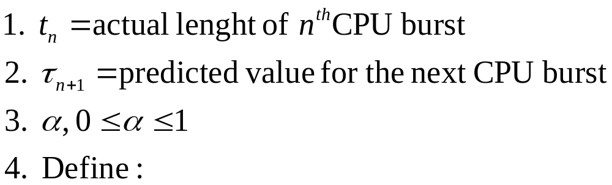
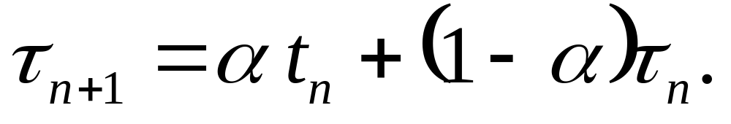

(The initial can be defined as a constant or as an overall system average)

Slide 25

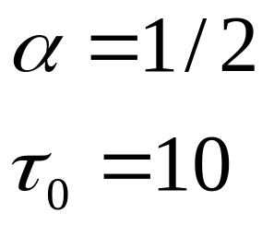
Prediction of the Length of the Next CPU Burst

Slide 26
Examples of Exponential Averaging
α =0
  τ_{n+1} = τ_{n}
  Recent history does not count.
α =1
  τ_{n+1} = t_{n}
  Only the actual last CPU burst counts.
If we expand the formula, we get:
    τ_{n+1} = α t_{n}+(1 - α) α t_{n} ₋₁ + …
    +(1 - α )^{j} α t_{n} _{-j} + …
    +(1 - α )^{n+1} τ₀
Since both α and (1 - α) are less than or equal to 1, each successive term has less weight than its predecessor.
<

Slide 27
Priority Scheduling
A priority number (integer) is associated with each process
The CPU is allocated to the process with the highest priority (smallest integer ≡ highest priority).
  Preemptive
  nonpreemptive
SJF is a priority scheduling where priority is the predicted next CPU burst time.

Slide 28
Priorities can be defined either internally or externally.
  Internally defined priorities use some measurable quantity or quantities to compute the priority of a process. (time limits, memory requirements, the number of open files, and the ratio of average I/O burst to average CPU burst,etc.)
  External priorities are set by criteria that are external to the operating system, (the importance of the process, the type and amount of funds being paid for computer use, the department sponsoring the work, and other, often political factors.)

Slide 29
Problem ≡ indefinite blocking (or starvation)
  – low priority processes may never execute.
Solution ≡ Aging
  – as time progresses increase the priority of the process.
<

Slide 30
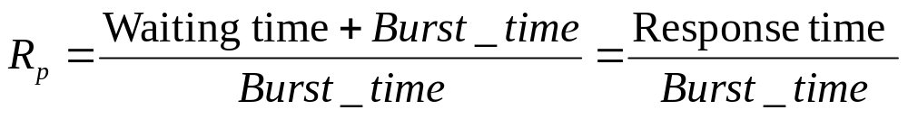
* Highest Response Ratio First
Highest Response Ratio First高响应比优先
  Response Ratio
  特征：
    如果作业的等待时间相同，则要求服务的时间愈短，其优先权愈高，因而该作业有利于短作业。
    当要求服务的时间相同时，作业的优先权决定于其等待时间，因而实现了先来先服务。
    对于长作业，当其等待时间足够长时，其优先权便可升到很高，从而也可获得处理机。

Slide 31
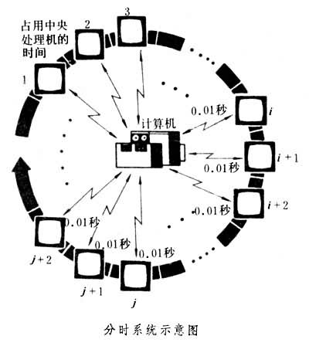
Round Robin Scheduling (RR)

Slide 32
Each process gets a small unit of CPU time (time quantum or time slice), usually 10-100 milliseconds. After this time has elapsed, the process is preempted and added to the end of the ready queue.
If there are n processes in the ready queue and the time quantum is q, then each process gets 1/n of the CPU time in chunks of at most q time units at once. No process waits more than (n-1)q time units.

Slide 33
Example of RR with Time Quantum = 20
Process Burst Time
P₁ 53
P₂ 17
P₃ 68
P₄ 24
The Gantt chart is:
P₁
P₂
P₃
P₄
P₁
P₃
P₄
P₁
P₃
P₃
0
20
37
57
77
97
117
121
134
154
162

Slide 34
The performance of the RR algorithm depends heavily on the size of the time quantum.
  q large ⇒ FIFO
  q small
    q must be large with respect to context switch, otherwise overhead is too high.
the RR approach is called processor sharing

Slide 35

Time Quantum and Context Switch Time

Slide 36
The average waiting time under the RR policy,is often quite long.
Typically, higher average turnaround than SJF, but better response.

Slide 37

Turnaround Time Varies With The Time Quantum
<

Slide 38
Multilevel Queue Scheduling
Multilevel Queue Scheduling has been created for situations in Which processes are easily classified into different groups.
  These types of processes have different response-time requirements, and so might have different scheduling needs.
Ready queue is partitioned into separate queues:
  foreground (interactive)
  background (batch)

Slide 39
The processes are permanently assigned to one queue
  generally based on some property of the process, such as memory size, process priority or process type.
Each queue has its own scheduling algorithm,
  foreground – RR
  background – FCFS

Slide 40

Scheduling must be done between the queues.
  Fixed priority scheduling
    i.e., serve all from foreground then from background
    Possibility of starvation
  Time slice
    – each queue gets a certain amount of CPU time which it can schedule amongst its processes
      i.e., 80% to foreground in RR
      20% to background in FCFS

Slide 41
highest priority
System processes
Interactive processes
Interactive editing processes
Batch processes
Student processes
lowest priority
Figure Multilevel queue scheduling.
<

Slide 42
Multilevel Feedback Queue Scheduling
A process can move between the various queues
  The idea is to separate processes with different CPU-burst characteristics; aging can be implemented this way.
quantum=8
quantum=16
FCFS
Figure Multilevel feedback queues.

Slide 43
Multilevel-feedback-queue scheduler defined by the following parameters:
  number of queues
  scheduling algorithms for each queue
  method used to determine when to upgrade a process to a higher-priority queue.
  method used to determine when to demote a process to a lower-priority queue
  method used to determine which queue a process will enter when that process needs service

Slide 44
Example of Multilevel Feedback Queue
Three queues:
  Q₀ – time quantum 8 milliseconds
  Q₁ – time quantum 16 milliseconds
  Q₂ – FCFS
Scheduling
  A new job enters queue Q₀ which is served FCFS. When it gains CPU, job receives 8 milliseconds. If it does not finish in 8 milliseconds, job is moved to queue Q₁.
  At Q₁ job is again served FCFS and receives 16 additional milliseconds. If it still does not complete, it is preempted and moved to queue Q₂.
<

Slide 45
■ Summary
CPU scheduling is the task of selecting a waiting process from the ready queue and allocating the CPU to it. The CPU is allocated to the selected process by the dispatcher.

Slide 46
First-come,first-served(FCFS) scheduling is the simplest scheduling algorithm, but it can cause short processes to wait for very long processes.
Shortest-job-first (SJF) scheduling is provably optimal, providing the shortest average waiting time. Implementing SJF scheduling is difficult because predicting the length of the next CPU burst is difficult. The SJF algorithm is a special case of the general priority-scheduling algorithm, which simply allocates the CPU to the highest priority process. Both priority and SJF scheduling may suffer from starvation. Aging is a technique to prevent starvation.

Slide 47
Round-robin (RR) scheduling is more appropriate for a time-shared (interactive) system. RR scheduling allocates the CPU to the first process in the ready queue for q time units, where q is the time quantum. After q time units, if the process has not relinquished the CPU, it is preempted and the process is put at the tail of the ready queue. The major problem is the selection of the time quantum. If the quantum is too large, RR scheduling degenerates to FCFS scheduling; if the quantum is too small, scheduling overhead in the form of context-switch time becomes excessive.

Slide 48
The FCFS algorithm is nonpreemptive; the RR algorithm is preemptive. The SJF and priority algorithms may be either preemptive or nonpreemptive.
Multilevel queue algorithms allow different algorithms to be used for various classes of processes. The most common is a foreground interactive queue, which uses RR scheduling, and a background batch queue, which uses FCFS scheduling. Multilevel feedback queues allow processes to move from one queue to another.

Slide 49
Exercises: 6.16

Slide 50
End of Chapter 6

