Slide 1

Chapter 2:
Operating-System Structures
Operating Systems

Slide 2

Chapter 2:
Operating-System Structures
2.1 Operating System Services
2.2 User and Operating-System Interface
2.3 System Calls
2.4 Types of System Calls
2.5 System Programs
2.6 Operating System Design and Implementation
2.7 Operating System Structure
Exercises
viewpoints of users
viewpoints of programmers
viewpoints of OS designers
Operating Systems

Slide 3


2.1 Operating System Services
提供给用户的服务:
  用户界面 UI—user interface
    命令行 （CLI —Command-Line Interface）,图形用户界面（GUI —Graphics User Interface）,批任务界面（Batch Interface）
  程序执行 Program execution
    系统必须能将程序加载到内存运行、终止执行
Operating Systems

Slide 4
  I/O操作 I/O operations
    A running program may require I/O, which may involve a file or an I/O device.
  文件系统操作 File-system manipulation
    programs need to read and write files and directories, create and delete them, search them, list file Information, permission management.
Operating Systems

Slide 5

  通信 Communications
    本机进程间或网络环境下不同主机的进程间交换信息 （exchange information）
      共享内存 shared memory
      消息传递 message passing
        packets moved by the OS
Operating Systems

Slide 6
  错误检测 Error detection
    操作系统必须经常地关注可能发生的错误（possible errors）
      可能会发生在CPU、memory hardware、 I/O devices、 user program
      对每种类型的错误，OS都要进行适当处理以确保正确的、一致性的计算（correct and consistent computing）
      调试工具（debugging facilities)能在很大程序上增强用户和程序员有效使用系统的能力。
Operating Systems

Slide 7
对系统本身的服务
  确保系统本身有效的资源共享操作
  资源分配 Resource allocation
    有些资源具有专门的分配代码（special allocation code）
      such as CPU cycles, main memory, and file storage
    而另外资源有通用的请求和释放代码（general request and release code）
      such as I/O devices
  账单 Accounting
    记录每个用户使用多少、何种类型的计算机资源
Operating Systems

Slide 8
  保护和安全 Protection and Security
    对于存储在多用户（multiuser）或联网计算机系统（networked computer system）中的信息，其拥有者可能想控制对信息的使用，并发进程（concurrent processes）不能相互干扰（interfere with each other）
    Protection
      确保所有对系统资源的访问是可控的
        ensuring that all access to system resources is controlled
    Security
      要求用户认证（user authentication），并防止对I/O设备的错误访问尝试（invalid access attempts）
    要使系统得到保护并保证安全，防范措施必须遍布整个系统
      If a system is to be protected and secure, precautions must be instituted throughout it.
Operating Systems

Slide 9
2.2 User and Operating-System
Interface
Command Interpreters 命令解释器
Graphical User Interfaces 图形用户接口
Operating Systems

Slide 10


2.3 System Calls
系统调用 System Call
  OS服务的编程接口（programming interface)
    通常用高级语言编写 (C or C++)
应用程序接口 API——Application Program Interface
  程序一般是通过API调用system call，而不是直接使用system call
  三种常用的API
    Win32 API for Windows
    POSIX API for POSIX-based systems (including virtually all versions of UNIX, Linux, and Mac OS X
    Java API for the Java virtual machine (JVM)
Operating Systems

Slide 11


  Example：the ReadFile() function in the Win32
    the parameters passed to ReadFile()
      HANDLE file—所要读取的文件句柄
      LPVOID buffer—读进写出的缓冲区
      DWORD bytesToRead—将要读入缓冲区中的字节数
      LPDWORD bytesRead—上次读操作读的字节数
      LPOVERLAPPED ovl—指示是否使用重叠I/O(overlapped I/O )
Operating Systems

Slide 12

API – System Call – OS Relationship
Operating Systems

Slide 13

  Standard C Library Example
    C program invoking printf() library call, which calls write() system call
Operating Systems

Slide 14
2.4 Types of System Calls
Process control 进程控制
File management 文件管理
Device management 设备管理
Information maintenance 信息维护
Communications 通信
Operating Systems

Slide 15
2.5 System Programs
系统程序为程序开发和执行提供了一个方便的环境
  其中一小部分只是系统调用的简单接口；其他的可能是相当复杂的。
分为如下几类:
  文件管理 File management
    Create, delete, copy, rename, print, dump(转储), list, and generally manipulate files and directories
Operating Systems

Slide 16
  状态信息 Status information
    从系统那里得到以下信息：date, time, amount of available memory, disk space, number of users
    提供详细的性能（performance）、登录（logging）和调试（debugging）信息
    有些系统还支持注册表（registry），用于存储和检索配置信息 （configuration information）
Operating Systems

Slide 17
  文件修改 File modification
    用于创建和修改文件的编辑器（editor）
    用于查找文件内容（contents of files）或完成文本转换（transformations of the text）的特殊命令（Special commands）
  编程语言支持 Programming-language support
    有时随操作系统提供：编译器（Compilers）、汇编程序（assemblers,）、调试程序（debuggers）和解释程序（interpreters ）
Operating Systems

Slide 18
  程序加载和执行 Program loading and execution
    绝对加载程序（Absolute loaders）、相对加载程序（relocatable loaders）、链接编辑器（linkage editors）和覆盖式加载程序（overlay-loaders
    高级语言和机器语言的调试系统（debugging systems for higher-level and machine language）
  通信 Communications
    提供在进程、用户和计算机系统之间建立虚拟连接的机制
Operating Systems

Slide 19
2.6 Operating System Design and Implementation
操作系统的设计和实现问题
  操作系统的设计和实现没有完整的解决方案，但有些方法证明是成功的。
    Design and Implementation of OS not “solvable”, but some approaches have proven successful
  不同操作系统的内部结构（Internal structure）有很大差别
  首要问题是定义系统的目标和规格（goals and specifications）
    受硬件以及系统类型的影响
Operating Systems

Slide 20
设计目标
  用户目标 User goals
    convenient to use, easy to learn, reliable, safe, and fast
  系统目标 System goals
    easy to design, implement, and maintain, as well as flexible, reliable, error-free, and efficient
Operating Systems

Slide 21
策略与机制
  策略（Policy）决定做什么；机制（ Mechanism）决定如何做。
  策略与机制剥离（separation）是一个非常重要的原理：
    将来改变策略时可获得最大的灵活性（maximum flexibility）
实现
  现在操作系统一般都是用高级语言编写
    Linux和Windows操作系统主要用C语言编写，少数主要用于设备驱动程序与保存和恢复寄存器状态的代码用汇编语言编写
    采用高级语言的好处与用高级语言编写应用程序类似。
Operating Systems

Slide 22
2.7 Operating-System Structure
操作系统的常用模块互连以组成内核的方法
  the way that the common components of OS are interconnected and melded into a kernel.
  目标：正确运行，易于修改
1. 简单结构 Simple Structure
  MS-DOS，UNIX
2. 分层方法 Layered Approach
3. 微内核 Microkernels
4. 模块化 Modules
Operating Systems

Slide 23
（1）简单结构 Simple Structure
MS-DOS
– written to provide the most functionality in the least space
  未划分成模块
    Not divided into modules
  尽管有一定的结构性，但其功能的接口和层次并未很好地分开
    Although MS-DOS has some structure, its interfaces and levels of functionality are not well separated
Operating Systems

Slide 24

MS-DOS Layer Structure
Operating Systems

Slide 25
UNIX
  – 受硬件功能的限制，早期的UNIX结构化很有限
    limited by hardware functionality, the original UNIX operating system had limited structuring.
Operating Systems

Slide 26
  UNIX OS 由两个独立的部分组成：
    系统程序 Systems programs
    内核 The kernel
      Consists of everything below the system-call interface and above the physical hardware
      Provides the file system, CPU scheduling, memory management, and other operating-system functions; a large number of functions for one level.
  大多数的功能都放在内核这一层。这使得UNIX难以增强，因为一部分的改动可能会对其他部分造成不利的影响。
Operating Systems

Slide 27

UNIX System Structure
Operating Systems

Slide 28
（2）分层方法 Layered Approach
操作系统分成若干层（级）
  The operating system is divided into a number of layers (levels)
  每层建立在较低层之上
    each built on top of lower layers.
  最底层（层0）是硬件；最高层（层N）是用户接口
    The bottom layer (layer 0), is the hardware; the highest (layer N) is the user interface.
  在模块化基础上，每层只能利用较低层的功能（操作）和服务
    With modularity, layers are selected such that each uses functions (operations) and services of only lower-level layers
Operating Systems

Slide 29

A layered Operating System
Operating Systems

Slide 30

An Operating System Layer
一个典型的操作系统层由数据结构和一组能被上一层调用的子程序集合所组成。
Operating Systems

Slide 31
好处 Benefits
  简化了调试和系统验证
困难 Difficulties
  对层的精确定义，因为一层只能使用其下的相邻层
缺点 Drawbacks
  与其他方法相比其效率较差。每层都为系统调用增加了额外开销
  补救 Remediaton
    使用数量更少而功能更多的分层设计。例如OS/2
Operating Systems

Slide 32
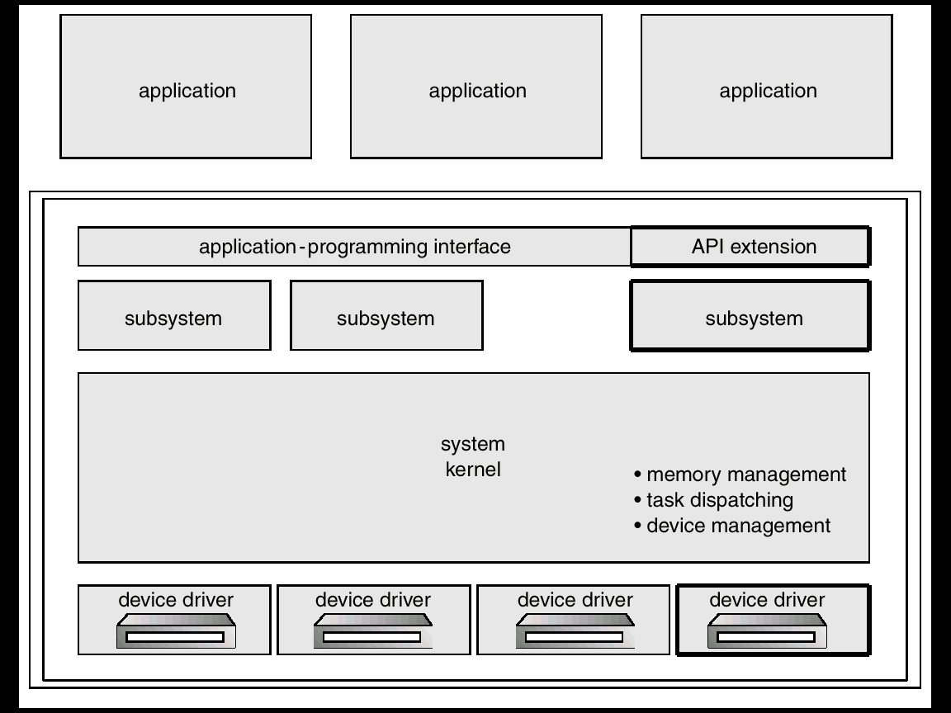
OS/2 Layer Structure
Operating Systems

Slide 33
（3）微内核 Microkernels
Moves as much from the kernel into “user” space
  微内核通常提供最小的进程和内存管理以及通信功能
  Communication takes place between user modules using message passing
好处 Benefits:
  Easier to extend a microkernel
  Easier to port the operating system to new architectures
  More reliable (less code is running in kernel mode)
  More secure
Operating Systems

Slide 34

损失 Detriments:
  Performance overhead of user space to kernel space communication
Examples
  Mach：20世纪80年代中期卡内基－梅隆大学研发
  Tru64 UNIX, Apple MacOS X, 实时操作系统QNX都是基于微内核的
  Windows NT采用混合结构：部分采用分层法，并结合微内核技术
Operating Systems

Slide 35

Windows NT Client-Server Structure
为每种类型的应用程序提供一个运行在用户空间的服务器。
内核协调客户应用程序和应用程序服务器之间的消息传递。
Operating Systems

Slide 36
（4）模块 Modules
现代操作系统实现模块化的内核（提供核心服务）
  Most modern operating systems implement kernel modules
  采用面向对象（object-oriented）的方法
  每个核心部件（core component）是独立的
  每个核心模块通过约定的接口访问其他模块
Operating Systems

Slide 37
动态实现特定的功能
  每个模块可在必要时加载到内核
  在启动时或运行时，都可动态连接附加的服务
    Dynamically links in additional services either during boot time or during run time.
总之，类似于分层，但更加灵活
  Overall, similar to layers but with more flexible
Operating Systems

Slide 38

Solaris Modular Approach
Operating Systems

Slide 39
Exercises
2.19 Why is the separation of mechanism and policy desirable?
2.21
  What is the main advantage of the microkernel approach to system design?
  How do user programs and system services interact in a microkernel architecture?
  What are the disadvantages of using the microkernel approach?
Operating Systems

Slide 40
End of Chapter 2
Operating Systems

