Slide 1
Part Two:
Process Management

Slide 2

Chapter 3 Processes 进程
Chapter 4 Threads 线程
Chapter 5 Process Synchronization 进程同步
Chapter 6 CPU Scheduling CPU调度
Chapter 7 Deadlocks 死锁

Slide 3
Chapter 3: Processes

Slide 4

CHAPTER OBJECTIVES
To introduce the notion of a process—a program in execution, which forms the basis of all computation.
To describe the various features of processes, including scheduling, creation, and termination.
To explore interprocess communication using shared memory and message passing.
To describe communication in client–server systems.

Slide 5

Chapter 3: Processes
3.1 Process Concept 进程概念
3.2 Process Scheduling 进程调度
3.3 Operations on Processes 进程操作
3.4 Interprocess Communication 进程间通信
3.5 Examples of IPC Systems
3.6 Communication in Client-Server Systems
客户端－服务器系统通信
3.7 Summary小结

Slide 6

3.1 Process Concept
what to call all the CPU activities
  Batch system – jobs
  Time-shared systems – user programs or tasks
  In many respects, all these activities are similar, so we call all of them processes
  Textbook uses the terms job and process almost interchangeably.

Slide 7

The Process
Process – a program in execution; process execution must progress in sequential fashion.
  进程：程序的一次执行; 进程执行必须以顺序方式推进
  The program code, also called text section
  Current activity including program counter, processor registers
  Stack containing temporary data
    Function parameters, return addresses, local variables
  Data section containing global variables
  Heap containing memory dynamically allocated during run time

Slide 8

Process in Memory

Slide 9
Comparison between Process and Program
  进程与程序的比较
  A program is a passive entity (executable file). a process is an active entity
    程序是静态实体，而进程是动态实体。
    Program becomes process when executable file loaded into memory

Slide 10
  two processes may be associated with the same program
    两个进程可能关联于同一个程序
  a process may spawn many processes as it runs
    一个进程运行期间往往会产生多个（子）进程
  a process itself can be an execution environment for other code
    Such as Java virtual machine (JVM)

Slide 11

Diagram of Process State
Process State
As a process executes, it changes state
  new: The process is being created.
  running: Instructions are being executed.
  waiting: The process is waiting for some event to occur.
  ready: The process is waiting to be assigned to a processor.
  terminated: The process has finished execution.

Slide 12
Process Control Block (PCB)
Information associated with each process (also called task control block)
Process state
  – running, waiting, etc
Program counter
  指示该进程将要执行的下一条指令的地址
CPU registers
  – contents of all process-centric registers
    累加器（accumulators）、索引寄存器（index registers）、栈指针（stack pointers）、通用寄存器（general-purpose registers）等等。

Slide 13
CPU scheduling information
  进程优先级（priority）、调度队列指针及其他调度参数。
Memory-management information
  base and limit registers的值, 页表或段表（page tables, or segment）
Accounting information
  CPU used, clock time elapsed since start, time limits
I/O status information
  the list of I/O devices allocated to this process, a list of open files, and so on

Slide 14

Process Control Block (PCB)

Slide 15

CPU Switch From Process to Process

Slide 16

Represented by the C structure task_struct
pid t_pid; /* process identifier */
long state; /* state of the process */
unsigned int time_slice /* scheduling information */
struct task_struct *parent; /* this process’s parent */
struct list_head children; /* this process’s children */
struct files_struct *files; /* list of open files */
struct mm_struct *mm; /* address space of this process */
Process Representation in Linux

Slide 17
Threads
So far, process has a single thread of execution
  a single thread of instructions is being executed
Consider having multiple program counters per process
  Multiple locations can execute at once
    Multiple threads of control -> threads
  Must then have storage for thread details, multiple program counters in PCB
  especially beneficial on multicore systems

Slide 18
4.2 Process Scheduling
Process scheduler selects among available processes for next execution on CPU

Slide 19
Scheduling Queues
Job queue – set of all processes in the system
  作业队列－－系统中所有进程的集合。
Ready queue – set of all processes residing in main memory, ready and waiting to execute
  就绪队列－－在内存、就绪并等待执行
Device queues – set of processes waiting for an I/O device
  设备队列－－等待某I/O设备的进程集合
Process migration between the various queues.

Slide 20

Ready Queue And Various I/O Device Queues

Slide 21
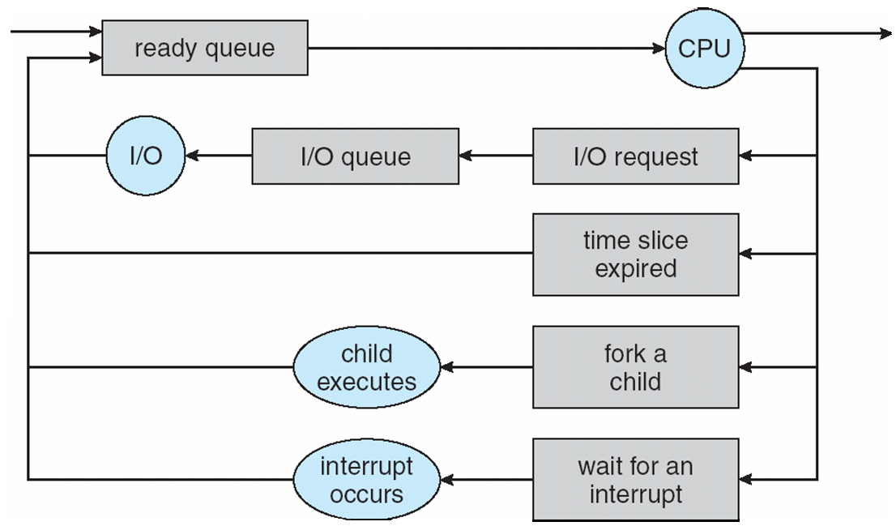
Queueing-diagram representation of process scheduling

Slide 22
Schedulers
A process migrates between the various scheduling queues throughout its lifetime
  一个进程在生命周期内不断地在不同调度队列间迁移
  The operating system must select, for scheduling purposes, processes from these queues in some fashion. The selection process is carried out by the appropriate scheduler
    操作系统必须根据调度目的从这些队列中按某种方式选择进程。这个选择过程由相应的scheduler来执行

Slide 23
Long-term scheduler (or job scheduler)
长程调度（作业调度）
  – selects which processes should be brought into the ready queue.
  Long-term scheduler is invoked infrequently (seconds, minutes) ⇒ (may be slow)
    长程调度调用较少（秒，分）＝>可以较慢
  The long-term scheduler controls the degree of multiprogramming
    长程调度控制着多道程序度

Slide 24
Short-term scheduler (or CPU scheduler, Process scheduler)
短程调度（CPU调度、进程调度）
  – selects which process should be executed next and allocates CPU.
  Sometimes the only scheduler in a system
  Short-term scheduler is invoked frequently (milliseconds) ⇒ (must be fast)
    短程调度程序调用十分频繁（毫秒）＝>必须快

Slide 25
Processes can be described as either:
  I/O-bound process I/O密集型进程
    spends more time doing I/O than computations, many short CPU bursts
  CPU-bound process 计算密集型进程
    spends more time doing computations; few very long CPU bursts

Slide 26
Long-term scheduler strives for good process mix
  长程调度力求合理的进程类型搭配
  If all processes are I/O-bound，the ready queue will almost always be empty, and the short－term scheduler will have little to do.
  If all processes are CPU bound, the I/O waiting queue will almost always be empty, devices will go unused，and again the system will be unbalanced.
  The system with the best performance will have a combination of CPU-bound and I／O-bound processes.

Slide 27
medium－term scheduler 中程调度
  removes processes from memory (and from active contention for the CPU), and thus reduces the degree of multiprogramming. At some later time, the process can be reintroduced into memory and its execution can be continued where it left off
    从内存（对CPU的争夺）中移除进程，从而降低多道程序度。后来某时，该进程会被重新引入内存并从离开时的位置继续执行

Slide 28

Addition of Medium Term Scheduling

Slide 29
  This scheme is called swapping（交换）.
    The process is swapped out, and is later swapped in, by the medium-term scheduler.
    Swapping may be necessary to improve the process mix, or because a change in memory requirements has overcommitted available memory, requiring memory to be freed up.

Slide 30
Context Switch 上下文切换
CPU Switch From Process to Process

Slide 31
context switch
  When CPU switches to another process, the system must save the state of the old process and load the saved state for the new process.
context
  The context of a process is represented in the PCB of a process; it includes the value of the CPU registers, the process state, and memory-management information.
Context-switch time is overhead
  Time dependent on hardware support

Slide 32
3.3 Operations on Processes
The processes in the system can execute concurrently, and they must be created and deleted dynamically. Thus, the operating system must provide a mechanism (or facility) for process creation and termination.
系统中的进程能够并发运行，且必须动态地创建和删除。因此，操作系统必须提供进程创建和终止的机制（或工具）
Process Creation 进程创建
Process Termination 进程终止

Slide 33
Process Creation
Parent process create children processes, which, in turn create other processes, forming a tree of processes
  父进程创建子进程，子进程进而创建其它进程，从而形成一棵进程树

Slide 34

A Tree of Processes in Linux

Slide 35
Resource sharing 资源共享
  Parent and children share all resources.
  Children share subset of parent’s resources.
  Parent and child share no resources.

Slide 36
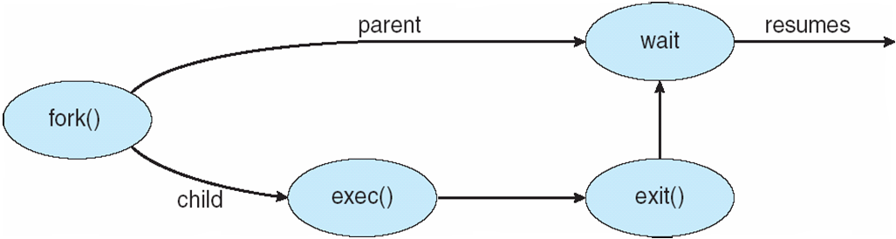
Execution执行
  Parent and children execute concurrently.
  Parent waits until children terminate.

Slide 37
Address space 地址空间
  Child duplicate of parent.
  子进程是父进程的副本。
  Child has a program loaded into it.
  子进程有加载程序进入（其地址空间）

Slide 38
UNIX examples （例，UNIX）
  fork system call creates new process
  系统调用fork创建新进程
  exec system call used after a fork to replace the process’ memory space with a new program.
  在一个fork系统调用之后，系统调用exec以一个新的程序替换进程的内存空间。

Slide 39
Process Termination
Process executes last statement and asks the operating system to decide it (exit).
进程执行最后一个语句之后（使用系统调用exit ）请求操作系统决定（终止）
  Output data from child to parent (via wait).
  子进程输出数据到父进程（通过系统调用wait ）
  Process’ resources are deallocated by operating system.
  由操作系统回收进程的资源。

Slide 40


Parent may terminate execution of children processes (abort)
父进程可以终止子进程的执行（系统调用 abort ）。
  Child has exceeded allocated resources.
  子进程使用了超过它所分配到的资源。
  Task assigned to child is no longer required.
  分派给子进程的任务不再需要。
  Parent is exiting.
  父进程要退出。
    Operating system does not allow child to continue if its parent terminates.
    如果父进程终止，操作系统不允许其子进程继续。
      Cascading termination.
    级联终止。

Slide 41
3.4 Inter-process Communication (IPC)
Processes within a system may be independent or cooperating
  Independent process cannot affect or be affected by the execution of another process
    Any process that does not share data with any other process is independent
  Cooperating process can affect or be affected by the execution of another process
    any process that shares data with other processes is a cooperating process

Slide 42
Reasons for cooperating processes:
  Information sharing 信息共享
  Computation speed-up 计算加速
    If we want a particular task to run faster, we must break it into subtasks, each of which will be executing in parallel with the others. Such a speedup can be achieved only if the computer has multiple processing elements (such as CPUs or I/O channels)
  Modularity 模块化
    We may want to construct the system in a modular fashion, dividing the system functions into separate processes or threads
  Convenience 方便性
    Even an individual user may have many tasks on which to work at one time. For instance, a user may be editing, printing, and compiling in parallel

Slide 43
Interprocess Communication (IPC)
  ——Two models of IPC
  Shared memory 共享内存
    Allows maximum speed and convenience of communication, as it can be done at memory speeds when within a computer.
    Faster than message passing
      since message-passing systems are typically implemented using system calls
  Message passing 消息传递
    Useful for exchanging smaller amounts of data, because no conflicts need be avoided.
    Easier to implement for inter-computer communication than shared memory

Slide 44
  Message passing provides better performance than shared memory on multi-core system
    在多核系统中，消息传递的性能高于共享内存

Slide 45
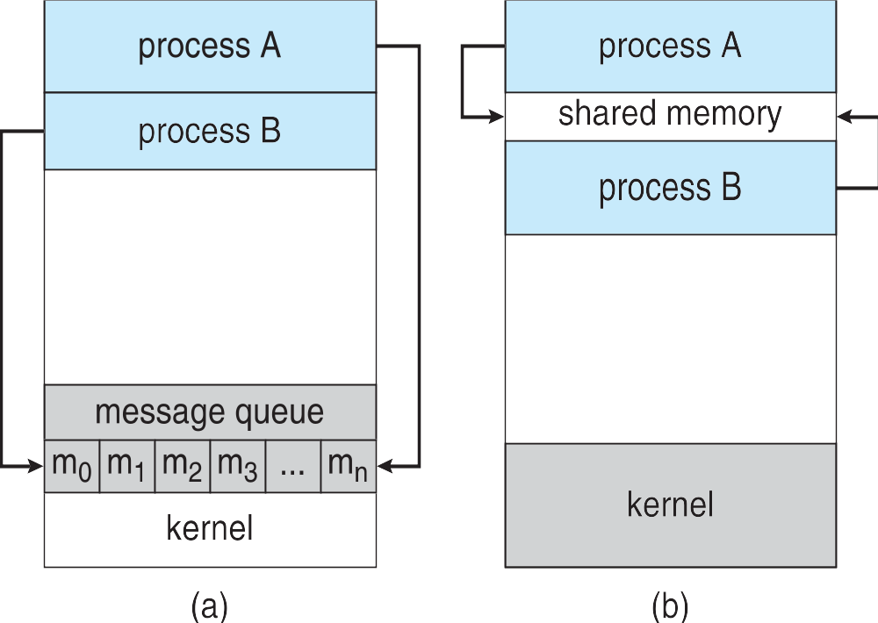
Communications models
(a) Message passing. (b) Shared memory

Slide 46
Shared-Memory Systems 共享内存系统
Shared-memory region 共享内存区域
  Location 位置
    Typically, a shared-memory region resides in the address space of the process creating the shared-memory segment.
    Other processes that wish to communicate using this shared-memory segment must attach it to their address space.
  Restriction 约束
    normally, the operating system tries to prevent one process from accessing another process’s memory.
    Shared memory requires that two or more processes agree to remove this restriction.

Slide 47
  The form of the data and the location
    determined by these cooperating processes and are not under the operating system’s control.
  Synchronization 同步
    The processes are responsible for ensuring that they are not writing to the same location simultaneously

Slide 48
Producer-Consumer Problem 生产者-消费者问题
  unbounded-buffer places no practical limit on the size of the buffer.
    无限缓冲区对缓冲区的大小未加实际限制
  bounded-buffer assumes that there is a fixed buffer size
    有限缓冲区假设固定大小的缓冲区

Slide 49

  bounded buffer
in,out
#define BUFFER_SIZE 10
Typedef struct {
. . .
} item;
item buffer[BUFFER_SIZE];
int in = 0;
int out = 0;

Slide 50
  Producer Process
item next produced;
while (true)
{
  /* produce an item in next produced */
  while (((in + 1) % BUFFER SIZE) == out)
    ; /* do nothing */
  buffer[in] = next produced;
  in = (in + 1) % BUFFER SIZE;
}

Slide 51
  Consumer Process
item next consumed;
while (true)
{
  while (in == out)
    ; /* do nothing */
  next consumed = buffer[out];
  out = (out + 1) % BUFFER SIZE;
  /* consume the item in next consumed */
}

Slide 52
  Solution is correct, but can only use BUFFER_SIZE-1 elements
    方案正确，但仅能利用BUFFER_SIZE-1个元素
  The scheme requires that these processes share a region of memory and that the code for accessing and manipulating the shared memory be written explicitly by the application programmer.
    该方案要求进程共享一个内存域，并且访问/操作共享内存的代码需要程序员显式地写出来
  Synchronization 同步问题

Slide 53

Message-Passing Systems
消息传递系统
Message passing provides an mechanism to allow processes to communicate and to synchronize their actions without sharing the same address space and is particularly useful in a distributed environment.
  消息传递系统提供了一种机制，允许进程通信、同步它们的行为。该机制不需要共享同一地址空间，尤其适用于分布式环境。
  An example: a chat program used on the World Wide Web.

Slide 54
A message-passing facility provides at least two operations:
  send(message) – message size fixed or variable
  receive(message)
If P and Q wish to communicate, they need to:
  establish a communication link between them
    之间建立一个通信连接
  exchange messages via send/receive
    通过send/receive交换消息。

Slide 55
Implementation of communication link 通信连接的实现
  physical implementation 物理实现
    (e.g., shared memory, hardware bus or network)
  logical implementation 逻辑实现
    (e.g., logical properties)

Slide 56
Implementation issues 实现问题
  How are links established? 连接如何建立
  Can a link be associated with more than two processes? 一个连接能否关联两个以上进程
  How many links can there be between every pair of communicating processes? 每对通信进程间可存在多少个连接
  What is the capacity of a link? 连接的容量
  Is the size of a message that the link can accommodate fixed or variable? 消息是定长的还是变长的
  Is a link unidirectional or bi-directional? 连接是单向的还是双向的

Slide 57
Methods for logically implementing a link and the send() / receive() operations
  连接逻辑实现的方法及send/receive操作
  Direct or indirect communication—Naming
    直接/间接通信——命名
  Synchronous or asynchronous communication--Synchronization
    同步/异步通信——同步
  Automatic or explicit buffering—Buffering
    自动/显式缓冲——缓冲

Slide 58
Naming 命名
Processes that want to communicate must have a way to refer to each other. They can use either direct or indirect communication
  要通信的两个进程必须有一种方法指定彼此—直接/间接通信

Slide 59
Direct Communication
Each process that wants to communicate must explicitly name the recipient or sender of the communication.
  Symmetry in addressing 对称寻址
    processes must name each other explicitly
    send (P, message) – send a message to process P
    receive(Q, message) – receive a message from process Q
  Asymmetry in addressing 非对称寻址
    only the sender names the recipient; the recipient is not required to name the sender
    send (P, message) – send a message to process P
    receive (id, message) – receive a message from any process; the variable id is set to the name of the process with which communication has taken place.

Slide 60
    Disadvantage 缺陷
      the limited modularity of the resulting process definitions. Changing the identifier of a process may necessitate examining all other process definitions.
      进程定义的模块性受到限制：要改变一个进程的id，必须检查所有其他进程的定义

Slide 61
Properties of communication link 通信连接的属性
  Links are established automatically.
    连接自动建立。
  A link is associated with exactly one pair of communicating processes
    一个连接严格地关联一对通信进程
  Between each pair of processes, there exists exactly one link
    每对进程仅存在一个连接
  The link may be unidirectional, but is usually bi-directional
    连接可以是单向的，但通常是双向的

Slide 62
Indirect Communication
Messages are directed and received from mailboxes (also referred to as ports)
  消息被发往邮箱（或端口）并从邮箱（端口）接收
  A mailbox can be viewed abstractly as an object into which messages can be placed by processes and from which messages can be removed.
  Each mailbox has a unique id.
  Processes can communicate only if they share a mailbox.
Primitives are defined as: 原语的定义
  send(A, message) – send a message to mailbox A
  receive(A, message) – receive a message from mailbox A

Slide 63
Properties of communication link 通信连接的属性
  Link established only if processes share a common mailbox
  A link may be associated with many processes.
  Each pair of processes may share several communication links.
  Link may be unidirectional or bi-directional.

Slide 64
Mailbox sharing
  P₁, P₂, and P₃ share mailbox A.
  P₁, sends; P₂ and P₃ receive.
  Who gets the message?
Solutions
  Allow a link to be associated with at most two processes.
  Allow only one process at a time to execute a receive operation.
  Allow the system to select arbitrarily the receiver. Sender is notified who the receiver was.

Slide 65
A mailbox may be owned either by a process or by the OS.
  邮箱可以由进程或操作系统所拥有
  Owned by a process
    that is, the mailbox is part of the address space of the process, then we distinguish between the owner and the user.
    即邮箱是进程地址空间的一部分，那么要区分拥有者（能通过邮箱接收消息）和使用者（只能向邮箱发送消息）。拥有者进程终止，则邮箱消失。
  Owned by the OS
    由操作系统所拥有的邮箱是独立的，不属于任何特定的进程。因此，操作系统必须提供机制，以允许进程进行如下操作:
      create a new mailbox
      send and receive messages through mailbox
      destroy a mailbox

Slide 66
Synchronization 同步
Message passing may be either blocking or non-blocking
  消息传递可以是阻塞或非阻塞
Blocking is considered synchronous
  阻塞称为同步
  Blocking send has the sender block until the message is received
  Blocking receive has the receiver block until a message is available

Slide 67
Non-blocking is considered asynchronous
非阻塞称为异步
  Non-blocking send has the sender send the message and continue
  Non-blocking receive has the receiver receive a valid message or null

Slide 68
send and receive primitives may be either blocking or non-blocking
    send 和 receive 原语可以是阻塞的或非阻塞的
  当send和receive都阻塞时，则发送者和接收者之间就有一个集合点（rendezvous）

Slide 69
Buffering 缓冲
Queue of messages attached to the link; implemented in one of three ways
  消息队列关联于连接；以下列三种方式之一实现
  Zero capacity – 0 messages 0容量－0消息
    Sender must wait for receiver (rendezvous).
  Bounded capacity – finite length of n messages
  有限容量－－有限长度的n个消息
    Sender must wait if link full.
  Unbounded capacity – infinite length 无限容量－无限长度
    Sender never waits

Slide 70
3.5 Examples of IPC Systems
–– Windows
Message-passing centric via advanced local procedure call (LPC) facility
  Only works between processes on the same system
  Uses ports (like mailboxes) to establish and maintain a connection

Slide 71
  Communication works as follows:
    Server processes publish connection-port objects that are visible to all
    The client opens a handle to the subsystem’s connection port object.
    The client sends a connection request.
    The server creates two private communication ports and returns the handle to one of them to the client.
    The client and server use the corresponding port handle to send messages or callbacks and to listen for replies.

Slide 72

Local Procedure Calls in Windows

Slide 73
3.6 Client-Server Communication
Sockets 套接字
Remote Procedure Calls 远程过程调用
Pipes 管道

Slide 74
Sockets 套接字
Socket
  an endpoint for communication 通信的端点
  IP : port
    port – a number included at start of message packet to differentiate network services on a host

Slide 75
Servers
  implementing specific services listen to well-known ports
  服务器实现的特定服务是通过监听熟知的端口进行的
    a telnet server listens to port 23
    an ftp server listens to port 21
    a web (or http) server listens to port 80
  All ports below 1024 are considered well known; we can use them to implement standard services
  所有低于1024的端口都认为是众所周知的，可以用它们来实现标准服务
  Special IP address 127.0.0.1 (loopback) to refer to system on which process is running

Slide 76
Client
  When a client process initiates a request for a connection, it is assigned a port by the host computer. This port is some arbitrary number greater than 1024.
  当客户机进程发出一个连接请求时，它被主机赋予一个端口。该端口是大于1024的某个任意数。

Slide 77
Example:
A client on host X with IP address 146.86.5.20 wishes to establish a connection with a web server (which is listening on port 80) at address 161.25.19.8, host X may be assigned port 1625.
The connection will consist of a pair of sockets: (146.86.5.20:1625) on host X and (161.25.19.8:80) on the web server. (Figure).
The packets traveling between the hosts are delivered to the appropriate process, based on the destination port number.
根据目的端口号，在主机间传输的数据包可分送给合适的进程。

Slide 78
Communication consists between a pair of sockets.
连接存在于一对套接字之间
All connections consist of a unique pair of sockets
所有连接都有一对唯一的套接字

Slide 79

Socket Communication
<

Slide 80
Communication using sockets 套接字通信
  common and efficient
  a low-level form of communication between distributed processes
  分布式进程间的低级通信形式
    sockets allow only an unstructured stream of bytes to be exchanged between the communicating threads. It is the responsibility of the client or server application to impose a structure on the data.

Slide 81
Remote Procedure Calls
远程过程调用
Remote procedure call (RPC)
  abstracts procedure calls between processes on networked systems
    RPC设计成抽象过程调用机制，用于通过网络进行连接的系统
  在许多方面都类似于IPC机制，并且通常建立在这种系统之上
  must use a message-based communication scheme to provide remote service
    必须采用基于消息的通信方案来提供远程服务

Slide 82
the messages exchanged in RPC communication
  are well structured
  Each message is addressed to an RPC daemon（后台） listening to a port on the remote system, and each contain an identifier of the function to execute and the parameters to pass to that function. The function is then executed as requested, and any output is sent back to the requester in a separate message
    每个消息被传递给远程系统监听端口的RPC后台，它们包含要执行函数的名称和传递给该函数的参数。然后该函数根据请求而执行，任何输出结果通过另一个消息送回给请求者

Slide 83
Port
  A port is simply a number included at the start of a message packet
    端口只是包含在消息包开头的数字
  a system normally has one network address, it can have many ports within that address to differentiate the many network services it supports
    系统通常有一个网络地址，可对应多个端口以区分不同的网络服务
  If a remote process needs a service, it addresses its messages to the proper port
    如果远程进程需要一个服务，则发送消息到相应的端口

Slide 84
  The semantics of RPCs allows a client to invoke a procedure on a remote host as it would invoke a procedure locally. The RPC system hides the details that allow communication to take place by providing a stub on the client side
  RPC允许客户机调用位于远程主机上的过程，就如同调用本地过程一样。RPC系统通过在客户机端提供存根（stub）来做到这一点

Slide 85
Stubs 存根
  client-side proxy（代理） for the actual procedure on the server
    Typically, a separate stub exists for each separate remote procedure.
      典型地，每个远程过程有一个独立的存根
    When the client invokes a remote procedure, the RPC system calls the appropriate stub, passing it the parameters provided to the remote procedure
      当客户端调用远程过程时，RPC系统调用相应的存根，并将提供给远程过程的参数传递给它

Slide 86
  The client-side stub locates the port on the server and marshalls（编组） the parameters, then transmits a message to the server using message passing.
  The server-side stub receives this message, unpacks the marshalled parameters, and peforms the procedure on the server
    If necessary, return values are passed back to the client using the same technique

Slide 87
Issues
  differences in data representation on the client and server machines 客户端和服务器端 数据表示的不同
  the semantics of a call 调用语义
    the operating system to ensure that messages are acted on exactly once
  the communication between a server and a client
    the binding of the client and the server port
    客户端、服务器端口的绑定

Slide 88
Pipes 管道
Acts as a conduit allowing two processes to communicate
  （管道）作为两个进程通信的渠道
Issues:
  Is communication unidirectional or bidirectional? 单向 or 双向
  In the case of two-way communication, is it half or full-duplex?
    在双向通信中，半双工 or 全双工
  Must there exist a relationship (i.e., parent-child) between the communicating processes?
    通信进程间是否必须存在某种关系（父子关系）
  Can the pipes be used over a network? 能否用于网络环境

Slide 89
Two common types of pipes
  Ordinary pipes 普通管道
    cannot be accessed from outside the process that created it. Typically, a parent process creates a pipe and uses it to communicate with a child process that it created.
  Named pipes 命名管道
    can be accessed without a parent-child relationship.

Slide 90

Ordinary Pipes 普通管道
  Ordinary Pipes allow communication in standard producer-consumer style
  Producer writes to one end (the write-end of the pipe)
  Consumer reads from the other end (the read-end of the pipe)

Slide 91
  Ordinary pipes are therefore unidirectional
  Require parent-child relationship between communicating processes
  Windows calls these anonymous pipes
  See Unix and Windows code samples in textbook

Slide 92
Named Pipes 命名管道
  Named Pipes are more powerful than ordinary pipes
  Communication is bidirectional
  No parent-child relationship is necessary between the communicating processes
  Several processes can use the named pipe for communication
  Provided on both UNIX and Windows systems

Slide 93
3.7 Summary
A process is a program in execution. As a process executes, it changes state. The state of a process is defined by that process' current activity. Each process maybe in one of the following states: new ready, running, waiting, or terminated.Each process is represented in the operating system by its own process-control-block (PCB).
进程是执行中的程序。随着进程的执行，它改变状态。进程状态由当前活动所定义。每个进程可处于下列状态之一：新建、就绪、运行、等待或终止。每个进程在操作系统内通过自己的进程控制块来表示。

Slide 94
A process, when it is not executing, is placed in some waiting queue. The two major classes of queues in an operating system are I/O request queues and the ready queue. Each process is represented by a PCB, and the PCBs can be linked together to form a ready queue. Long-term(or job) scheduling is the selection of processes to be allowed to contend for the CPU. Normally, long-term scheduling is heavily influenced by resource allocation considerations, especially memory management. Short-term (or CPU) scheduling is the selection of one process from the ready queue.
当前不在执行的进程被放在某个等待队列中。操作系统的两个主要队列类型是I/O请求队列和就绪队列。就绪队列包括所有就绪可执行的并等待CPU的进程。每个进程都由PCB来表示，PCB链接起来就形成了一个就绪队列。长程（或作业）调度选择进程来竞争CPU。通常，长程调度会受资源分配考虑严重影响，尤其是内存管理的影响。短程（或CPU）调度从就绪队列中选择进程。

Slide 95
The processes in the system can execute concurrently. There are several reasons for allowing concurrent execution: information sharing, computation speedup, modularity, and convenience. Concurrent execution requires mechanisms for process creation and deletion.
系统内的进程能并发执行。有许多理由允许并发执行：信息共享，加快计算，模块化和方便性。并发执行需要创建和终止进程的机制。

Slide 96
The processes executing in the operating system may be either independent processes or cooperating processes. Cooperating processes must have the means to communicate with each other. Principally, two complementary communication schemes exist: shared memory and message systems.
操作系统中的执行进程可以是独立进程或协作进程。协作进程要有互相通信的机制。主要存在两种互补的通信形式：共享内存和消息系统。

Slide 97
The shared-memory method requires communicating processes to share some variables. The processes are expected to exchange information through the use of these shared variables. In a shared-memory system, the responsibility for providing communication rests with the application programmers; the operating system needs to provide only the shared memory. The message-system method allows the processes to exchange messages. The responsibility for providing communication may rest with the operating system itself. These two schemes are not mutually exclusive, and can be used simultaneously within a single operating system.
共享内存方法要求通信进程共享一些变量。进程通过使用这些共享变量来交换信息。对于共享内存系统，提供通信的责任主要在于应用程序员；操作系统只需要提供共享内存。 消息系统方法允许进程交换信息。提供通信的主要责任在于操作系统本身。 这两种方法并不互相排斥，能在同一操作系统内同时实现。

Slide 98
A socket is defined as an endpoint for communication. A connection between a pair of applications consists of a pair of sockets, one at each end of the communication channel.RPCs are another form of distributed communication.An RPC occurs when a process (or thread) calls a procedure on a remote application. RMI is the Java version of an RPC. RMI allows a thread to invoke a method on a remote object just as it would invoke a method on a local object.The primary distinction between RPCs and RMIs is that the data being passed to a remote procedure are in the form of an ordinary data structure. RMI allows objects to be passed in remote method calls.

Slide 99
End of Chapter 3

