Slide 1

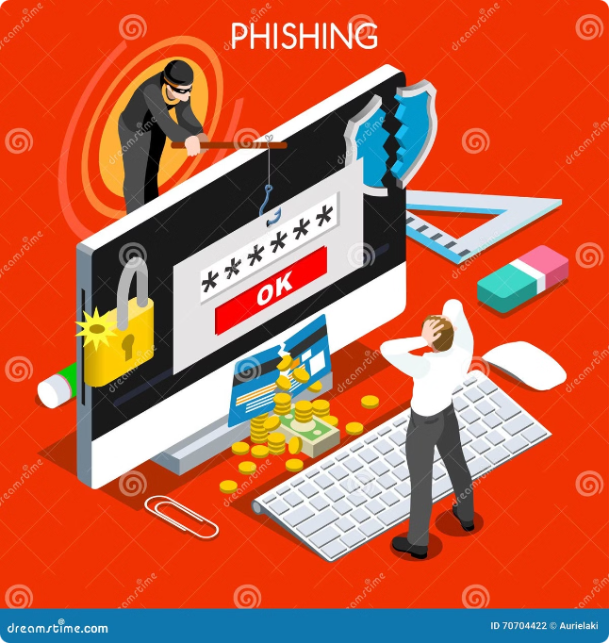
Introduction to Phishing Attacks
Phishing attacks are a common cybersecurity threat where scammers try to trick you into revealing sensitive information or installing malware. Understanding how phishing works is the first step to protecting yourself and your organization.

Slide 2
Understanding Phishing Tactics
Deceptive Emails
Fake Websites
Social Engineering
Phishers send convincing emails that appear to be from legitimate companies or contacts, enticing you to click malicious links or download infected files.
Scammers create websites that closely resemble real ones to steal your login credentials or other personal data.
Phishers use psychological manipulation to influence your behavior, such as creating a false sense of urgency or authority.

Slide 3
Identifying Phishing Emails
Sender Address
Suspicious Links
Urgent Requests
Carefully inspect the email address - it may look similar to a real one but have slight differences.
Hover over any links to see the actual URL before clicking. Phishing links often have random characters or look unfamiliar.
Be wary of emails that create a false sense of urgency, such as threatening account suspension or promising reward.

Slide 4





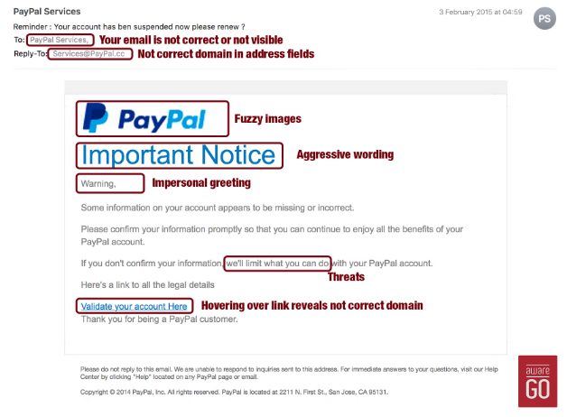
Recognizing Phishing Websites
HTTPS
SSL Certificate
Look for the "https://" prefix, which indicates a secure connection. Phishing sites often lack this.
Verify the website has a valid SSL certificate to ensure it's legitimate.
Strange Domain
Suspicious Forms
Be suspicious of domains that don't match the company's official website.
Avoid entering sensitive information on pages with unusual or excessive form fields.

Slide 5

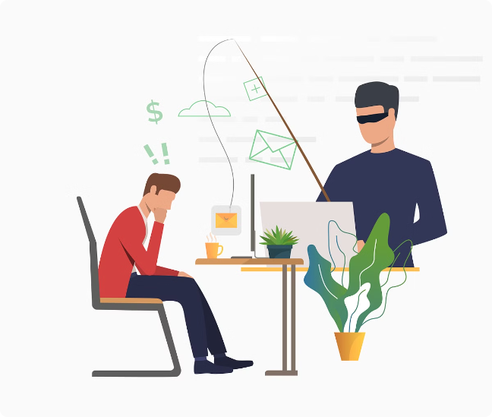



Protecting Against Social Engineering
Question Requests
If asked to share sensitive information, verify the legitimacy of the request before responding.
Validate Identity
Confirm the identity of the person contacting you, even if they claim to be a supervisor or authority figure.
Trust Your Instincts
If something feels off, don't hesitate to double-check or refuse the request.

Slide 6

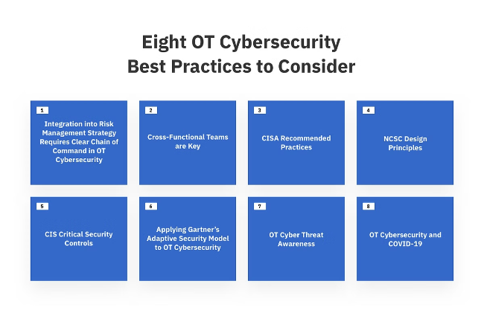
Best Practices for Avoiding Phishing
Cybersecurity Training
Verify Before Clicking
Educate yourself and your team on the latest phishing techniques and how to identify them.
Always double-check the source before opening links or attachments, even if they appear to be from a trusted contact.
Use Cybersecurity Tools
Backup Data Regularly
Leverage antivirus software, firewalls, and email filtering to help detect and block phishing attempts.
Maintain regular backups of your important data in case of a successful phishing attack.

Slide 7

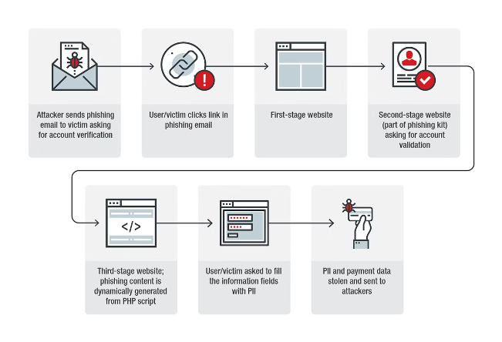
Reporting and Responding to Phishing
1
Identify
Recognize the signs of a phishing attempt and don't interact with the malicious content.
2
Report
Notify your organization's IT or security team, and forward the phishing email to the appropriate authorities.
3
Respond
If you've already provided sensitive information, immediately change any affected passwords and monitor your accounts for suspicious activity.

Slide 8

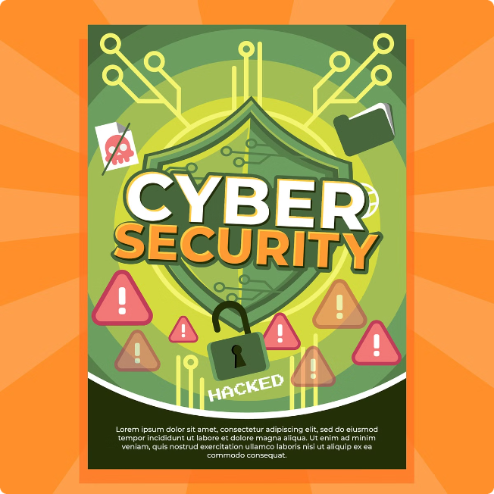
Conclusion and Key Takeaways
1
Phishing Awareness
2
Vigilance and Caution
Staying informed about the latest phishing tactics is crucial to protecting yourself and your organization.
Always exercise caution when dealing with unsolicited emails, links, or requests for sensitive information.
3
Proactive Measures
4
Reporting and Response
Implementing robust cybersecurity measures and training can significantly reduce the risk of falling victim to a phishing attack.
Quickly identifying and reporting phishing attempts, as well as taking appropriate actions, can mitigate the potential damage.

