Slide 1
Web-Server-Application
FanYuting
S17160474

Slide 2


Slide 3


Slide 4
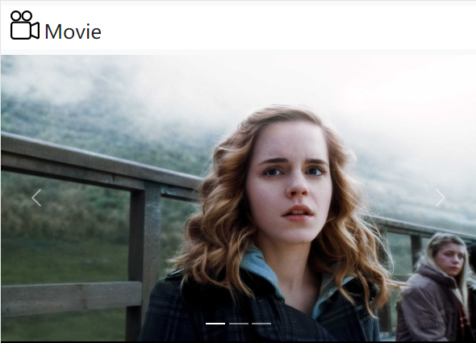

Slide 5
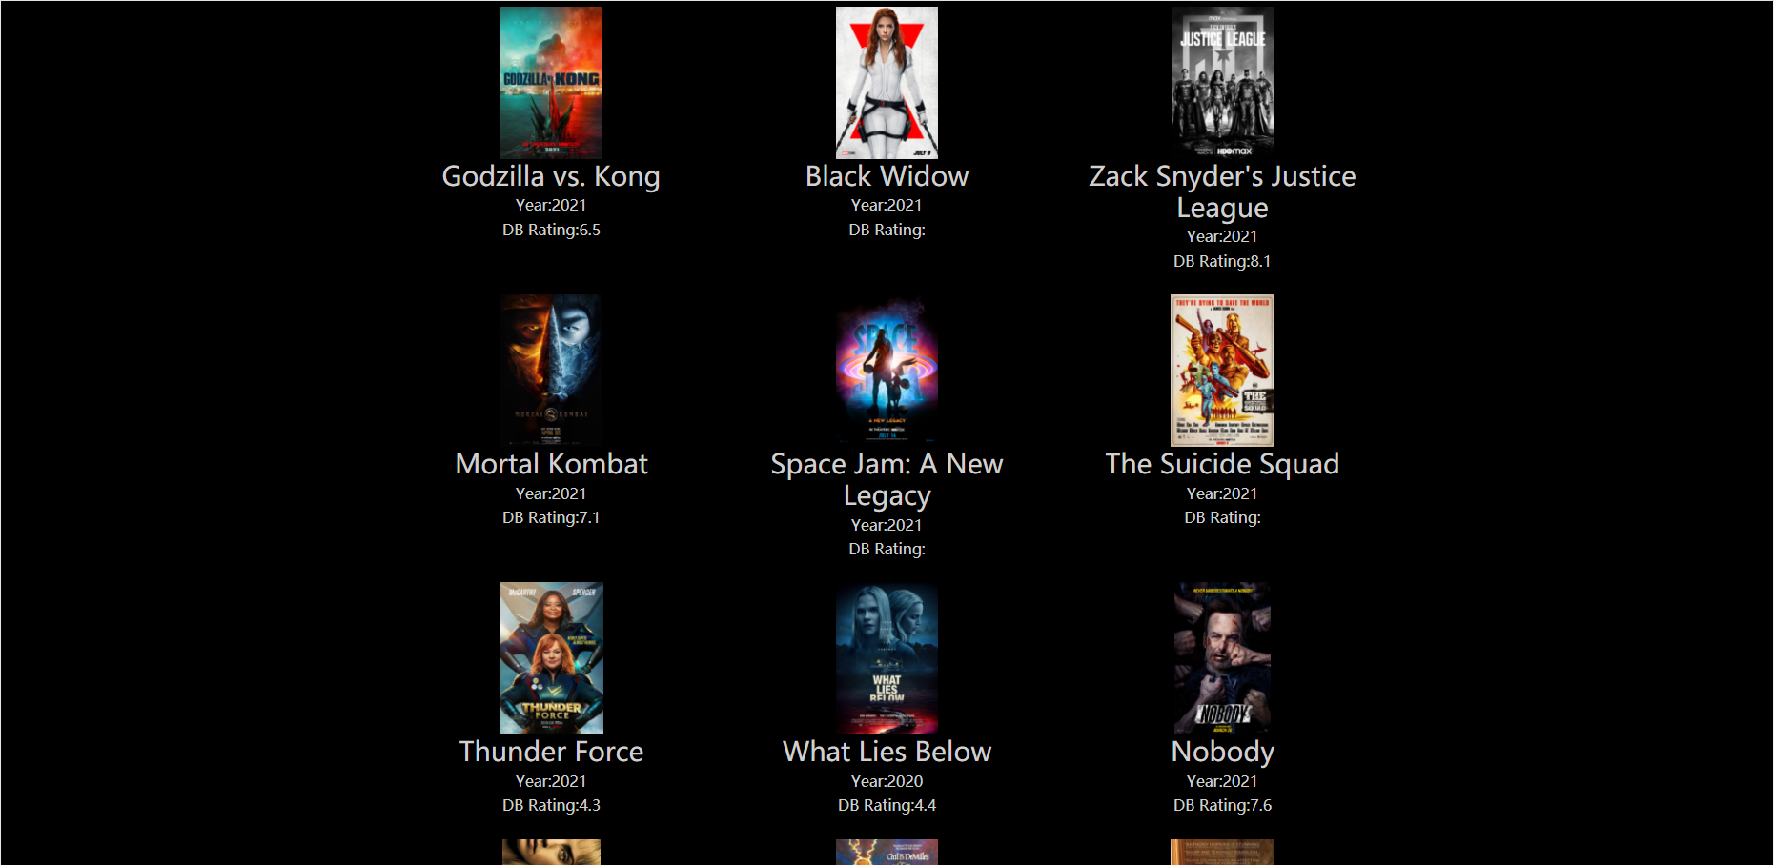

Slide 6
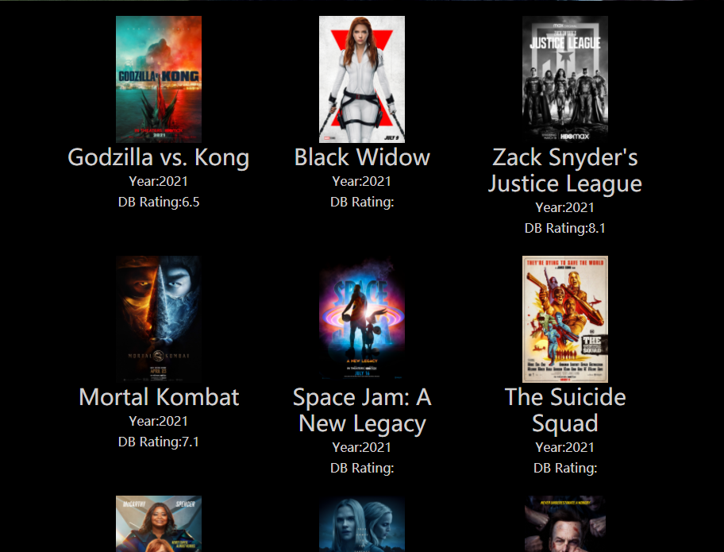

Slide 7


