Slide 1

ShopEase
30-Post Social Media Campaign
Ready-to-publish designs and copy — web development, SEO & content, and Easypaisa / JazzCash payment integration
shopeasepay.com · fb.com/Shopeasepay · August 2026

Slide 2
Brand System
One visual language across all 30 posts
Midnight Navy
Growth Teal
Signal Amber
Mist Gray
Slate
#0A1F44
#00B3A4
#FFB100
#F4F6FA
#5A6B85
Primary background · headlines
Brand accent · icons · wordmark
CTA buttons · stat callouts
Light backgrounds · cards
Secondary text on light
Typography
Voice
Poppins — headlines & display (SemiBold / Bold, tight leading) Inter — body, labels & captions Noto Nastaliq Urdu — optional Urdu accents on Facebook (This deck previews with Arial/Calibri; production artwork uses the faces above.)
Lead with the reader's business outcome, never the tool.
Confident and warm — zero hype words.
Partnership language: “we build with you.”
One CTA per caption; 4–8 Pakistan-market hashtags.

Slide 3
Eight Layout Templates
Every post uses one archetype — build each once in Canva or Figma, then reuse
A
Bold Statement
B
Stat Spotlight
Full-bleed gradient, oversized headline, amber CTA chip
One huge number in teal or amber; claim beneath
C
Carousel
D
Testimonial Card
Gradient cover, numbered slides, CTA slide to close
Giant quote mark, amber stars, client row
E
Checklist
F
Split Panel
Teal check-circles; amber bar on the key row
Myth vs. fact / before vs. after, ✕ and ✓ panels
G
Device Mockup
H
CTA Banner
Laptop or phone frame with annotated UI
Navy ground, benefit checks, large amber button

Slide 4
10-Week Posting Calendar
Three posts per week, rotating pillars — never all-sales, never all-education
Weeks 1–2
Posts 1 · 7 · 13 + 2 · 8 · 25
Anchor statements, first carousels, first CTA
Weeks 3–4
Posts 3 · 9 · 14 + 4 · 10 · 26
Stats, checklists, and the free-audit offer
Weeks 5–6
Posts 5 · 11 · 15 + 6 · 12 · 16
Depth on all three service pillars
Weeks 7–8
Posts 19 · 20 · 17 + 21 · 22 · 27
Success stories + sale-season urgency
Weeks 9–10
Posts 23 · 18 · 28 + 24 · 29 · 30
Proof, services recap, founder close
Timing: LinkedIn Tue–Thu 9–11 a.m. PKT · Instagram & Facebook 7–9 p.m. PKT · reply to comments within the first hour · pin Post 29 on every profile

Slide 5
PILLAR 1 · POSTS 1–6
Modern Web Development
MERN-stack capability translated into business outcomes: speed, security, scalability, and a process that doesn't intimidate first-time website buyers.

Slide 6
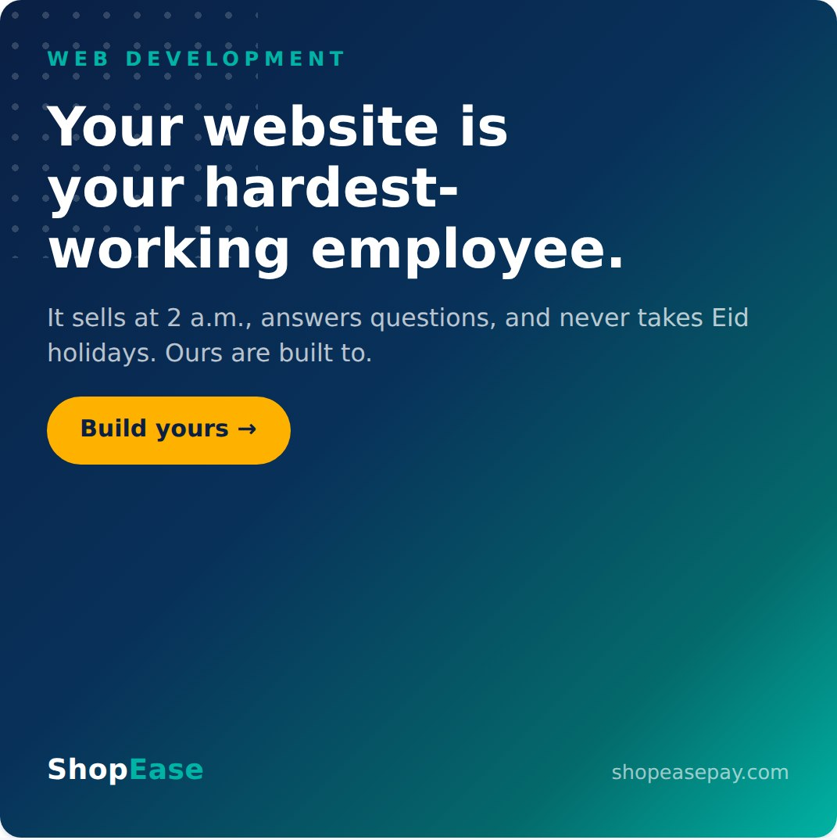
01 Your Hardest-Working Employee
1080×1080 · Template A · Bold Statement · LinkedIn + Facebook
CAPTION
Your best salesperson doesn't sleep.
A well-built website takes orders at 2 a.m., answers the questions you're tired of repeating, and represents your brand perfectly every single time — whether one customer visits or ten thousand.
We build fast, secure, custom web stores on the MERN stack for businesses across Pakistan that are ready to grow beyond their DMs.
If your business still lives only on Instagram and WhatsApp, let's change that. Book a free consultation — link in bio.
#WebDevelopment #EcommercePakistan #DigitalPakistan #OnlineStore #SmallBusinessPakistan #BusinessGrowth
POSTING CONTEXT
Campaign opener. Publish first, Tuesday–Thursday morning (9–11 a.m. PKT) when business owners check feeds.

Slide 7
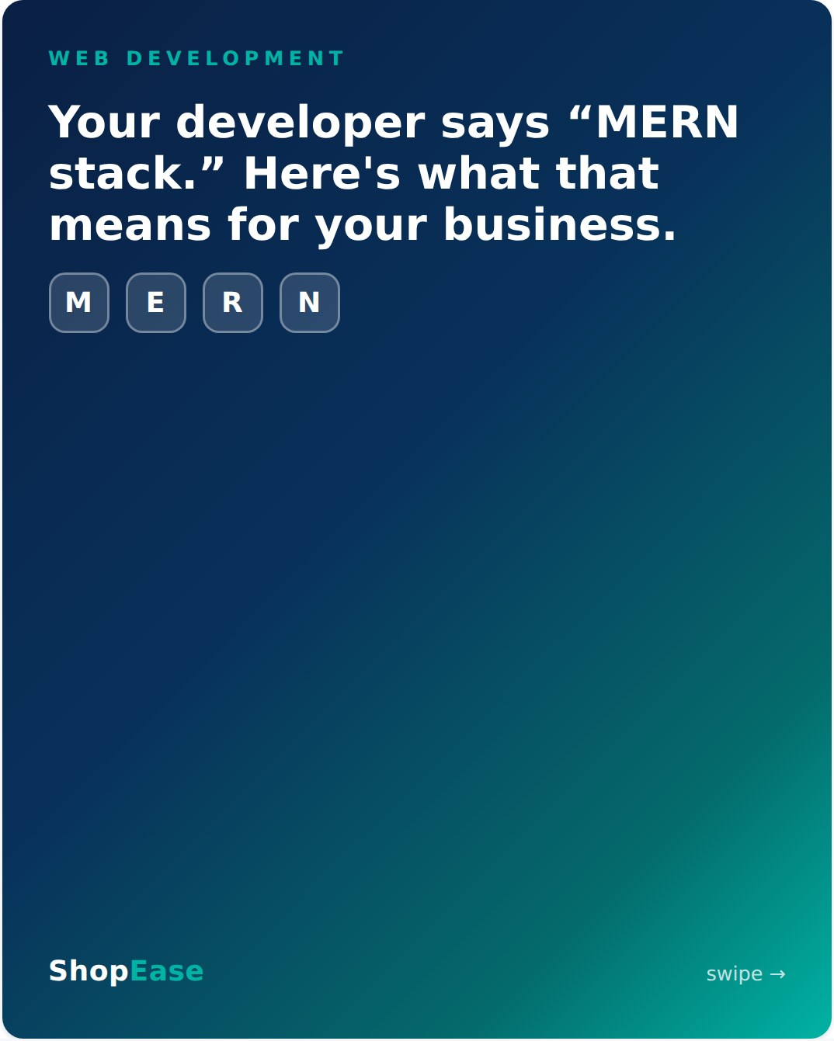
02 MERN, in Plain Business Terms
1080×1350 · 6 slides · Template C · Carousel · Instagram + LinkedIn
CAPTION
"We build on the MERN stack" — great, but what does that actually do for your business? 🧵
Swipe for the no-jargon version. The short answer: a store that loads instantly, never buckles on sale day, and scales as you grow — the same technologies powering Netflix and PayPal, sized for your business.
You shouldn't need a computer science degree to invest in your own website. That's what we're here for.
Questions about your current site's tech? Ask in the comments — we answer all of them.
#MERNStack #WebDevelopment #EcommercePakistan #TechExplained #DigitalPakistan #OnlineStore
POSTING CONTEXT
Mid-week educational slot. Carousels earn the highest saves — pin to the profile grid. Slides: cover → MongoDB → Express → React → Node.js → CTA.

Slide 8
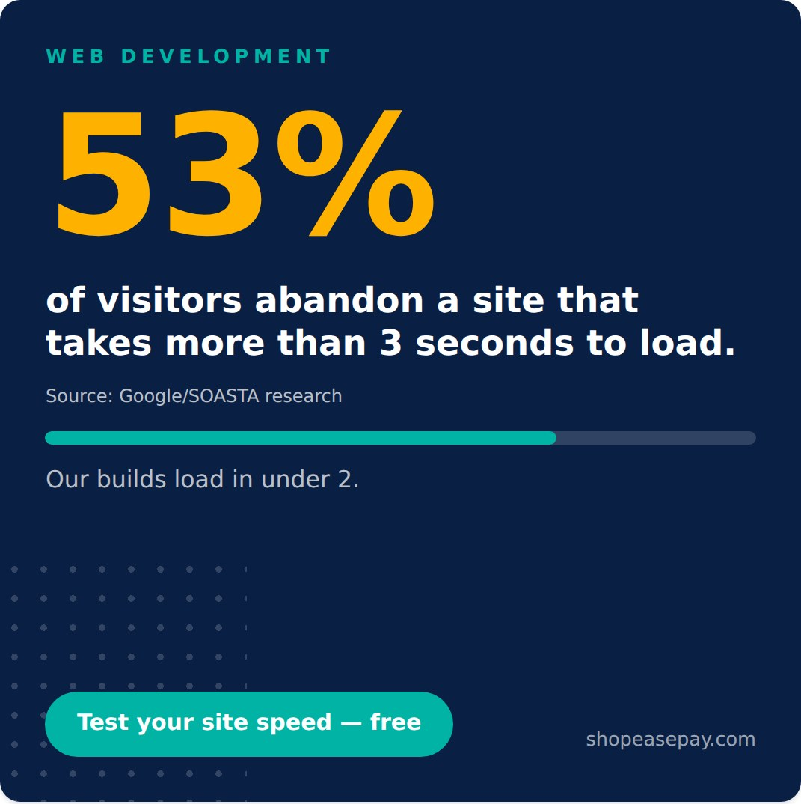
03 The 3-Second Rule
1080×1080 · Template B · Stat Spotlight · Instagram + Facebook
CAPTION
You have 3 seconds. ⏱️
More than half of your visitors won't wait longer than that for your site to load. Every extra second is a customer walking out of a shop they never fully entered — and you paid to bring them there.
Speed isn't a luxury feature. It's the difference between an ad budget that converts and one that evaporates. Every store we ship is performance-tested to load in under 2 seconds on Pakistani mobile networks, because that's where your customers actually are.
Want to know your site's real load time? Comment "SPEED" and we'll run a free audit.
#WebPerformance #EcommercePakistan #WebDevelopment #ConversionRate #DigitalPakistan #SmallBusinessPakistan
POSTING CONTEXT
Pair with the "SPEED" comment hook to drive engagement; respond to every comment within the first hour.

Slide 9
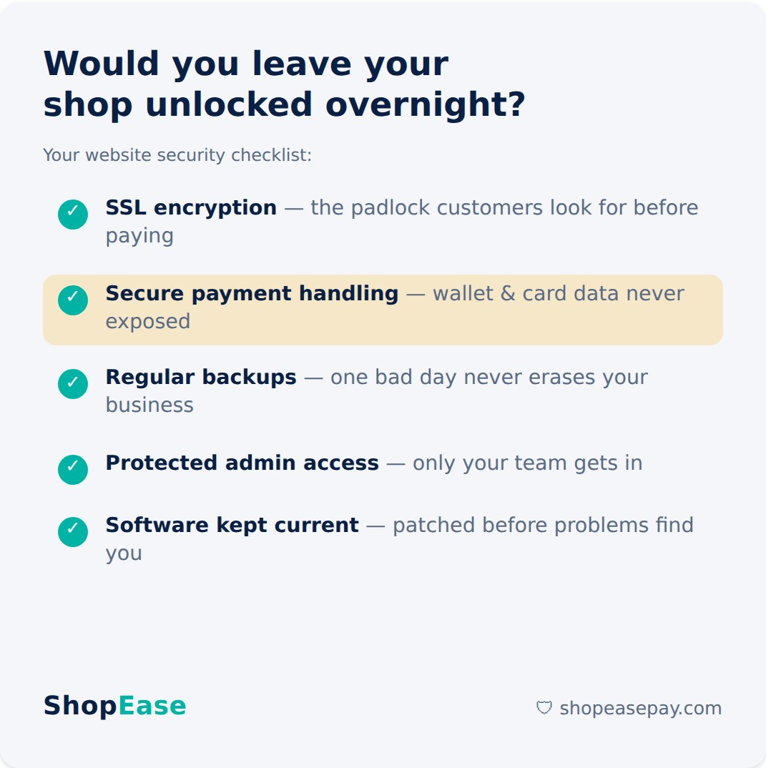
04 Is Your Website a Locked Shop?
1200×1200 · Template E · Checklist · LinkedIn (reshare to Facebook)
CAPTION
You lock your shop every night. Is your website locked too?
One security incident can cost more than years of hosting — lost orders, lost data, and hardest of all, lost customer trust. Once a customer sees a browser warning on your checkout page, they rarely come back.
Every site we build ships with all five of these as standard, not as add-ons. Security isn't a premium tier — it's the foundation.
Not sure whether your current site would pass this checklist? Send us a message — we'll take a look, no strings attached.
#WebsiteSecurity #EcommercePakistan #WebDevelopment #SSL #PakistanBusiness #TrustMatters
POSTING CONTEXT
Decision-makers care about risk. Good Monday post — practical, saves well.

Slide 10
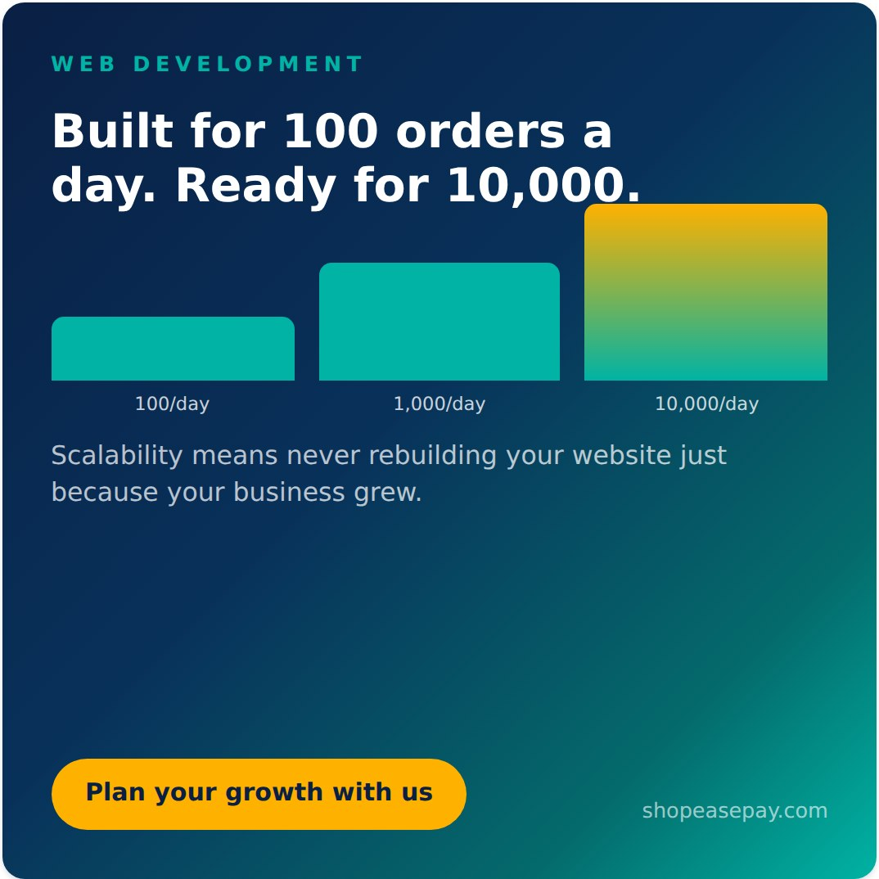
05 Built for 100 Orders, Ready for 10,000
1200×1200 · Template B · Stat Spotlight · LinkedIn (+ Instagram pre-season)
CAPTION
The most expensive website is the one you have to build twice.
We've met too many business owners whose site worked fine at 100 orders a day — then a viral reel, a TV mention, or a strong sale season arrived, and everything crashed at the exact moment it mattered most.
Scalable architecture means your store grows with your ambition: more products, more traffic, more orders, same solid foundation. You invest once, and it keeps up.
Planning for growth is cheaper than repairing for it. Let's talk about where your business is headed — free consultation, link in bio.
#Scalability #EcommercePakistan #WebDevelopment #BusinessGrowth #DigitalPakistan #MERNStack
POSTING CONTEXT
Speaks to owners planning expansion. Strong August–October, ahead of 11.11 and winter sales.

Slide 11
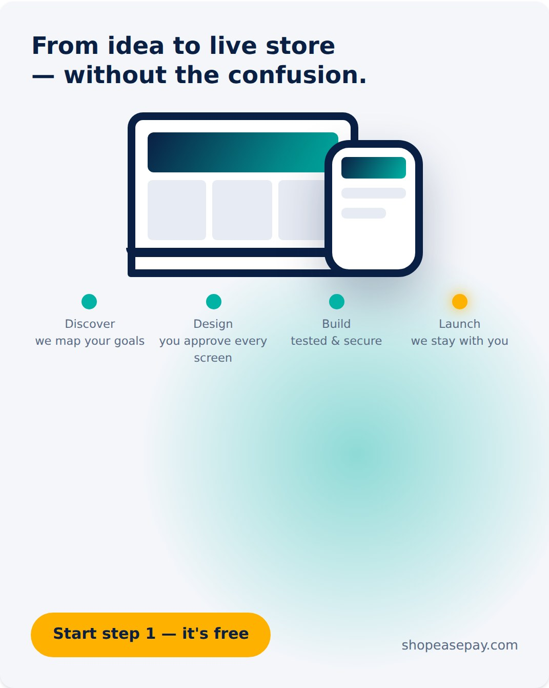
06 From Idea to Live Store
1080×1350 · Template G · Device Mockup · Instagram + Facebook
CAPTION
"I want a website, but I don't know where to start."
We hear this every week — and it's exactly why our process starts with a conversation, not a contract. Here's how an idea becomes your live store:
1️⃣ Discover — we understand your business, customers, and goals
2️⃣ Design — you see and approve every screen before we build
3️⃣ Build — clean, fast, secure development on the MERN stack
4️⃣ Launch — your store goes live, and we stay for support and growth
No jargon. No surprises. No disappearing after launch — we're a growth partner, not a one-time vendor.
Step 1 is a free discovery call. Book yours through the link in bio.
#WebDevelopment #OnlineStore #EcommercePakistan #SmallBusinessPakistan #DigitalPakistan #StartupPakistan
POSTING CONTEXT
Excellent for first-time website buyers; boost to a cold audience of small business owners.

Slide 12
PILLAR 2 · POSTS 7–12
SEO & Content Strategy
Visibility, reach, and traffic — SEO framed as compounding, ownable growth rather than a mysterious black box.

Slide 13
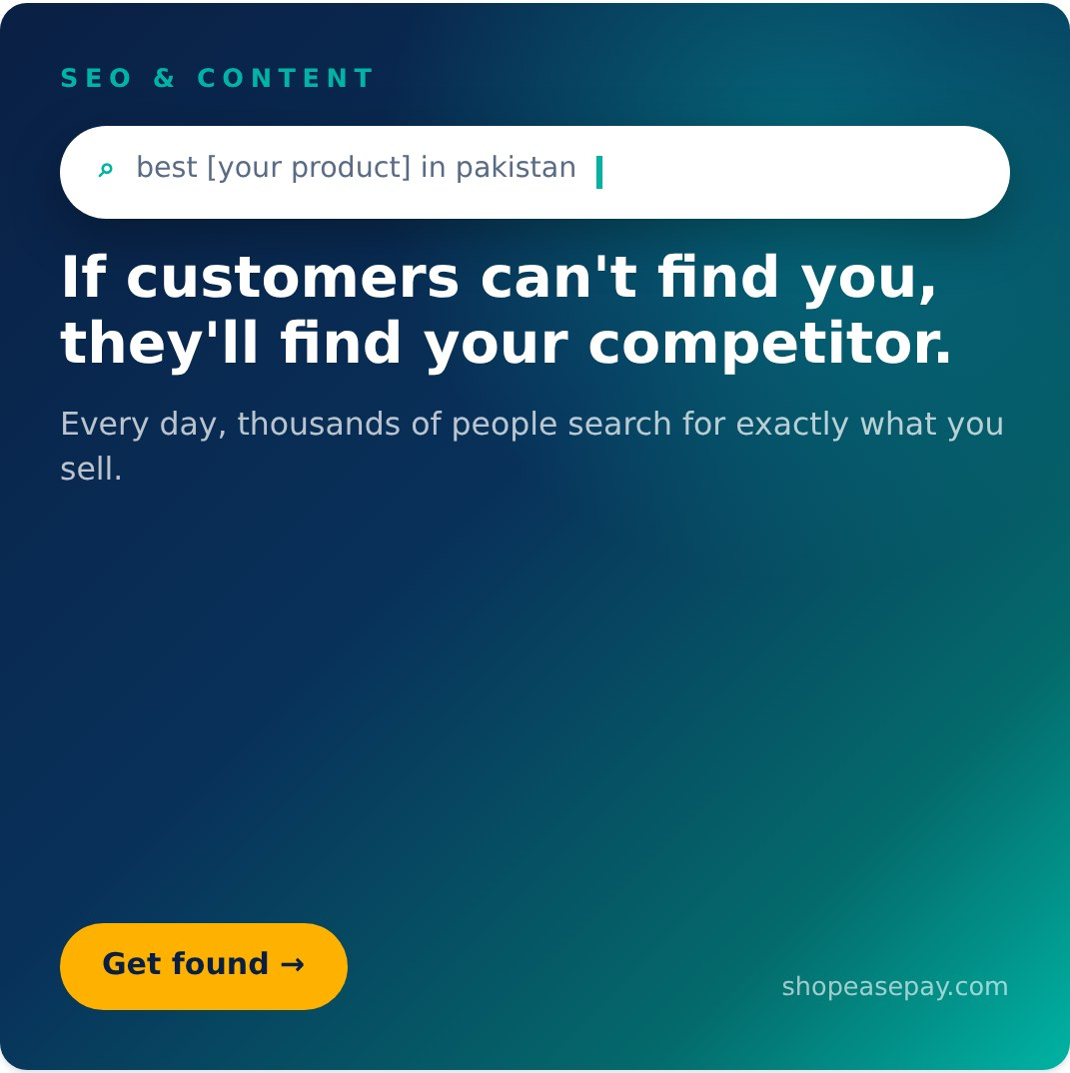
07 Found or Forgotten
1080×1080 · Template A · Bold Statement · All platforms
CAPTION
Right now, someone is searching Google for exactly what you sell.
The only question is whose website they'll find.
SEO isn't a technical luxury — it's your shop sign on the busiest street in the world. Businesses that rank get a steady stream of customers who arrive already looking to buy. Businesses that don't are invisible at the exact moment of highest intent.
We build data-driven SEO and content strategies that put growing Pakistani businesses in front of the customers already searching for them.
Want to know what your customers are searching for? Comment "SEARCH" and we'll share the top queries in your industry.
#SEO #DigitalPakistan #ContentStrategy #PakistanBusiness #OnlineVisibility #BusinessGrowth
POSTING CONTEXT
Pillar anchor. LinkedIn Tuesday morning; the comment hook feeds the algorithm on Instagram and Facebook.

Slide 14
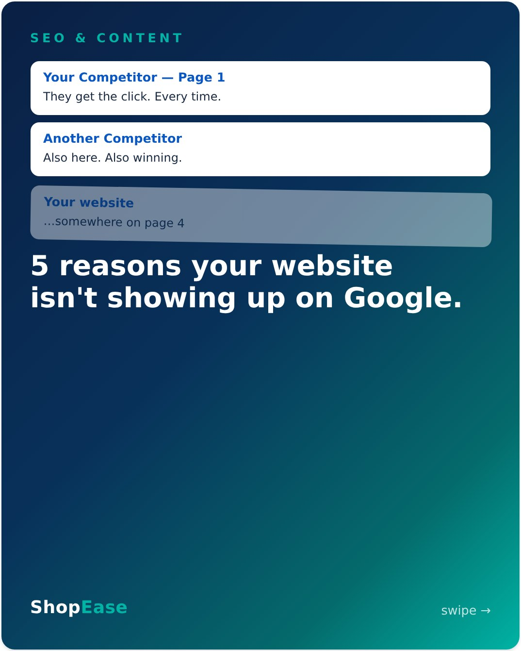
08 5 Reasons You're Invisible on Google
1080×1350 · 7 slides · Template C · Carousel · Instagram + LinkedIn
CAPTION
Your website isn't on page 1 of Google. It's not bad luck — it's usually one of these five reasons. 👉 Swipe.
The encouraging part: every single one is fixable, and fixing them compounds. SEO done right in month 1 is still bringing you customers in month 24 — it's the closest thing to owning, rather than renting, your traffic.
We start every SEO engagement with a full audit so you know exactly where you stand before spending a rupee on strategy.
Want yours? The audit is free — link in bio.
#SEO #SEOAudit #DigitalPakistan #ContentStrategy #EcommercePakistan #SmallBusinessPakistan
POSTING CONTEXT
High-save educational content. Schedule mid-week; pin to the LinkedIn featured section. Slides: cover → speed → keywords → stale content → no mentions → hidden errors → CTA.

Slide 15
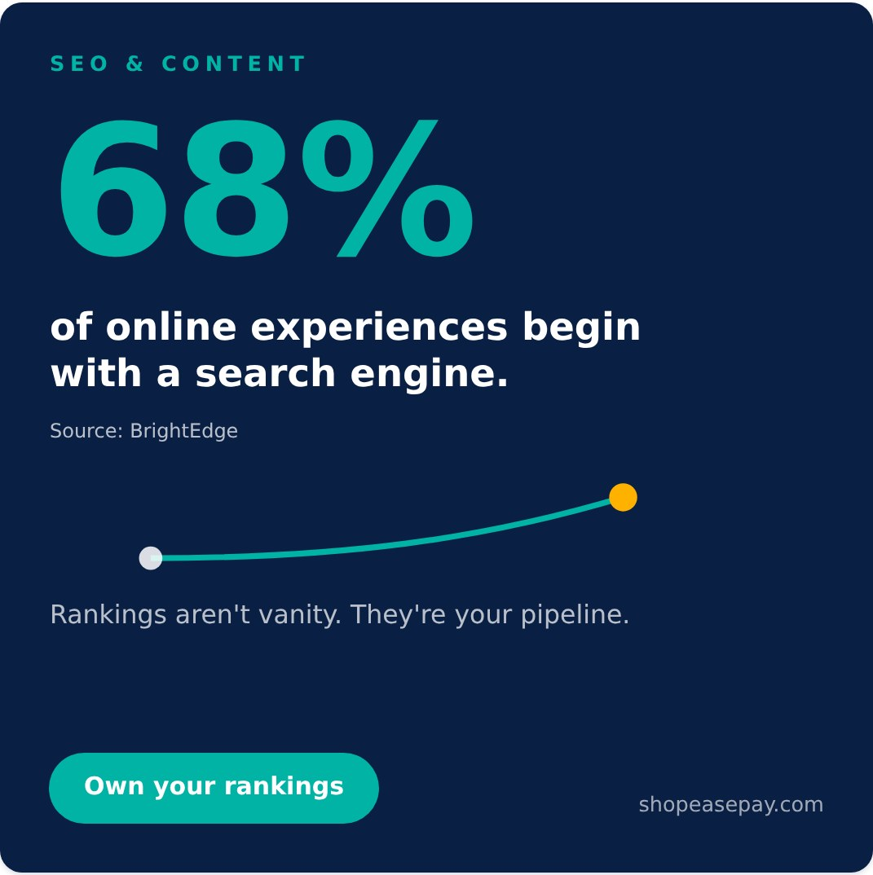
09 Where Buying Journeys Begin
1080×1080 · Template B · Stat Spotlight · LinkedIn (+ IG story poll)
CAPTION
68% of online experiences begin with a search engine. Not with an ad. Not with social media. With a search.
That means for most of your future customers, the journey to buying from you starts in a Google search box — and where you rank decides whether that journey includes you at all.
Paid ads stop working the moment you stop paying. Rankings keep working while you sleep. The smartest growth budgets in 2026 do both — but only one of them compounds.
Let's build your search pipeline. Free strategy call, link in bio.
#SEO #DigitalMarketing #DigitalPakistan #BusinessGrowth #ContentStrategy #PakistanBusiness
POSTING CONTEXT
Stat posts perform with B2B decision-makers. Reshare as an Instagram story with a poll sticker ("Do you know what you rank for?").

Slide 16
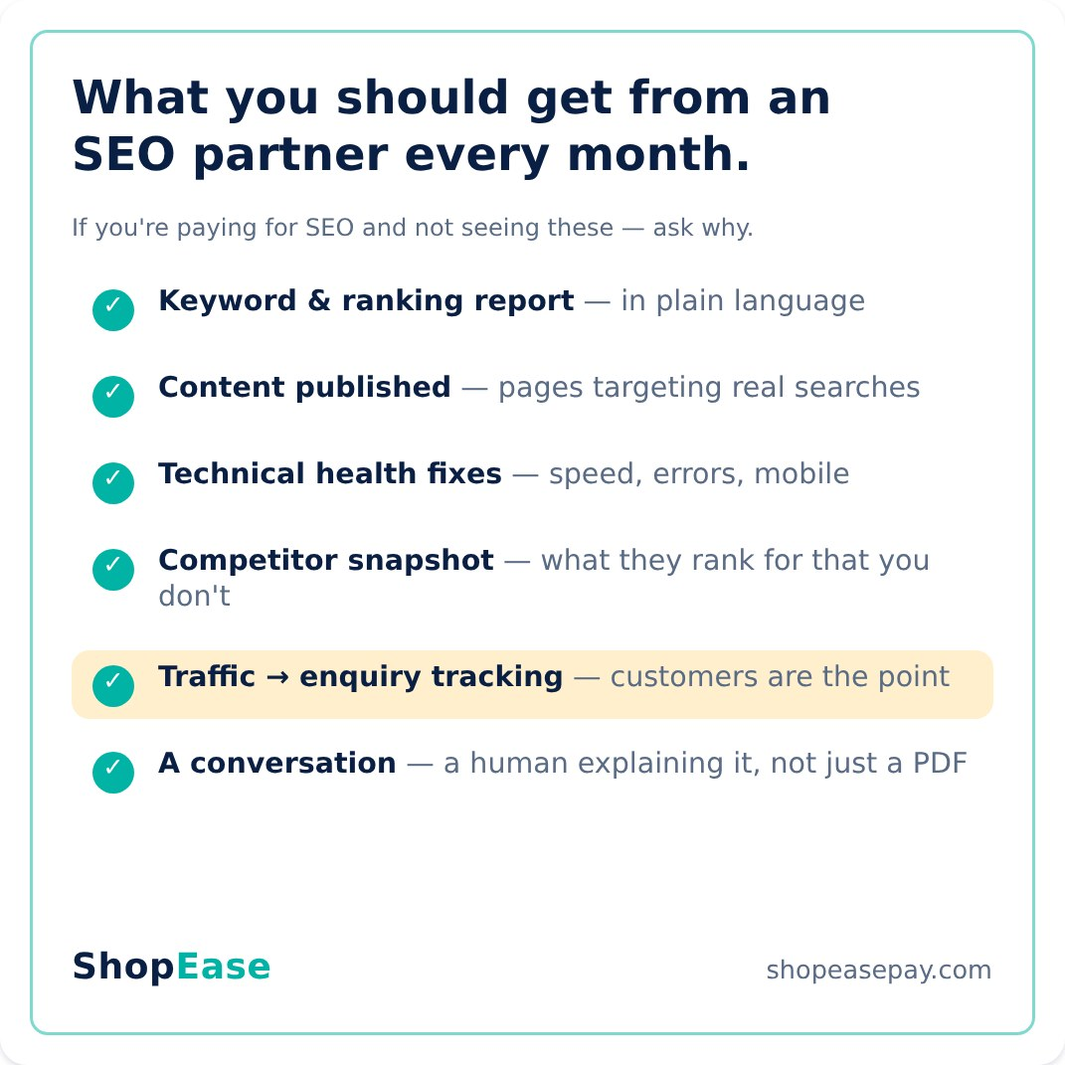
10 What a Real SEO Partner Does Monthly
1200×1200 · Template E · Checklist · LinkedIn (+ Instagram)
CAPTION
"We're doing SEO for you" should never be the whole report.
SEO has a reputation problem in our market — too many businesses pay monthly for months and can't say what they actually received. So here's our transparency checklist: six things you should expect from any SEO partner, including us. Screenshot it. Use it in your next vendor meeting. ✅
We send every client a plain-language monthly report and walk through it on a call — because you can't steer growth you don't understand.
If your current SEO reporting doesn't look like this, let's talk. Link in bio.
#SEO #ContentStrategy #DigitalPakistan #TransparentMarketing #PakistanBusiness #SmallBusinessPakistan
POSTING CONTEXT
Trust-builder and differentiator. The "screenshot this" mechanic drives saves.

Slide 17
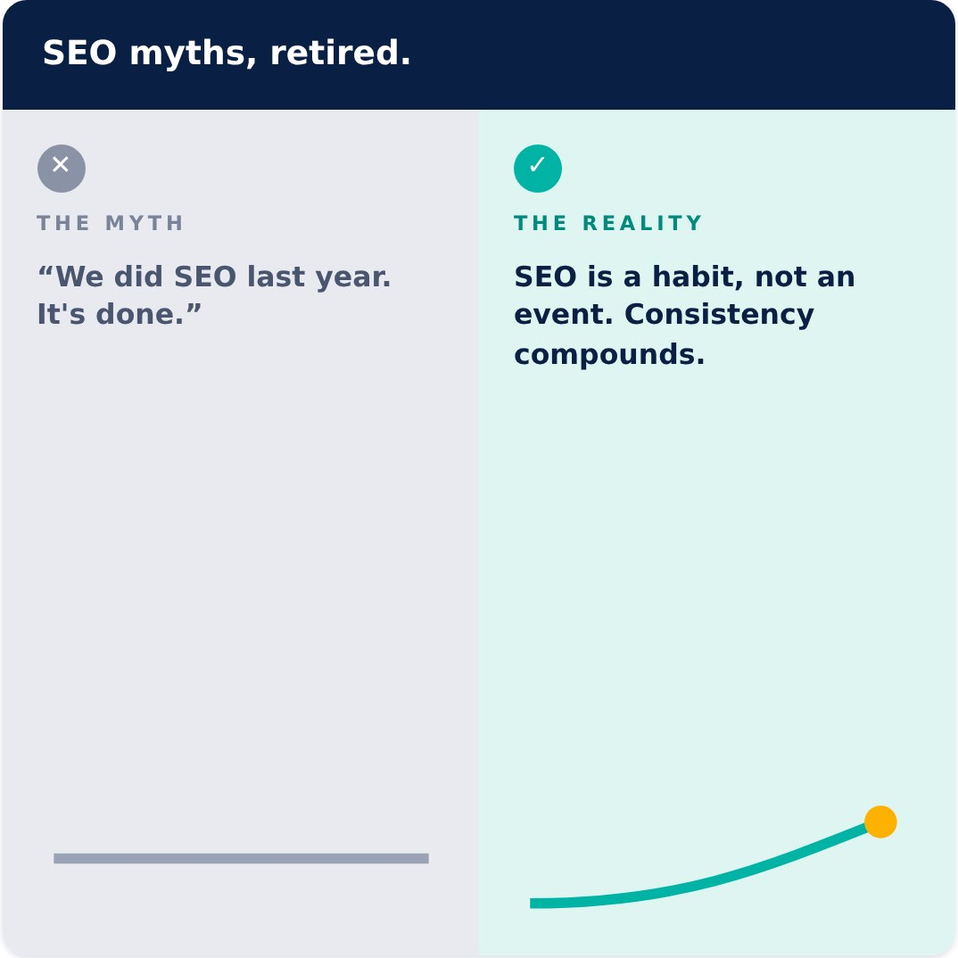
11 SEO Is Not a One-Time Fix
1080×1080 · Template F · Split Panel · Instagram + Facebook
CAPTION
"We already did SEO." 🚫
We hear this a lot — and it's like saying "we already did exercise." Search rankings are a living scoreboard: Google updates its algorithm thousands of times a year, competitors publish, customer search habits shift.
The reality? Consistency wins. A steady monthly rhythm of content, fixes, and refinement compounds into page-1 positions that are genuinely hard for competitors to take from you. That durability is the whole point.
Stop sprinting occasionally. Start compounding. Free SEO strategy call — link in bio.
#SEO #SEOMyths #ContentStrategy #DigitalPakistan #BusinessGrowth #PakistanBusiness
POSTING CONTEXT
Myth-bust formats earn comments and shares; invite debate in the replies. Good Friday-afternoon post.

Slide 18
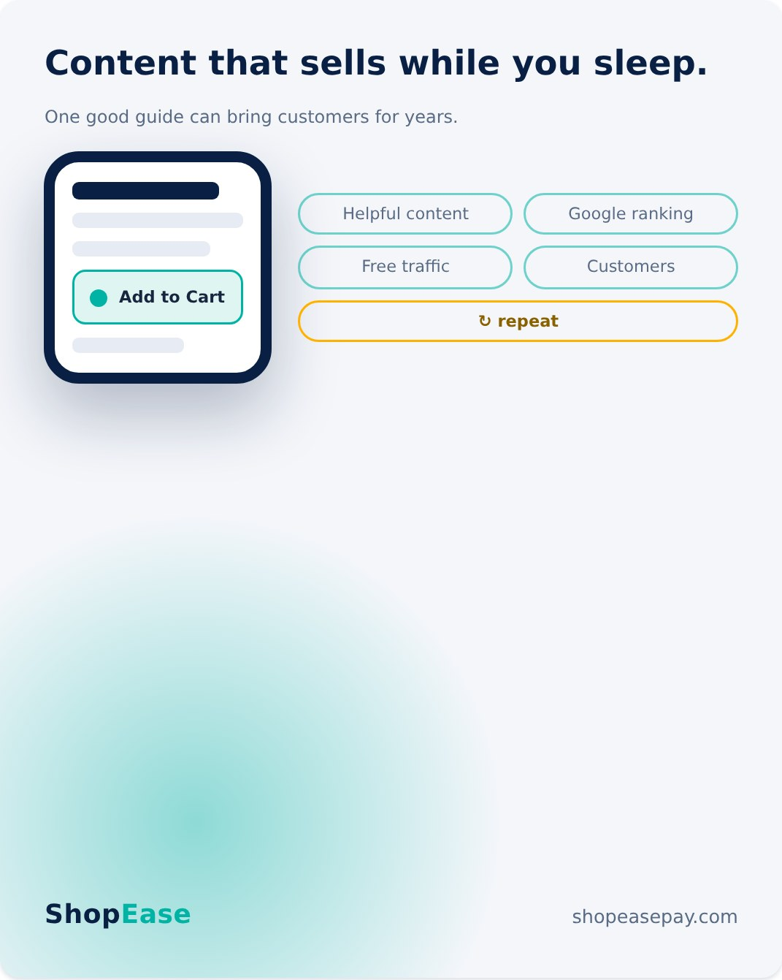
12 Content That Sells While You Sleep
1080×1350 · Template G · Device Mockup · Instagram + LinkedIn
CAPTION
Your best salesperson might be a blog post. 📝
A size guide. A "how to choose" article. An honest comparison. Content like this answers the questions your customers are already Googling — and every answer is a doorway into your store that stays open 24/7, at zero cost per click.
This is what content strategy actually means: not posting for the sake of posting, but building a library of assets that rank, earn trust, and quietly convert — month after month, while you focus on running the business.
We plan, write, and optimize it end-to-end. Curious what content your customers are searching for? Comment "CONTENT" and we'll tell you.
#ContentStrategy #ContentMarketing #SEO #DigitalPakistan #EcommercePakistan #BusinessGrowth
POSTING CONTEXT
Publish the same week as Post 9 to reinforce the organic-traffic narrative; the comment hook feeds lead generation.

Slide 19
PILLAR 3 · POSTS 13–18
Payment Gateway Integration
Easypaisa & JazzCash — meeting customers where their money already is. Fast onboarding, fewer abandoned carts, no COD headaches.

Slide 20
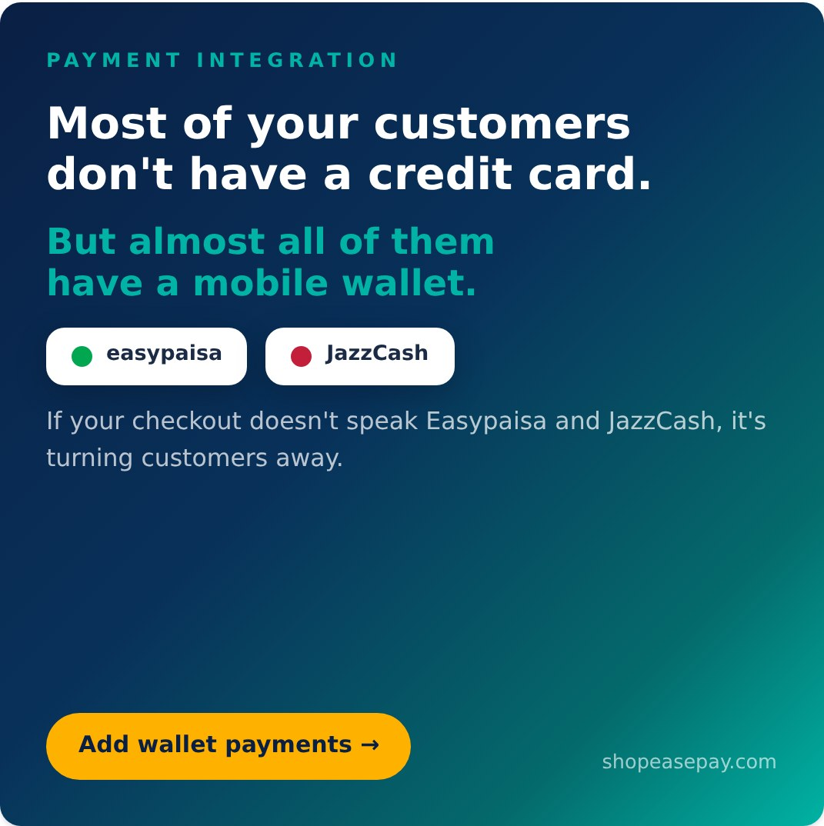
13 Can They Actually Pay You?
1080×1080 · Template A · Bold Statement · Facebook + Instagram (+ LinkedIn)
CAPTION
Here's the checkout question that decides your conversion rate in Pakistan:
"Can I pay with Easypaisa or JazzCash?"
Card penetration here is a fraction of wallet penetration — tens of millions of Pakistanis carry their money in a mobile wallet, not on a Visa. A checkout built only for cards (or only for cash on delivery) quietly filters out the majority of your buyers at the final step.
We integrate Easypaisa and JazzCash directly into your store — smooth for your customer, automatic for you.
Is your checkout wallet-ready? If not, let's fix that this month. Link in bio.
#Easypaisa #JazzCash #EcommercePakistan #DigitalPayments #PakistanBusiness #OnlineStore
POSTING CONTEXT
Pillar anchor — publish first and boost it. Broadest SME reach in Pakistan is on Facebook.

Slide 21
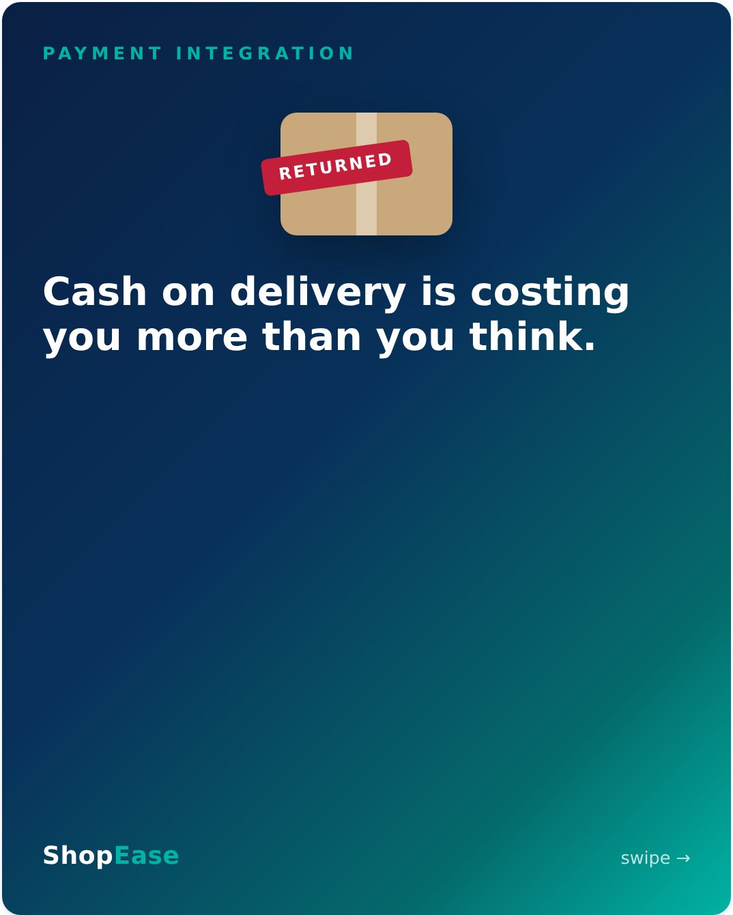
14 The True Cost of Cash on Delivery
1080×1350 · 6 slides · Template C · Carousel · Instagram + Facebook
CAPTION
COD feels free. It isn't. 📦
Every online seller in Pakistan knows the pain: the parcel that comes back refused, the cash stuck with the courier, the "order" that was never real. Swipe for the four hidden costs of running on cash on delivery alone →
The fix isn't dropping COD overnight — it's giving customers a prepaid option they already trust. When Easypaisa and JazzCash sit right in your checkout, a meaningful slice of buyers happily pays upfront: committed orders, instant cash flow, zero reconciliation drama.
We'll integrate both wallets into your store and have you accepting prepaid orders fast. Details at the link in bio.
#CashOnDelivery #Easypaisa #JazzCash #EcommercePakistan #DigitalPayments #OnlineSellerPakistan
POSTING CONTEXT
Deeply relatable to active sellers — expect comment stories; engage with every one. Strong paid-promotion candidate. Slides: cover → refused parcels → frozen cash flow → fake orders → reconciliation → CTA.

Slide 22
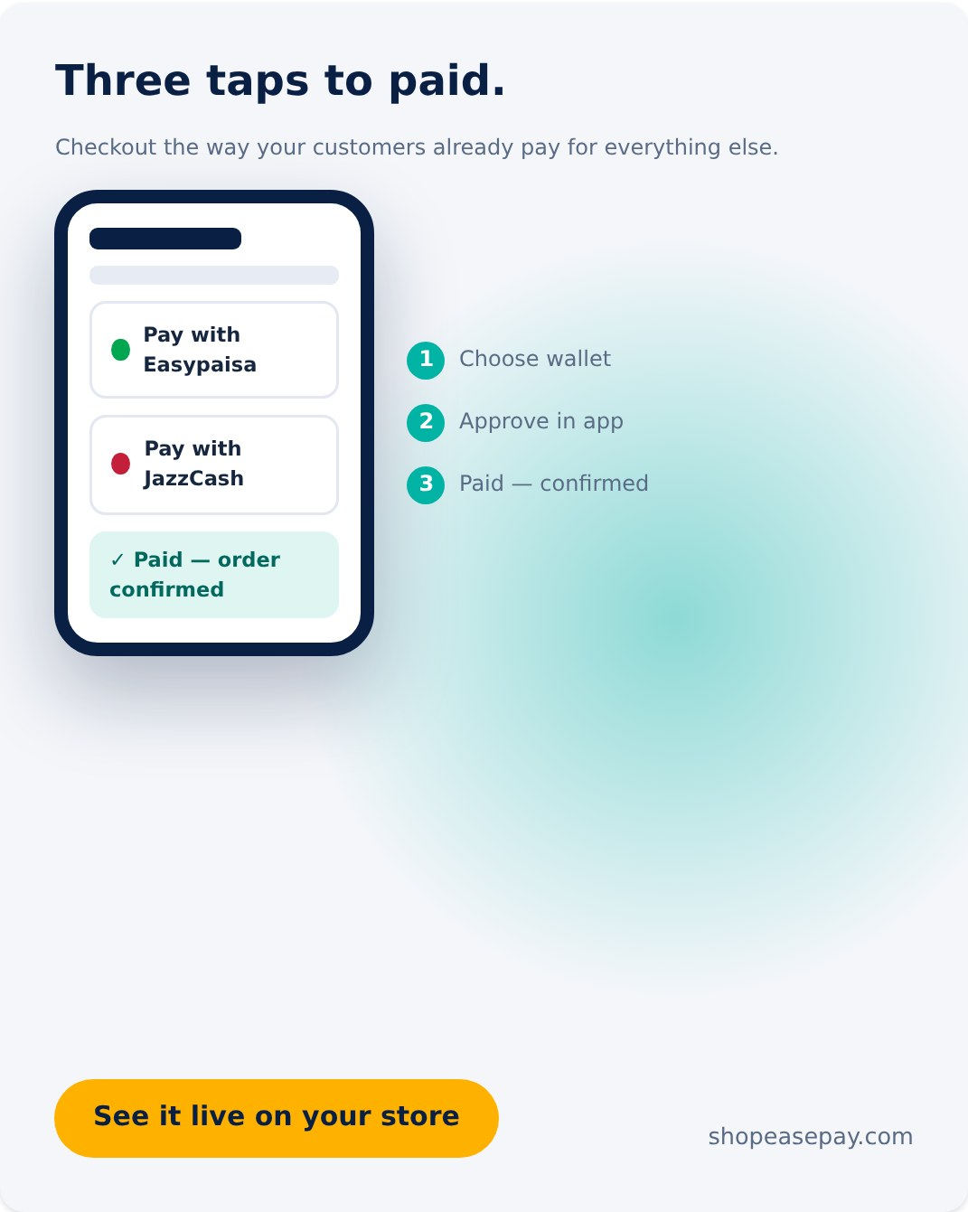
15 Three Taps to Paid
1080×1350 · Template G · Device Mockup · Instagram + Reels cover
CAPTION
Your customer already pays their electricity bill, mobile load, and Careem rides with a wallet. Their money lives in Easypaisa and JazzCash.
So why does your checkout make them go find a card they may not even have?
With native wallet integration, paying you takes three taps: choose wallet → approve in app → done. No forms, no friction, no "I'll complete this later" (they won't).
Familiar payment = trusted payment = completed order. It's the simplest conversion upgrade most Pakistani stores can make.
Want to see it running on your own store? Book a free demo — link in bio.
#Easypaisa #JazzCash #CheckoutExperience #EcommercePakistan #DigitalPayments #ConversionRate
POSTING CONTEXT
Animate the three taps as a 15-second screen-recording Reel using the same design. LinkedIn reshare with a shorter caption.

Slide 23
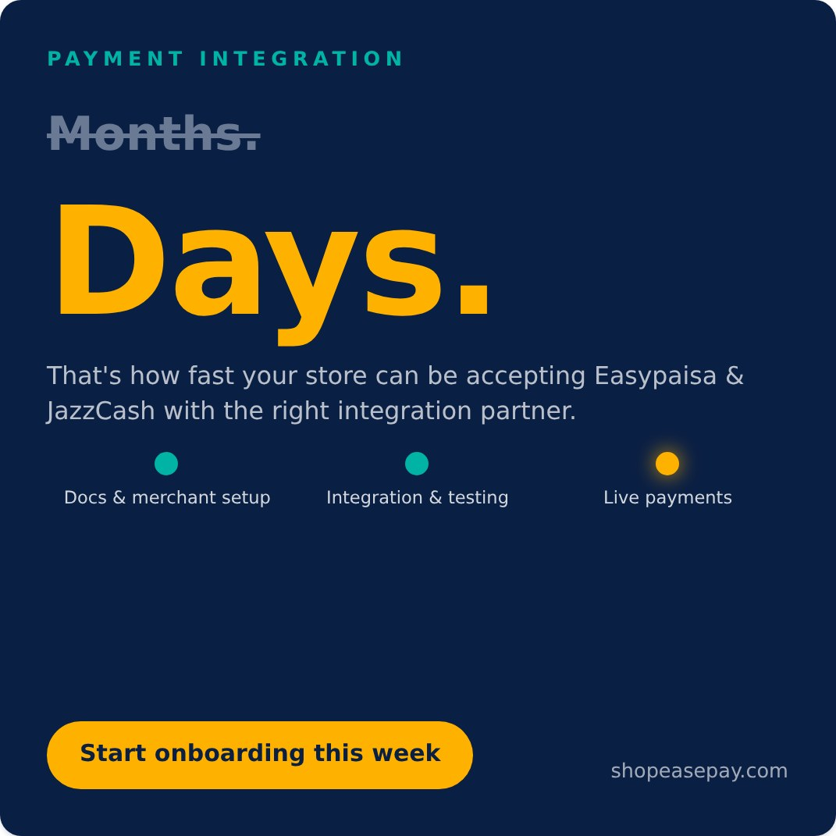
16 Live in Days, Not Months
1080×1080 · Template B · Stat Spotlight · LinkedIn + Facebook
CAPTION
"Payment gateway integration" sounds like a six-month corporate project. It doesn't have to be.
The slow part is rarely the technology — it's not knowing the process: which merchant documents you need, how approval works, how to test properly, what to configure and in which order. We've done it enough times that nothing surprises us anymore.
We handle the merchant onboarding paperwork alongside you, build the integration, test every edge case, and take you live — in days, not months.
Every week without wallet payments is a week of quietly lost orders. Let's start yours now — link in bio.
#PaymentGateway #Easypaisa #JazzCash #EcommercePakistan #FastOnboarding #DigitalPakistan
POSTING CONTEXT
Targets owners who want wallets but assume it's painful — addresses the objection head-on. Post 3–4 days after Post 13.

Slide 24
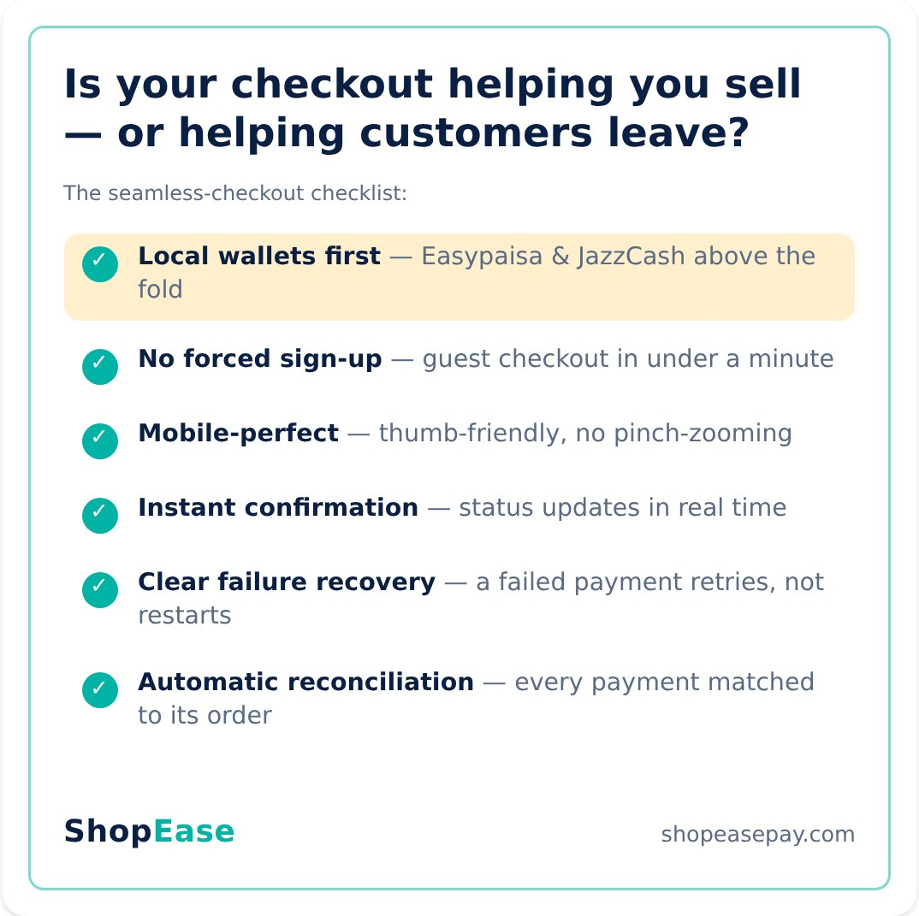
17 Seamless Checkout Checklist
1200×1200 · Template E · Checklist · LinkedIn + Instagram
CAPTION
Abandoned carts aren't a mystery. Walk through your own checkout on your phone tonight and count the obstacles. 🛒
Every extra field, every forced account, every "we only accept bank transfer" is a paying customer you already convinced — lost at the last metre. Checkout is where marketing money either becomes revenue or evaporates.
This is our six-point standard for every store we build or upgrade. Screenshot it and audit yourself — or send us your store link and we'll do it for you, free.
#CheckoutOptimization #Easypaisa #JazzCash #EcommercePakistan #AbandonedCart #ConversionRate
POSTING CONTEXT
The self-audit mechanic drives saves; the free-audit offer drives DMs. Schedule between Posts 15 and 18.

Slide 25
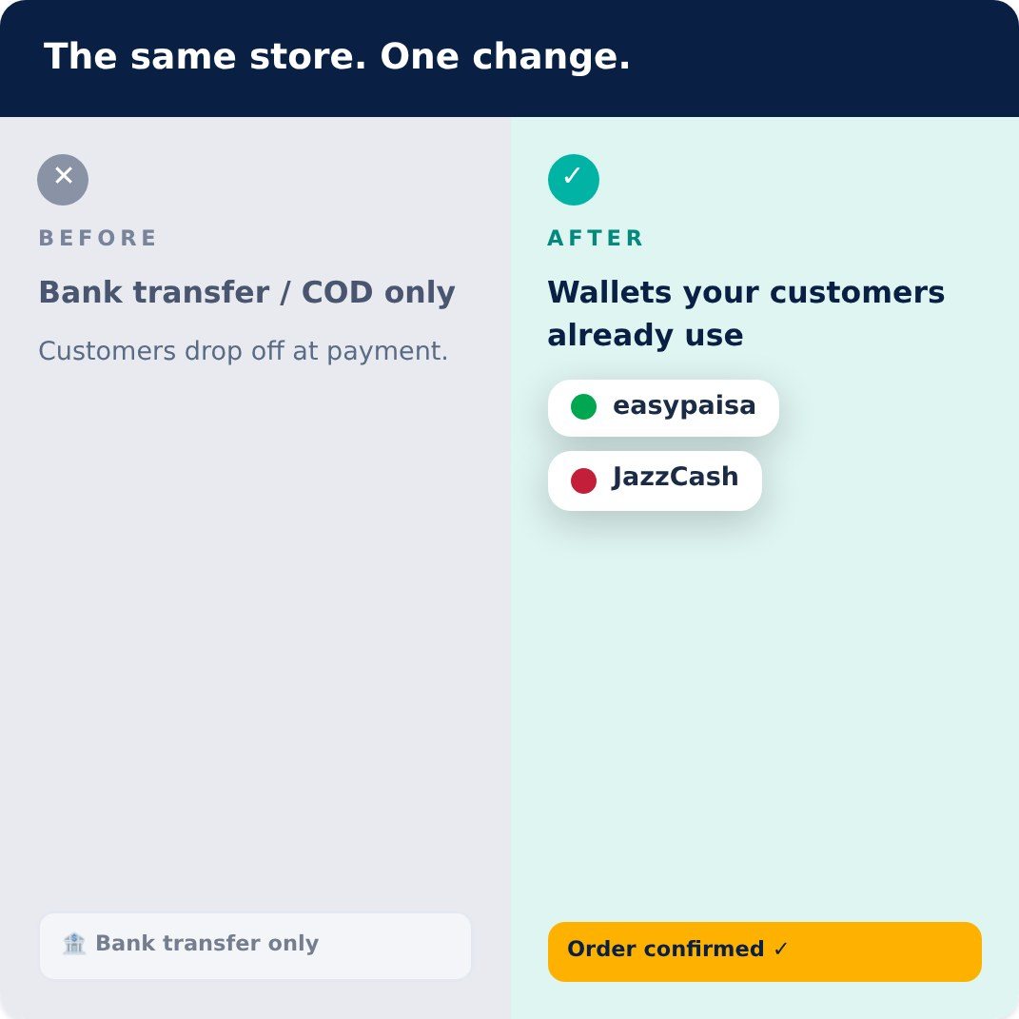
18 Checkout, Before & After
1080×1080 · Template F · Split Panel · Instagram + Facebook
CAPTION
Same products. Same prices. Same traffic. One change at checkout. 🔁
When customers see payment options they already use daily, hesitation disappears. When they see "bank transfer only" — or nothing but COD — doubt walks in, and doubt doesn't buy.
Wallet integration isn't a technical upgrade. It's a trust upgrade at the exact moment trust matters most: when someone is holding their money out to you.
Ready for your own before-and-after? We'll integrate Easypaisa and JazzCash into your store in days. Free consultation — link in bio.
#BeforeAndAfter #Easypaisa #JazzCash #EcommercePakistan #DigitalPayments #OnlineStorePakistan
POSTING CONTEXT
Before/after stops the scroll. Pillar closer — retarget engagers of Posts 13–17 with it.

Slide 26
PILLAR 4 · POSTS 19–24
Customer Success Stories
Three client stories, each told twice: a quote card for the emotional beat, a case-study carousel for the results beat.

Slide 27
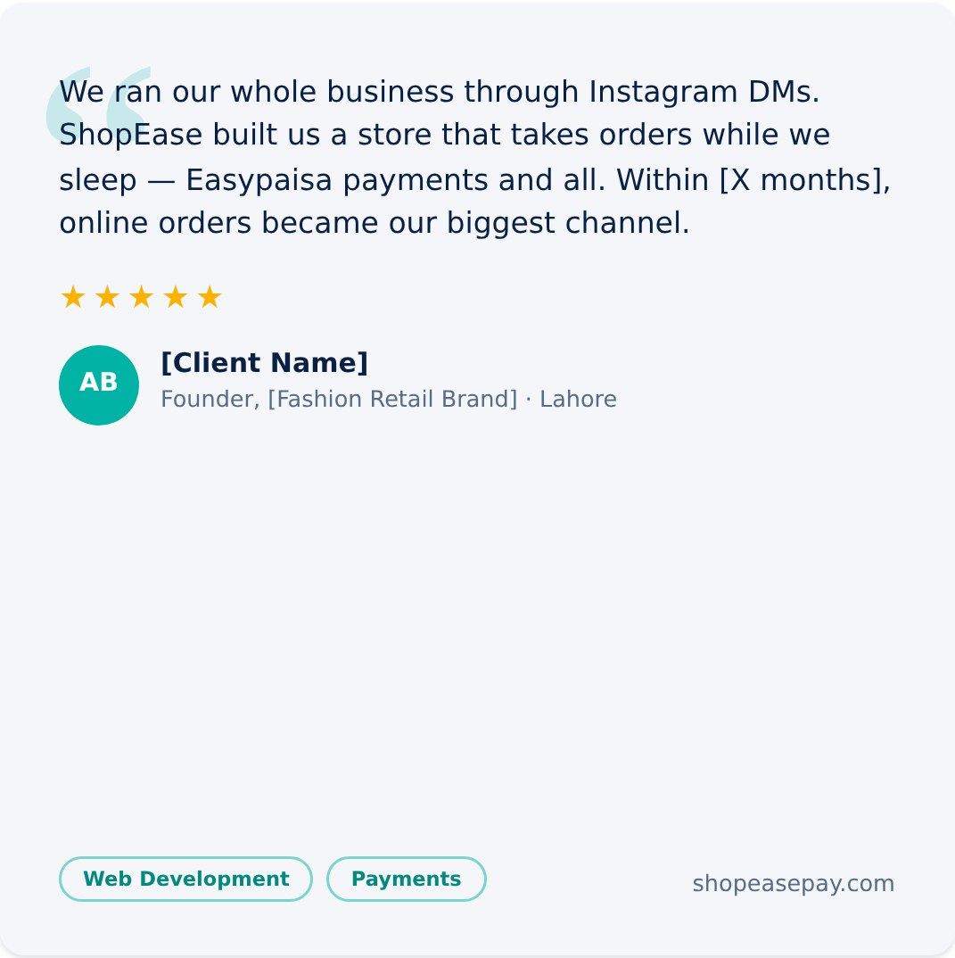
19 Testimonial: The Store That Left the DMs
1080×1080 · Template D · Testimonial Card · Instagram + Facebook
CAPTION
From "DM to order" to a store that never sleeps. 🌙
When [Client Name] came to us, [Fashion Retail Brand] was thriving on Instagram — and drowning in it. Every order meant manual messages, payment screenshots, and address confusion.
We built them a custom MERN-stack store with Easypaisa and JazzCash checkout. Now customers browse, pay, and order on their own — and the team spends those hours growing the brand instead of managing chats.
Your business might be one website away from getting its evenings back. Let's talk — link in bio.
#CustomerSuccess #EcommercePakistan #WebDevelopment #Easypaisa #SmallBusinessPakistan #ClientStory
POSTING CONTEXT
Publish early in the pillar; testimonials perform best after a week of value-first posts. Bracketed client fields: fill with permission or run anonymized.

Slide 28
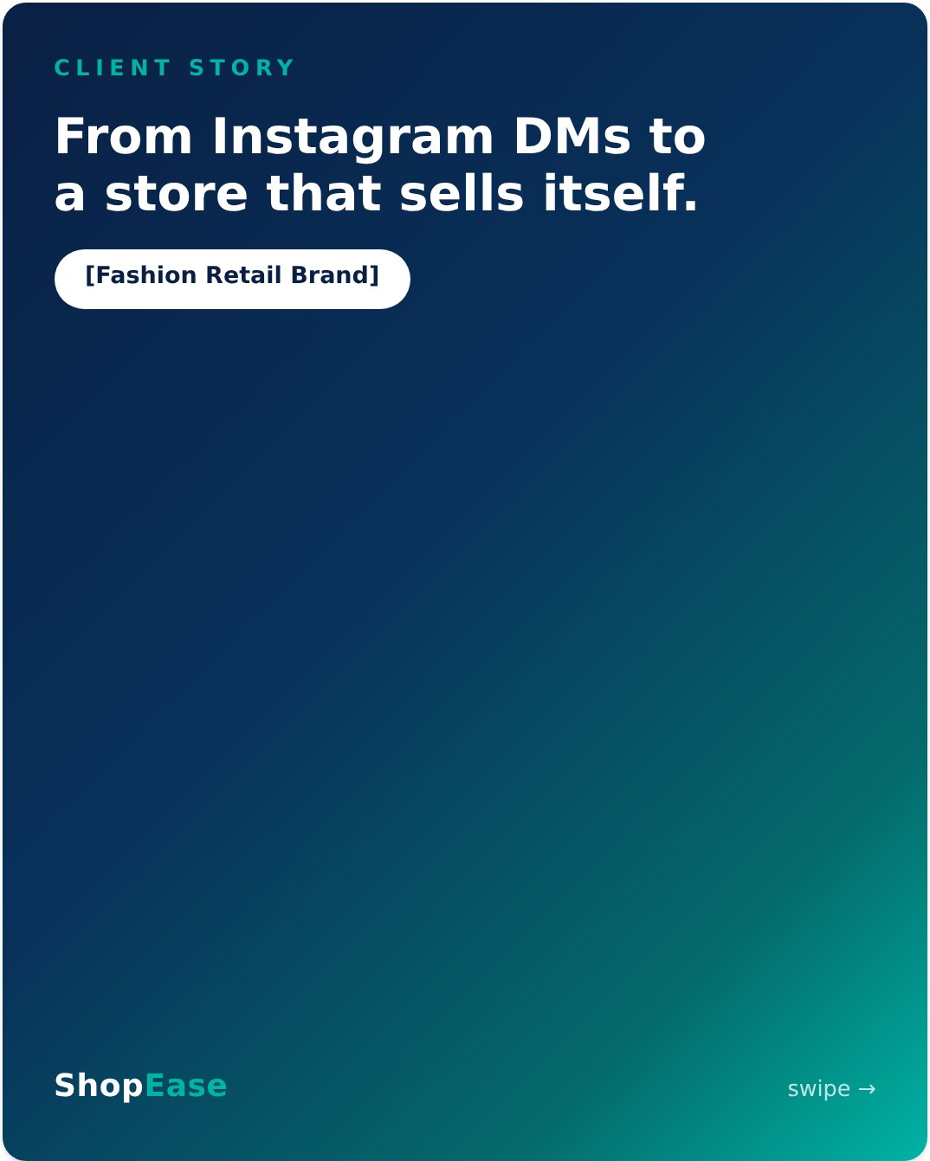
20 Case Study: [Fashion Retail Brand]
1080×1350 · 5 slides · Template C · Carousel · LinkedIn + Instagram
CAPTION
Case study: what actually changed when [Fashion Retail Brand] stopped selling through DMs. 🧵 Swipe →
The challenge: a great product buried under manual order-taking. The build: a custom store with local wallet checkout. The result: [X]% more monthly orders, [X] hours a week back, and a growing share of prepaid payments that ended their COD return problem.
No magic — just the right foundation, built once, built properly.
If your growth is trapped in your inbox, we should talk. Free consultation, link in bio.
#CaseStudy #EcommercePakistan #WebDevelopment #Easypaisa #JazzCash #BusinessGrowth
POSTING CONTEXT
Post 3–4 days after Post 19 so the quote primes the case study. Fill [X] metrics only with client-approved numbers. Slides: cover → challenge → build → result → CTA.

Slide 29
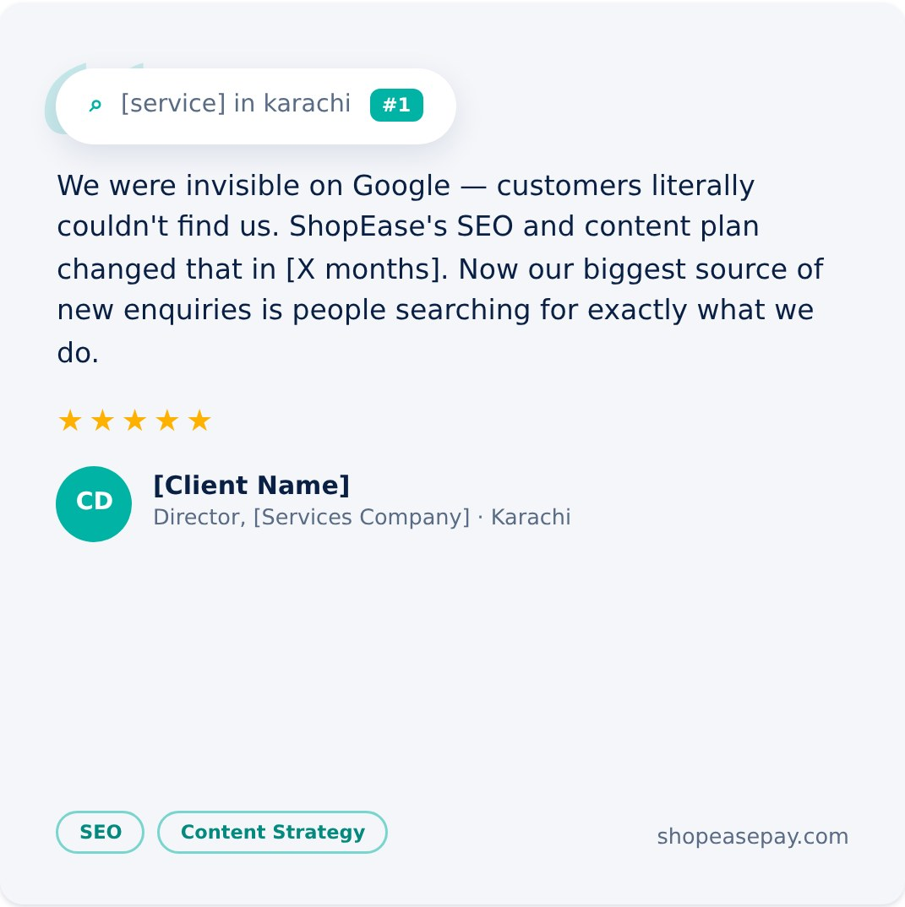
21 Testimonial: Found on Page One
1080×1080 · Template D · Testimonial Card · LinkedIn (reshare to Facebook)
CAPTION
"Customers couldn't find us." Now they can't miss them. 🔎
[Services Company] had years of experience and a strong reputation — offline. Online, they were on page 4 of Google, which is the same as nowhere.
A structured SEO and content program — real keyword research, monthly content their customers actually search for, and technical fixes under the hood — moved them onto page one for the searches that matter. Today, search is their biggest source of new enquiries, and it costs them nothing per click.
Being great at what you do isn't enough if no one can find you. Let's make you findable — link in bio.
#CustomerSuccess #SEO #ContentStrategy #DigitalPakistan #PakistanBusiness #ClientStory
POSTING CONTEXT
B2B services story resonates on LinkedIn. Pair within the same week as an SEO pillar post.

Slide 30
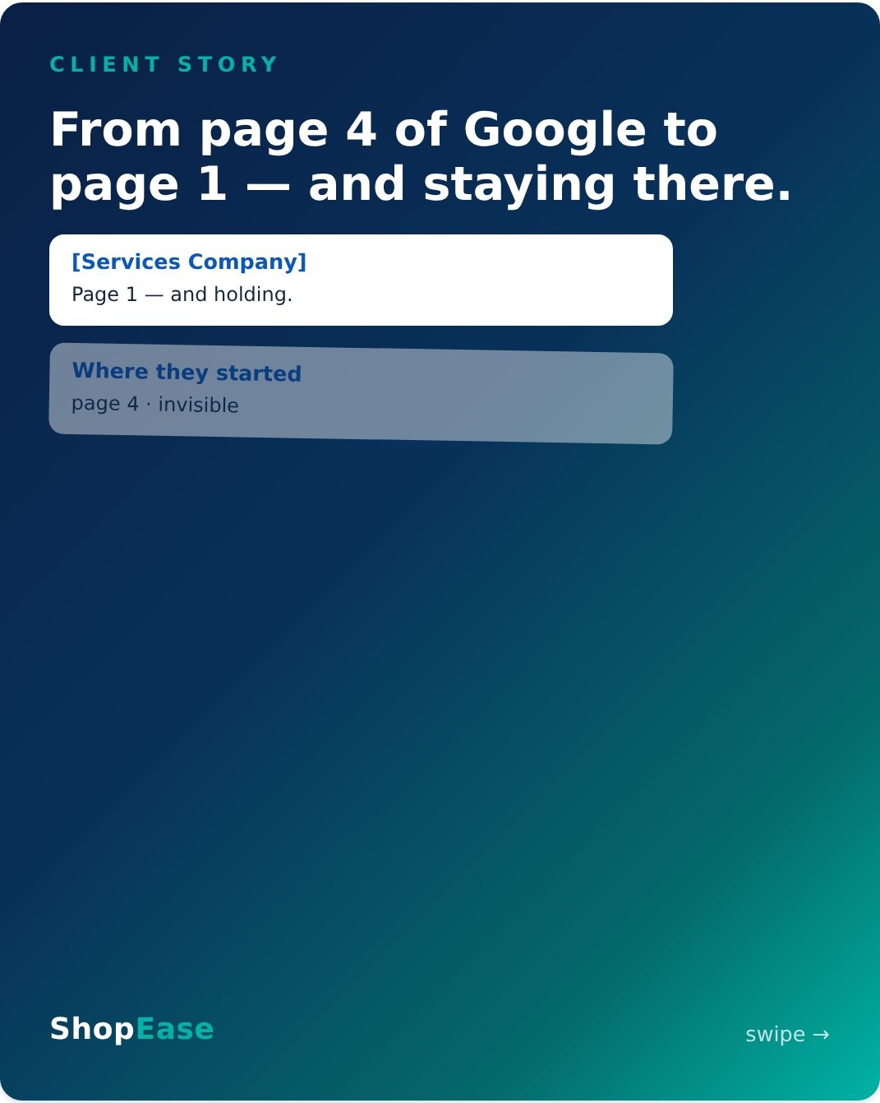
22 Case Study: [Services Company]
1080×1350 · 5 slides · Template C · Carousel · LinkedIn
CAPTION
Case study: how [Services Company] went from invisible to unmissable on Google. Swipe →
No tricks, no shortcuts — a disciplined monthly rhythm of content, optimization, and technical fixes. That's what modern SEO is: compounding work that turns into rankings competitors can't easily take back.
[X] months in, organic search became their single biggest enquiry channel. It still is.
Want to know how far you are from page 1? The audit is free — link in bio.
#CaseStudy #SEO #ContentStrategy #DigitalPakistan #BusinessGrowth #PakistanBusiness
POSTING CONTEXT
Excellent retargeting creative for anyone who engaged with Posts 7–12. Slides: cover → challenge → strategy → result → CTA.

Slide 31
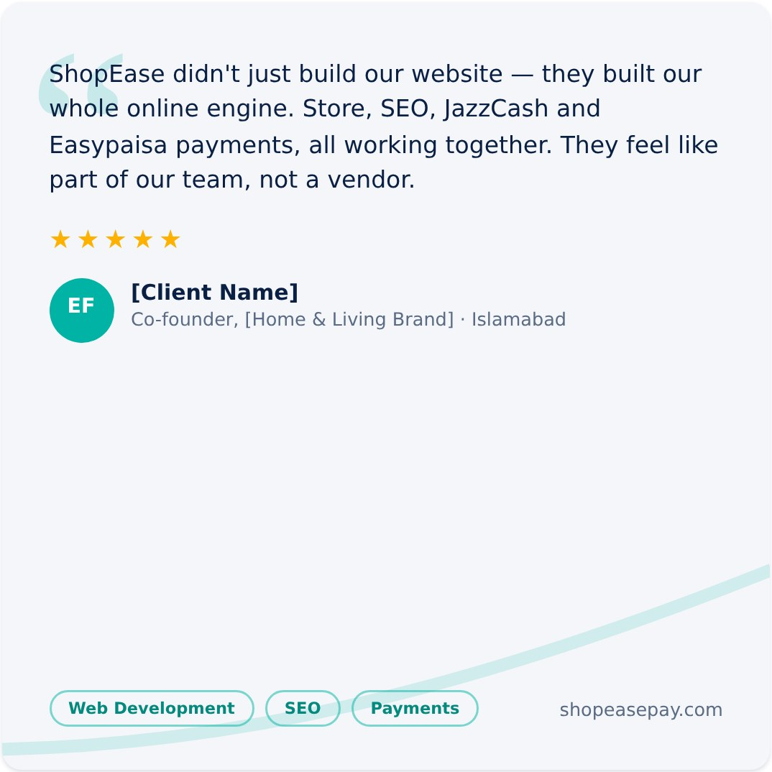
23 Testimonial: The Growth Partner
1080×1080 · Template D · Testimonial Card · LinkedIn + Instagram
CAPTION
The best compliment we get isn't about code. It's this: "They feel like part of our team." 🤝
[Home & Living Brand] came to us for a website. What they got was a growth engine: a fast custom store, an SEO program that brings buyers in, and wallet payments that let those buyers pay in seconds. Each piece makes the others work harder — that's the point of having one partner instead of three vendors.
We measure our success in your growth, not in deliverables shipped.
Looking for a partner, not a supplier? That's the only way we work. Link in bio.
#CustomerSuccess #GrowthPartner #EcommercePakistan #WebDevelopment #SEO #JazzCash
POSTING CONTEXT
The "all three services" proof point — schedule just before the CTA pillar begins, as the bridge into conversion content.

Slide 32
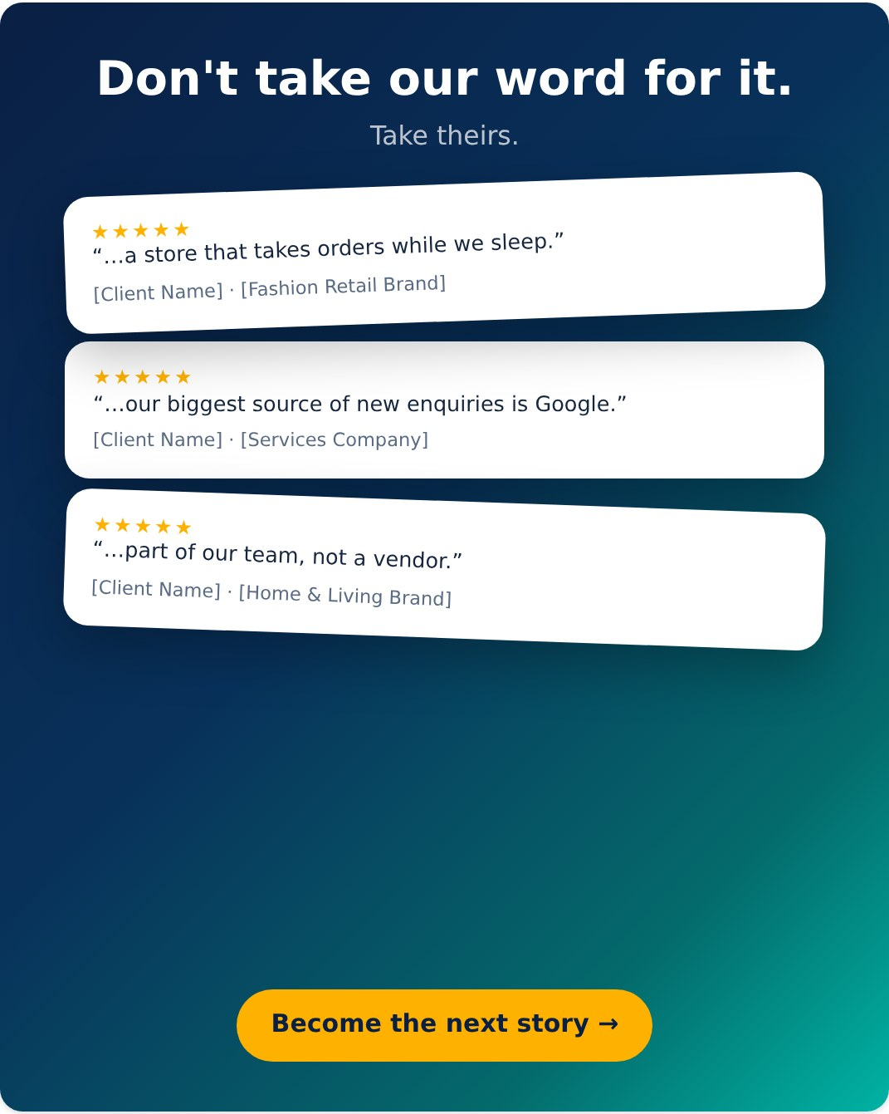
24 Wall of Love
1080×1350 · Template D · Multi-quote · All platforms
CAPTION
Three businesses. Three different challenges. One thing in common: they stopped renting their growth and started owning it. 💬
A fashion brand that escaped its DMs. A services firm that conquered page one. A home brand running store, search, and payments as one engine.
Every one of these started the same way — with a free consultation and an honest conversation about goals.
Yours can start today. Link in bio. 🚀
#Testimonials #CustomerSuccess #EcommercePakistan #DigitalPakistan #BusinessGrowth #WallOfLove
POSTING CONTEXT
Pillar finale — pin to profile, and reuse as the primary retargeting creative for warm audiences across the whole campaign.

Slide 33
PILLAR 5 · POSTS 25–30
Call-to-Action Posts
Direct conversion: consultations, audits, seasonal urgency, engagement hooks, and a warm founder close.

Slide 34
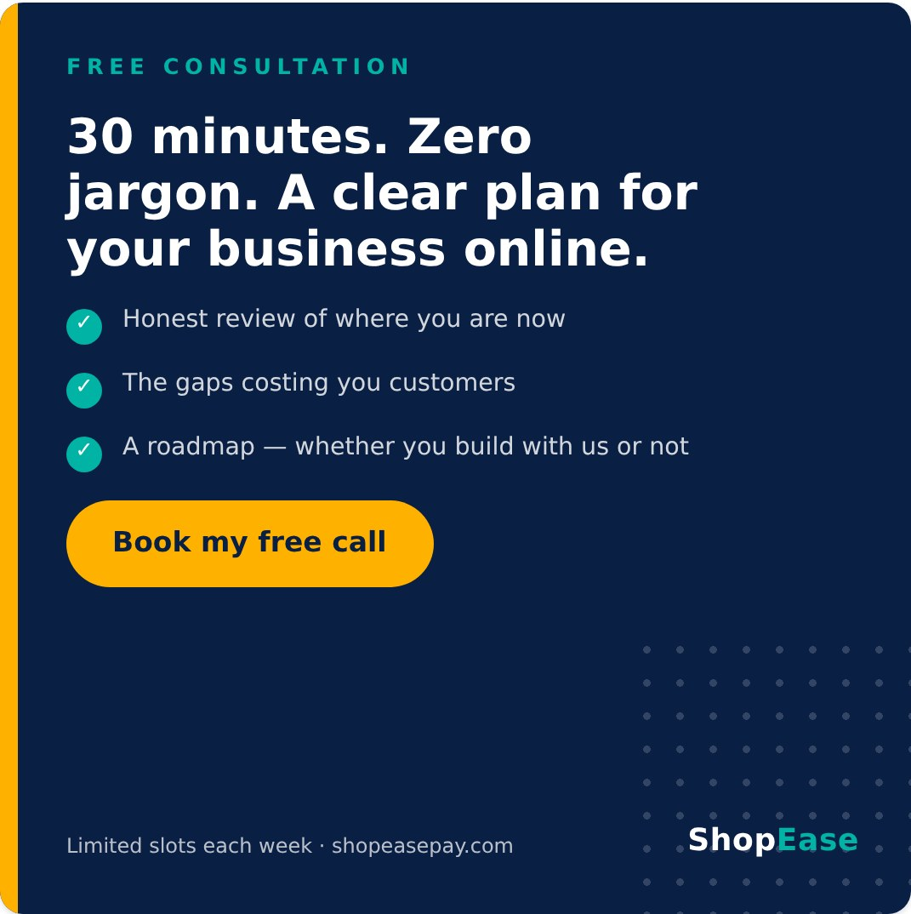
25 The Free Consultation
1080×1080 · Template H · CTA Banner · All platforms
CAPTION
The most useful 30 minutes you'll spend on your business this month — and it costs nothing. 📞
In one free consultation call, we'll look at your current online presence together and tell you honestly: what's working, what's leaking customers, and what we'd fix first. You leave with a clear roadmap either way — no obligation, no pressure, no jargon.
Why free? Because every client we have started with this exact conversation. Good partnerships begin with honest advice, not sales scripts.
Slots are limited each week. Book yours at the link in bio.
#FreeConsultation #DigitalPakistan #BusinessGrowth #WebDevelopment #SEO #PakistanBusiness
POSTING CONTEXT
The campaign's core conversion post. Run organically first, then as the primary ad creative to warm audiences. Repost monthly with rotated headlines.

Slide 35
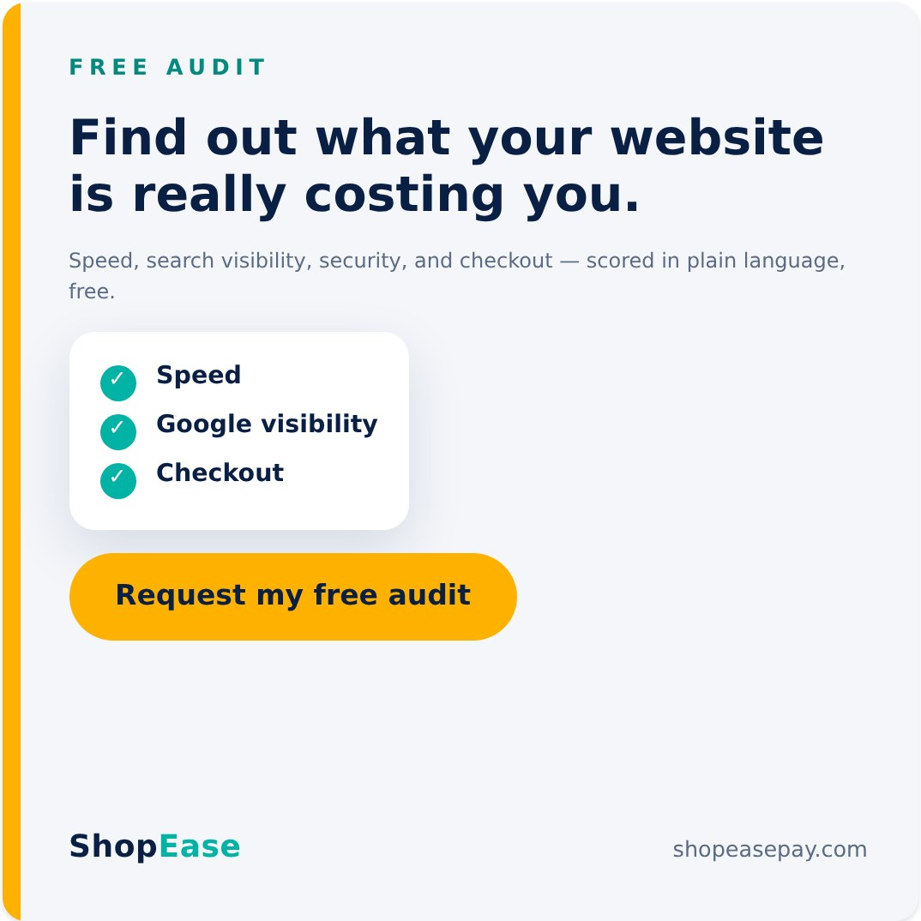
26 The Free Website & SEO Audit
1080×1080 · Template H · CTA Banner (light) · Facebook + Instagram (+ LinkedIn)
CAPTION
Your website might be quietly losing customers right now. Slow pages. Invisible on Google. A checkout that makes people give up. You'd never know — visitors don't file complaints, they just leave. 📋
Our free audit checks the four places money leaks out of a website:
⚡ Speed — do visitors wait or bounce?
🔎 Visibility — can Google find and rank you?
🔒 Security — would customers trust your checkout?
🛒 Conversion — how many obstacles before payment?
You get a plain-language scorecard and the three fixes we'd make first. Free, no strings — comment "AUDIT" or hit the link in bio.
#FreeAudit #WebsiteAudit #SEO #EcommercePakistan #DigitalPakistan #SmallBusinessPakistan
POSTING CONTEXT
Comment-trigger works hard on FB/IG; the LinkedIn version swaps the comment hook for the link. Great lead-gen ad for cold audiences.

Slide 36
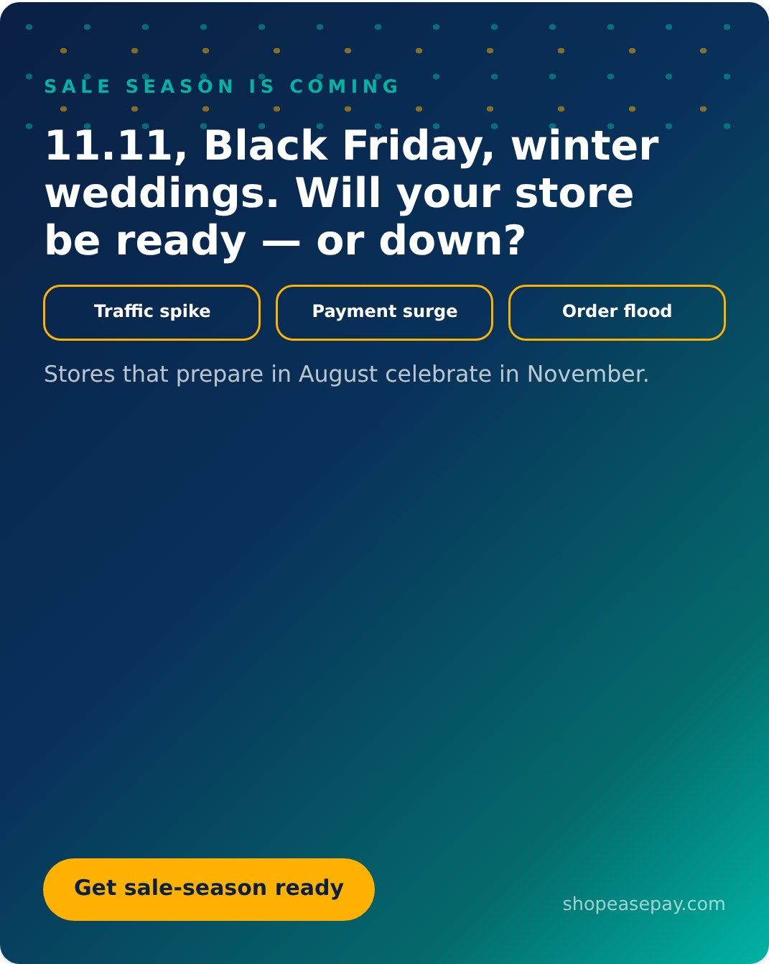
27 Ready for the Rush?
1080×1350 · Template A · Urgency · Instagram + Facebook
CAPTION
Every November, the same two stories. 🛍️
Store A prepared: fast pages under heavy traffic, wallet payments flowing, orders auto-confirmed. Their best month ever.
Store B "planned to fix things later": crashed on 11.11 morning, checkout failures all weekend, refund chaos into December.
The difference wasn't luck — it was starting in August. Right now is exactly when smart stores get their speed, scale, and Easypaisa/JazzCash checkout battle-tested for the busiest quarter of the year.
Sale season rewards the prepared. Which store will you be? Book a readiness call — link in bio.
#SaleSeason #1111Sale #BlackFriday #EcommercePakistan #Easypaisa #JazzCash #BusinessGrowth
POSTING CONTEXT
Publish August–September; re-run with updated countdown copy in October. Strong boost candidate to e-commerce owner audiences.

Slide 37
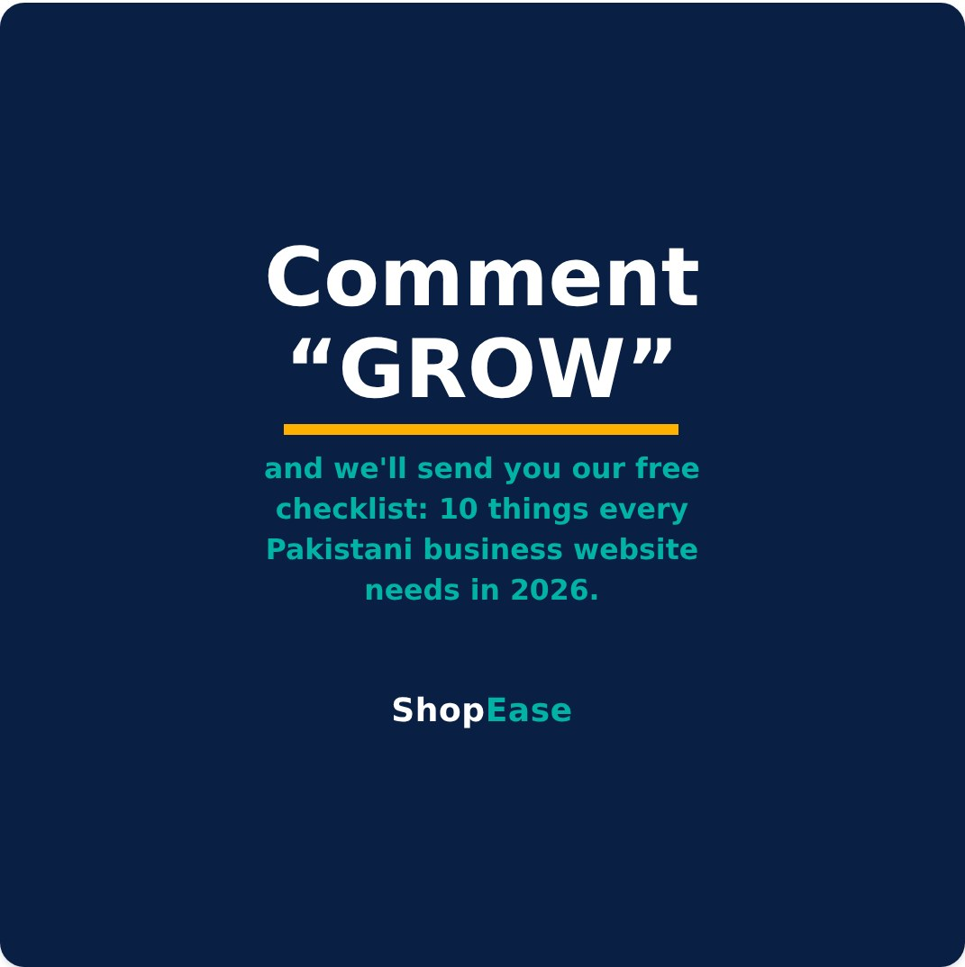
28 Comment “GROW”
1080×1080 · Minimal engagement hook · Instagram + Facebook only
CAPTION
No long caption today. Just a gift. 🎁
We've condensed everything we check before launching any client's website into one practical checklist: "10 Things Every Pakistani Business Website Needs in 2026." Speed, Google visibility, wallet payments, security, mobile experience — with simple yes/no checks you can run yourself.
Comment "GROW" and we'll DM it to you, free.
(And if your site fails more than three checks — you know where to find us. 😉)
#FreeResource #Checklist #DigitalPakistan #EcommercePakistan #SmallBusinessPakistan #GrowOnline
POSTING CONTEXT
Comment-to-DM mechanic. Reply to every "GROW" within hours. Requires the 10-point checklist PDF lead magnet to exist before posting.

Slide 38
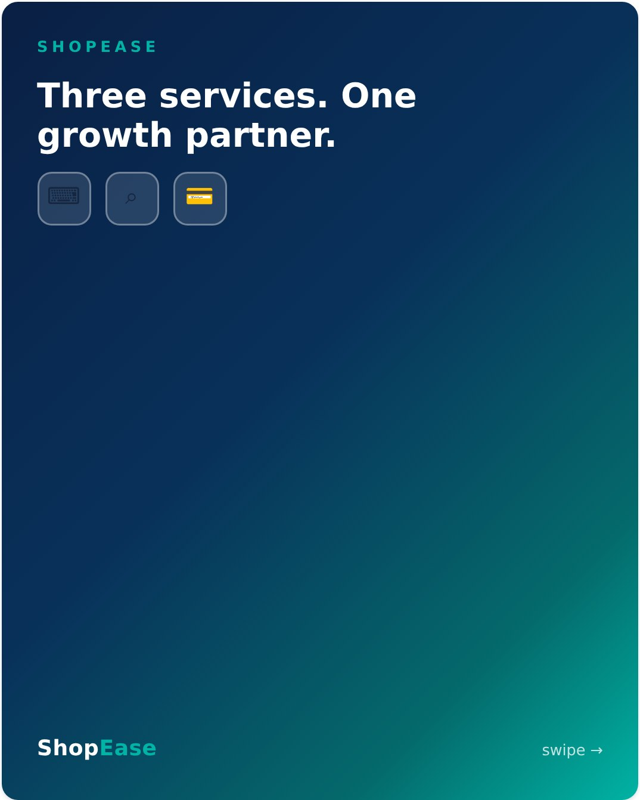
29 Three Services, One Partner
1080×1350 · 4 slides · Template C · Carousel · All platforms — pin everywhere
CAPTION
A website nobody finds is a brochure. Traffic that can't pay you is a statistic. 🧩
Online growth only works when the whole engine runs together:
🛠️ BUILD — a fast, secure custom store on the MERN stack
🔎 BE FOUND — SEO & content that bring in ready-to-buy searchers
💳 GET PAID — Easypaisa & JazzCash checkout that converts them
Most agencies sell you one piece. We build the engine — and stay to help you drive it. That's what a growth partner means.
Start where every client starts: a free consultation. Link in bio.
#GrowthPartner #WebDevelopment #SEO #Easypaisa #JazzCash #EcommercePakistan #DigitalPakistan
POSTING CONTEXT
The definitive "what we do" post. Pin to the top of every profile. Ideal first ad for cold audiences before retargeting with pillar content. Slides: cover → BUILD → BE FOUND → GET PAID/CTA.

Slide 39
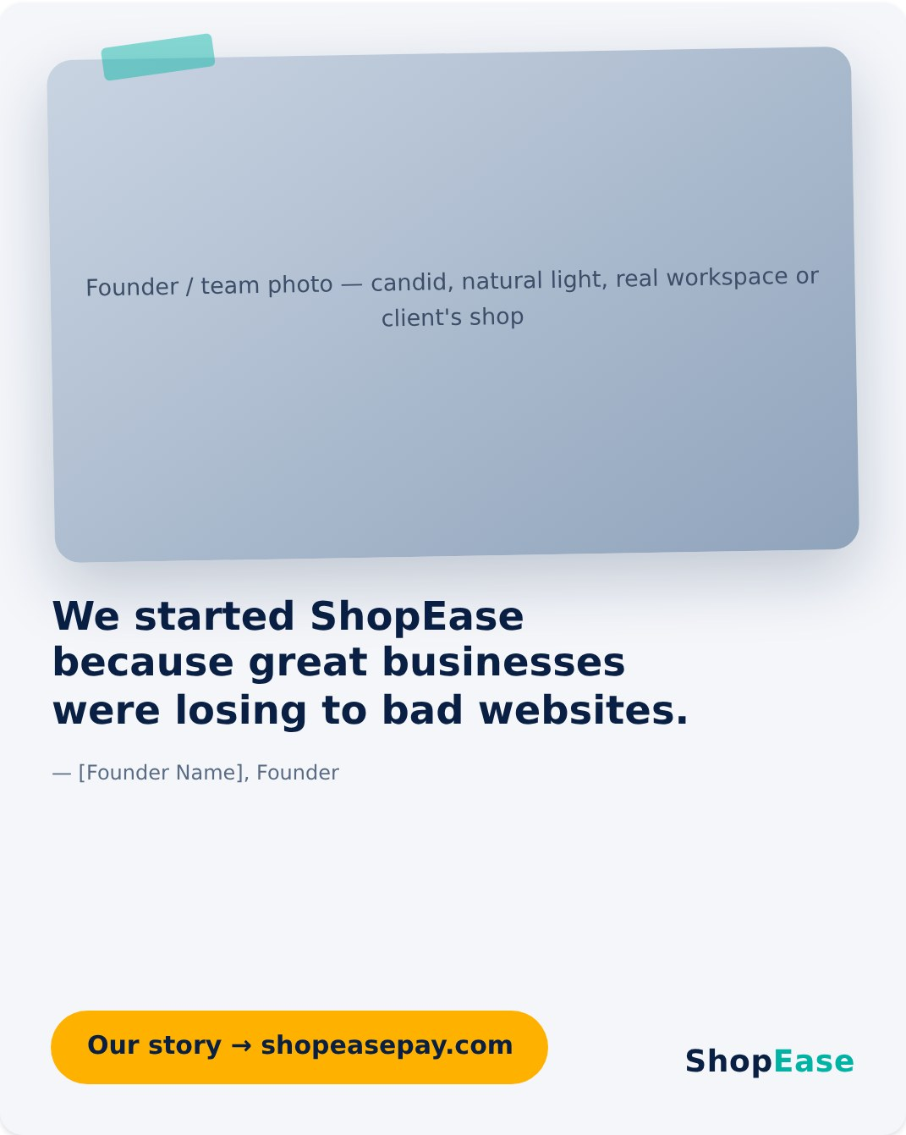
30 Why We Built ShopEase
1080×1350 · Template G · Photo-led · LinkedIn — founder profile first
CAPTION
A personal note, from our founder. 💚
"Everywhere I looked, I saw brilliant Pakistani businesses — incredible products, loyal customers, real hustle — losing online to competitors with worse products and better websites. Slow sites. Invisible on Google. Checkouts that couldn't take an Easypaisa payment in a country that runs on it.
That gap felt unfair. So we built ShopEase to close it: world-class web development, honest SEO, and payments that work the way Pakistan actually pays — delivered like a partner, not a vendor.
Every client's growth chart is why we do this. If you're building something, we'd love to build with you."
— [Founder Name], Founder, ShopEase
Start the conversation: link in bio.
#FounderStory #ShopEase #DigitalPakistan #PakistanStartups #SmallBusinessPakistan #GrowthPartner
POSTING CONTEXT
Founder-voice posts outperform brand posts on LinkedIn — publish from the founder's personal profile, reshare from the page. Campaign closer. Needs founder name, photo, and approval.

Slide 40
Before you publish
Fill the [bracketed] client names and [X] metrics in Posts 19–24 — or run the quotes anonymized. Metrics only with client-approved numbers.
Add the founder's name, photo, and sign-off for Post 30.
Produce the “10 Things Every Pakistani Business Website Needs in 2026” checklist PDF before running Post 28.
Re-verify the third-party stats in Posts 3 and 9 (Google/SOASTA, BrightEdge).
Match final artwork to the live logo and colors on shopeasepay.com and fb.com/Shopeasepay.
Full specs & source: marketing/shopease-social-posts/ · shopeasepay.com · fb.com/Shopeasepay

