Slide 1
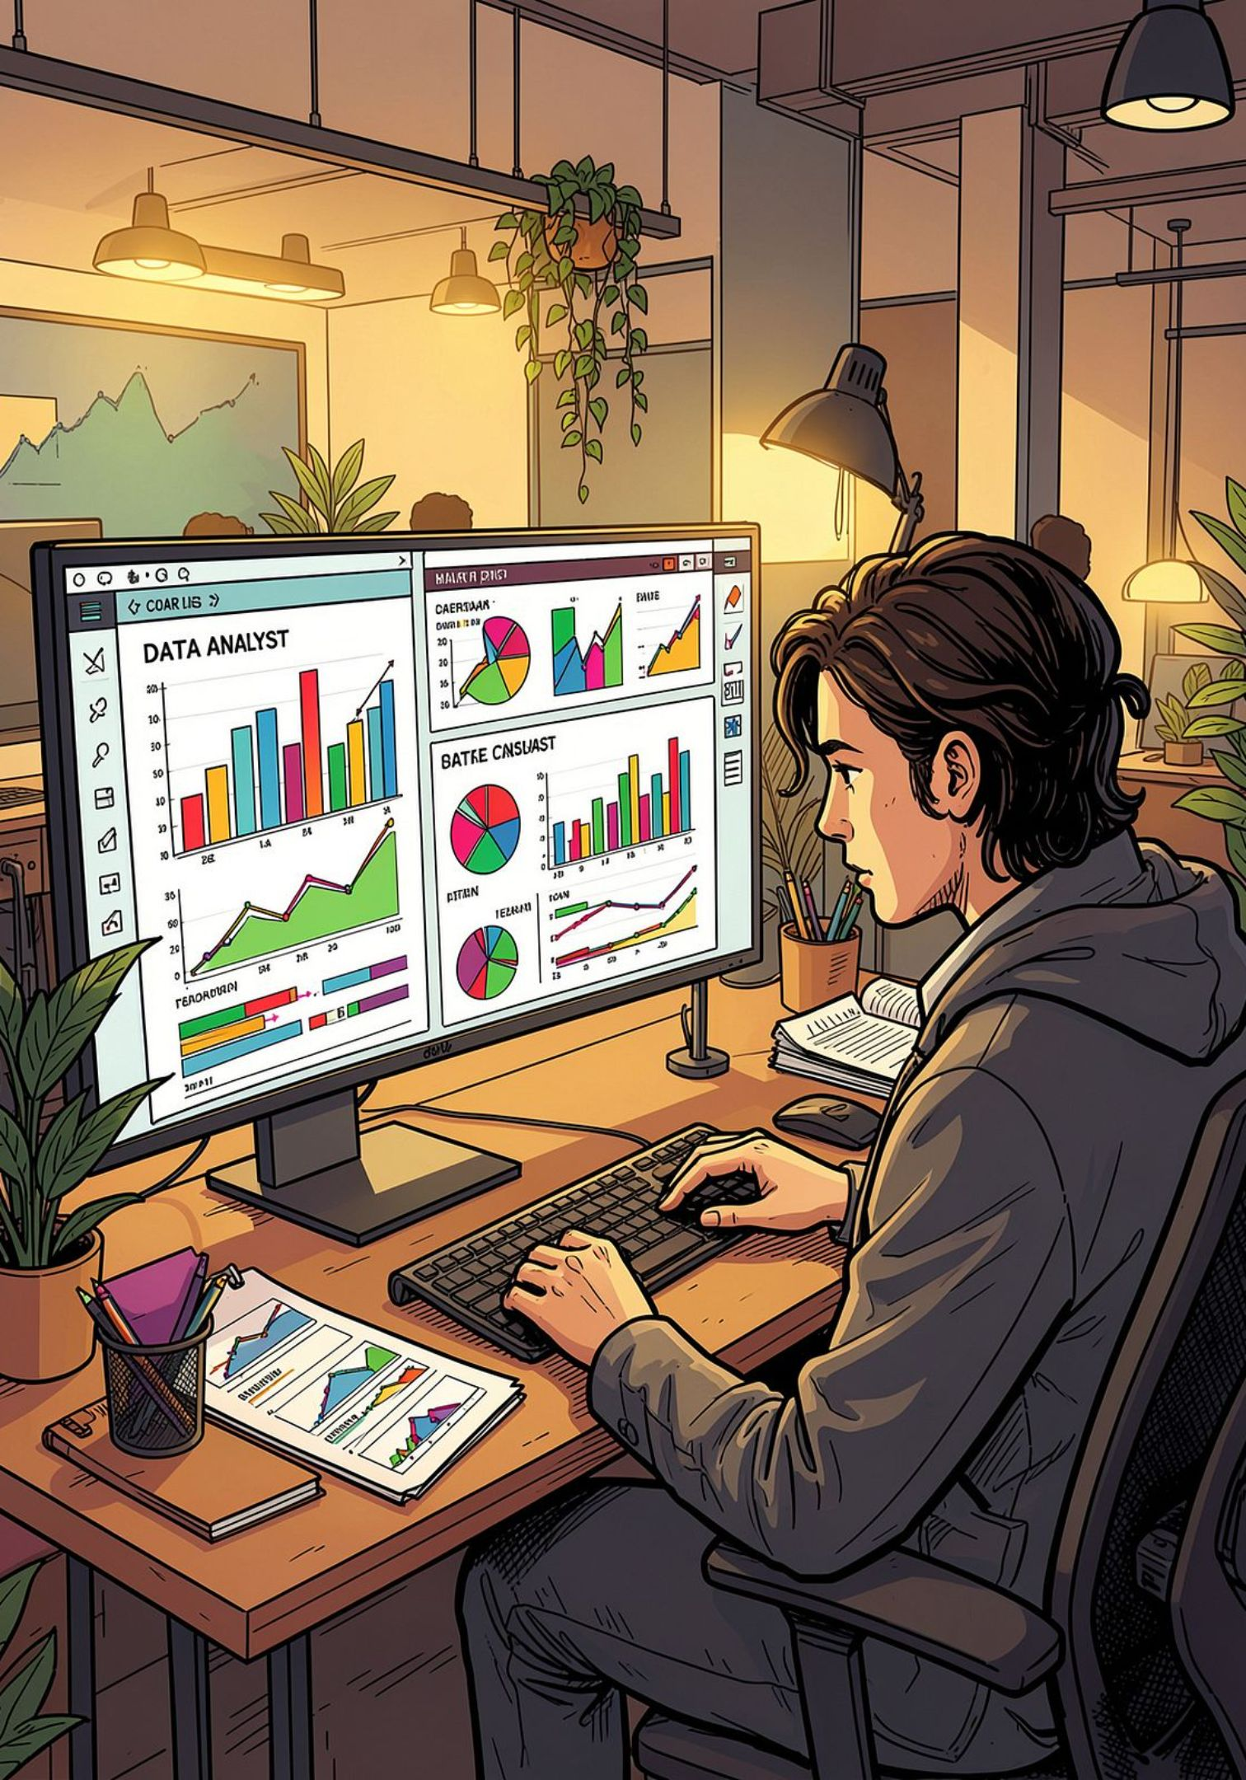
Customer Shopping Behavior Analysis
Uncovering insights from 3,900 purchases to guide strategic business decisions

Slide 2
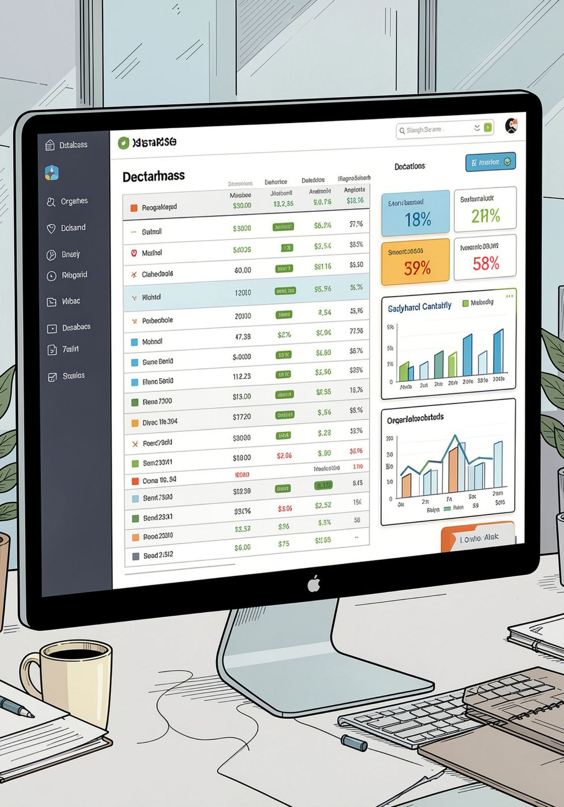
Dataset Overview
A comprehensive transaction dataset covering customer demographics, purchase history, and behavioral signals — ready for deep-dive analysis.
3,900
18
Total Purchases
Data Columns
Transactions analyzed across all customer segments
Comprehensive fields spanning demographics and behavior
37
Missing Values
Only in Review Rating — handled via median imputation

Slide 3
Data Preparation Process
A structured pipeline ensured data quality and analytical readiness before any insights were drawn.
01
02
03
Data Loading
Initial Exploration
Missing Data Handling
Imported the dataset using pandas for initial processing
Structure checks and summary statistics to understand data distribution
Imputed Review Rating values using the median to preserve data integrity
04
05
Feature Engineering
Database Integration
Created age group segments and purchase frequency metrics
Connected to PostgreSQL for scalable, repeatable analysis

Slide 4
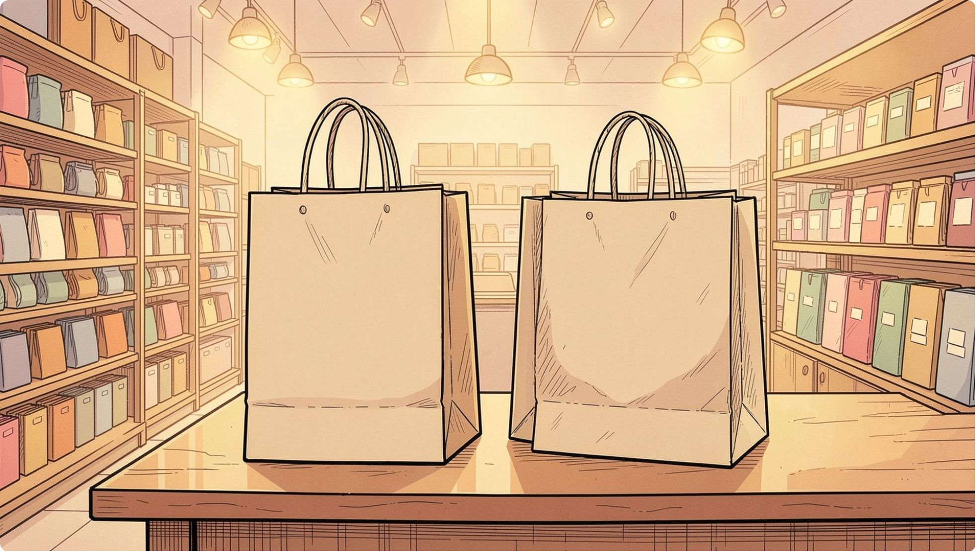


Revenue by Gender Analysis
Key Insight
Female customers generate slightly higher total revenue than male customers, suggesting an opportunity to refine gender-based marketing strategies.
Gender-based marketing strategies could further optimize revenue streams by tailoring offers to each segment's purchasing behavior.
Female
Male
Higher total revenue contribution
Strong baseline spending patterns

Slide 5
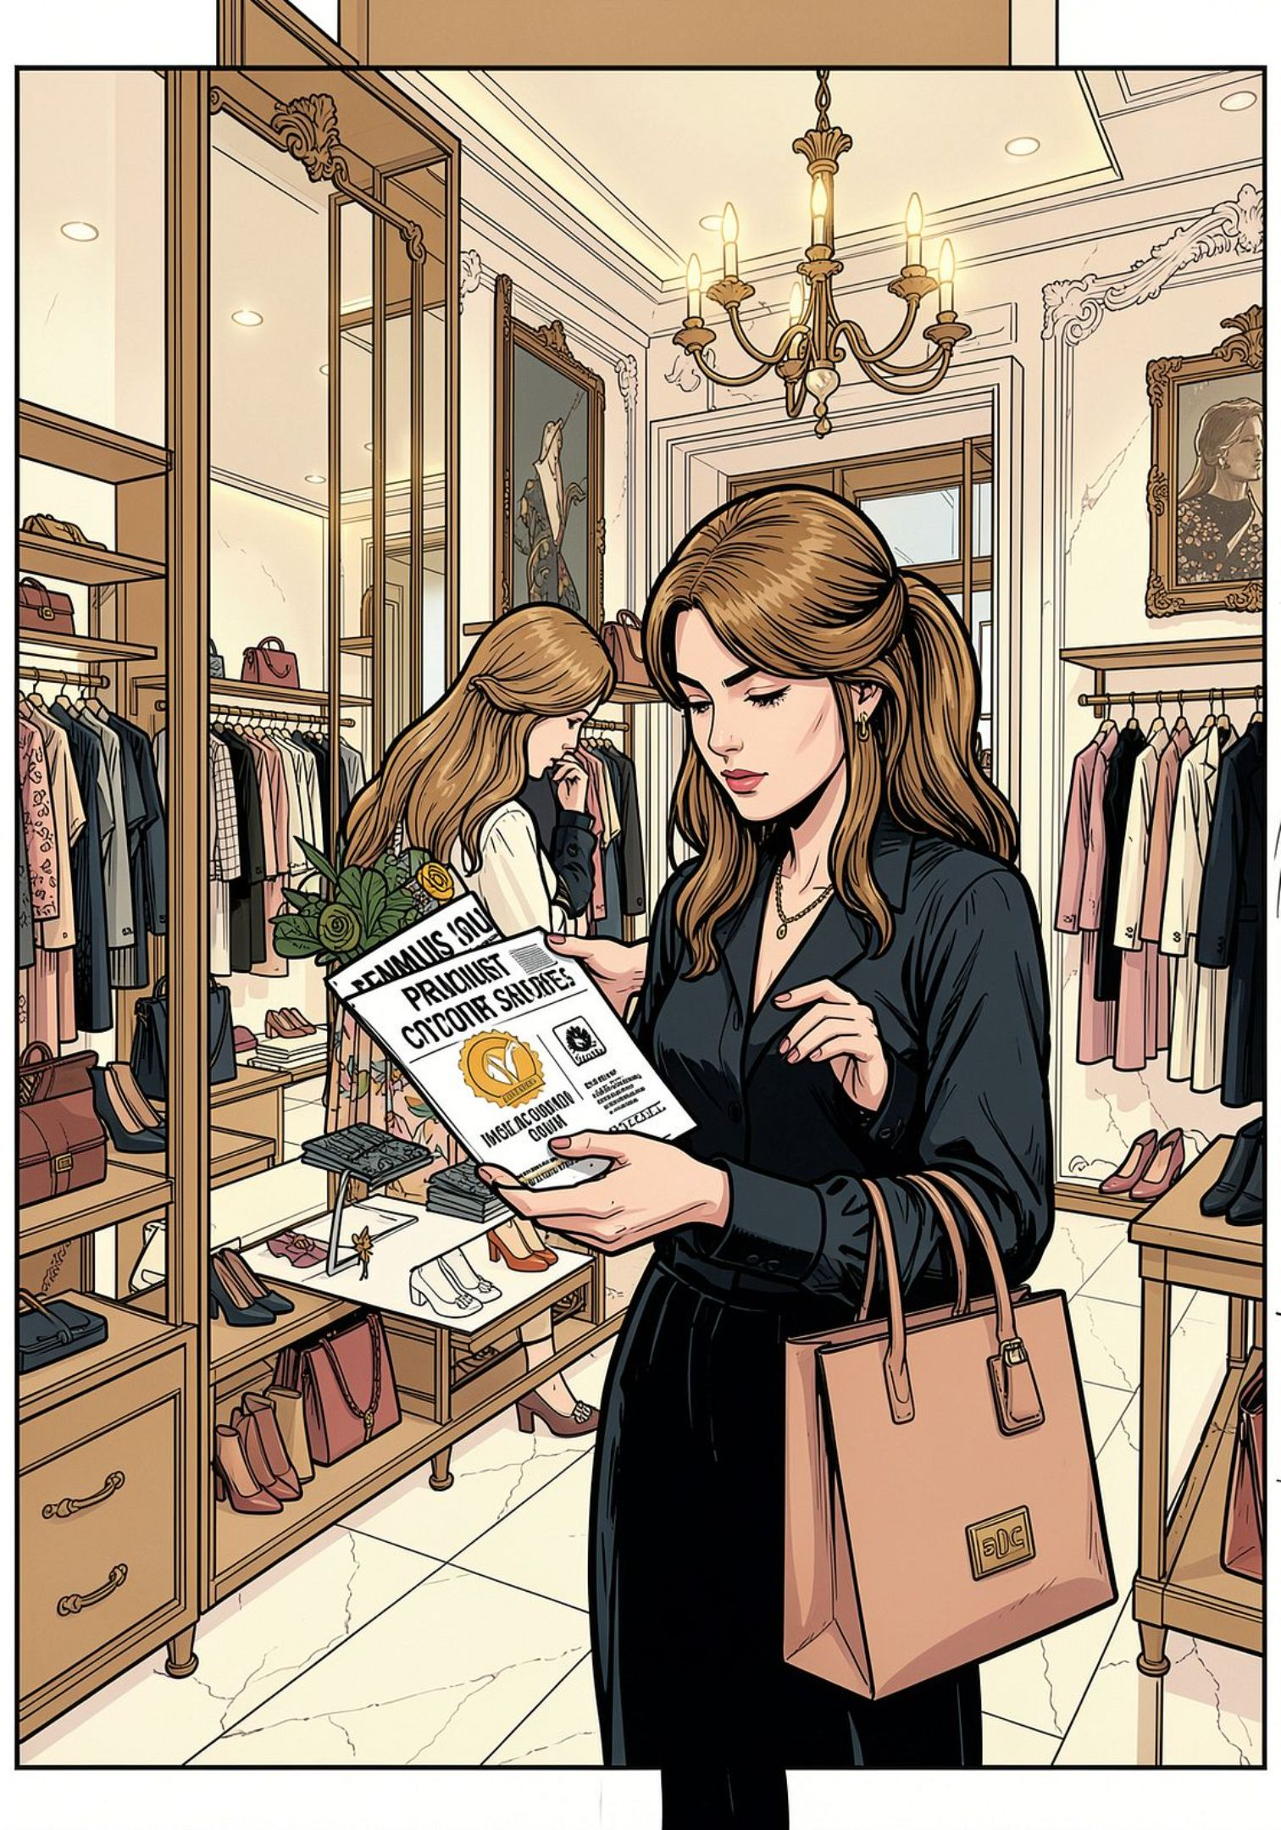
High-Value Discount Users
Customers who combine above-average spending with discount usage represent a uniquely valuable segment — deal-savvy yet high-revenue.
Smart Shoppers
High spenders who actively maximize value through discounts — they buy more, not just cheaper
Strategic Opportunity
Target premium customers with exclusive, members-only offers to reinforce loyalty and increase frequency

Slide 6
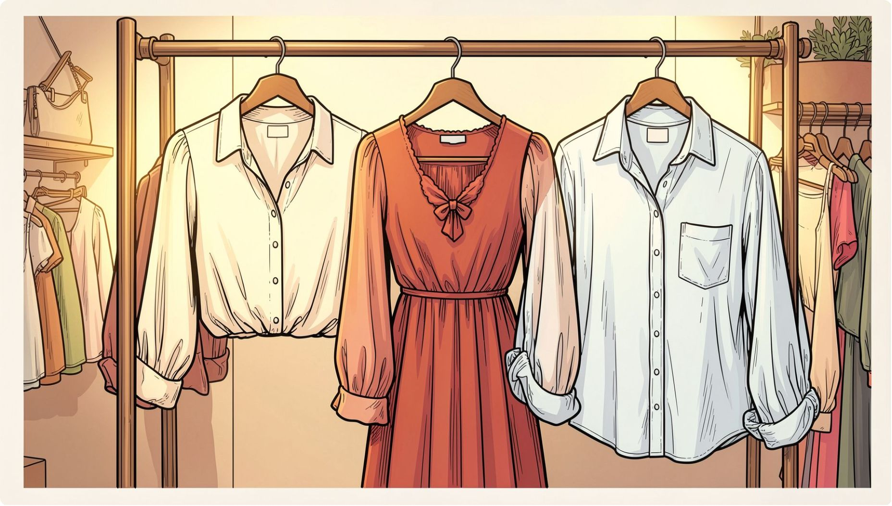

Top-Rated Products
Customer Satisfaction Leaders
Three product categories consistently earn the highest review ratings, signaling strong quality perception and repeat-purchase potential.
Feature these categories prominently in marketing campaigns and new customer onboarding flows.
👚 Blouse
👗 Dress
👔 Shirt
Highest customer satisfaction across all reviews
Consistently excellent ratings and strong approval
Reliable quality with broad customer appeal

Slide 7

Shipping Preferences Impact
Shipping choice is a meaningful signal of purchase intent — customers who select express shipping consistently spend more per transaction.
$65
$58
Express Shipping
Standard Shipping
Average purchase amount — customers who prioritize speed spend more
Average purchase amount — price-sensitive segment
Express shipping customers spend 12% more per transaction. Consider promoting express options at checkout to nudge higher basket sizes.

Slide 8
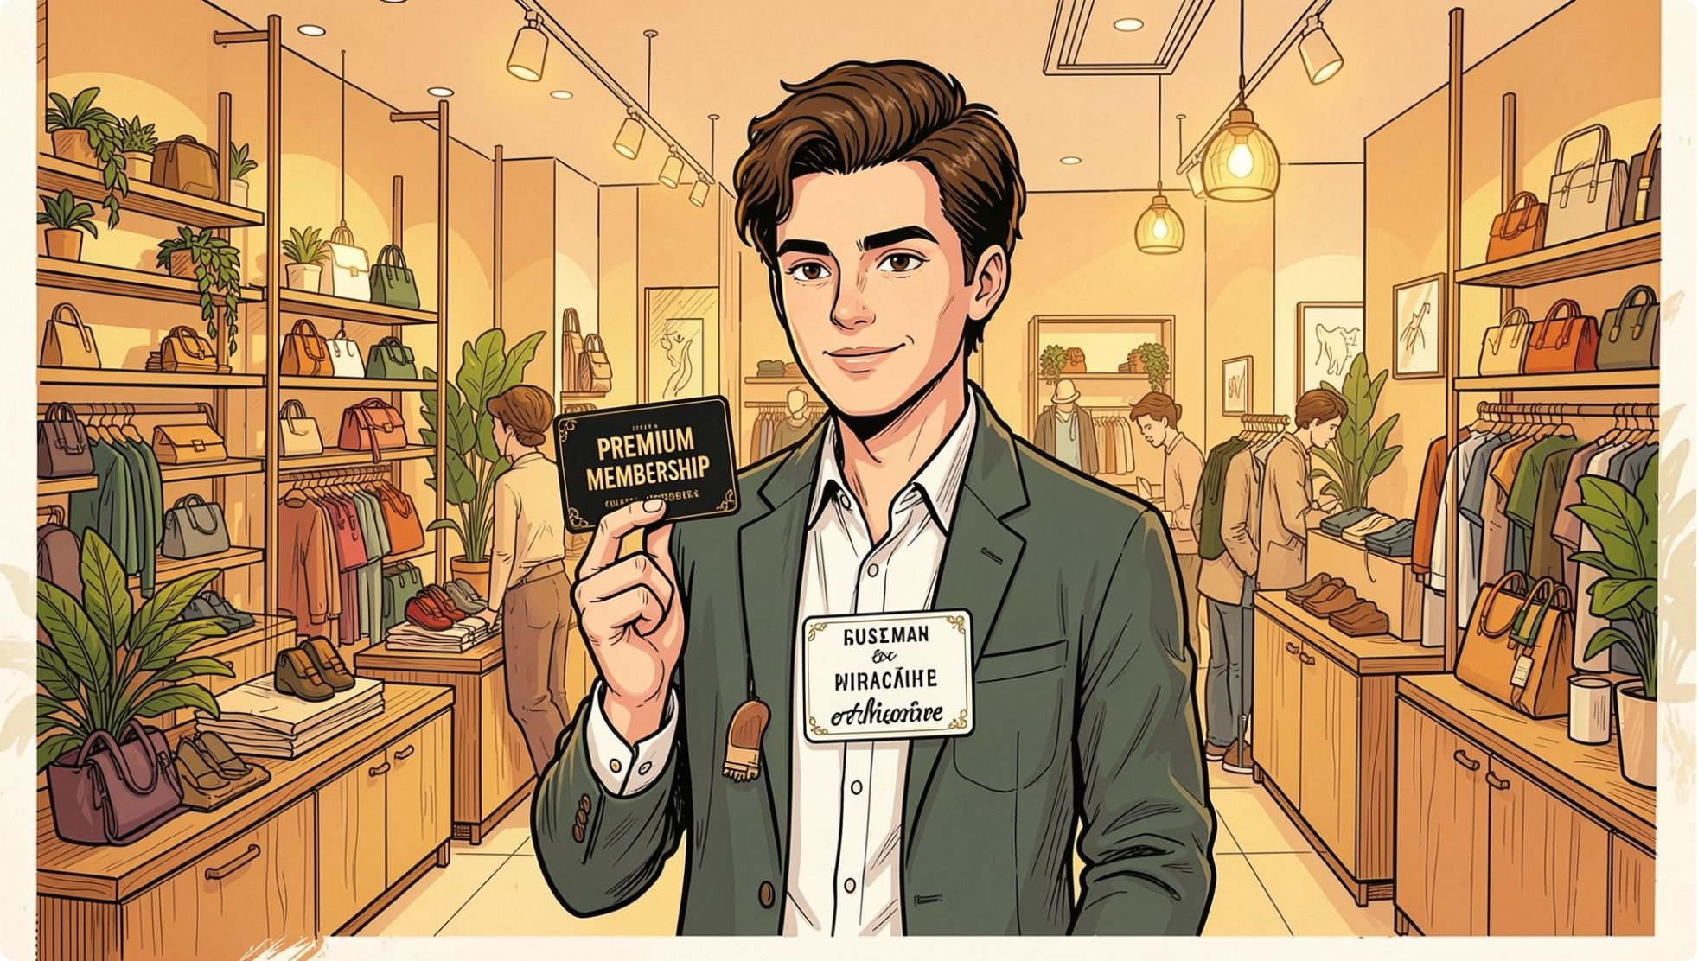

Subscription Impact
Subscribers Drive Disproportionate Value
Subscription customers consistently outperform non-subscribers across every key metric — making subscription growth a top strategic priority.
Higher Spend
Revenue Share
Loyalty Rate
Subscribers spend more per transaction than non-subscribers
Subscription customers contribute a significant share of total revenue
Subscribers show markedly higher repeat purchase frequency

Slide 9
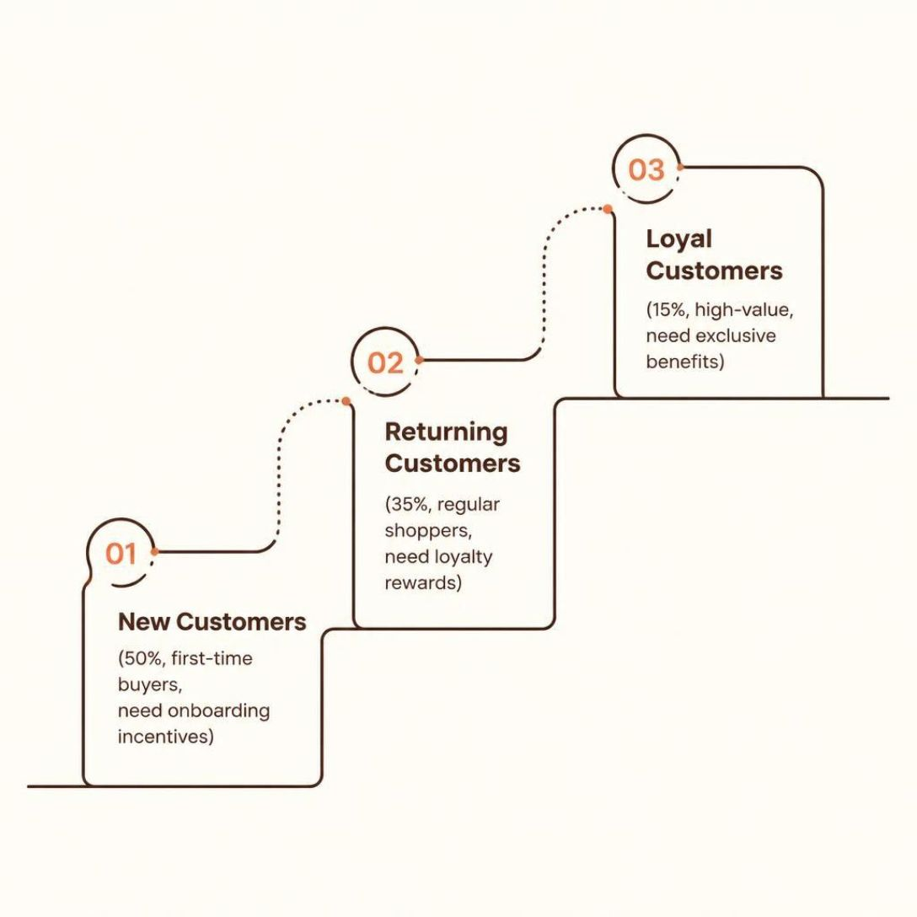

Customer Segmentation
Three Tiers of Customer Value
Half the customer base are first-time buyers — the greatest growth opportunity lies in converting them up the loyalty ladder.
Focus on converting New → Returning → Loyal through targeted onboarding and rewards.
1
Loyal — 15%
High-value, repeat customers
2
Returning — 35%
Regular shoppers with growth potential
3
New — 50%
First-time buyers needing conversion

Slide 10





Strategic Recommendations
Four high-impact actions to drive revenue growth and customer retention.
Boost Subscriptions
Promote exclusive subscriber benefits to grow the highest-value segment
Loyalty Programs
Reward repeat buyers to accelerate New → Returning → Loyal conversion
Targeted Marketing
Focus campaigns on high-revenue segments and express shipping users
Product Positioning
Highlight top-rated products — Blouses, Dresses, Shirts — in all campaigns

