Slide 1
Linear Methods for Classification
Jie Lu, Joy, Lucian
{jielu+,joy+, llita+}@cs.cmu.edu

Slide 2
Linear Methods for Classification
What are they?
  Methods that give linear decision boundaries between classes
  Linear decision boundaries {x: β₀ + β₁^{T} x = 0}
How to define decision boundaries?
  Two classes of methods
  Model discriminant functions δ_{k}(x) for each class as linear
  Model the boundaries between classes as linear

Slide 3
Two Classes of Linear Methods
Model discriminant functions δ_{k}(x) for each class as linear
  Linear regression fit to the class indicator variables
  Linear discriminant analysis (LDA)
  Logistic regression (LOGREG)
Model the boundaries between classes as linear (will be discussed on next Tuesday)
  Perceptron
  Non-overlap support vector classifier (SVM)

Slide 4
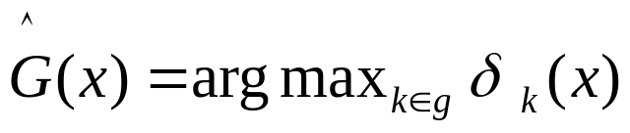
Model Discriminant Functions δ_{k}(x) For Each Class
Model
  Different for linear regression fit, linear discriminant analysis, and logistic regression
Discriminant functions δ_{k}(x)
  Based on the model
Decision Boundaries between class k and l
  {x: δ_{k}(x) = δ_{l}(x)}
Classify to the class with the largest δ_{k}(x) value

Slide 5

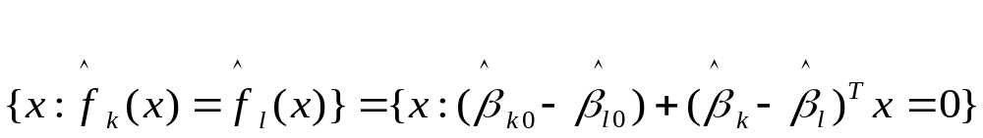
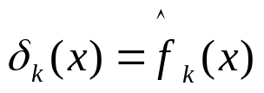

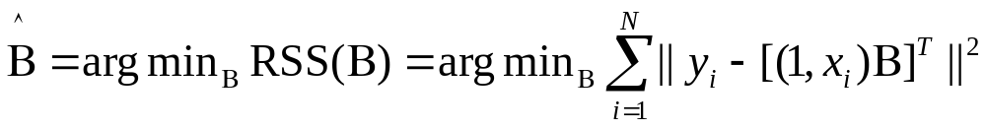
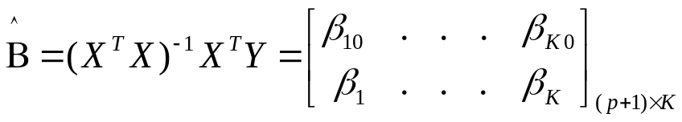
Linear Regression Fit to the Class Indicator Variables
Linear model for k^{th} indicator response variable
Decision boundary is set of points
Linear discriminant function for class k
Classify to the class with the largest value for its δ_{k}(x)
Parameters estimation
  Objective function
  Estimated coefficients

Slide 6

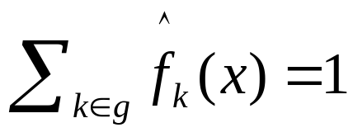
Linear Regression Fit to the Class Indicator Variables
Rationale
  An estimate of conditional expectation
  An estimate of the target value
  An observation:
  Why?
    A “straightforward” verification --- see next page
    courtesy of Jian zhang and Yan Rong

Slide 7
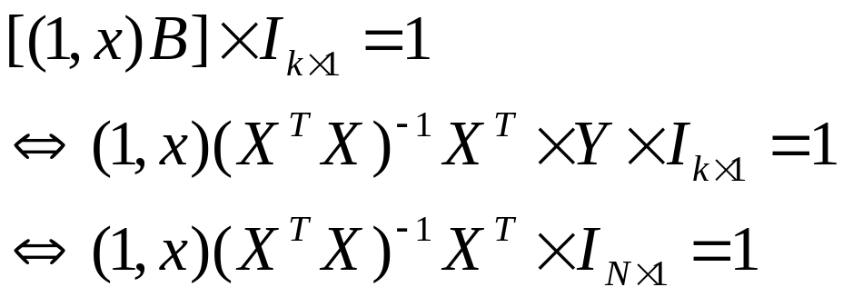
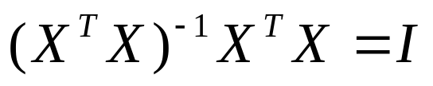
Linear Regression Fit to the Class Indicator Variables
Verification of
We want to prove
which is equivalent to prove
Notice that
(Eq. 1)
(Eq. 2)

Slide 8

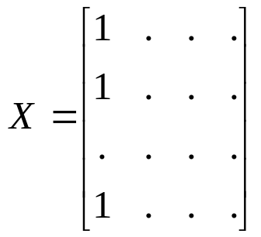
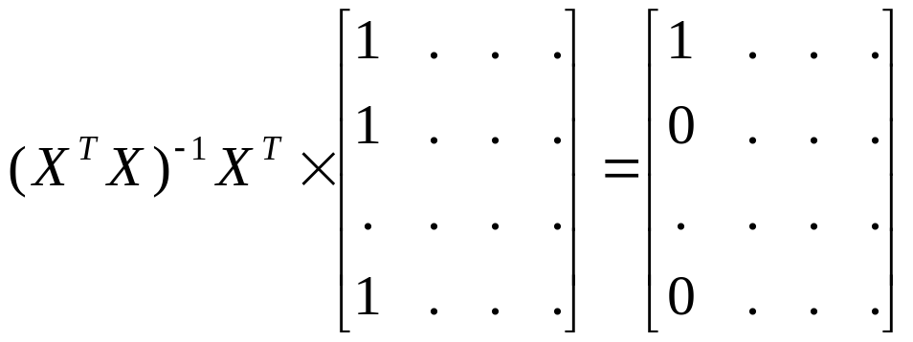
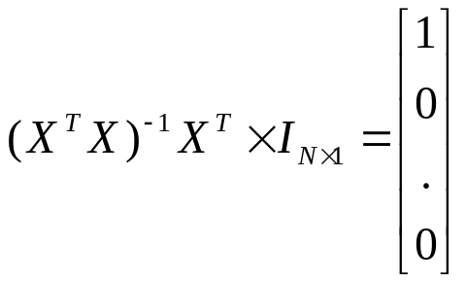
Linear Regression Fit to the Class Indicator Variables
And the augmented X has
From Eq. 2: we can see that
Which means that

Slide 9
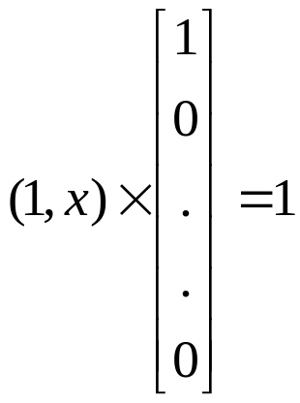
Linear Regression Fit to the Class Indicator Variables
Eq. 1 becomes:
True for any x.

Slide 10
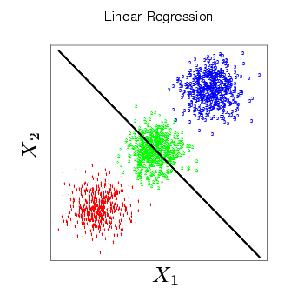
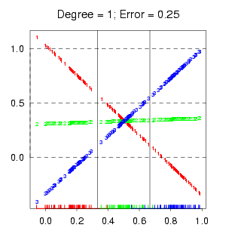
Mask
Problem
  When K≥3, classes can be masked by others
  Because the rigid nature of the regression model:

Slide 11
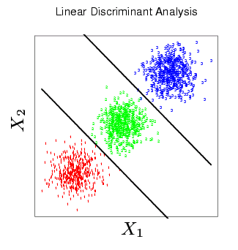
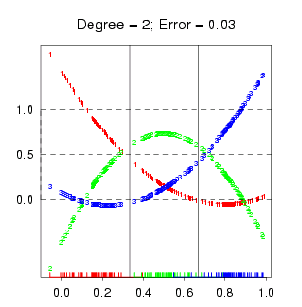
Mask(2)
Quadratic Polynomials

Slide 12
Linear Regression Fit
Question: P81 Let's just consider binary classification. In "machine learning course", when we transfer from regression to classification, we fit a single regression curve on samples of both two classes, Then we decide a threshold on the curve and finished classification. Here we use two regression curves ,each for a category.Can you compare the two methods? (Fan Li)
y
+++++
x
------

Slide 13
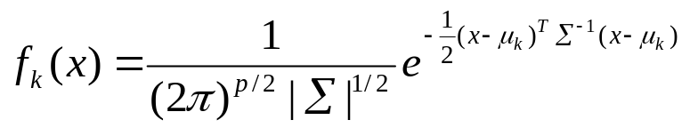
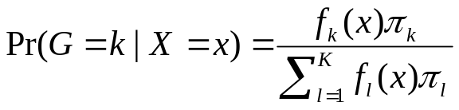
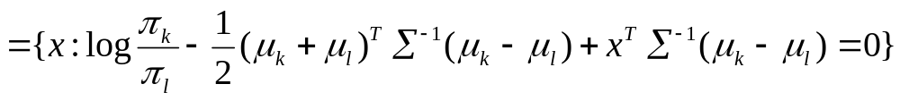
Linear Discriminant Analysis (Common Convariance Matrix Σ)
Model class-conditional density of X in class k as multivariate Gaussian
Class posterior
Decision boundary is set of points

Slide 14
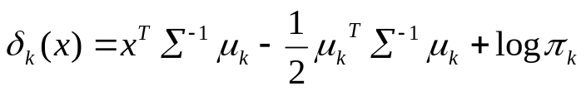
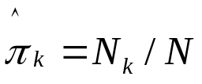
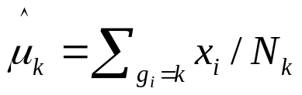
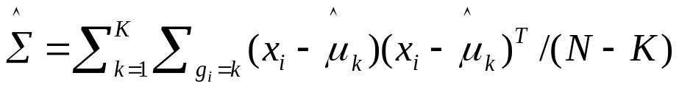
Linear Discriminant Analysis (Common Σ) con’t
Linear discriminant function for class k
Classify to the class with the largest value for its δ_{k}(x)
Parameters estimation
  Objective function
  Estimated parameters

Slide 15
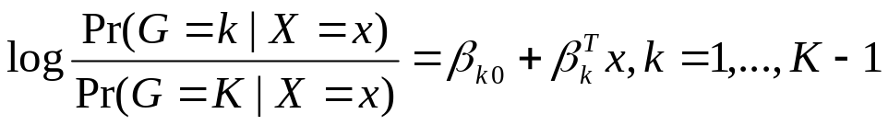
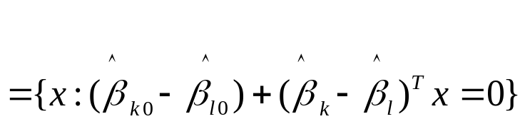

Logistic Regression
Model the class posterior Pr(G=k|X=x) in terms of K-1 log-odds
Decision boundary is set of points
Linear discriminant function for class k
Classify to the class with the largest value for its δ_{k}(x)

Slide 16
Questions
The log odds-ratio is typically defines as log(p/(1-p)), how is this consistent with p96 where they use log(pk/pl) where k,l are different classes in K. (Ashish Venugopal)

Slide 17
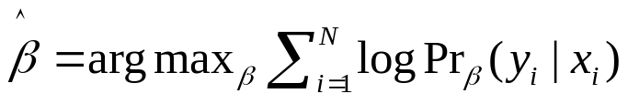
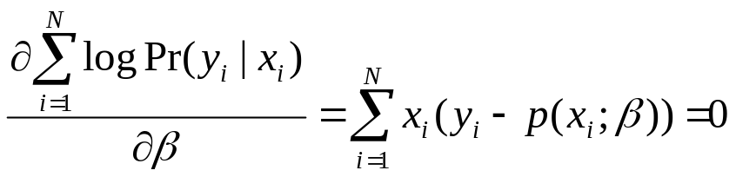
Logistic Regression con’t
Parameters estimation
  Objective function
  Parameters estimation
    IRLS (iteratively reweighted least squares)
    Particularly, for two-class case, using Newton-Raphson algorithm to solve the equation (pages 98-99 for details)

Slide 18
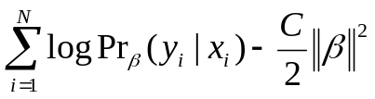
Logistic Regression con’t
When it is used
  binary responses (two classes)
  As a data analysis and inference tool to understand the role of the input variables in explaining the outcome
Feature selection
  Find a subset of the variables that are sufficient for explaining their joint effect on the response.
  One way is to repeatedly drop the least significant coefficient, and refit the model until no further terms can be dropped
  Another strategy is to refit each model with one variable removed, and perform an analysis of deviance to decide which one variable to exclude
Regularization
  Maximum penalized likelihood
  Shrinking the parameters via an L₁ constraint, imposing a margin constraint in the separable case

Slide 19
Questions
p102 Are stepwise methods the only practical way to do model selection for logistic regression (because of nonlinearity + max likelihood criteria)? (comparing to section 3.4: what about the bias/variance tradeoff, where we could shrink coefficient estimates instead of just setting them to zero?) (Kevyn Collins-Thompson)

Slide 20
Classification by Linear Least Squares vs. LDA
Two-class case, simple correspondence between LDA and classification by linear least squares
  The coefficient vector from least squares is proportional to the LDA direction in its classification rule (page 88)
For more than two classes, the correspondence between regression and LDA can be established through the notion of optimal scoring (Section 12.5).

Slide 21
Questions
On p88 paragraph 2 it says "the derivation of LDA via least squares does not use a Gaussian assumption for the features" - how can this statement be made, simply because the least squares coefficient vector is proportional to the LDA direction, how does that remove the obvious Gaussian assumptions that are made in LDA? (Ashish Venugopal)

Slide 22
LDA vs. Logistic Regression
LDA (Generative model)
  Assumes Gaussian class-conditional densities and a common covariance
  Model parameters are estimated by maximizing the full log likelihood, parameters for each class are estimated independently of other classes, Kp+p(p+1)/2+(K-1) parameters
  Makes use of marginal density information Pr(X)
  Easier to train, low variance, more efficient if model is correct
  Higher asymptotic error, but converges faster
Logistic Regression (Discriminative model)
  Assumes class-conditional densities are members of the (same) exponential family distribution
  Model parameters are estimated by maximizing the conditional log likelihood, simultaneous consideration of all other classes, (K-1)(p+1) parameters
  Ignores marginal density information Pr(X)
  Harder to train, robust to uncertainty about the data generation process
  Lower asymptotic error, but converges more slowly

Slide 23




Generative vs. Discriminative Learning
(Rubinstein 97)
 | Generative | Discriminative
Example | Linear Discriminant Analysis | Logistic Regression
Objective Functions | Full log likelihood: | Conditional log likelihood
Model Assumptions | Class densities: e.g. Gaussian in LDA | Discriminant functions
Parameter Estimation | “Easy” – One single sweep | “Hard” – iterative optimization
Advantages | More efficient if model correct, borrows strength from p(x) | More flexible, robust because fewer assumptions
Disadvantages | Bias if model is incorrect | May also be biased. Ignores information in p(x)

Slide 24
Comparison between LDA and LOGREG
(ErrorRate / Standard Error) | True Distribution
 | Highly non-Gaussian | N/A | Gaussian
LDA | 25.2/0.47 | 9.6/0.61 | 7.6/0.12
LOGREG | 12.6/0.94 | 4.1/0.17 | 8.1/0.27
(Rubinstein 97)

Slide 25
Questions
Can you give a more detailed explanation about the difference between the two methods: linear discriminant analysis and linear logistic regression. (P. 80. book: the essential difference between them is in the way the linear function is fit to the training data.) (Yanjun Qi)
P105 first paragrpha. Why conditional likelihood need 30% more data to do as well? (Yi Zhang)
The book says logistic regression is safer. Then it says LDA and logistic regression work very similar even when LDA is used in inappropriately, why not use LDA? Using LDA, we have a change to save 30% training data in case the assumption on marginal distribution is true. How inappropriately will make LDA worse than logistic regression? (Yi Zhang)
Figure 4.2 Shows the different effects from linear regression and linear
Discriminant analysis on one data set. Can we have a more deep and general understanding about when linear regression does not work well compared with linear discriminant analysis? (Yanjun Qi)

Slide 26
Questions
On p88 paragraph 2 it says "the derivation of LDA via least squares does not use a Gaussian assumption for the features" - how can this statement be made, simply because the least squares coefficient vector is proportional to the LDA direction, how does that remove the obvious Gaussian assumptions that are made in LDA? (Ashish Venugopal)
p91 - what does it mean to "Sphere" the data with a covariance matrix? (Ashish Venugopal)
The log odds-ratio is typically defines as log(p/(1-p)), how is this consistent with p96 where they use log(pk/pl) where k,l are different classes in K. (Ashish Venugopal)

Slide 27
Questions
Figure 4.2 on p. 83 gives an example of masking and in text, the authors go on to say, "a general rule is that...polynomial terms up to degree K - 1might be needed to resolve them". There seems to be an implication that adding polynomial basis functions according to this rule could be detrimental sometimes. I was trying to think of a graphical representation of a case where that would occur but can't come up with one. Do you have one? (Paul Bennett)
(p. 80) what do the decision boundaries for the logit transformation space look like in the original space? (Francisco Pereira)
(p. 82) whis is E(Y_k|X=x) = Pr(G=k|X=x)? (Francisco Pereira)
(p. 82) the target approach is just "predicting a vector of with all 0s except 1 at the position of the true class"? (Francisco Pereira)
(p. 83) Can all of this be seen as projecting the data into a line with a given direction and then dividing that line according to the classes (seems so in 2 class case, not sure in general). (Francisco Pereira)

Slide 28
Questions
What is the difference between logistic regression and exponential model, in terms of definition, properties and experimental results? ( Discriminative VS Generative) [Yan Liu]
The question is on the Indicator response matrix: as a general way to decompose the multi-class classification problems to binary-class classification problems, when it is applied, how do we evaluate the results? (Error rate or something else?) There is a good way called ECOC (Error Correcting Output Coding) to reduce multi-class problems to binary-class problems, can we use the same way as indicator response matrix and do linear regression? [Yan Liu]
On page82. Why it is quite straight forward to that sum f,(x) =1 for any x?
As is said in the book (page 80), if the problem is linearly non-separable, we can expand our variable set X1, X2,.., Xp by including their squares and cross-product and solve it. Furthermore, this approach can be used with any basis transformation. In theory, can any classification problems be solved using this way? (Maybe in practical, we might have the problems like “curse of dimension”) [Yan Liu]

Slide 29
Questions
one important step for applying regression method to the classification problem is to encode the class label into some code scheme. In the book, it only illustrates the simplest one. More complicated code scheme includes the redundant code. However, it is not necessary to encode the class label into N region. Do you think it is possible to encode it with real number and actually achieve better performance? [Rong Jin]
P.82. Book: If we allow linear regression onto basis expansions h(X) ofthe inputs,this approach can lead to consistent estimates of the probabilities.I do not fully understand this sentence. [Yanjun]
In LDA, book tells us that it is easy to show that the coefficient vectorfrom leastsquares is proportional to the LDA diretion given by 4.11.Then how to understand this correspondence occurs for any distinct coding ofthe targets? [Yanjun]
Both LDA and QDA performs well on an amazingly large and diverse set ofclassification tasks.But LDA assumes the data covariances are approximatel equal. Then i feelthis methodis too restricted to the general case, right? [Yanjun]

Slide 30
Questions
The indicator matrix Y in the 4.2 first paragraph is a matrix of 0's and1's, with each row having a single 1. It seems that we can extends it to multi-label data by allowing each row having two or more 1, and for the model using Eq. 4.3. Have this way been tried in multi-label classification problem? [Wei-hao]

Slide 31
References
Rubinstein, Y. D., & Hastie, T. (1997). Discriminative vs. informative learning. In Proceedings Third International Conference on Knowledge Discovery and Data Mining, pp. 49--53.
Jordan, M. I. (1995) "Why the logistic function? A tutorial discussion on probabilities and neural networks," Technical Report
  A. Y. Ng and M. I. Jordan, "On Discriminative vs. Generative Classifiers: A Comparison of Logistic Regression and Naive Bayes," Neural Information Processing Systems
  p88 "QDA is generally preferred to LDA (in the quadratic space)". Why,and how do you decide which to use?(Is the main reason because QDA is more general in what it can modelaccurately, in not assuming a common covariance across classes?) [Kevyn]
"By relying on the additional model assumptions,we have more information about the parameters,and hence can estimate them more efficiently (low variance)“, how? [Jian]

