Slide 1
Supply Chain Inventory Management using Deep RL
Reinforcement Learning
Deetya Ashish Mehta

Slide 2
Problem Statement
Too much stock => excess holding costs, tied up capital.
Too little stock => stockouts, lost revenue, customer churn.
Traditional methods (EOQ, reorder-point) assume stationary demand. They fail under noisy, real world conditions.
Demand data is stochastic: seasonal spikes, supply disruptions and promotions violate static assumptions.
OBJECTIVE: Learn an ordering policy that maximizes cumulative profit while keeping stockout frequency low.

Slide 3
Existing Approaches - Classical & RL Methods
Classical OR:
EOQ / (s,S) Policy: Wilson(1913) / Arrow et al.(1951) - closed form formulae; optimality only under stationary Gaussian demand.
Newsvendor Model: Single period stochastic demand solved analytically; fails for multi period; lost sales settings.
MILP / Stochastic Demand: Exact optimization but NP-hard at scale; computationally infeasible for long horizons.
Tabular RL:
Q-Learning(Watkins 1989): Discrete state-action table; converges to optimal policy for small MDPs. (Our baseline)
SARSA: On-policy variant; more conservative but slower convergence than Q-Learning.

Slide 4
Existing Approaches - Classical & RL Methods
Deep RL:
DQN(Mnih et al. 2015): Experience replay + target network stabilise training; first scalable value-based Deep RL.
LSTM-DQN(Hausknecht & Stone 2015): Adds recurrent memory to handle partial observability / demand truths.
PPO(Schulman et al. 2017): Clipped surrogate objective prevents catastrophic policy updates; state-of-the-art policy gradient.
A3C/VPG: Asynchronous actor-critic and vanilla PG - predecessors to PPO; higher variance.

Slide 5
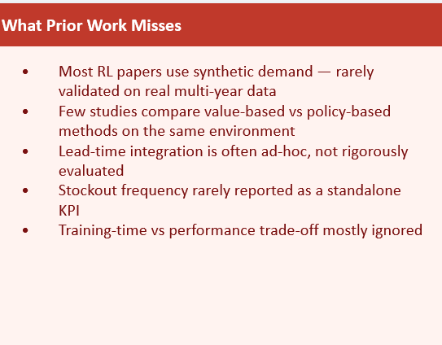
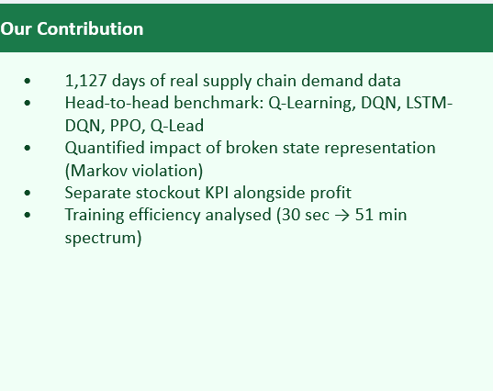
Gap in Literature and Our Contribution

Slide 6
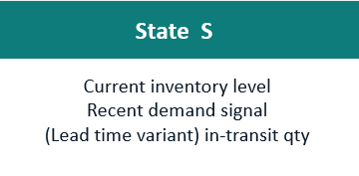
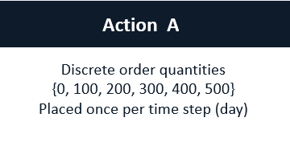
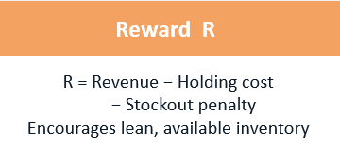
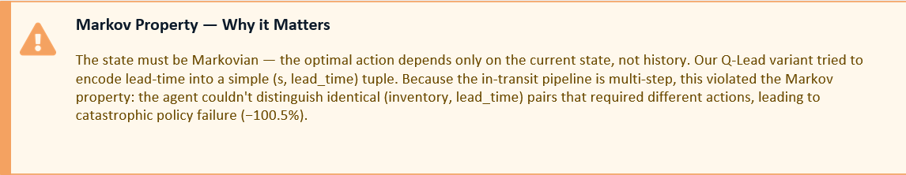
MDP Formulation - State, Action, Reward

Slide 7
Early Implementations & Exploratory Work

Slide 8
Environment Design: Discrete vs Continuous
Discrete Env(Q-Learning / TD(0)): simple_supply_chain_qlearning.py
State space: 63 hand-crafted states
3 inventory bins x 3 demand bins x 7 day-of-week
Actions: {0,200,400,600} units
Reward: revenue - $2/unit holding - $15/unit stockout - $100 order cost
Limitation: inventory 201 and 499 look identical to the agent
Continuous Env(PPO): envs/inventory_env.py
4D Observation vector(normalised): =>inventory level
=>7 day average demand
=>sin(day-of-week) & cos(day-of-week)
Sinusoidal encoding avoids Day 6 => Day 0 discontinuity.
Enables neural net to learn smooth periodic patterns.

Slide 9
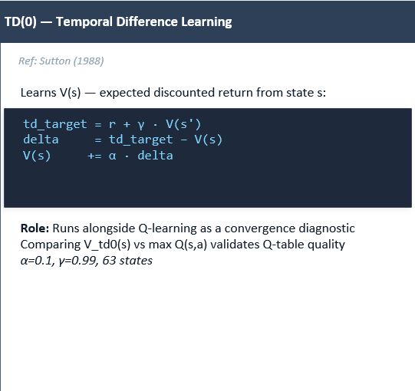
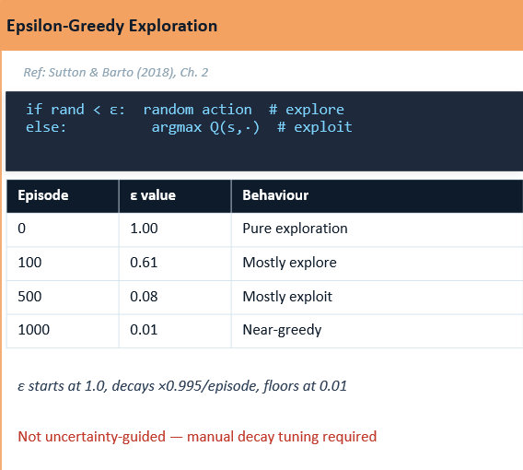
TD(0) State-Value Estimator & Epsilon-Greedy Exploration

Slide 10
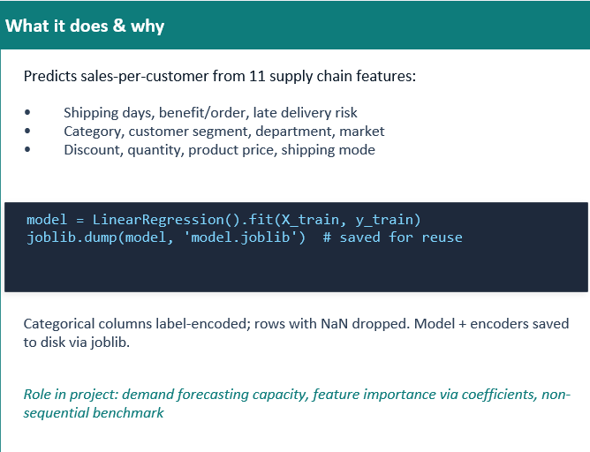
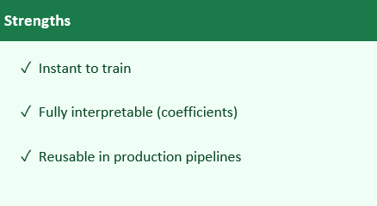
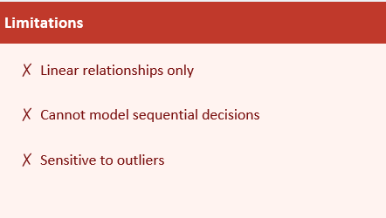
Linear Regression - Supervised Demand Forecasting Baseline

Slide 11
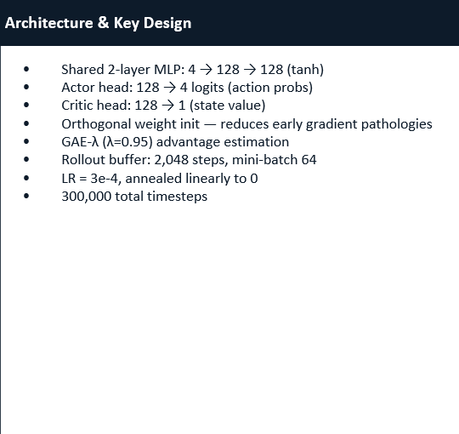
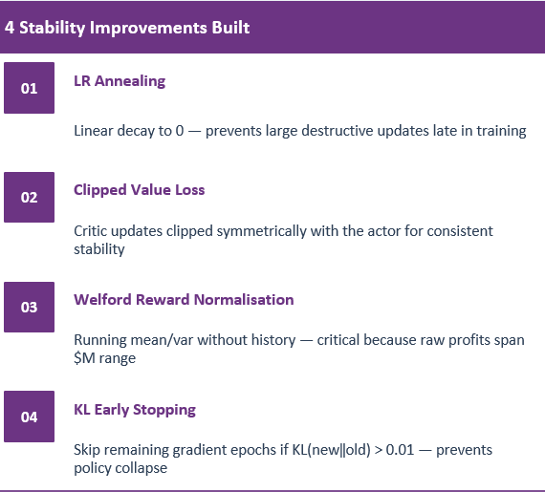
PPO - Early Implementation

Slide 12
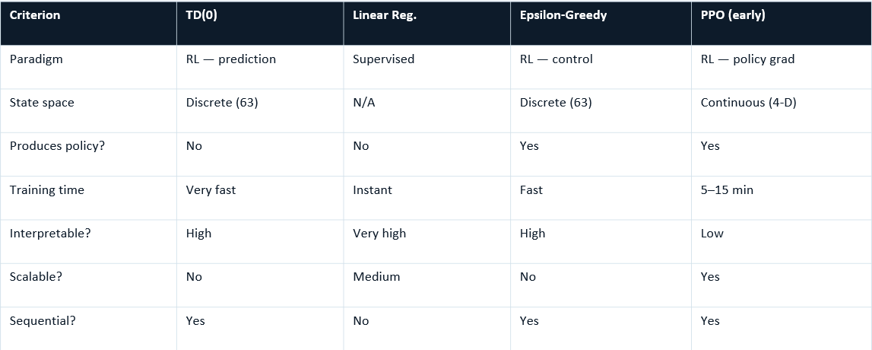
Early Implementation Component Comparison
These components established the dual-environment design and hyperparameter intuitions carried into the final LSTM-DQN and DQN implementations

Slide 13
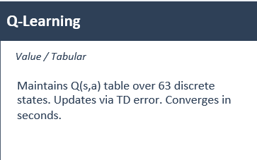
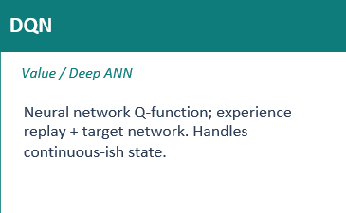
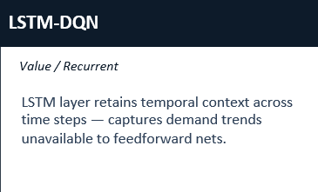
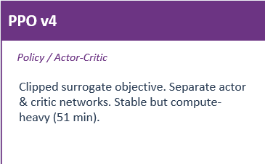
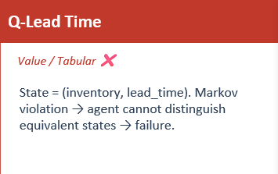
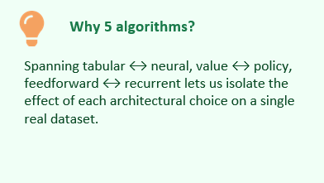
Algorithms Implemented

Slide 14
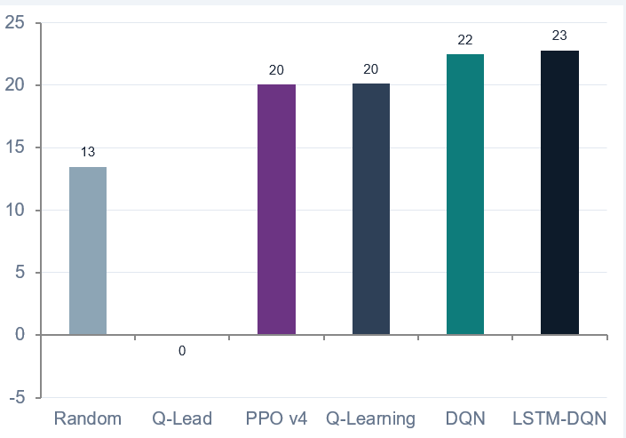
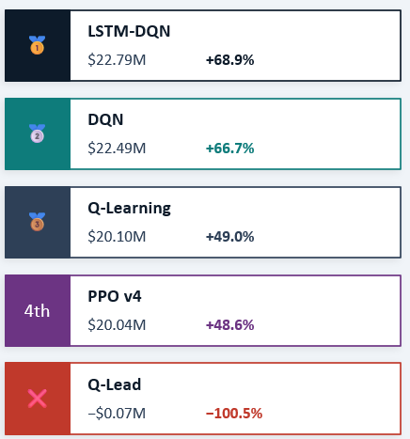
Results - All 5 Algorithms vs Random Baseline ($13.49M)

Slide 15
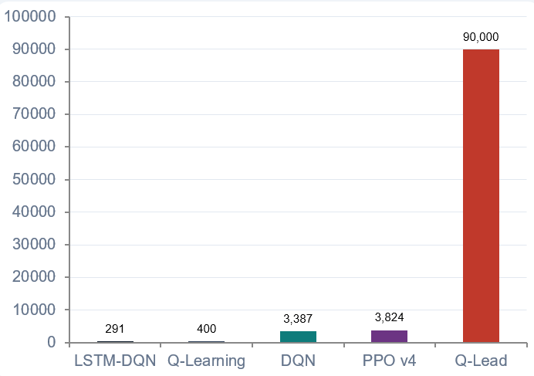
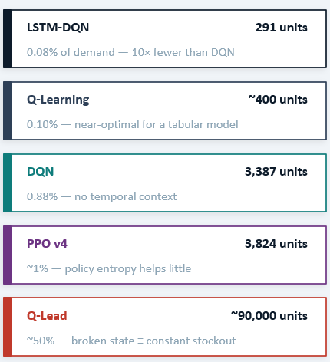
Stockout Analysis - A Critical Business KPI

Slide 16
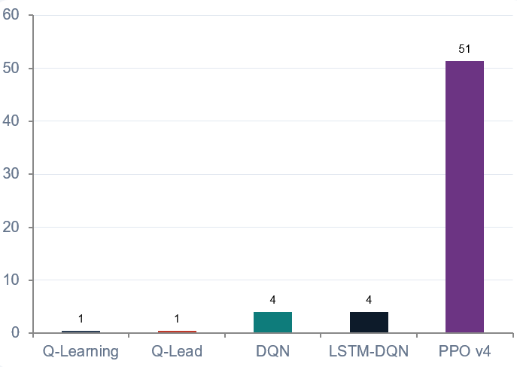
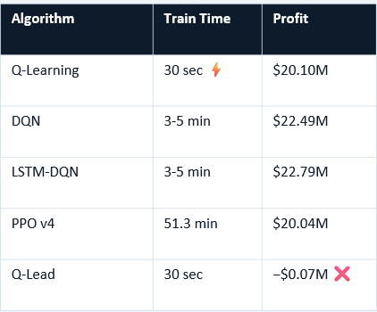
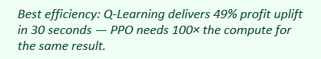
Training Efficiency - Performance vs Compute

Slide 17
Key Insights
Q-Learning is surprisingly competitive:
49% profit improvement with a simple 63 state table trained in 30 seconds. For moderate problem sizes, discrete state discretization works extremely well - neural overhead isn’t always justified.
LSTM Memory != Profit, But it kills Stockouts:
LSTM-DQN leads by only $310K(1.3%) over DQN, yet delivers 10x fewer stockouts (291 vs 3,387). In production, stockout prevention is often worth more than marginal profit gains.
Value-based beats Policy-based here:
All three value-based methods outperform PPO. Discrete, small action spaces strongly favour value methods - they are more sample efficient and converge faster without reward signal normalisation.
State Representation is Mission Critical:
Encoding lead time naively violates the Markov property. Q-Lead earns -$65K on 1,127 days vs $20-22M for correct formulations. A bad state representation guarantees a bad policy - no algorithm can fix it.

Slide 18
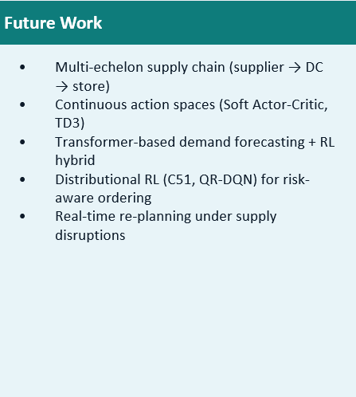
Recommendations & Future Work
Deployment Recommendations:
Max Performance: LSTM-DQN – best performance + fewest stockouts.
Speed + Quality:
Q-Learning – 49% uplift, 30 second training.
Explainability:
Q-Learning – Q-table interpretable by business.
Research Baseline:
PPO – actor-critic architecture for policy studies.
Avoid entirely:
Q-Lead – Markov violation guarantees failure.

Slide 19
Conclusion
68.9%
profit improvement by LSTM-DQN over random policy
10x
fewer stockouts with LSTM vs standard DQN(291 vs 3,387)
30sec
Q-Learning training – matches PPO’s profit at 100x lower cost
-100%
profit collapse from a single Markov property violation(Q-Lead)

Slide 20
References
[1] Stranieri, F. & Stella, F. (2022). A Deep Reinforcement Learning Approach to Supply Chain Inventory Management. arXiv:2204.09603.
[2] Hubbs, C.D. et al. (2020). OR-Gym: A Reinforcement Learning Library for Operations Research Problems. arXiv:2008.06319.
[3] Boute, R.N. et al. (2021). Deep Reinforcement Learning for Inventory Optimization: A Roadmap. European Journal of Operational Research.
[4] DataCo Supply Chain Dataset — Constante, F. et al. (2019). DataCo Smart Supply Chain for Big Data Analysis. Mendeley Data.
[5] Hausknecht, M. & Stone, P. (2015). Deep Recurrent Q-Learning for Partially Observable MDPs. arXiv:1507.06527. (LSTM-DQN)
[6] Mnih, V. et al. (2015). Human-level control through deep reinforcement learning. Nature, 518(7540), 529–533. (DQN)
[7] Schulman, J. et al. (2017). Proximal Policy Optimization Algorithms. arXiv:1707.06347. (PPO)
[8] Schulman, J. et al. (2015). High-Dimensional Continuous Control using Generalized Advantage Estimation. arXiv:1506.02438. (GAE-λ used in PPO)

