Slide 1
NLP GROUP PROJECT
Restaurant Recommendation
From Reviews
Finding what is actually good on the menu, from Zomato customer reviews
Deesampan Vongsurit · 6510766 Wattanan Jiratriluk · 6520214
Notes:
Two-person NLP group project: we train a sentiment model on 133,389 Zomato reviews, then use it to find which dishes customers like at three Bangalore restaurants.

Slide 2
1
The problem
• Restaurants receive hundreds of reviews every month
• The useful information — which dishes people like — is buried in unstructured text
• Manual reading is slow, inconsistent, and does not scale
• Menu decisions end up being made on intuition
12,494
1.3M
restaurants in the dataset
raw review entries
3
524
median reviews per restaurant
reviews at the busiest
The cost
Weak dishes stay on the menu. Strong dishes go unpromoted.
Notes:
The unit of opinion is not the review, it is the dish mentioned inside it.

Slide 3
2
Why this needs NLP
“The salad was amazing, but the chicken breast was cold and greasy.”
One review. One star rating. Two opposite opinions.
A star rating cannot express this
So we work at clause level
It describes the whole review, so both dishes receive the same sentiment.
Ranking dishes this way silently credits every dish for opinions aimed at something else.
Split the review at sentence boundaries and at but / however / although.
Classify each clause separately and attribute it only to the dishes inside it.
Notes:
This example is the justification for the whole project. Star ratings are review-level; opinions are dish-level.

Slide 4
3
The dataset
Zomato Bangalore Restaurants (Kaggle) — 51,717 rows × 17 columns, 548 MB
rate
votes
reviews_list
Restaurant level.
Zomato's displayed average, e.g. 4.1/5.
Restaurant level.
How many people rated it at all.
The only field with text.
Each entry carries its own star rating.
These are not interchangeable — we verified it
• rate differs from the mean of its own reviews by 0.55 stars on average; only 6.7% agree within 0.05
• votes exceeds the review count in 87.9% of rows, median ratio 11× — text reviews are only ~6% of all ratings
• Never train on rate: it is an average, so a 1-star review at a 4.5-star restaurant would be labelled positive
Notes:
Text reviewers are a self-selected minority who skew toward strong opinions. That is a sampling bias in our corpus.

Slide 5
4
The big picture: two scripts, one website
Everything the project does, from the Kaggle file to the page. Dark boxes are our code; white boxes are files.
the model
sentiment_tfidf_lr.pkl
zomato.csv
Kaggle file, 548 MB
train_model.py
cleans the corpus, trains the model
run_pipeline.py
the 6 NLP stages
web/data.js
the numbers the page shows
index.html
the website
site_reviews.csv
1,400 reviews of 3 restaurants
src/ · run once
src/ · run any time
Training side
Website side
1.3M
→
134,612
1,400
→
122
raw review entries (1,317,782)
clean, star-labelled reviews to learn from
reviews of 3 Bangalore restaurants
dishes found; 34 have enough opinions to rank
Notes:
train_model.py runs once: it cleans the Kaggle corpus, trains the sentiment model and picks the 3 restaurants. run_pipeline.py can run any time: it reads the 1,400 reviews, finds dishes, scores clauses with the model and writes data.js, which index.html shows. No server is needed.

Slide 6
5
Cleaning the noise
BEFORE — a real review, as stored
AFTER — what the model reads
RATED⏎ Amazing chicken biryani.... lunch sorted...ÃƒƒÃ‚ƒÃƒ‚Ã‚¢ÃƒƒÃ‚ƒ…
Amazing chicken biryani. lunch sorted.
BOX8 – Desi Meals, 5★. Fixed: Zomato's RATED prefix, repeated dots, broken emoji bytes.
Training corpus · train_model.py
Website reviews · run_pipeline.py
1,317,782 review entries, split out of 51,717 rows
Raw reviews
1,400
N1 Empty after cleaning
−6
143,789 after removing repeats (−1,173,993 = 99.2% of all removals)
N2 Duplicate (same text, same restaurant)
−3
N3 Fewer than 2 words
−70
134,612 after boilerplate, length, language and label checks
N4 Not English (under 70% Latin letters)
−0
Left for the website
1,321
Tools: hashlib (repeats) · ftfy + re (repair text) · langdetect (English only)
Tools: re, unicodedata
Notes:
Two cleanings. The training corpus: 1,317,782 entries become 134,612; removing repeats is 99.2% of everything removed. The website's 1,400 reviews go through four rules, N1 to N4, and 1,321 are left. Every removed website review is listed on its restaurant's page with the reason.

Slide 7
6
Two traps in deduplicating this data
Trap 1 — the obvious key fails silently
Trap 2 — the obvious fix loses data
All 51,717 url values are unique, so deduplicating on url removes nothing and reports success.
Zomato appends a ?context= query string encoding the category listing.
Deduplicating on (name, address) and keeping one row per restaurant drops 32,803 real reviews.
Category listings hold partially different review sets, not copies.
The correct order
Explode every row to review level first, then deduplicate on (restaurant, review_text).
Restaurant-level deduplication must never happen first.
Notes:
Both traps are silent failures. Neither produces an error message.

Slide 8
7
Training the sentiment model
TF-IDF turns a review into word weights; logistic regression learns which words mean positive, neutral or negative.
Stars become labels, for free
Accuracy on 26,678 test reviews it never saw
★ 4.0 – 5.0
→
positive
81,213
Always say “positive”
60.5%
★ 3.0 – 3.5
→
neutral
25,035
VADER (ready-made word list)
72.7%
★ 2.5 or less
→
negative
28,364
Our model: TF-IDF + logistic regression
82.2%
Every review carries its own star rating — no hand labelling.
Keeping “not” is worth +2.1 points
The website's restaurants are held out
82.2% with not / no / never kept, 80.0% with the default stopword list. The next slide shows why.
Their 1,223 reviews are removed before training. The other 133,389: 90,704 to learn, 16,007 to check ideas, 26,678 to test.
Notes:
Labels come from each review's own stars: 4 or more positive, 3 to 3.5 neutral, 2.5 or less negative. Our model gets 82.2% right on 26,678 unseen reviews, against 72.7% for VADER and 60.5% for always guessing positive. The three website restaurants never enter training.

Slide 9
8
The trap in standard cleaning advice
Stopword lists contain not, no, never and nor. Strip them and “the biryani was not good” becomes “biryani good”.
We measured the cost
The model proves the mechanism
Keeping not, no, never … 82.2% accuracy 77.4% F1
Default stopword list 80.0% accuracy 74.9% F1
Cost of stripping them: −2.1 points accuracy, −2.5 points F1
not +8.18 → negative
not good +6.15 → negative
not bad +4.12 → positive
not disappointed +6.17 → positive
Opposite sentiments, all carried by the same word.
These weights were learned from 90,704 star-rated reviews — we never told the model that negation matters. Delete not from the corpus and these phrases collapse into the same words.
Notes:
An ablation measures impact on the downstream task, not just activity. This is the strongest evidence in the report.

Slide 10
9
From one review to dish opinions
1
Find the dishes
“The salad was amazing, but the chicken breast was cold and greasy.”
the restaurant's menu + RapidFuzz for typos
2
Split into clauses
The salad was amazing,
but the chicken breast was cold and greasy.
at . ! ? ; and before but, however …
3
Hide the dish name
The ____ was amazing,
the ____ was cold and greasy.
and a leading “but”, so only the opinion is read
4
Score each clause
+1.00
no side
−0.93
no side
our model: P(positive) − P(negative), from −1 to +1
−1
−0.4
+0.4
+1
−1
−0.4
+0.4
+1
5
Take a side at ±0.4
salad → liked
chicken breast → not liked
+0.4 or more liked, −0.4 or less not liked
Notes:
The example from our proposal, run through our model and the pipeline's clause rules. The model scores the salad clause +1.00 and the chicken clause −0.93, so the salad gets a 'liked' vote and the chicken breast a 'not liked' vote. A star rating would give both dishes the same label.

Slide 11
10
What clause-level attribution changed
32.9%
19
747
of dish opinions differ from the review's own star rating (246 of 747)
reviews like one dish and dislike another
dish opinions, from the 416 reviews that name a dish
A rough check with star ratings: obvious errors, VADER → our model
44 → 21
A dish marked liked inside a 1-star review, or not liked inside a 5-star review, is very likely wrong. Out of 747 dish opinions, VADER made 44 such errors; our model with the final rules makes 21. This shows the rules remove obvious errors — it does not measure clause accuracy.
Notes:
This is the concrete payoff of replacing ABSA with clause-level attribution.

Slide 12
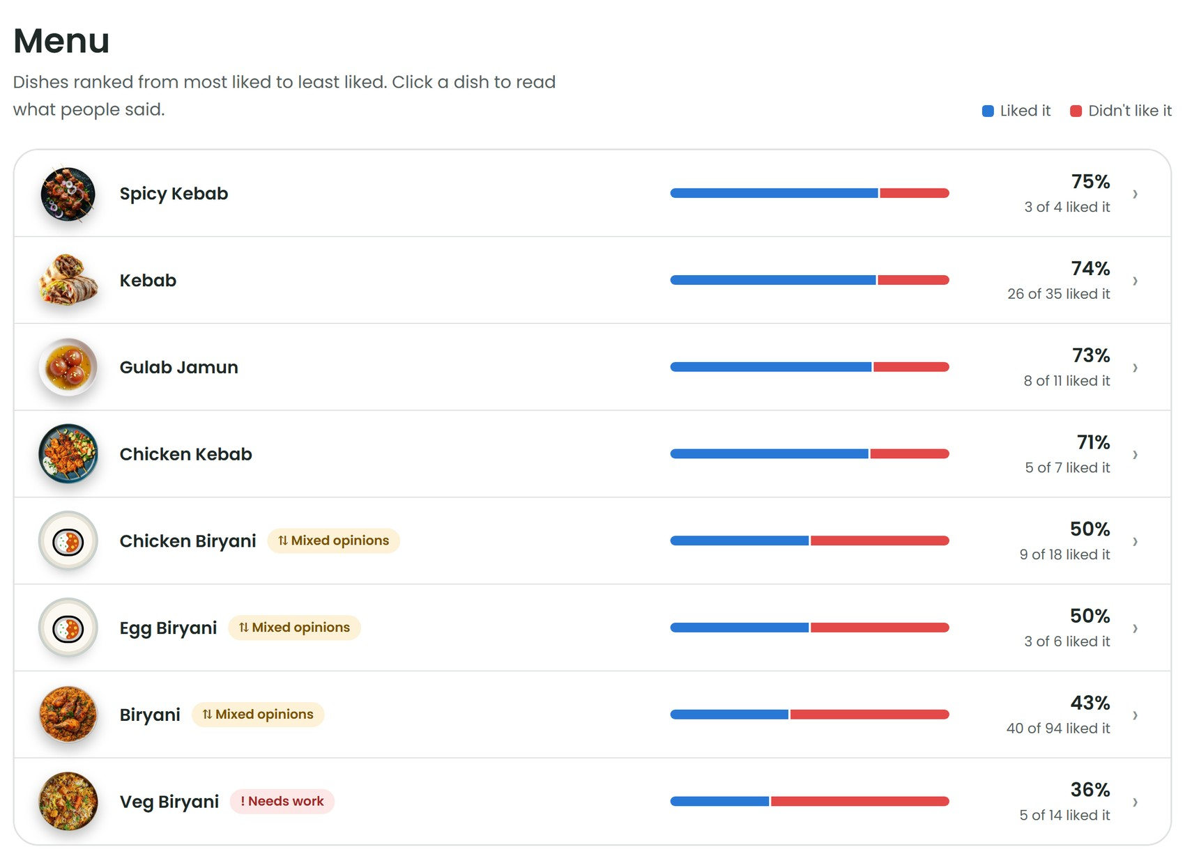
11
The result, and proof it is really NLP
How a dish is counted
One vote per review per dish. A dish is ranked once 4 reviews take a side; with fewer it is “too little to judge”.
Proof test: edit one review
“mouth watering and tasty af!” → “stale and tasteless!”, rebuild: Gulab Jamun drops from 8 to 7 of 11 liked.
One honest limitation
Clause accuracy is not measured: we have no clause-level labels, only the star-rating check.
Figure 1: index.html#biriyani-nights — the menu, ranked by how many reviewers liked each dish.
Notes:
Demo: double-click output_project/web/index.html, open Biriyani Nights. Proof: change one Gulab Jamun review in site_reviews.csv from praise to complaint, run start.bat, and the count drops from 8 of 11 to 7 of 11. Undo with git checkout.

Slide 13
12
Limitations
• Neutral-class F1 of 0.582 — the model is weak on “in between” reviews
• Sampling bias — text reviewers are ~6% of raters and skew toward strong opinions
• 905 of 1,321 cleaned reviews mention no dish; our sample restaurants are delivery-led
• No manual audit of removed reviews, so filter precision is unmeasured
• Clause accuracy is not measured directly — we have no clause-level labels
• The 15-character (corpus) and 2-word (website) thresholds are unvalidated
• No timestamps in the dataset, so no trend over time is possible
• Dish finding has weak supervision only — no precision or recall reported
Notes:
Stating limitations precisely is more persuasive than hiding them. Each is a concrete next step.

Slide 14
CONCLUSION
Reviews become menu decisions
89.1%
of the corpus was duplicated — removing repeats was 99.2% of all rows removed
82.2%
accuracy of our trained model, against 72.7% for the ready-made VADER
32.9%
of dish opinions differ from the review's own star rating
Instead of reading every review, an owner can see which dishes to promote, which to fix, and which to cut — with the evidence one click away.
Notes:
Close by returning to the business question: what is actually good on the menu.

