Slide 1
Python Basics
Lakshmi Priya

Slide 2
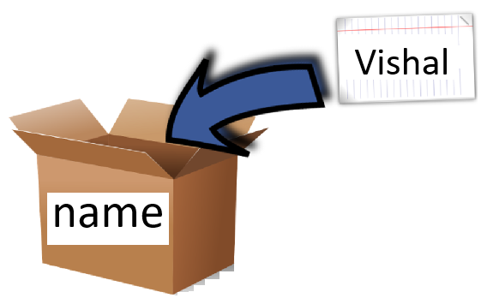
Storing value in to a variable
Value
Variable
name=‘Vishal’

Slide 3
Valid Variable Names
name = ‘Vishal’
age = 17
height = 5.11
a = 1.5 + 0.5j

Slide 4
Case Sensitive
Python is case sensitive
Variable, age is different from Age

Slide 5
print()
print() function is used to output data to the output device(screen)
print(name)
print(age)
print(height)
print(a)

Slide 6
Rules for naming a variable
Must begin with a letter (a-z,A-Z) or underscore(_)
Other characters can be letters, numbers, or _
Case Sensitive
Reserved words cannot be used for variable names

Slide 7
Strings
A string is a list of characters
Strings are created by enclosing in single or double quotes
String can have spaces: “Hello World”

Slide 8
Strings
An empty string is a string that has 0 characters
Python strings are immutable
Triple quotes are used while creating multiline string

Slide 9
Strings
a = ‘Welcome to Python World’
b = “Hello World”
c = ‘’’ Good morning,
how are you doing
today’’’

Slide 10
Numbers
a = 10
b = 3
c = 3.0
print(a/b) #quotient
print(a/c)
print(a//c) #floor division
print(a%b) #remainder
print(a**b) #exponent

Slide 11
Relational Operators
Relational operators compares the values.
It either returns True or False according to the condition
Operator | Description | Syntax
> | Greater than, True if x is greater than y | x>y
< | Less than, True if x is less than y | x<y
== | Equal to , True if both x and y are equal | x==y
!= | Not equal to, True if both x and y are not equal | x!=y
>= | Greater than or equal to, True if x is greater than or equal to y | x>=y
<= | Less than or equal to, True if x is less than or equal to y | x<=y

Slide 12
Logical Operators
Logical operators perform Logical AND, Logical OR and Logical NOT operations
Operator | Description | Syntax
and | True if both x and y are true | x and y
or | True if either of x and y is true | x or y
not | True if x is false | not x

Slide 13
Booleans
A boolean expression (or logical expression) evaluates to one of two states true or false.
Python provides the boolean type that can be either set to True or False.
Note: True and False are capitalized

Slide 14
Examples
a = True
b = False
print(a)
print(a and b)
print(a or b)
print((4>6) and (7<3))
print((3==3.0) and (7<10))

Slide 15
input()
input() function is used to take the input from the user
name = input(‘Enter your name : ‘)
print(name)

