Slide 1
Installing Python on Windows

Slide 2
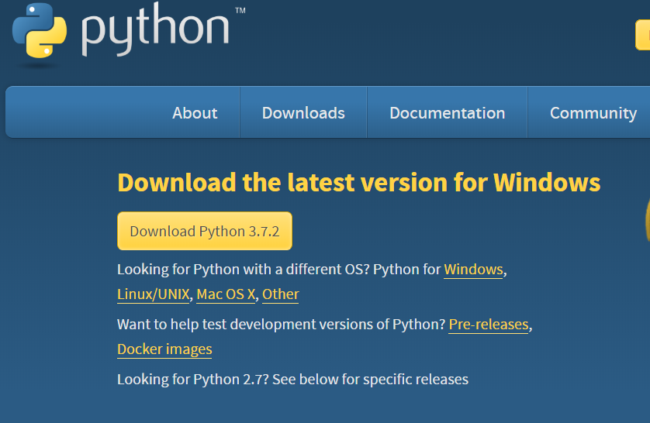
1. Open the site www.python.org/downloads/, following screen will be displayed.

Slide 3

2. Click on ‘Download Python 3.7.2’
3. File ‘python-3.7.2.exe’ will be downloaded.
4. Double click on the file

Slide 4
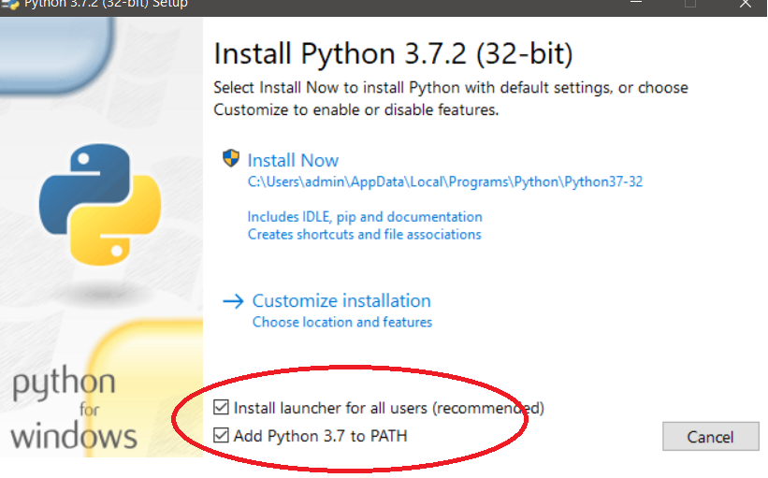
5. Click on ‘Run’ button
6. Select ‘Add Python 3.7 to PATH’
7. Click on ‘Install Now’

Slide 5
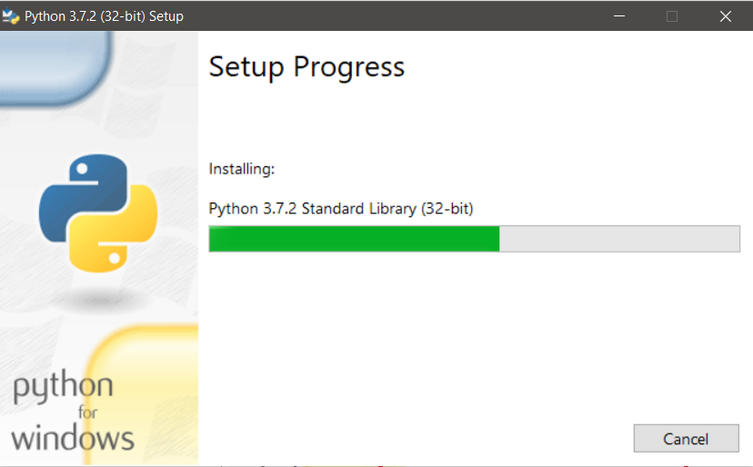
Python Installation in Progress

Slide 6
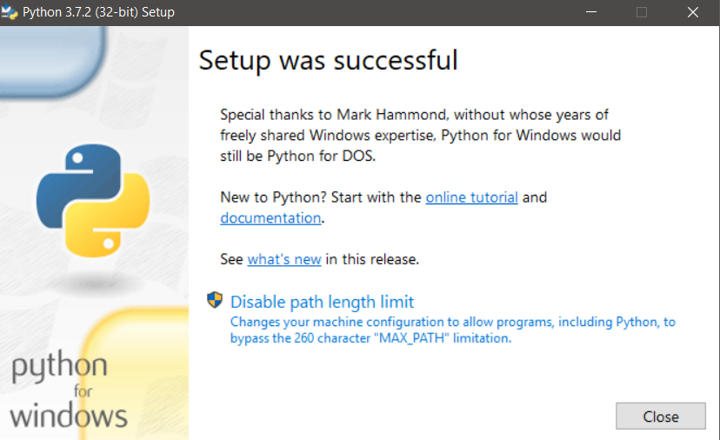

Slide 7
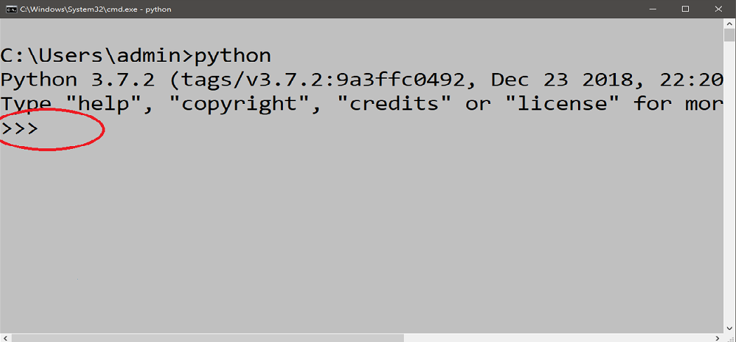
8. To check for the successful installation of python, Open the command prompt and type ‘python’
9. >>>(Python prompt with three greater than symbols will be displayed)

Slide 8
Congratulations Python has been installed successfully

