Slide 1

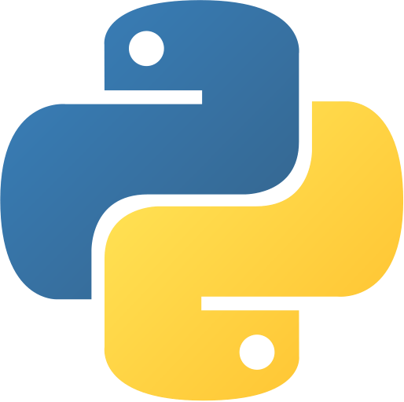
Python Use Cases
Lakshmi Priya P

Slide 2
Use Cases - Python
Python is a high-level general purpose programming language that offers multiple paradigms like
object-orientation, functional programming
for software development.
It works on cross-platform operating systems and can be used across to develop a wide range of applications like
image processing,
text processing,
web and enterprise level using scientific, numeric and data from network.
BitTorrent, YouTube, Dropbox, Deluge, Cinema 4D and Bazaar are a few globally-used applications

Slide 3

Industrial Applications
Industrial and Business Applications of Python

Slide 4
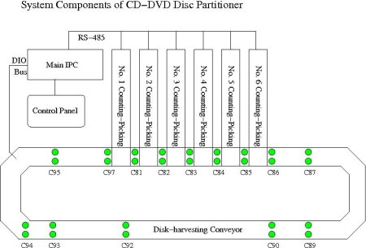
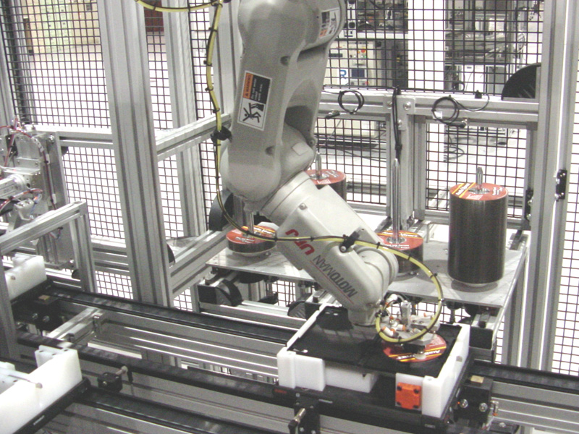
CD/DVD Packaging Hardware
In the wholesale market, CD/DVD discs are sold in units of 10, 20 or 50 in one shrink-wrapped bulk package.
Acqutek Corporation was contracted by Micro Image Precision Co. Ltd to develop the control software for this partitioner machine.
The entire GUI software code to control this machine is written in Python!
Notes:
https://www.python.org/success-stories/python-to-control-cddvd-packaging-hardware/

Slide 5
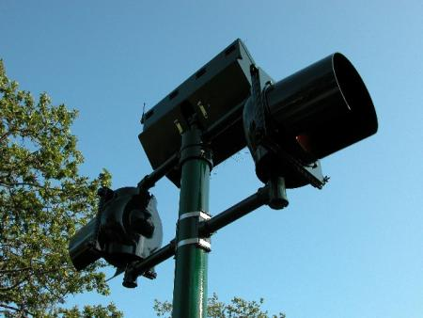
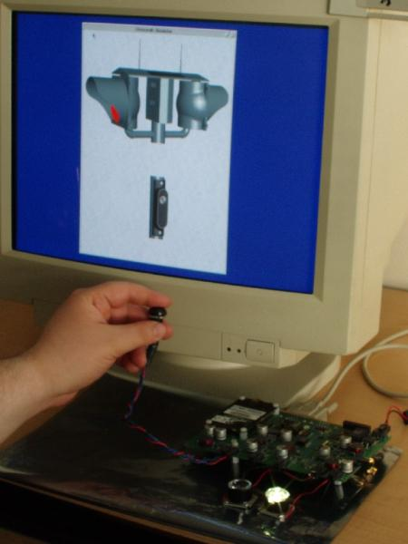

Traffic and Navigation Beacons
Carmanah Technologies is a Canadian corporation that provides signaling and solar lighting solutions for infrastructure projects around the world.
It has presence over 110 countries in over 400,000 installations.
This company uses Python in its embedded systems simulators.
Notes:
https://www.python.org/success-stories/carmanah-lights-the-way-with-python/

Slide 6
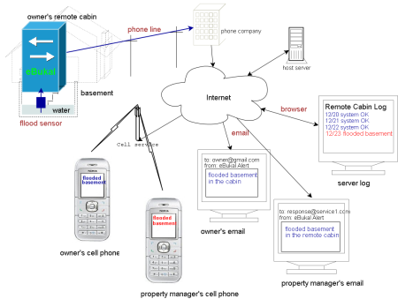
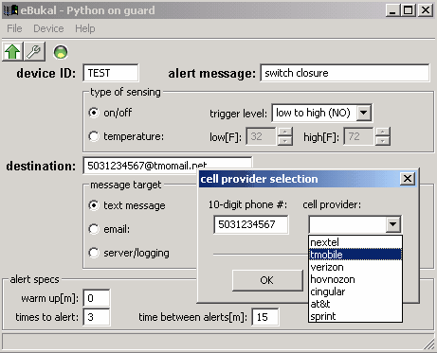
Security and Automation
VAHNZ Controls developed its eBukal remote alarm device to leverage their knowledge of microcontroller interfacing and Internet protocols, creating an innovative solution for the field of building automation.
Its messaging configuration user interface is based on wxPython.
Notes:
https://www.python.org/success-stories/python-on-guard/

Slide 7
Governmental Applications
Governmental and Administrative Applications of Python

Slide 8
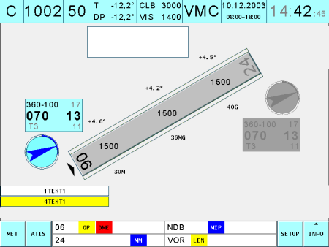

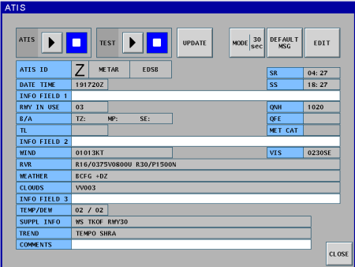
Air Traffic Control
Frequentis is one of the world’s leading providers for safety-critical solutions in Air Traffic Management and Public Safety & Transport.
Frequentis has been using Python in its TAPtools® product family, which focuses on the Tower and Airport Tools segment of Air Traffic Control.
These tools are used by air traffic controllers to track weather conditions, control runway lighting, and to monitor and control navigational aid instruments.
Notes:
https://www.python.org/success-stories/frequentis-taptools-python-in-air-traffic-control/

Slide 9
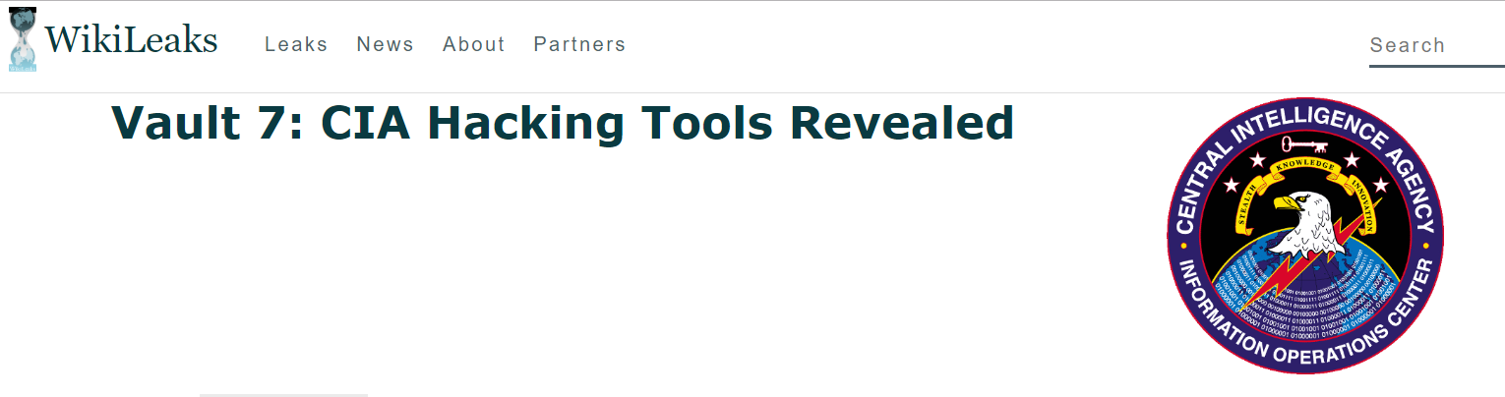
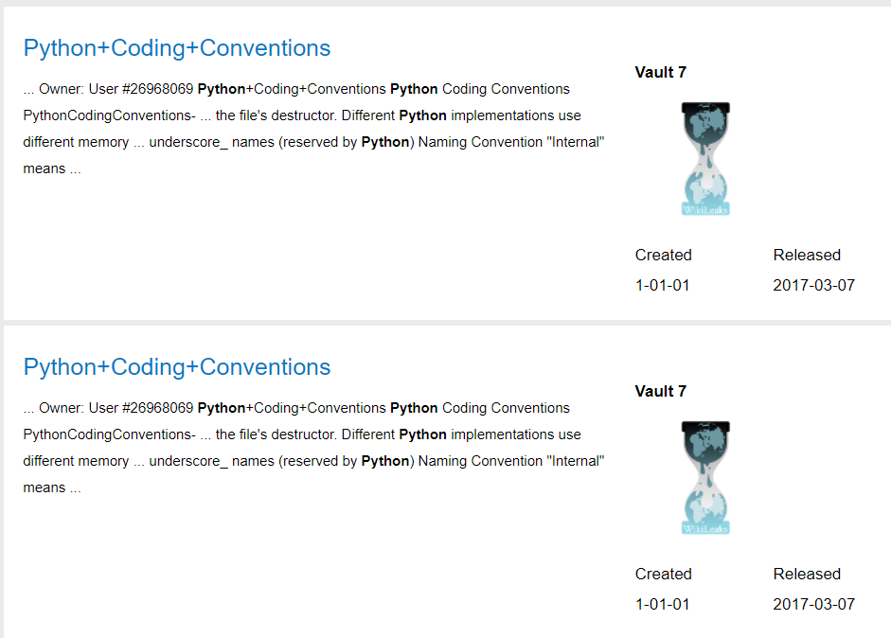
Hacking Tools
Though not officially admitted, CIA reportedly uses Python in it’s secret hacking tools.
Notes:
https://www.reddit.com/r/Python/comments/5y2boe/cia_uses_python_a_lot/

Slide 10
Scientific Applications
Scientific Applications of Python

Slide 11
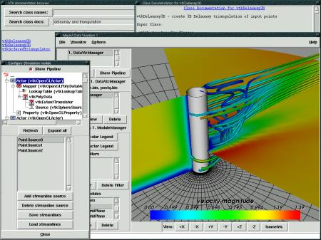
Scientific Data Visualisation
MayaVi is an open source data visualisation tool written entirely in Python.
The tool is used to visualise Computational Fluid Dynamics (CFD) data.
MayaVi also has many applications in Aerospace industry.
Notes:
https://www.python.org/success-stories/python-for-scientific-data-visualization/

Slide 12
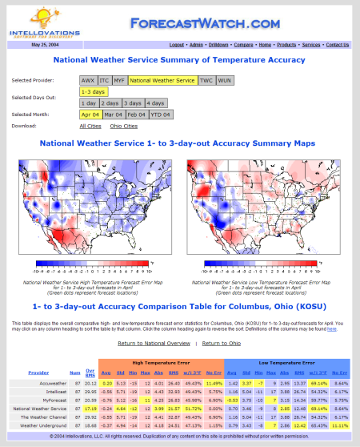
Meteorology
ForecastWatch.com provides rating to the accuracy of the weather reports from Accuweather, MyForecast.com, and The Weather Channel.
Over 36,000 weather forecasts are collected every day for over 800 U.S. cities, and later compared with actual climatological data.
These comparisons are used by meteorologists to improve their weather forecasts, and to compare their forecasts with others.
The website uses Python to generate ratings.
Notes:
https://www.python.org/success-stories/python-to-help-meteorologists/

Slide 13
Web Applications
Web Frameworks and Web Applications of Python

Slide 14


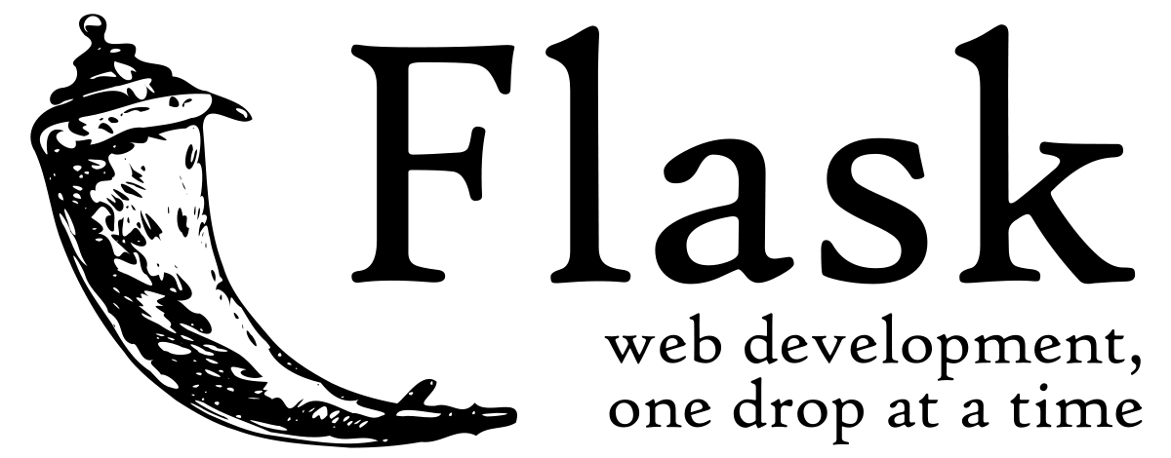
Web Frameworks
Python has been used to create a variety of web-frameworks including CherryPy, Django, TurboGears, Bottle, Flask etc.
These frameworks provide standard libraries and modules which simplify tasks related to content management, interaction with database and interfacing with different internet protocols such as HTTP, SMTP, XML-RPC, FTP and POP.

Slide 15

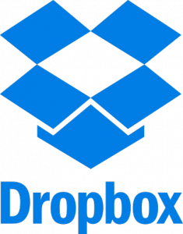

Web Applications
With features that include special libraries, extensibility, scalability and easily readable syntax, Python is a suitable coding language for customizing larger applications.
Reddit, which was originally written in Common Lips, was rewritten in Python in 2005.
Python also contributed in a large part to functionality in YouTube.
Dropbox, a cloud storage website is entirely written in Python.

Slide 16
Software Applications
Software Applications using Python

Slide 17




Image Processing
Python has been used to make 2D imaging software such as Inkscape, GIMP, Paint Shop Pro and Scribus.
Further, 3D animation packages, like Blender, 3ds Max, Cinema 4D, Houdini, Lightwave and Maya, also use Python in variable proportions.
Notes:
https://www.invensis.net/blog/it/applications-of-python-in-real-world/

Slide 18
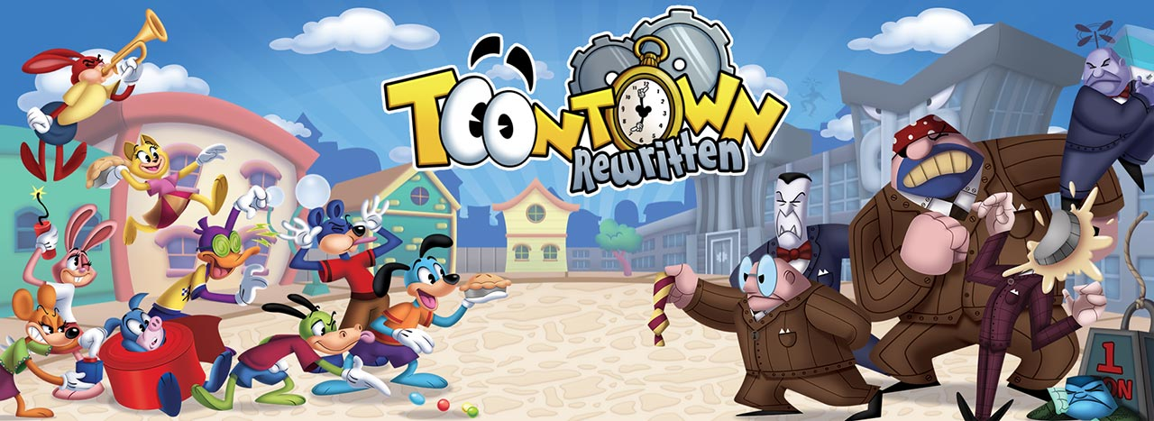

Game Designing
Python has various modules, libraries and platforms that support development of games.
For example, PySoy is a 3D game engine supporting Python 3, and PyGame provides functionality and a library for game development.
There have been numerous games built using Python including Civilization-IV, Disney’s Toontown Online, Vega Strike etc.
Notes:
Outdated. Python is no more used for games.

Slide 19
Python allows for parsing a text file, generating sample inputs to test an application, content scrapping from blogs and sites.
Python is used for automation, to automate repetitive and basic process like mass mail send-outs and other deployments.
Python is used from animation to enterprise level web applications
Python is great for writing API and interacting with the database. Python was used for back-end integrations and development of such famous sites as Instagram, Quora, and Dropbox.
Two major Python back-end development tools are Django and Flask

Slide 20
Python has powerful libraries for data analysis, manipulation and visualization.
Python libraries such as pandas, NumPy, and scikit-learn and others bring features from R and Matlab to python development.
Python has many libraries to build and implement machine learning algorithms (eg., PyBrain, Pylearn2,scikit-learn,etc)
For working with human language data, Python offers NLTK platform.
Python is extensible in C/C++ in which you ca run large-scale data mining faster

Slide 21
Quora opted for python to avoid getting stuck in for legacy issues.
They opted for python because it was fast enough for most of what they need to do.
They also had confidence on pythons ecosystem development potential and thought it’d be good for the life of their codebase

Slide 22
Preen.Me is an Israeli fashion retail startup aiming to transform the way people shop for beauty products today. Because the project implies intense data analytics and visualization, the project team chose python over other general purpose languages for primary web app coding
Other reasons why Python was chosen include, but aren’t limited to:
Python is free and open source
Python is extensible in c/C++
Python has a clear syntax and is extremely powerful in datamining and analysis
Python has many libraries and tools to enhance and improve web development

Slide 23
Thank You.
Lakshmi Priya P
+91 98666 11005
plakshmipriya@gmail.com

