Slide 1
Debugging in Python

Slide 2
Is it possible to debug Python Program
Yes

Slide 3
How to debug Python Program
Using Python debugging module

Slide 4
Which module has to be imported?
import pdb

Slide 5
How to use Python debugger
Example: buggy.py
print “****** Debugging Python Code *******”
a = “Python”
b = “Debugger”
c = “Module”
name = a + b + c
print name

Slide 6
buggy.py
Insert the following statement at the beginning of your Python Program
import pdb

Slide 7
buggy.py
Insert the following code from where you want to begin your tracing
pdb.set_trace()

Slide 8
buggy.py
import pdb
print “****** Debugging Python Code *******”
a = “Python”
pdb.set_trace()
b = “Debugger”
c = “Module”
name = a + b + c
print name

Slide 9
How to execute the program?
Run the program from the command line
Prompt> python buggy.py
Note: Tracing will be started when pdb.set_trace() is encountered in the program.

Slide 10
How to execute the program?
c:\examples>python ex3.py
******* Debugging Python Code *******
> c:\examples\ex3.py(6)<module>()
-> b=“Debugger”
(Pdb)

Slide 11
Debugging Commands
How to view debugging commands
help command at (pdb) lists the commands supported
(Pdb) help
(Pdb) help next

Slide 12
Debugging Commands
Command | Description
l(list) | shows where you are in your script
n(next) | steps to next line of execution
s(step) | steps in to next line of execution, including functions
r(return) | steps to the end of currently executing function
c(continue) | executes code
q(quit) | exit the debugger
?(help) | shows all commands

Slide 13
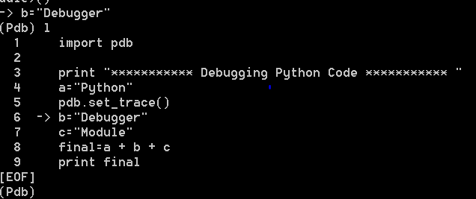
pdb command : l
Lists where you are in the script

Slide 14

pdb command : n
Step to next line of execution:

Slide 15
How to run debugger from the command line
c:\pythonExamples> python –m pdb pdb_script.py
> c:\pythonExamples\pdb_script.py(3)<modu
le>()
(Pdb)

Slide 16
How to run debugger within the interpreter
>>> import pdb_script
>>>import pdb
>>>pdb.run(‘pdb_script.pdbEx(5).go()’)
(Pdb)

Slide 17
Example2
Example2: pdb_script.py
import pdb
class pdbEx(object):
def __init__(self, num_loops):
self.num_loops = num_loops
def go(self):
for i in range(self.num_loops):
pdb.set_trace()
print "Value of i is >>>> : ",i
return
if __name__ == '__main__':
pdbEx(5).go()

