Slide 1


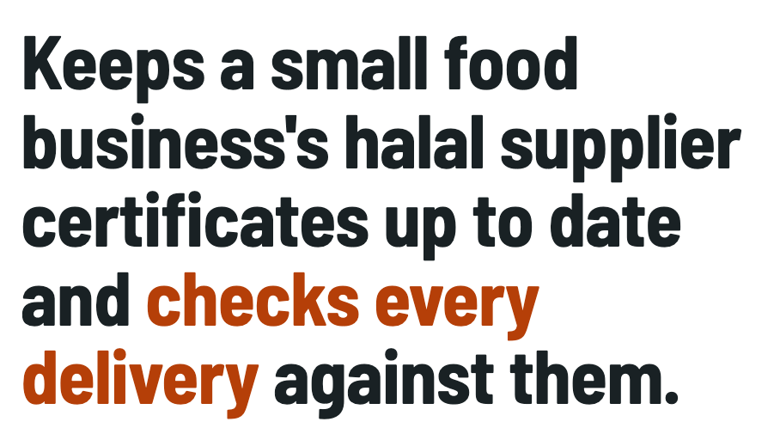





Notes:
Hi, we're team README later, and our product is called Loupe. It's an Orbyte module that keeps a small food business's halal supplier certificates up to date and checks every delivery against them. Anything that doesn't match goes to a supervisor, so problems get caught at the door, before the audit.

Slide 2
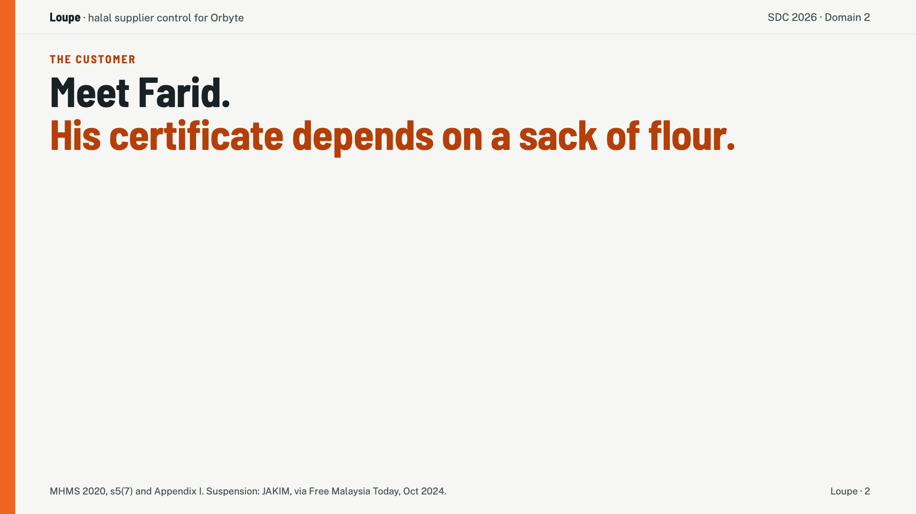
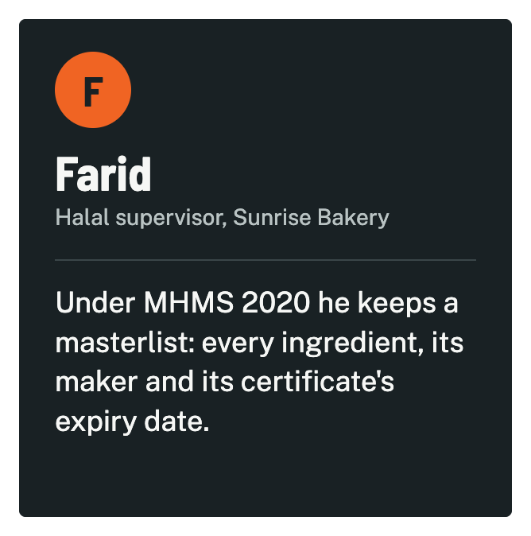
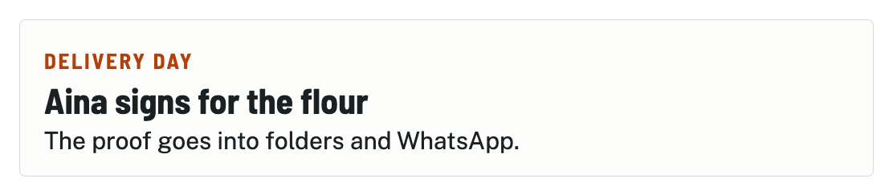
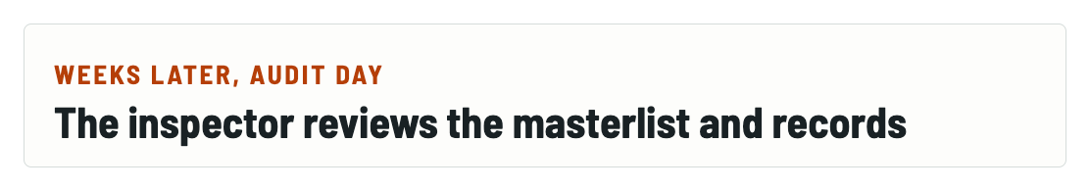
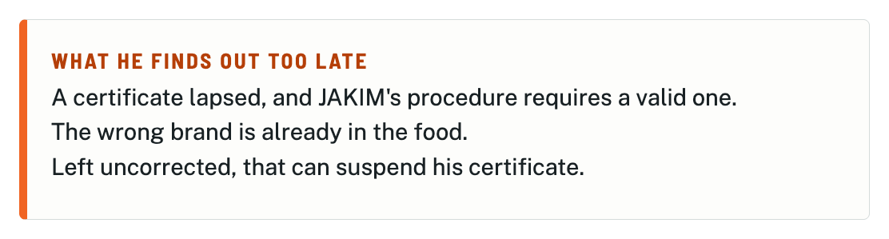
Notes:
Meet Farid, our sample customer. He's the halal supervisor at a small bakery, and he also works in the kitchen. JAKIM's rulebook, MHMS 2020, has him keep a masterlist, which is a record of every ingredient, who makes it, and when its halal certificate expires. When flour arrives, Aina signs for it at the door, and the proof goes into folders and WhatsApp. Weeks later, an inspector reviews the records. That's when Farid finds out a supplier's certificate had lapsed, or a different brand is already in the food. If that isn't corrected in time, the bakery's certificate can be suspended.

Slide 3
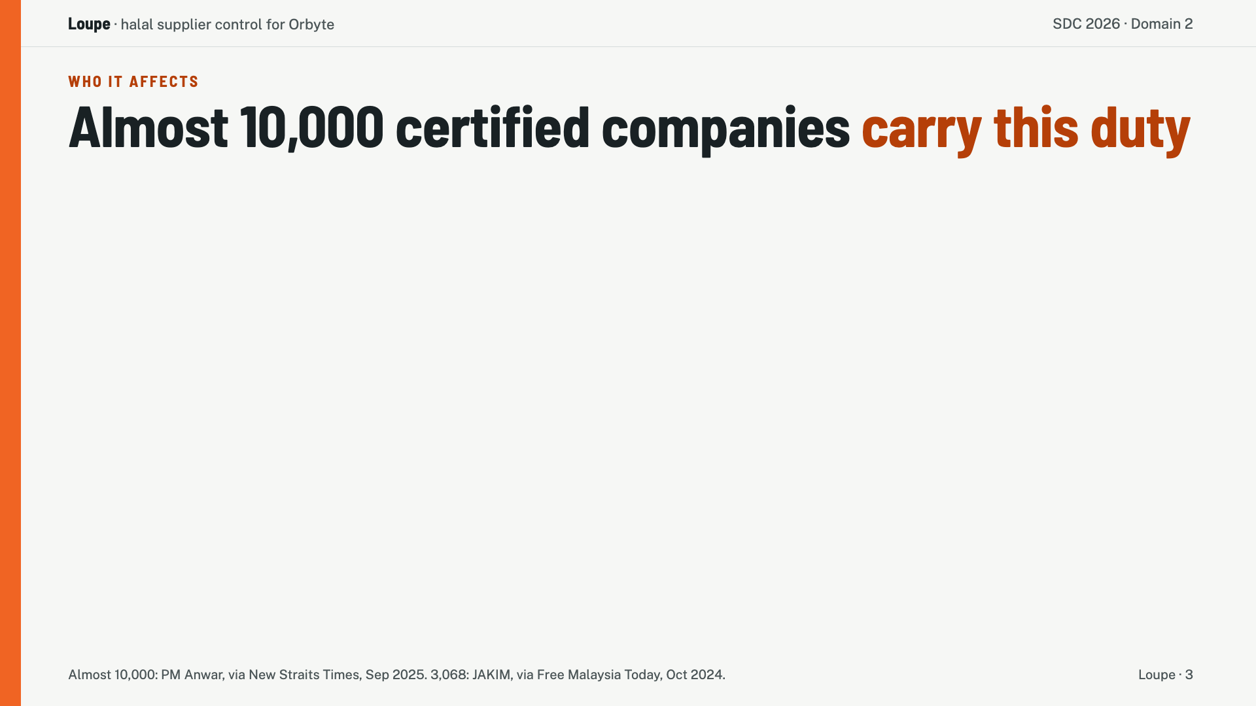
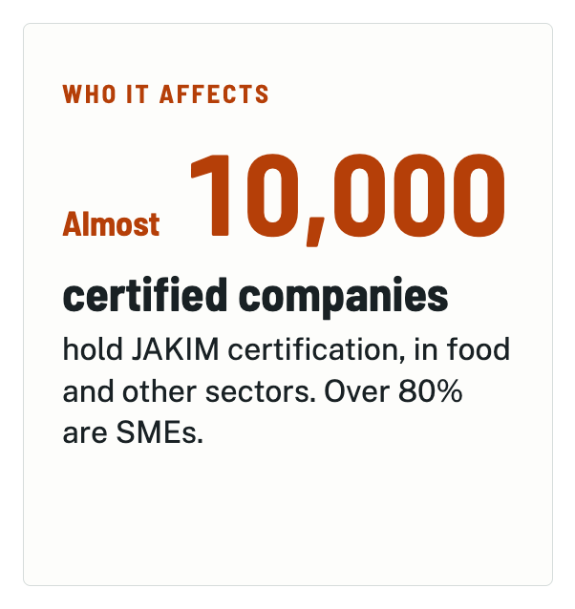
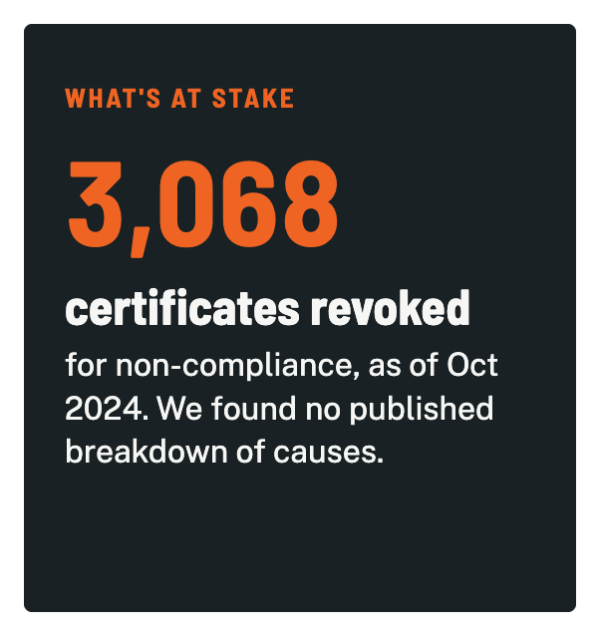
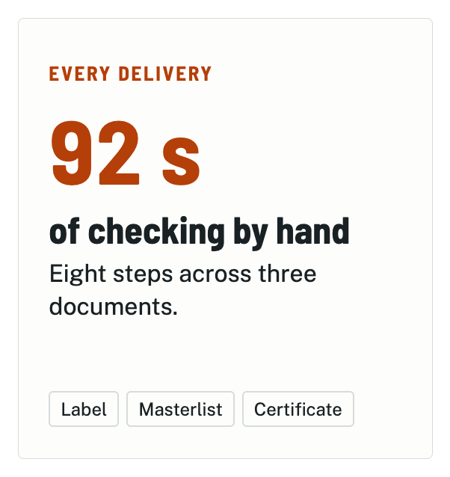
Notes:
Farid isn't alone. As of September 2025, almost 10,000 companies held JAKIM certification, and over 80% were SMEs. And in October 2024, JAKIM had revoked 3,068 certificates for non-compliance. And from our own manual timing, checking one delivery by hand takes 92 seconds and eight steps.

Slide 4
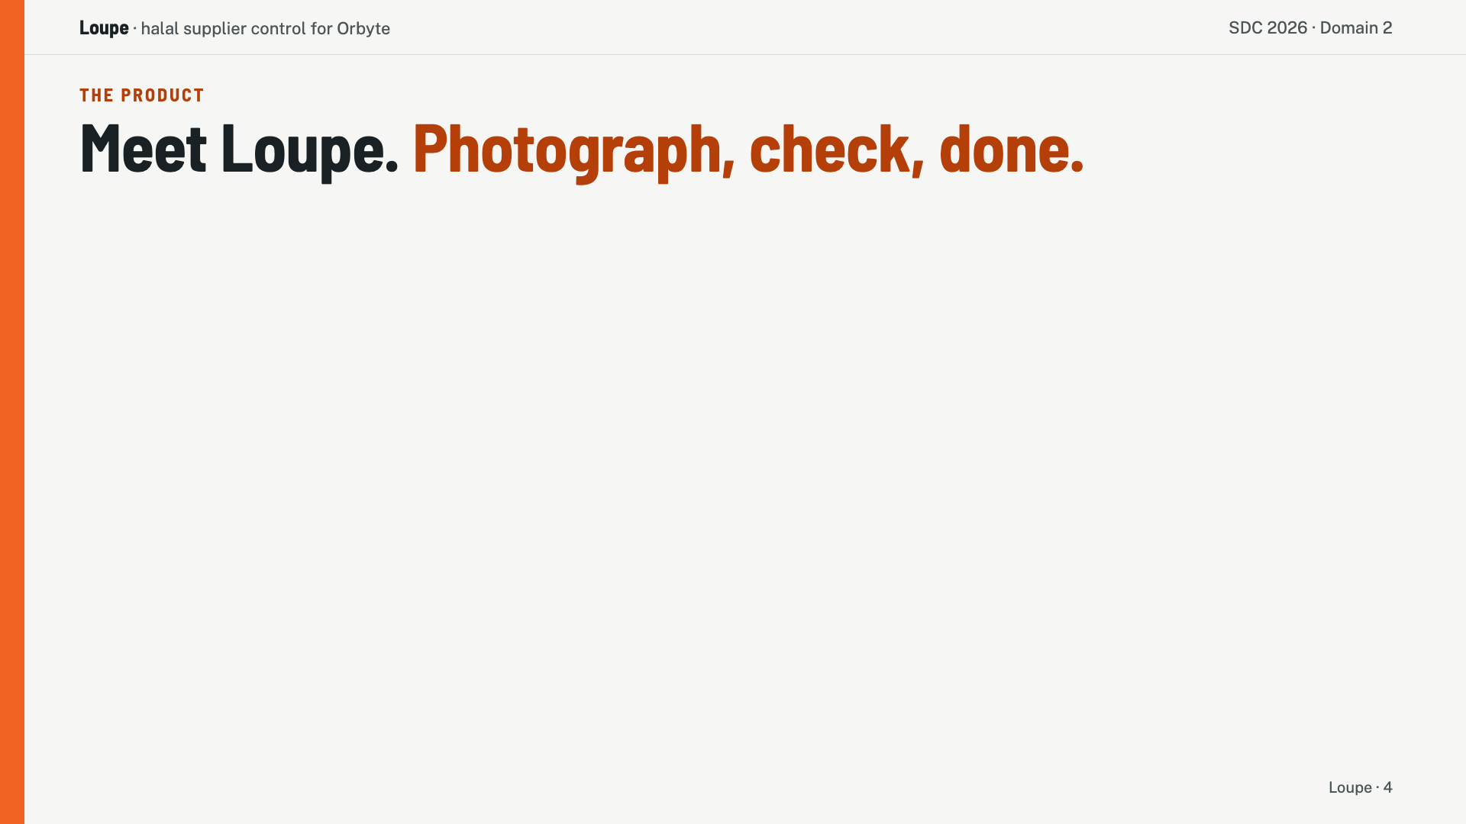
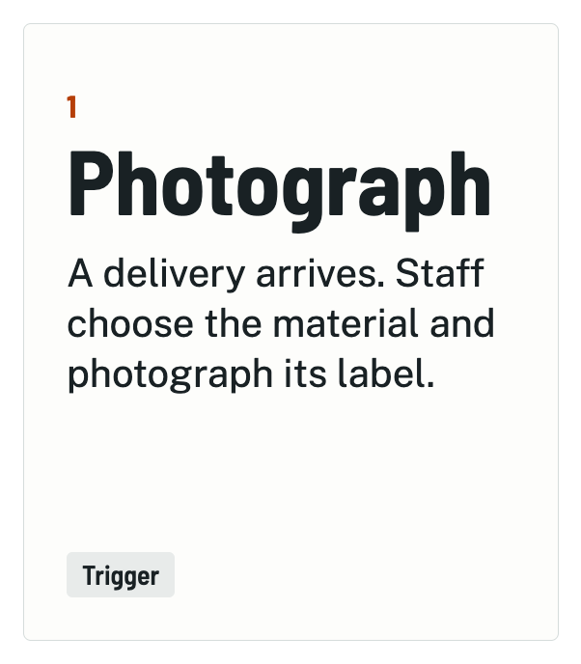
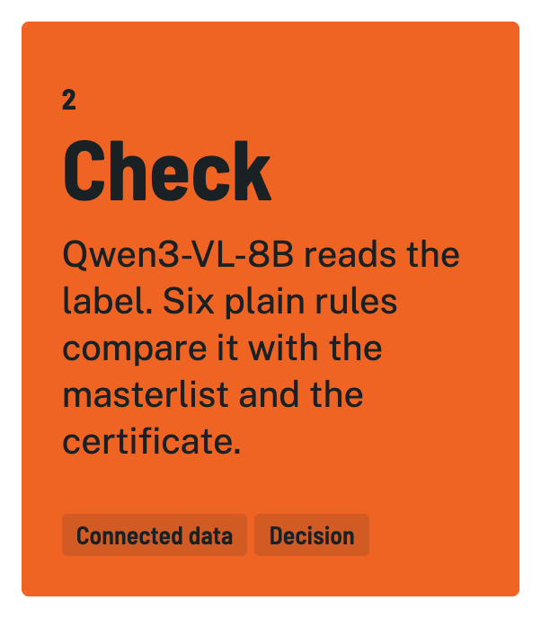
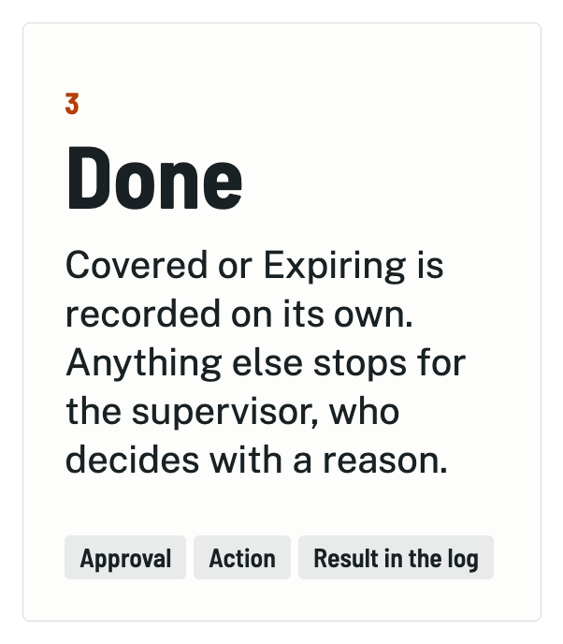
Notes:
This is why built Loupe. When a delivery arrives, staff choose the material and photograph its label. Our vision model reads the product, brand and maker from the photo. Then six deterministic rules do the checking. They check that the label is readable, it matches the approved material, the certificate covers it and is valid, the issuer is recognised, and that a halal mark is visible. Anything that fails a rule will get flagged for Farid to check.

Slide 5
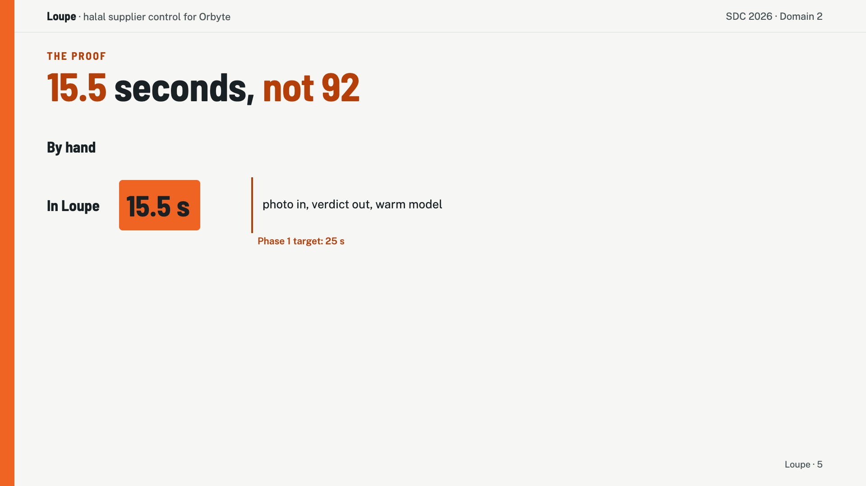
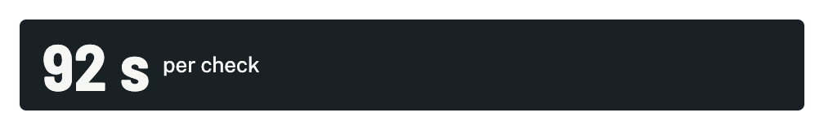
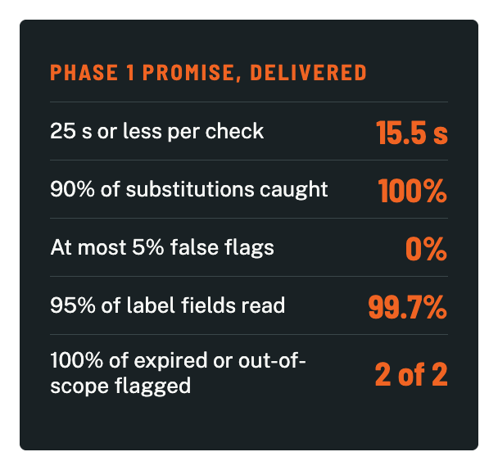
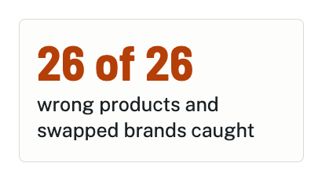
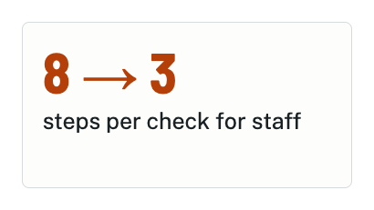
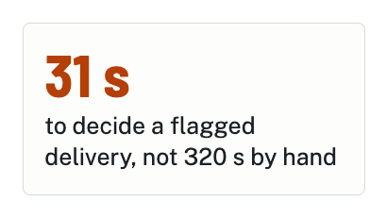
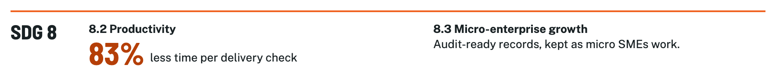
Notes:
Here's what using Loupe instead gives you. On Loupe, a check takes 15.5 seconds instead of from 92. That's 83% less time, which is our SDG 8.2 contribution. Staff also go from eight steps per check to three. A flagged delivery takes Farid about 31 seconds to decide, down from 320. Across 32 synthetic labels, it caught all 26 wrong products and swapped brands, with no false flags. These results have beaten our Phase 1 targets.

Slide 6
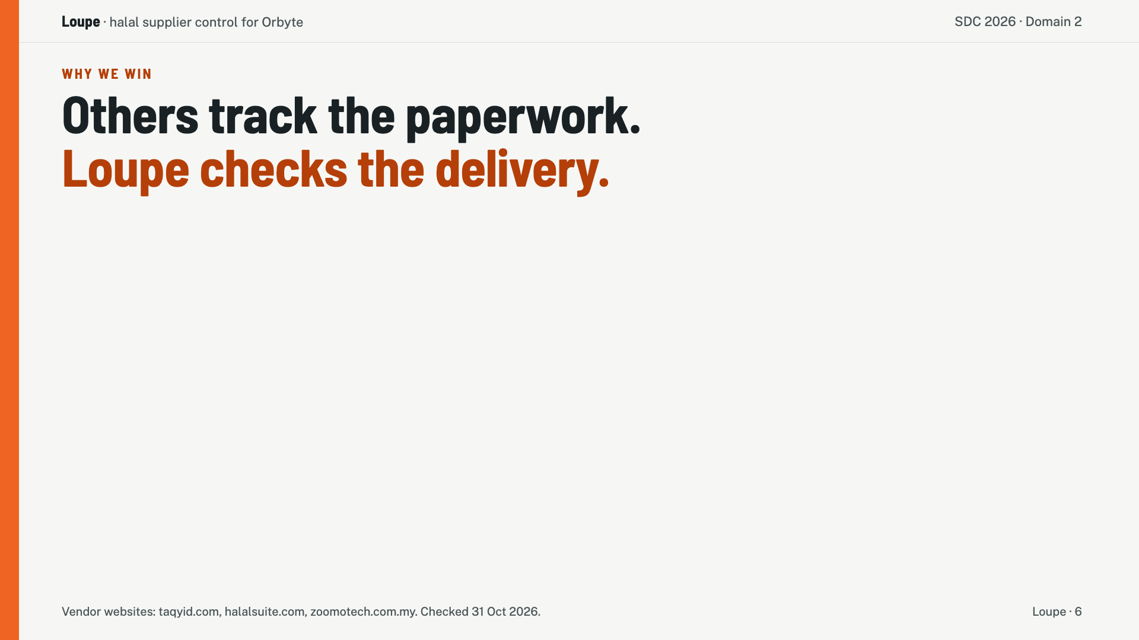
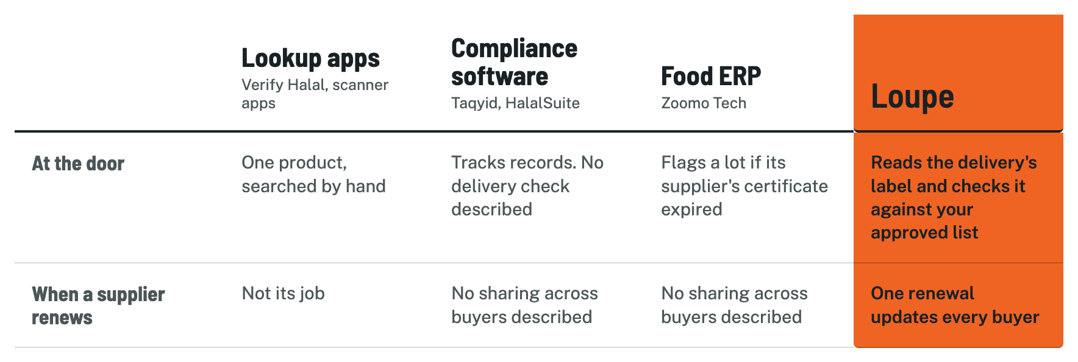
Notes:
Other tools on the market right now only track the paperwork. Verify Halal looks up one product at a time. Taqyid and HalalSuite manage certificates and audits. From their public websites, we found no one else who reads the label on the actual delivery and checks it against your approved list, or shares one supplier renewal with every buyer.

Slide 7
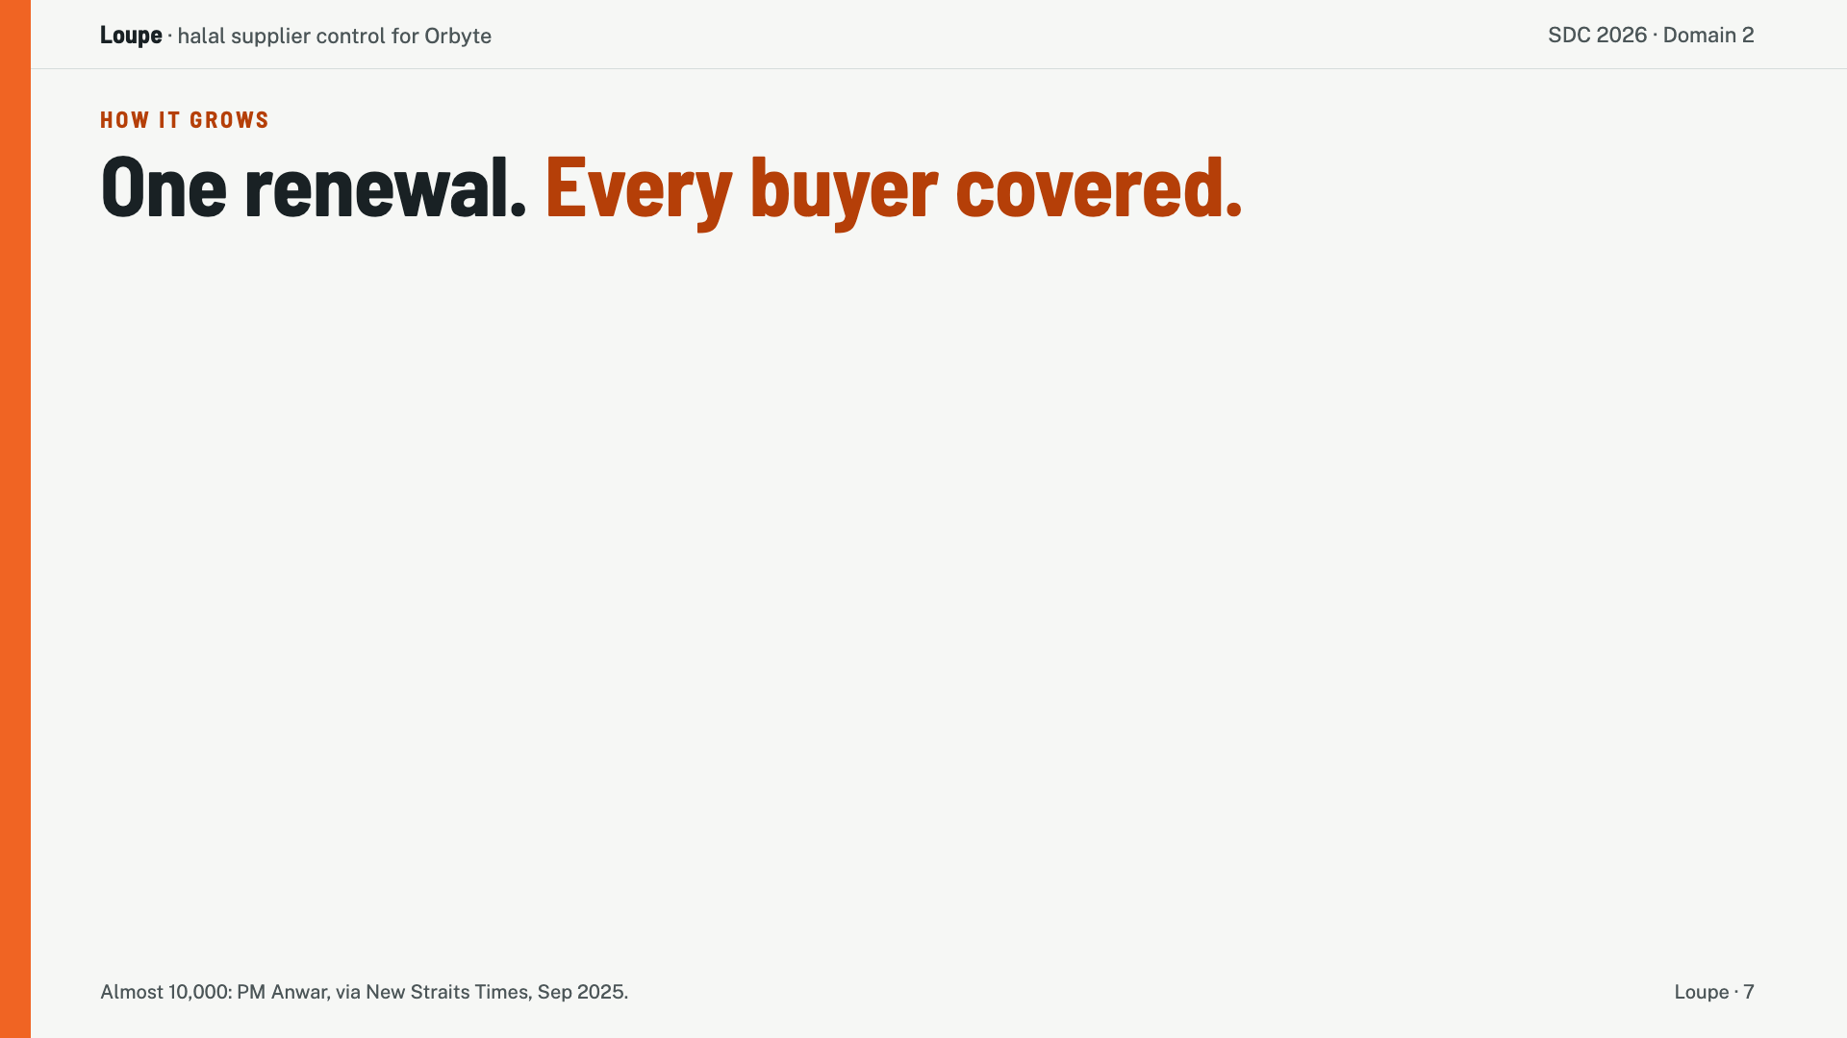
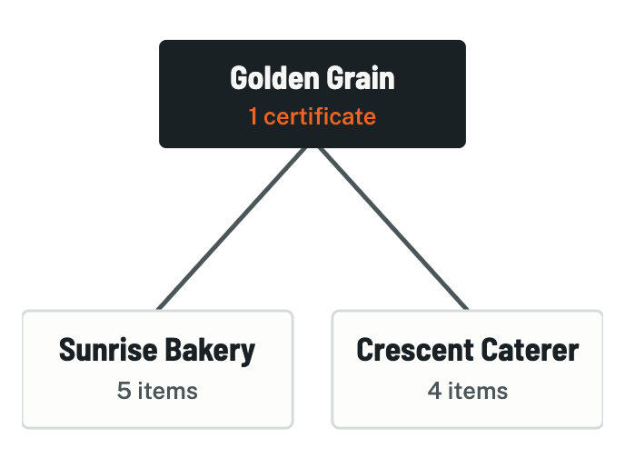
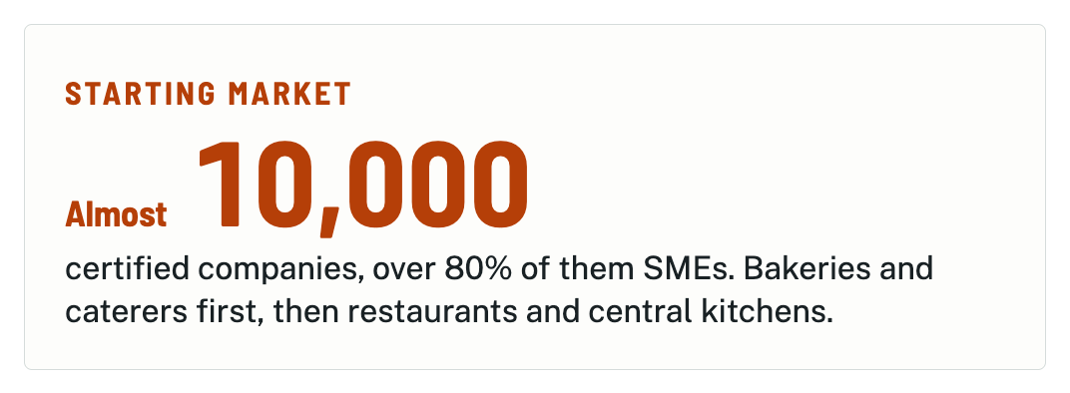
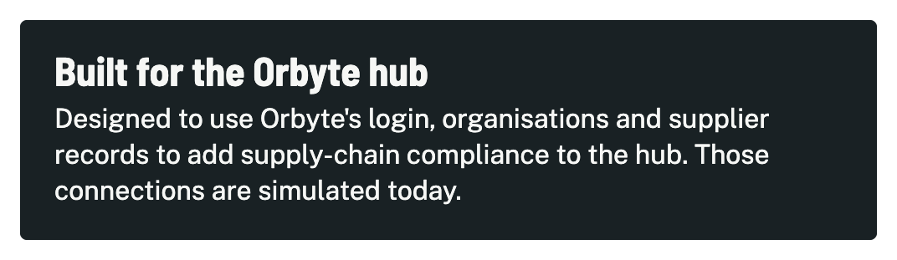
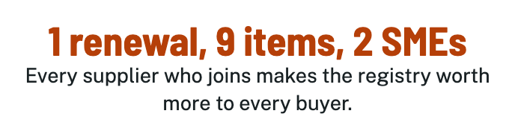
Notes:
That sharing is the business. If ten bakeries buy from one supplier, today each chases its own copy of the same certificate. With Loupe, the supplier renews once and all ten update. In our demo, one renewal updates nine items across two businesses. So every new supplier makes Loupe more useful to every buyer. A second business needs no new code, only its own ingredient list, people and settings.

Slide 8
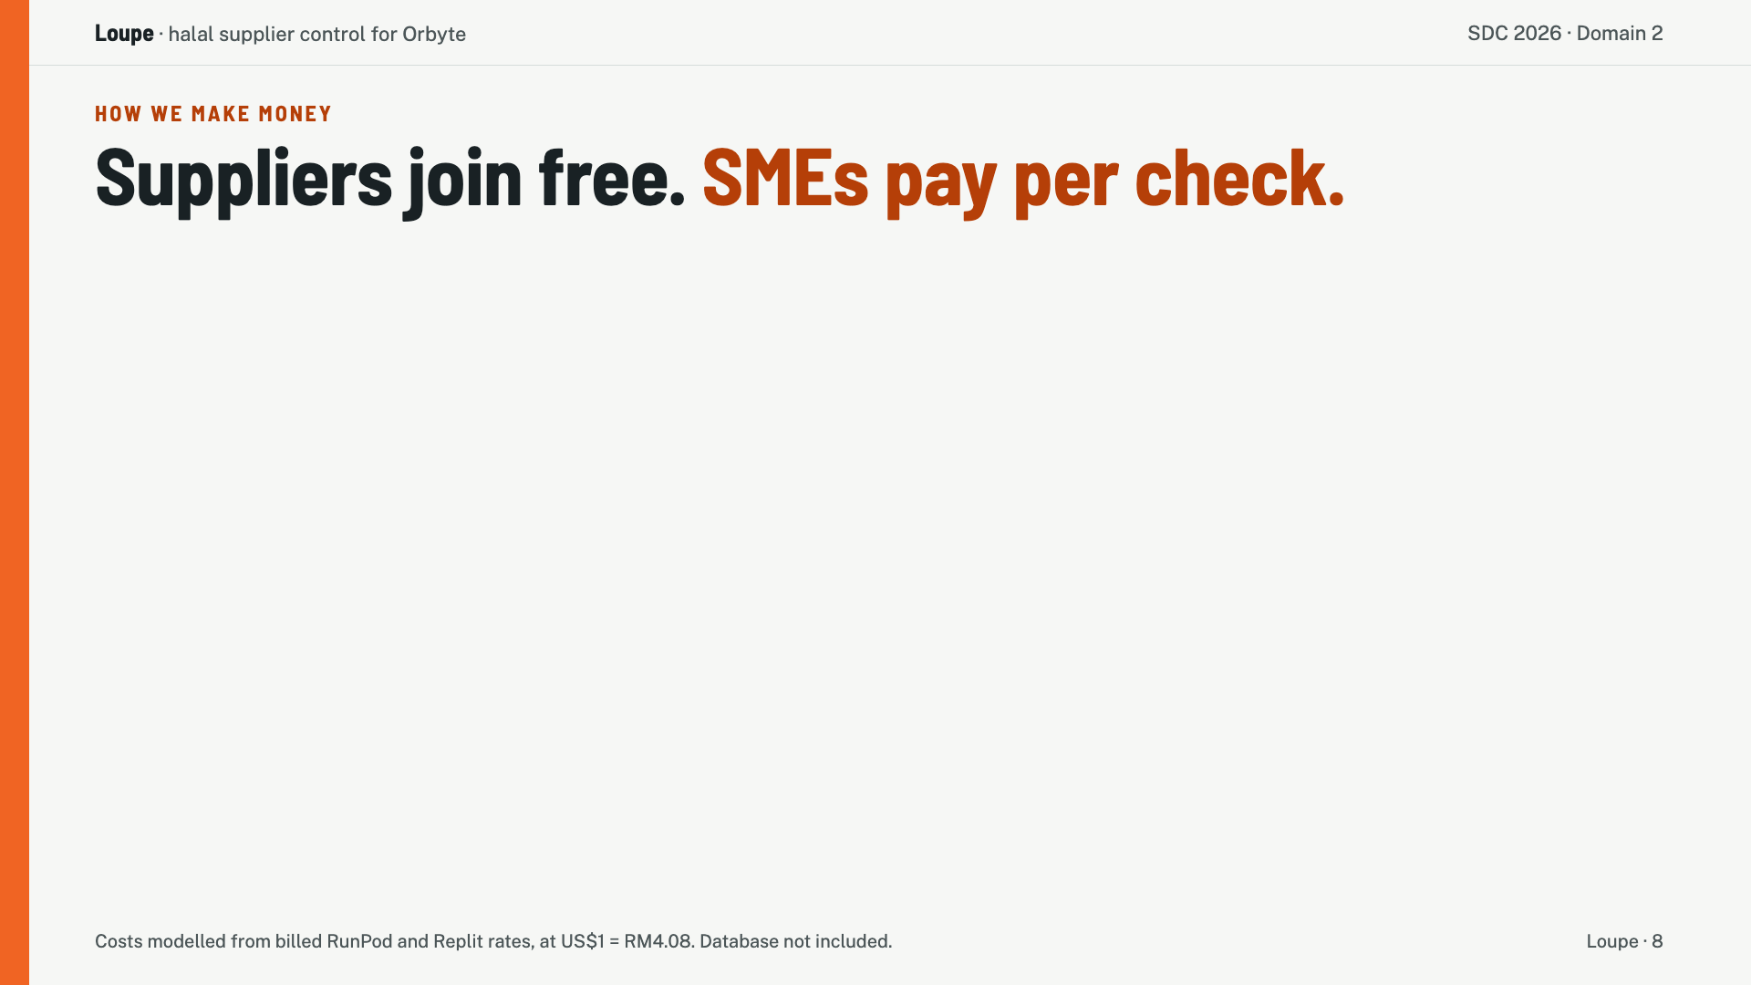
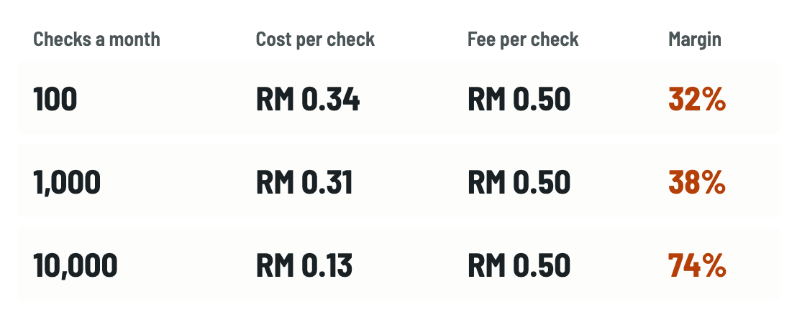
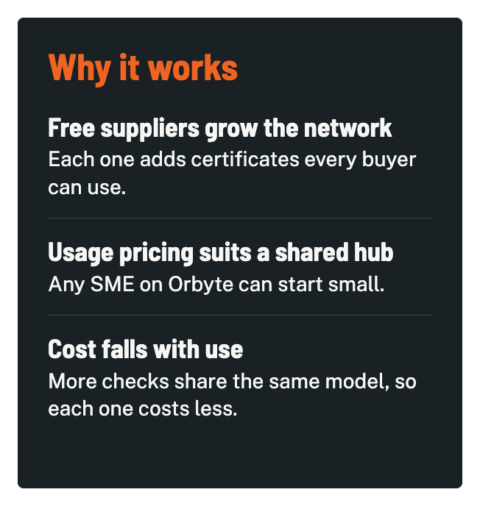

Notes:
So this is our business model. Suppliers will join free, and SMEs pay 50 sen per check, so a bakery doing 130 checks a month pays RM65. Our computing cost is about 31 sen a check at a thousand checks a month. At ten thousand, it's cheaper to keep the model running, and the cost falls to about 13 sen. So our margin grows as the network does.

Slide 9
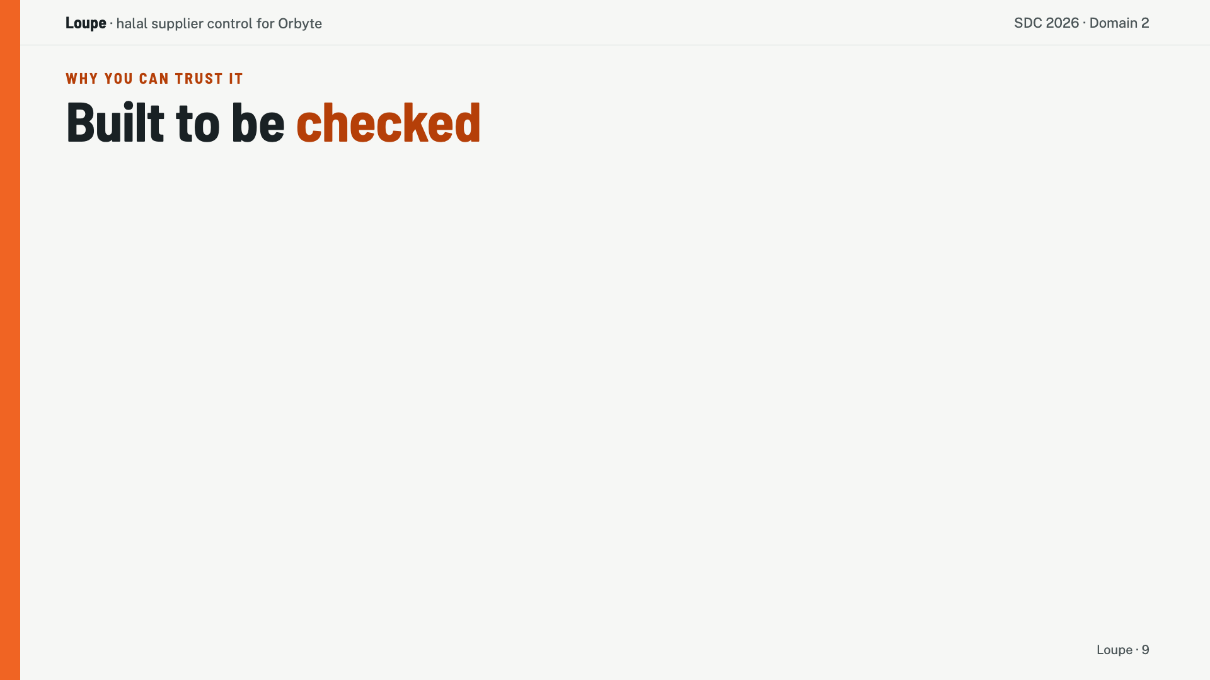
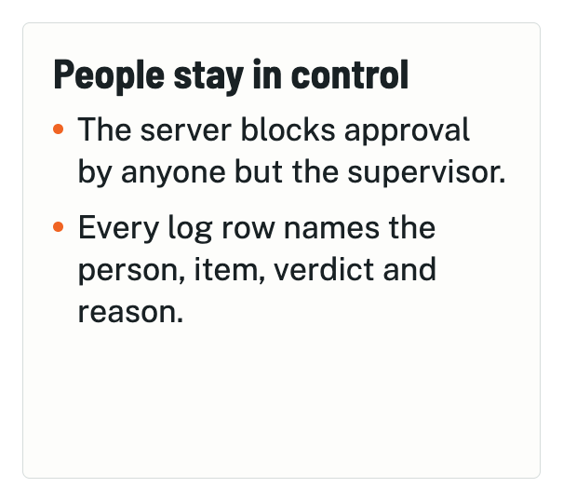
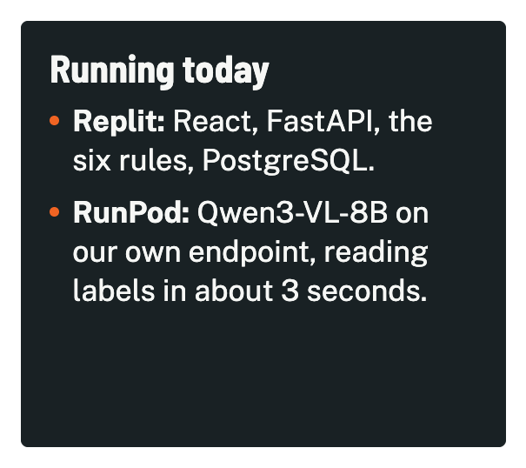
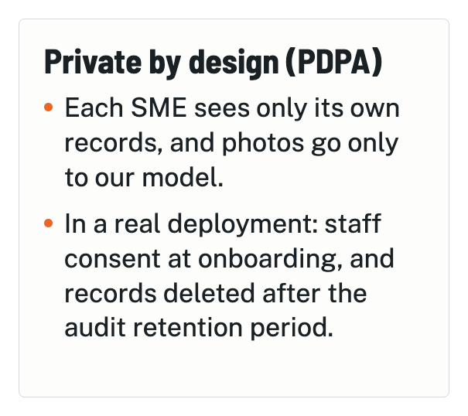
Notes:
Loupe is built to be checked. The server blocks approval by anyone except the supervisor, and every log row names the person, the item, the verdict and the reason. Each SME sees only its own records, and photos go only to our own model. But don't take our word for it. My teammates will now show you the live demo.

Slide 10


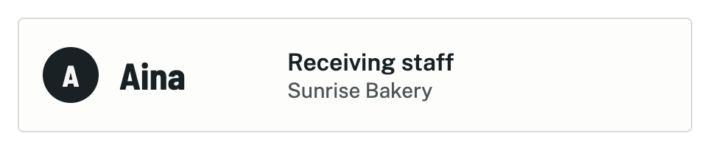
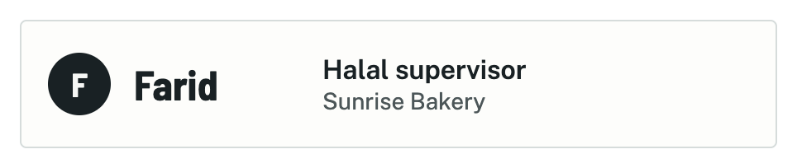
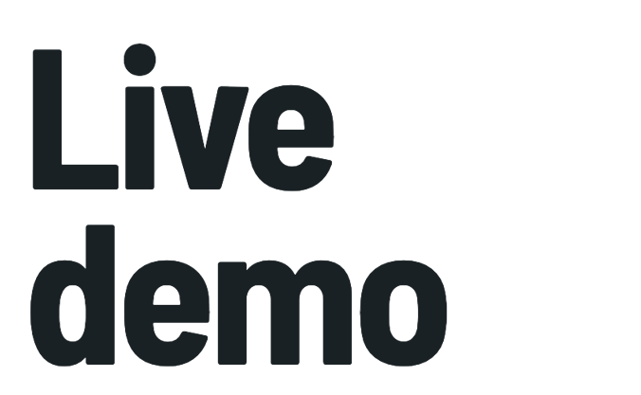
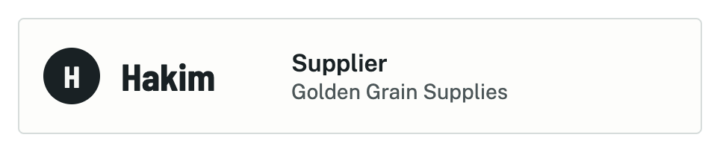
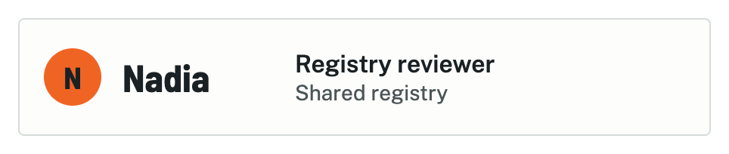

Notes:
Demo A and Demo B run the live demo, 4:30. Raise one finger at 3:30. Hard stop at 9:50 overall.

