Slide 1

HR Analytics Dashboard
A Data-Driven Insight into Human Resources Metrics
Tools: Tableau, Excel
By
Deevanshi Chauhan

Slide 2
Project Objective
Understand key HR metrics to help the company analyze and improve workforce management.
Identify trends in employee demographics, performance, hiring, and attrition.
Enable data-driven decision-making through interactive dashboards.

Slide 3
Dataset Overview
Data Source: Sample HR dataset
Contains:
- Employee Name, Age, Gender
- Department, Position, Salary
- Hire Date, Termination Reason
- Performance Scores, Satisfaction

Slide 4
Key Metrics & KPIs
Employee Turnover Rate
Hiring Rate
Time to Fill Positions
Gender and Age Distribution
Department-wise Employee Count
Performance Scores & Satisfaction

Slide 5
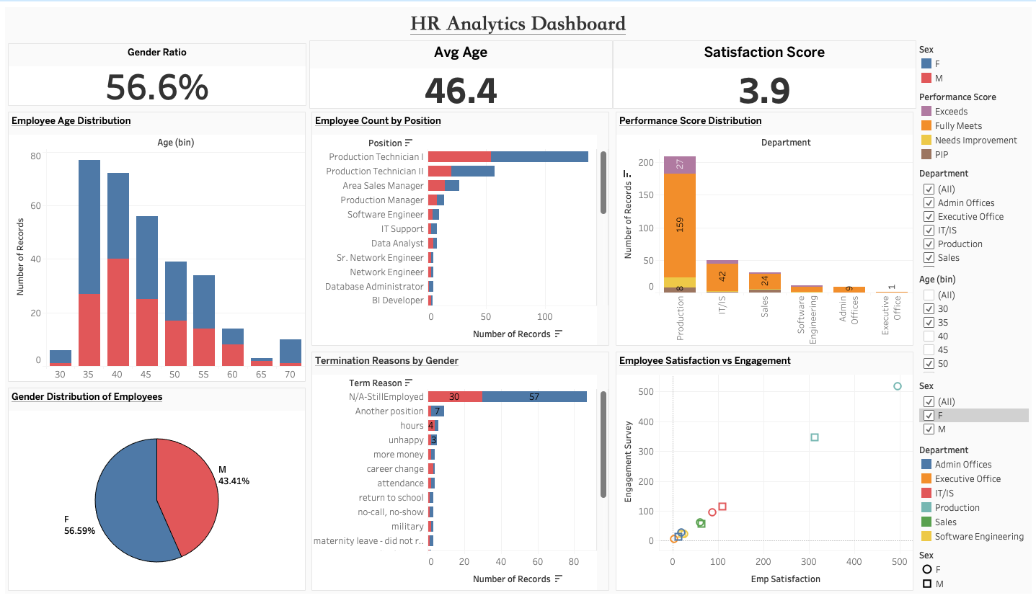
Dashboard Overview
Interactive dashboard with multiple filters: Gender, Department, Age, etc.
Visual storytelling using charts and graphs.
Designed for HR and management stakeholders.

Slide 6
Dashboard Highlights
Demographics: Visual breakdown by gender, age, department.
Turnover Trends: Clear insights into when and why employees leave.
Performance: Identify high and low-performing segments.
Hiring Trends: Track new hires across time and departments.

Slide 7
Gender Distribution: Slightly male-dominated workforce.
Departmental Distribution: Sales and HR departments are relatively larger.
Attrition Rate: Higher in Sales and Support; reasons mostly personal or dissatisfaction.
Hiring Trend: New hires peak around mid-year, indicating seasonal hiring.
Performance Insights: Most employees have average performance scores.
Age Distribution: 25–34 age group forms the bulk of workforce and attrition cases.

Slide 8
Insights & Recommendations
High turnover in specific departments → Investigate workload or leadership.
Imbalance in gender distribution → Review diversity hiring practices.
Time to fill roles is high → Optimize recruitment pipeline.

Slide 9
Tools & Techniques Used
Tableau: Data visualization and dashboard creation.
Excel: Data preprocessing and cleaning.
Calculated Fields: For metrics like turnover and hiring rates.
Charts Used: Histograms, Pie Charts, Bar Graphs, Line Charts, Scatter Plots.

Slide 10
Conclusion
Created a dynamic dashboard for HR analytics.
Delivered actionable insights using visual storytelling.
Showcases practical knowledge of Tableau and data analysis.

Slide 11

Thank You

