Slide 1
Exploratory Data Analysis
Project completed as part of post graduate program in Artificial Intelligence and Machine Learning, UT Texas Austin

Slide 2
Introduction and objectives
The data set consists of 3 types of treadmills from a retail store.
The store is called Cardio Good Fitness.
The aim of the exploratory data analysis is to
make a customer profile for the products using descriptive statistics, univariate and multivariate analysis
and generate a set of insights and recommendations for the company.

Slide 3
The data consists of:
Product bought by the customers – TM195, TM498 and TM798
Age – in years
Gender
Education – in no. of years, of the customer
Relationship status – of the customer
Usage – Average number of times the customer wants to use the treadmill every week
Fitness – a self rated fitness score of the customer (5 –very fit, 1 – very unfit)
Income – of the customer
Miles – number of miles the customer expects to run

Slide 4
Exploratory Data Analysis (EDA)
Loading and importing packages
Loading dataset
Previewing dataset
Checking columns, shape, datatypes, missing values
Descriptive statistics for the dataset
Univariate, bivariate and multivariate analysis for the dataset
Insights gained from the analysis
Recommendations based on the analysis

Slide 5
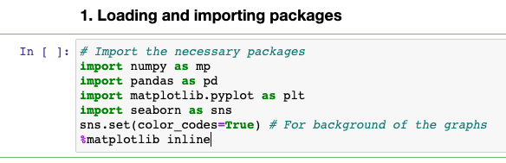
Loading and importing packages
Numpy – python library, scientific computing – has a multidimensional array object, derived objects like matrices,
Operations such as sorting, logical operations, linear algebra, statistical operations etc
Pandas – python package – data structures (series, dataframe) designed to work with relational or labeled data
Matplotlib – python library – creating static and interactive visualizations in python
Seaborn – visualization library built on top of matplotlib

Slide 6
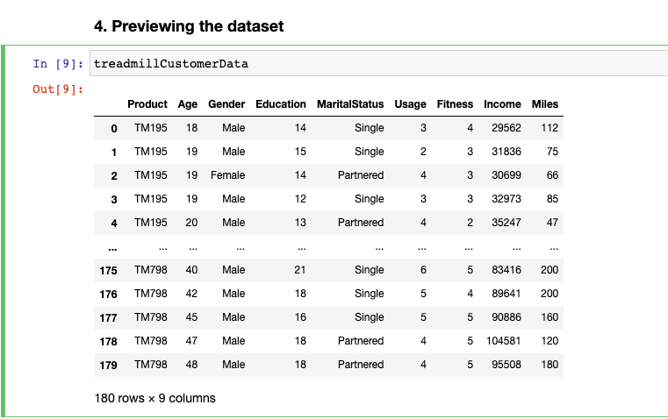
The dataset
Original dataset is in a CSV file
We import the dataset into a pandas dataframe
There are 180 rows and 9 columns in the data
Quick glance tells us that the data has categorical values as well as continuous values.

Slide 7
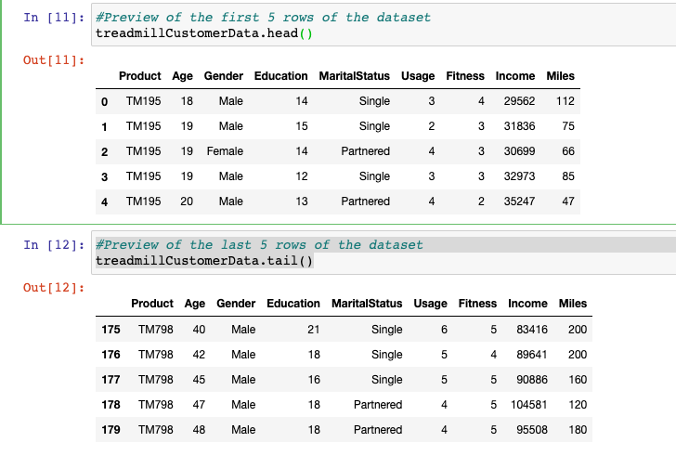
Preview of the dataset
There are 9 columns in the data set.
Data has product name, and the data about the customers who bought them.
The customer data that is provided
Is about their age, gender, education, relationship status, and how much they expect to the use the treadmill.
In addition, the data also has fitness, income and miles that the customers expect to run.

Slide 8
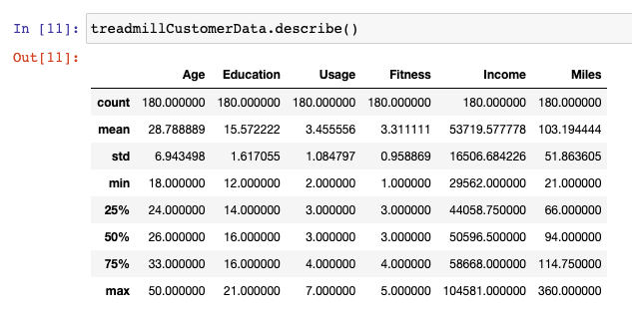
Descriptive statistics for the dataset
Continuous variables – age, education, usage, fitness, income, miles
The age range for the 180 customers was 18 to 50 years for the 3 treadmill products
The mean age for the customer was 28.7 years and median age was 26 years
The inter-quartile range for the age was approximately 9 years (75% - 25%)
75% of the customers were below the age of 33 years
The income range for the 180 customers was ~ 29k to 104k.
The mean income was ~53,719 dollars, median income was 50,596 dollars.
The mean and median usage (expected) was ~ 3 times per week
Overall, the 180 customers rated themselves a 3.3 on the fitness scale.
The average miles they expected to use the treadmill was 103 miles. The units are not given for this column, but it can be interpreted to be per month ( assuming a person walks 3 miles a day)

Slide 9
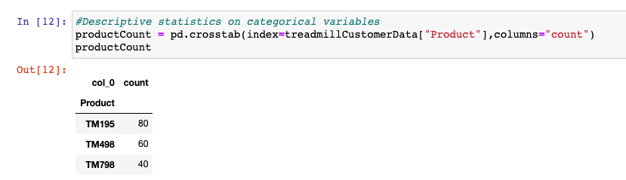
Descriptive statistics on categorical variables
TM195 product was sold the most (80 items).

Slide 10
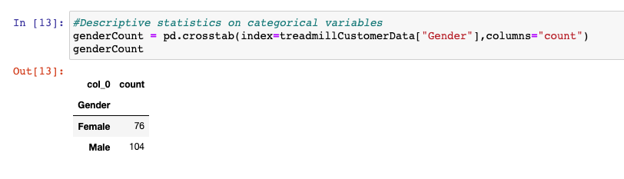
Descriptive statistics on categorical variables
Among the 180 customers, 104 customers were male and 76 were female. Hence, we can conclude that more male customers bought treadmills as compared to the females in the given dataset.

Slide 11
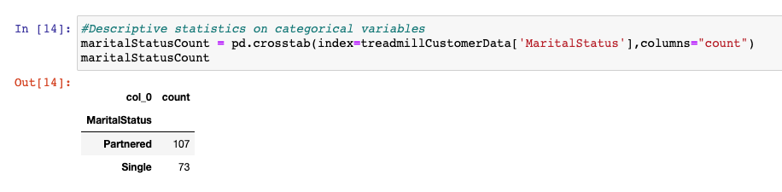
Descriptive statistics on categorical variables
Among the 180 customers, 107 customers had a partner, while 73 were single. Thus, more partnered customers bought treadmills as compared to single customers in the given dataset.

Slide 12
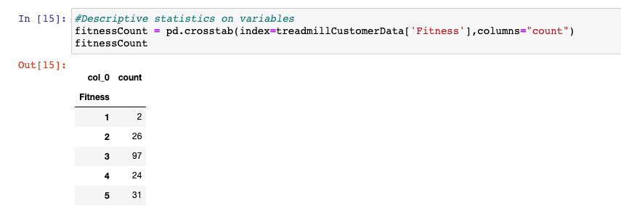
Descriptive statistics on categorical variables
Among the 180 customers, 97 customers rated themselves as being in the middle of the fitness scale which had a range of 1 (poor shape) and 5 (excellent shape). So the people who rated themselves fairly fit on a scale of 1-5 were the biggest chunk of customers who bought treadmills.

Slide 13
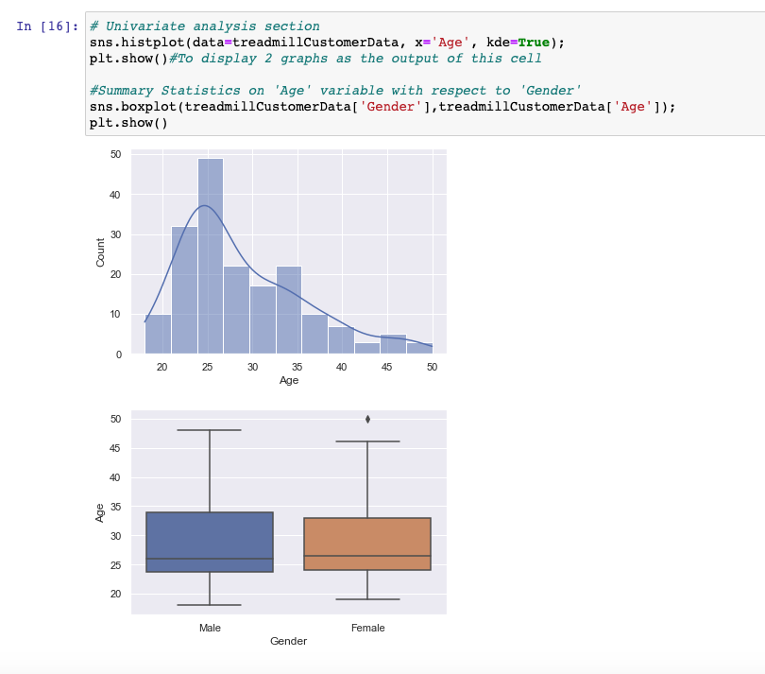
Univariate analysis for the dataset
The mean and median are different for the frequency distribution for the age of the customer. The distribution is slightly skewed to the right (positive skew). The tail is to the right, so less number of middle aged/older customers bought the treadmill products as compared to younger people.
A large number of customers were around 25 years old.
Distribution of age for males and females were fairly similar.
One outlier present for age among the female customers (female who was aged 50 was outside the whiskers of the box plot, so the data point can be considered an outlier.

Slide 14
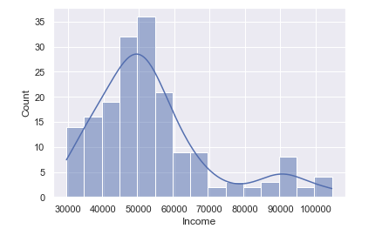
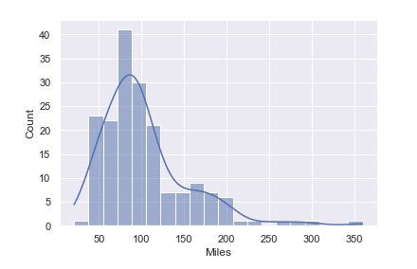
Univariate analysis for the dataset
Data is right skewed for the above variables. As income increases, the count goes lower. The same goes for miles variable.

Slide 15
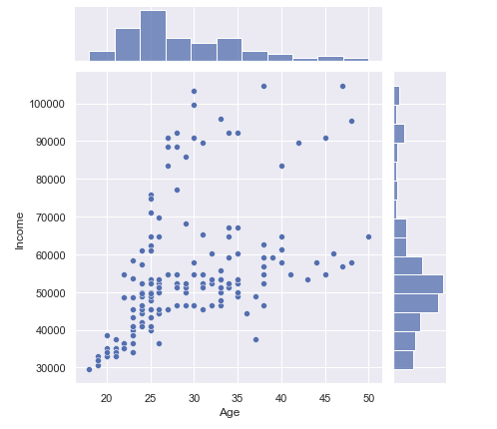
Bivariate analysis
In the jointplot, we can see that most of the customers are clustered around the young ages, and mostly under 70,000 dollars on the income side.

Slide 16

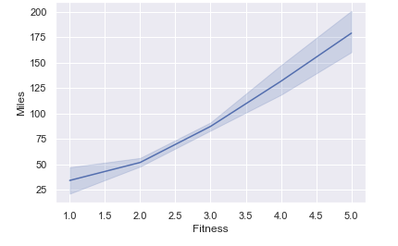
Bivariate analysis
Fitness versus Miles was fairly straightforward relationship.
The higher people rated themselves on the fitness scale, the more the number of miles customers expected to walk/run each week.

Slide 17
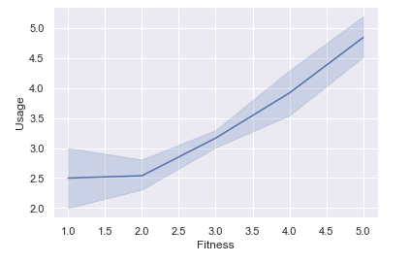
Bivariate analysis
Fitness versus Usage had a similar straightforward relationship. The higher the people rated themselves on the fitness scale, the more number of times the customers expected to use the treadmills.

Slide 18
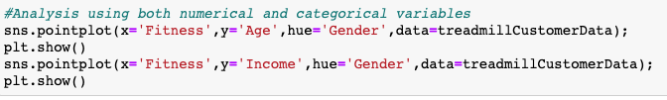
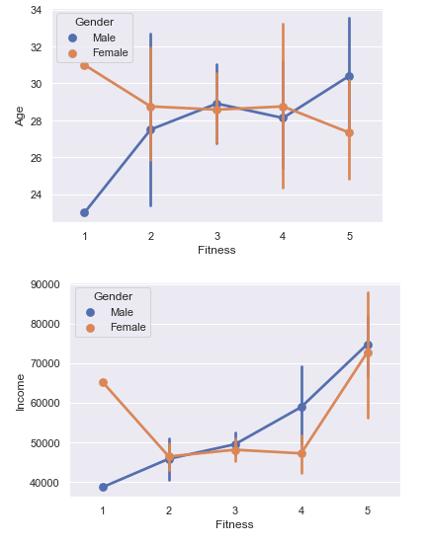
Analysis using both numerical and categorical variables
For Fitness versus Age and categorized by Gender in the first plot on the left, we can see that females above 30 yrs happened to rate themselves low on the fitness scale, while males above age of 30 did not. There is similar disagreement towards the other end of the fitness scale. However, both makes and females around the mean and median age had a similar self-rating on the fitness scale.
For Fitness versus Income, and categorized by Gender in the second plot on the left – both males and females with higher incomes rated themselves more fit.

Slide 19
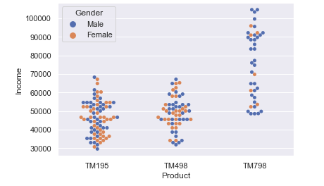
Analysis using both numerical and categorical variables
Majority of the customers who bought the two products TM195 and TM498 products were below 70,000 dollars.

Slide 20

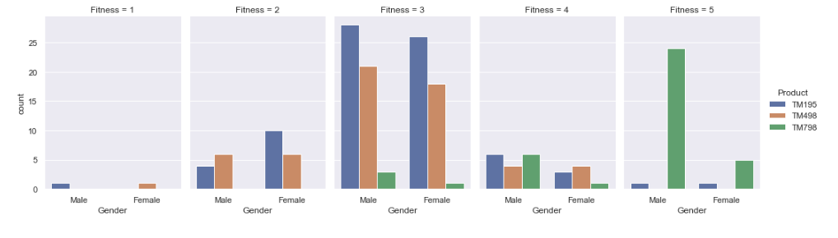
Analysis using both numerical and categorical variables
People who rated themselves above average on the fitness scale (fitness scale > 3) were the customers who bought product TM798.
Also, the # of females who bought TM798 and who rated themselves rated 5 on the fitness scale vastly outnumbered the males.
There were no instances of customers who rated themselves 1 or 2 on the fitness scale who bought a single TM798.

Slide 21

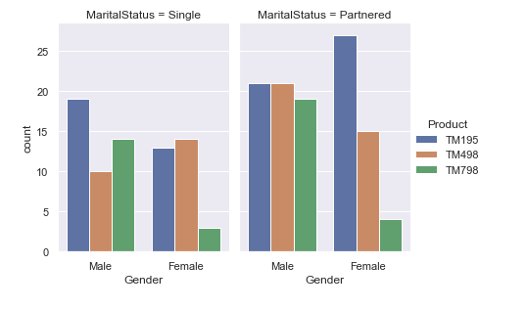
Analysis using both numerical and categorical variables
Female customers who had a partner preferred product TM195 over the other two products TM498 and TM798.
Male single customers who preferred product TM195 over the other two products TM498 and TM798.

Slide 22
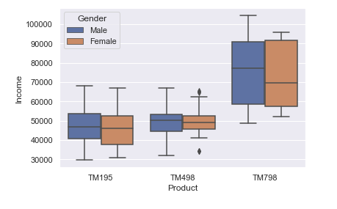
Analysis with both numerical and categorical variables
Male and female custoemrs who had higher incomes preferred product TM798.
The difference in the median income of the male customers who bought TM798 as compared to the other two products was approximately 30,000 dollars.

Slide 23
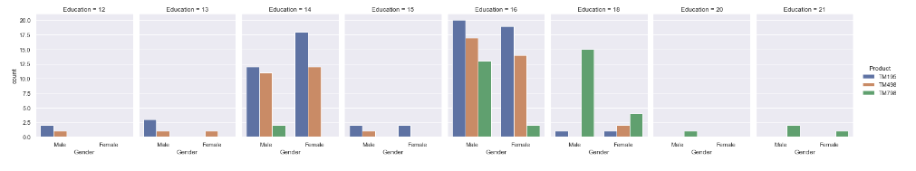
Category plot
For customers who had education more than 18 years, the only product they bought was the TM798.

Slide 24
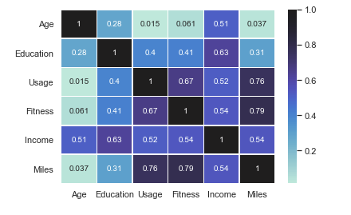
Correlation analysis among the continuous variables
There is some observed correlation between fitness and miles the customers expect to walk/run every week (0.79). Also, there is a correlation relationship between the fitness and usage, and income and education.

Slide 25
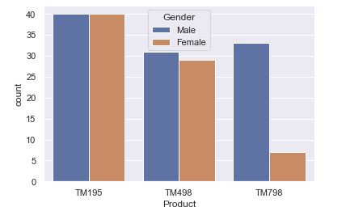
For product TM195, the count of male and female customers is the same. For product TM498, the count of male and female customers was similar.
For TM798, the count of male customers was much higher than the count of female customers.

Slide 26
References/Citations
https://pandas.pydata.org/docs/getting_started/overview.html
https://numpy.org/doc/stable/user/whatisnumpy.html
https://matplotlib.org/
https://seaborn.pydata.org/

