Slide 1
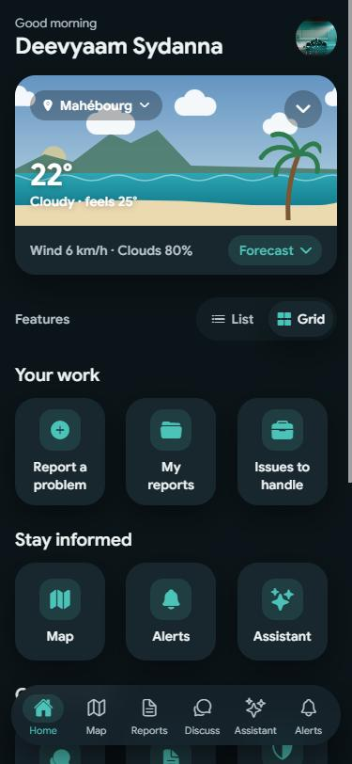

Ansam Moris
Report it. Follow it. Fix it, together.
A community app for Mauritius, in Kreol, Français and English.
“Ansam” means “together” in Kreol Morisien
Notes:
Ansam Moris means "together, Mauritius". It is a community app where anyone in Mauritius can report a local problem, follow what happens to it, and talk with their neighbours, in Kreol, French or English.

Slide 2



Local problems get lost, not fixed
Hard to report
No follow-up
Many are left out
Which office handles a pothole, a dark street or rubbish? People give up before they start.
Once a complaint is made, nobody can see if it was received, who has it or when it will be fixed.
Forms in one language and complicated apps shut out people who aren’t confident with phones.
Notes:
Three things stop local problems from being fixed. Reporting is confusing, so people give up. There is no follow-up, so nobody knows what happened. And the tools that exist leave out people who are not comfortable with technology or with formal French and English.

Slide 3
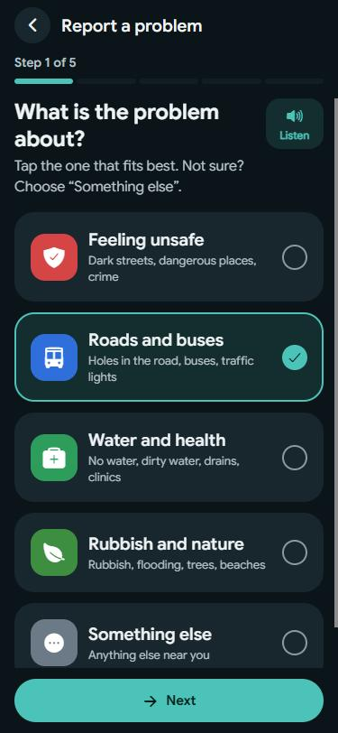




One app to report, follow and talk
Report in 5 plain steps
One question per screen, a Listen button, photos and an optional map pin.
See it on the map
Every report as a pin you can choose, plus safety and dark-spot layers.
Talk in Discuss
One friendly room for the community, moderated by local volunteers.
Ask the assistant
Answers in Kreol, French or English, and turns a photo into a draft report.
Notes:
Ansam Moris brings everything into one place. Reporting takes five short steps with one plain question per screen, and every step can be read aloud. Reports show on a map. The community talks in one moderated room. And an assistant answers questions in Kreol, French or English, and can turn a photo into a draft report that the person checks and sends.

Slide 4





From “I saw it” to “it’s fixed”
Spot it
Report it
Back it
Act on it
Fixed
A hole in the road, a broken light, rubbish
Photo, place and a few words, in minutes
Neighbours tap “Me too” so it gets noticed
Verified authorities update the status
Everyone who cared gets notified
Every report shows its progress: Reported → Sent to an authority → In progress → Fixed
Notes:
This is the journey of a report. Someone spots a problem and reports it with a photo and the place. Neighbours back it with "Me too", which shows how many people it affects. A verified authority, such as a council, updates its status, and when it is fixed everyone who reported or backed it is notified. Anyone can see where each report stands at any time.

Slide 5
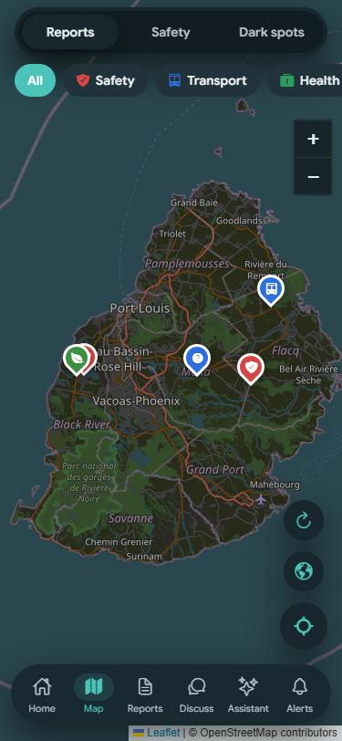




Built for everyone, built for trust
Clear to anyone
Three languages
Plain words, big buttons, every step read aloud
Kreol Morisien, Français and English
Trusted roles
Privacy first
Verified authorities, moderators and admins
Post anonymously; location only if you choose; EU data region
Notes:
Ansam Moris is designed for people who struggle with technology: plain words, big buttons, and every step can be read aloud. It works in Kreol, French and English. Real people are accountable: authorities are verified, and moderators and admins keep the community safe. Privacy comes first: people can post anonymously, location is only attached when they choose, and data is stored in the EU region.

Slide 6
Ready to pilot with one town
1
2
3
Pilot
Go to the stores
Grow
Launch with one municipal council and its residents
Publish on Google Play and the App Store
More councils, ministries and volunteer moderators
We’re looking for: a council to pilot with, and support to host the assistant and publish the apps.
Try it today: ansam-moris.vercel.app
Notes:
The app works today on the web and Android. The next step is a pilot with one municipal council and its residents, then publishing on Google Play and the App Store, and growing to more councils, ministries and volunteer moderators. We are looking for a council partner and support to host the assistant and publish the apps. You can try it now at ansam-moris.vercel.app.

