Slide 1

ONLINE LEARNING MANAGEMENT SYSTEM
Submitted to: Mr. Brijendra Pal Singh
Submitted by: Deewakar Kumar & Riddhima Rai

Slide 2

COGNITION
"Technology will not replace great teachers, but technology in the hands of great teachers can be transformational." - George Couros

Slide 3

WELCOME TO COGNITION
COGNITION is a software application or web-based platform designed to facilitate the management, administration, and delivery of educational content. It serves as a centralized hub for organizing, tracking, and delivering learning materials and activities.
COGNITION plays a crucial role in the modern education and training environment, providing a centralized and efficient way to deliver and manage educational content.
COGNITION helps streamline the learning process by providing a centralized platform for course creation, content delivery, and learner management. They enable organizations to efficiently deliver and track training programs, monitor learner progress, and assess performance.
The goal of COGNITION is to enhance the learning experience, make the administration of educational programs more efficient, and provide valuable insights into the effectiveness of training initiatives through data and analytics.

Slide 4
Key Features of Cognition

Slide 5
01
User Management
02
Course Management
03
Communications & Collaborations
Course Creation: Enables instructors to create and organize courses, modules, and lessons.
Content Upload: Allows the uploading of various types of content, such as documents, videos, quizzes, and presentations.
Course Catalog: Provides a centralized location for users to browse and enroll in available courses.
Discussion Forums: Facilitates online discussions among students and instructors.
Messaging Systems: Allows direct communication between users.
Announcements: Enables administrators and instructors to broadcast important information to users.
User Registration: Allows users (students, instructors, administrators) to create accounts.
User Authentication: Ensures secure access to the system with usernames and passwords.
04
Assessment & Evaluation
05
Reporting & Analytics
06
Update & Support
Quizzes and Exams: Supports the creation and administration of assessments.
Grading: Automates the grading process and provides feedback to learners.
Progress Tracking: Allows learners to track their progress and completion status.
User Progress Reports: Generates reports on individual and overall course progress.
Assessment Analytics: Provides insights into quiz and exam performance.
Attendance Tracking: Monitors user attendance and participation.
Regular Updates: Ensures the LMS stays current with technology and security standards.
Technical Support: Provides assistance to users in case of issues or inquiries.

Slide 6
Explanation of Home page & About page
HTML for Content Region
HTML (Hypertext Markup Language) is used to create the structure of the webpage. It defines the content and layout of different sections on the home page. This includes elements like headings, paragraphs, images, links, and other HTML tags that organize and present the information on the page
Inline CSS:
Some styling is applied inline, directly within the HTML elements. This involves “ style ” attributes within specific HTML tags to apply styling rules. For example, you might set the color or font size of a particular text element directly within the HTML tag using inline CSS.
Internal CSS:
internal CSS is applied within the ’<style>’ tags in the ‘<head>’ section of the HTML document. This allows you to define styles that apply to the entire page or specific sections. Internal CSS is placed directly within the HTML file and is not shared across multiple pages.
External CSS:
External CSS is applied by linking to a separate CSS file. This file contains all the styling rules for our website and is referenced in the HTML file. External CSS is useful for maintaining a consistent look across multiple pages as the same stylesheet can be linked to all pages. It promotes a modular and organized approach to styling.

Slide 7
Explanation of Login page & Registration page
In Login & Registration
This indicates that the described practices apply specifically to the login and registration sections of a website or application.
Use Of Javascript Based On My Needs
In the login and registration sections of our website, we employ JavaScript to enhance the functionality and user experience within the content region. JavaScript is utilized to handle dynamic elements, perform client-side validations, and create a more interactive and responsive interface. Additionally, in certain instances throughout our platform, there is a specific requirement for the implementation of JavaScript to meet specific needs or functionalities
Use Of HTML & CSS Based On My Needs
In the login and registration sections of our website and application, we have employed HTML and CSS to design and style the content region. Additionally, we have hinted that there are other requirements or needs in different parts of our project that go beyond the HTML and CSS implementation.

Slide 8

SYSTEM REQUIRED
Hardware Requirements
RAM
ROM
Software Requirements
Visual Studios

Slide 9
Screenshots of the pages by:
Riddhima Rai

Slide 10
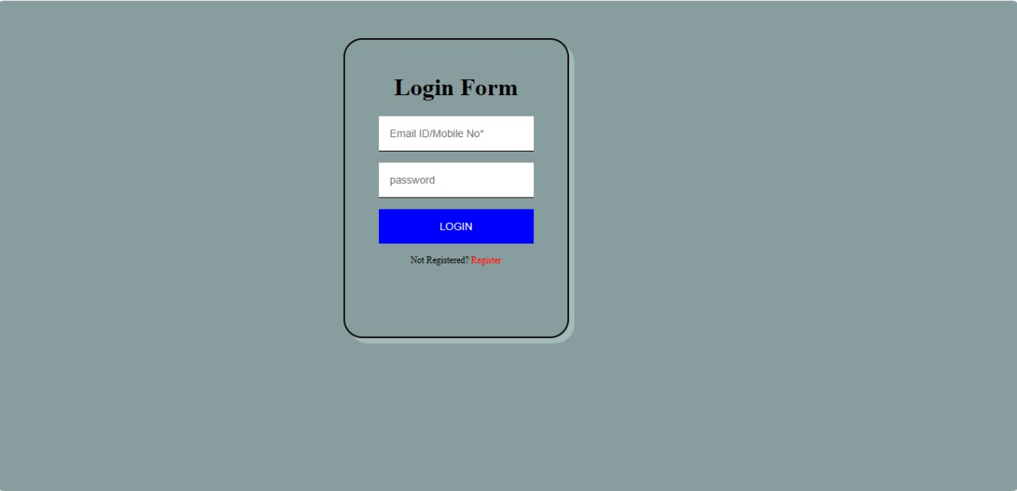
LOGIN PAGE

Slide 11
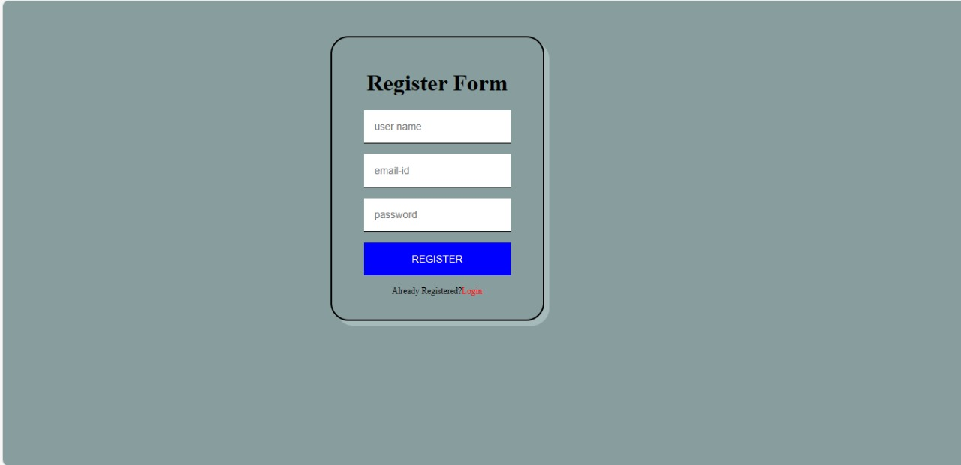
REGISTRATION PAGE

Slide 12
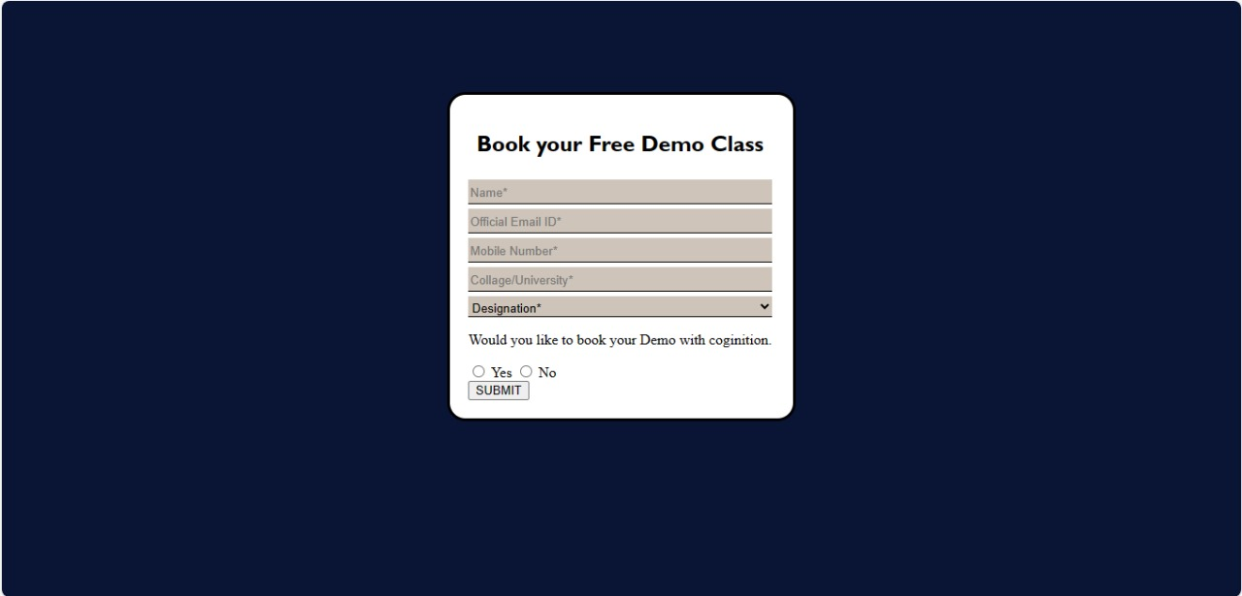
BOOKING DEMO CLASS PAGE

Slide 13

HOME PAGE

Slide 14
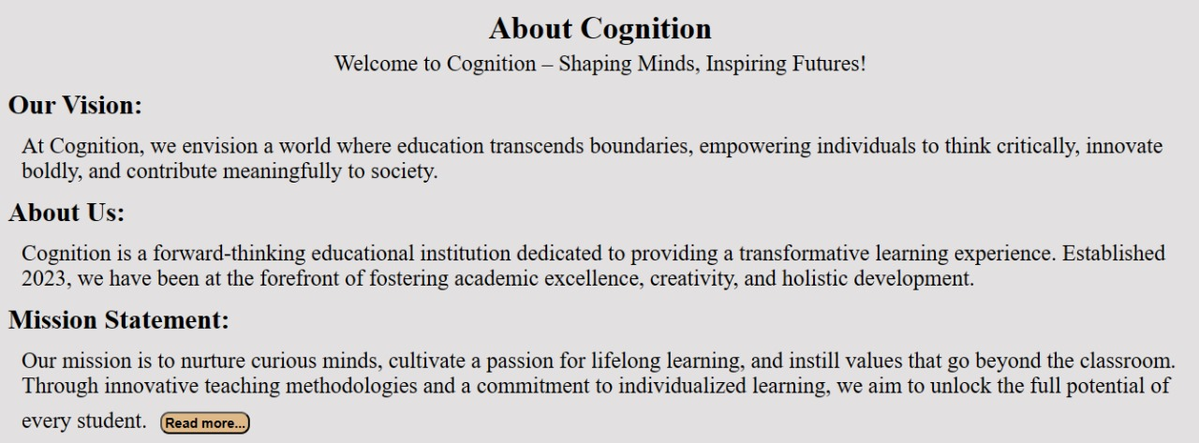
ABOUT PAGE

Slide 15
Screenshots of the pages by:
Deewakar Kumar

Slide 16
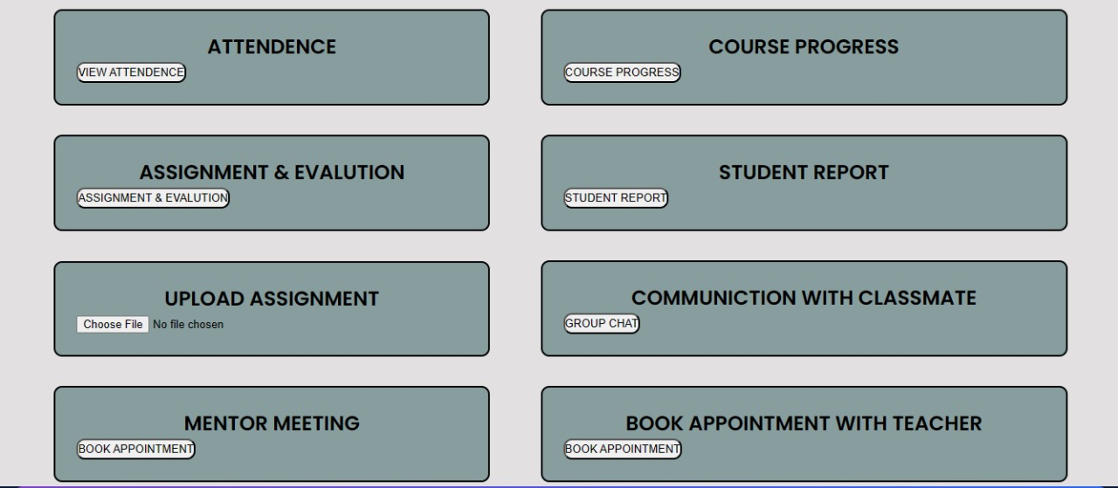
STUDENT PORTAL PAGE

Slide 17
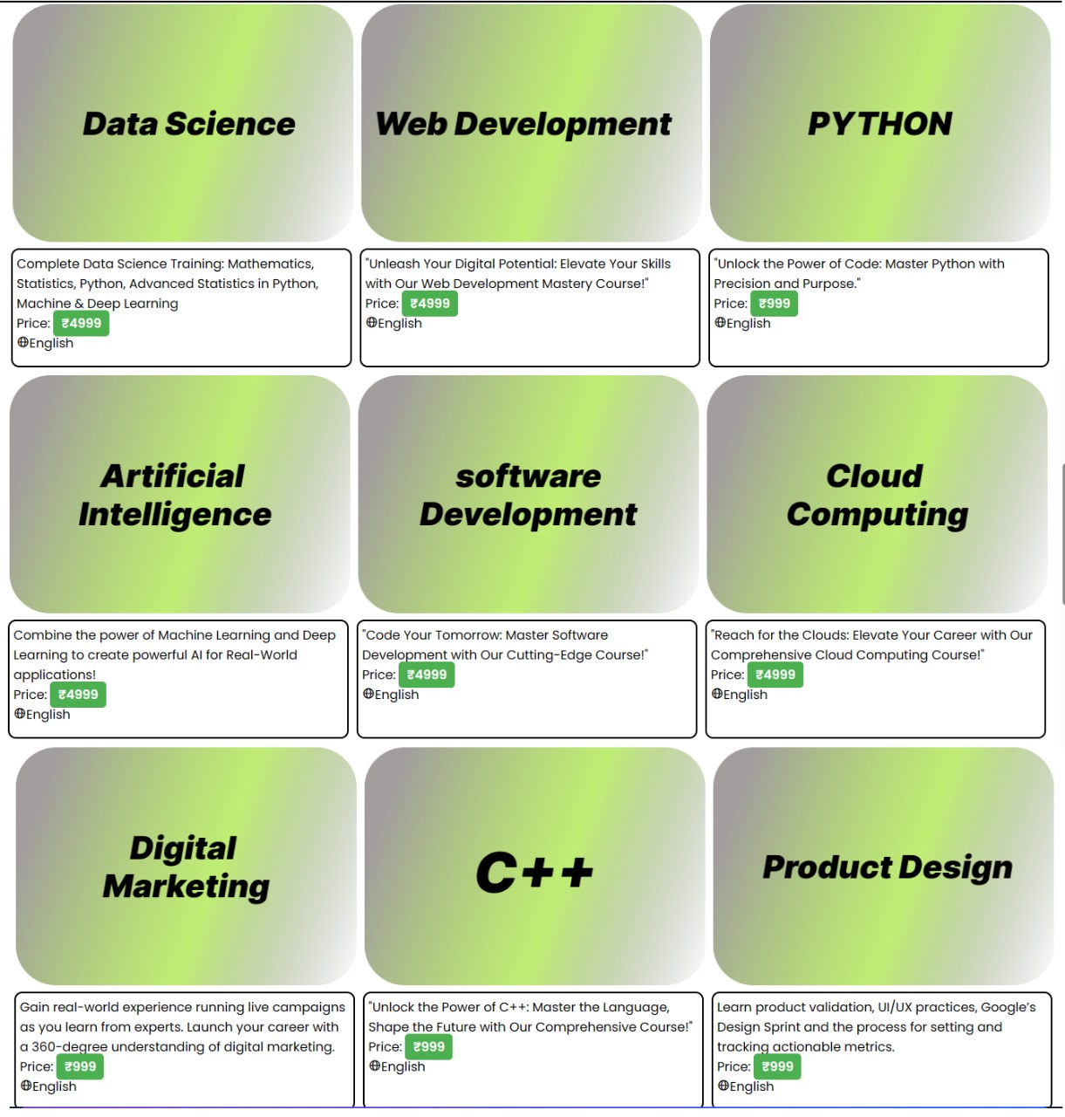
COURSE PAGE

Slide 18
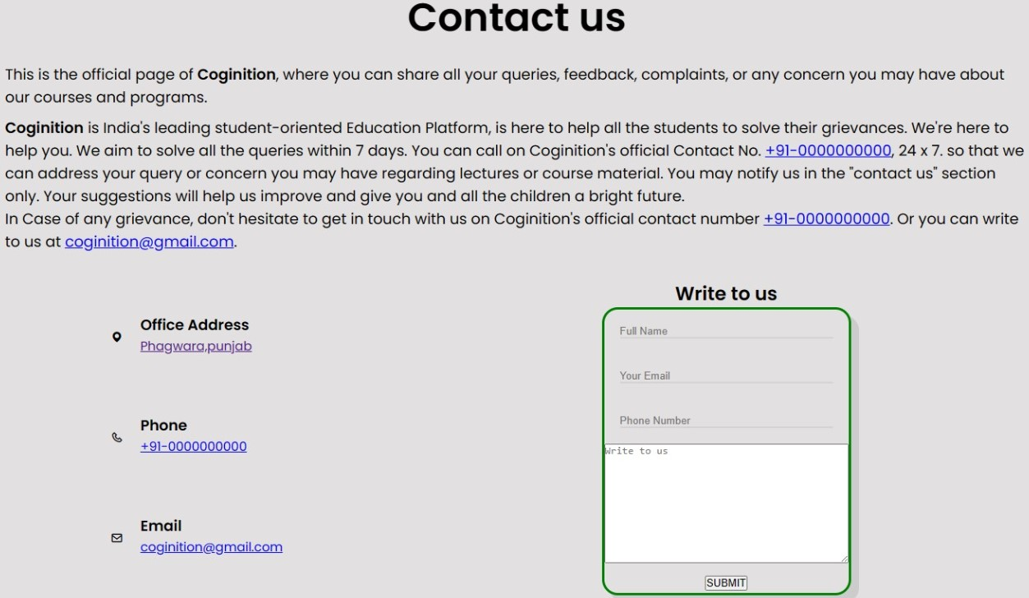
CONTACT PAGE

Slide 19
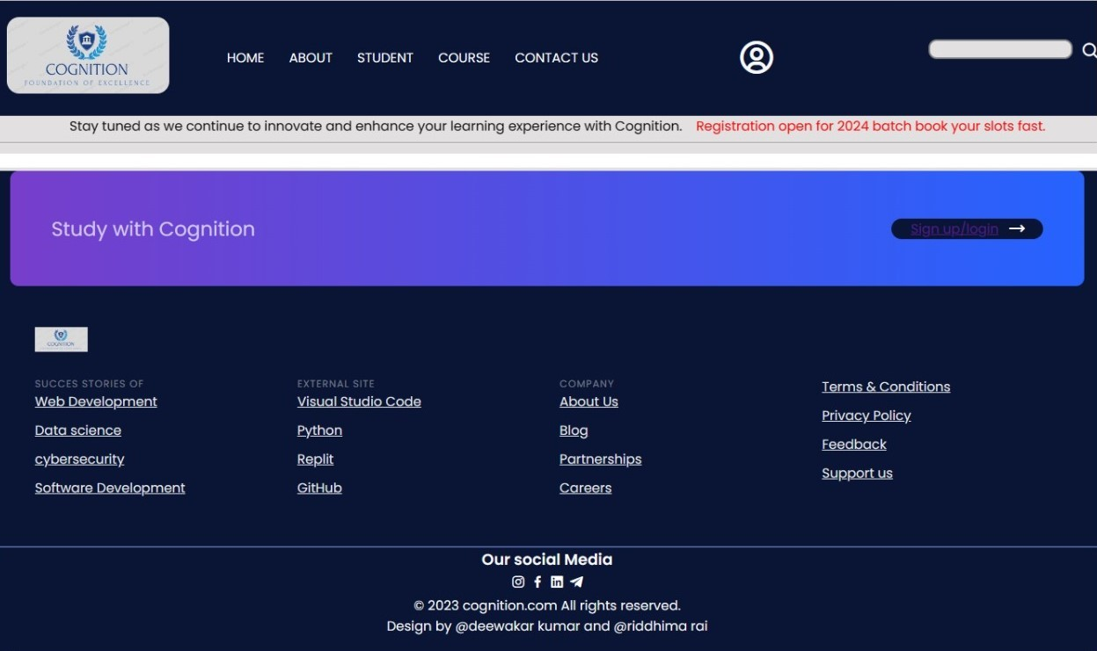
NAVBAR & FOOTER SECTION

Slide 20

References:
https://www.w3schools.com/
https://boxicons.com/
https://github.com/

Slide 21
Thank you

