Slide 1

CAREER TRENDS EXPLORER AND PERSONALIZED JOB MATCHING
BY: - DEEWANKAR SHARMA

Slide 2

INTRODUCTION
OBJECTIVE
TO DESIGN A COMPREHENSIVE JOB MARKET ANALYSIS DASHBOARD AND A PERSONALIZED JOB RECOMMENDATION ENGINE, UTILIZING MACHINE LEARNING AND VISUALIZATION TECHNIQUES.
KEY HIGHLIGHTS
PREDICTIVE ANALYTICS
Workforce insights

Slide 3
KEY QUESTIONS ADDRESSED
WHAT ARE THE HIGH-DEMAND ROLES IN THE MARKET?
How are salaries distributed across regions?
What are the emerging job categories?
How can job seekers receive tailored recommendations?

Slide 4
SITUATIONAL OVERVIEW
CURRENT SCENARIO:
THE JOB MARKET IS DYNAMIC AND INFLUENCED BY TECHNOLOGICAL DISRUPTIONS AND CHANGING WORK PREFERENCES (E.G., REMOTE JOBS)
SOLUTION:
A DATA-DRIVEN PLATFORM THAT COMBINES HISTORICAL AND LIVE JOB POSTINGS TO PROVIDE ACTIONABLE INSIGHTS FOR JOB SEEKERS AND RECRUITERS.

Slide 5
DATA OVERVIEW
DATASET
COLLECTED JOB POSTING DATA FROM FEBRUARY 2024 TO MARCH 2024.
Key columns: title, link, published_date, hourly_low, hourly_high, budget, country.
INITIAL INSIGHTS:
SIGNIFICANT MISSING VALUES IN HOURLY_LOW, HOURLY_HIGH, AND BUDGET.
Outliers detected in budget and hourly rate columns.

Slide 6
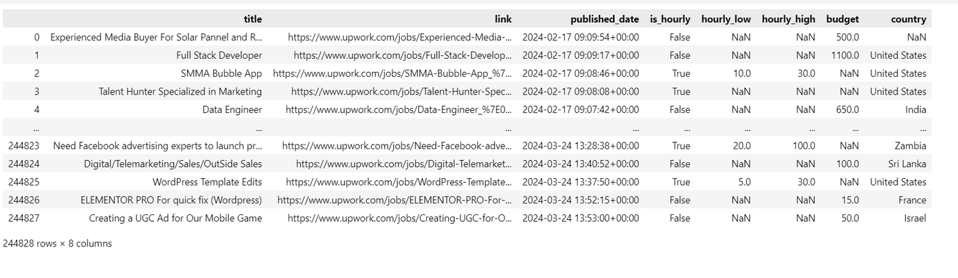
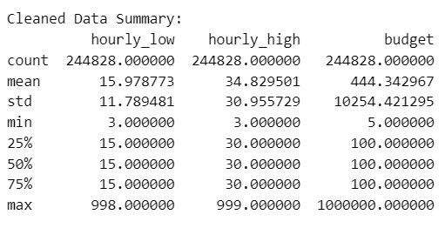
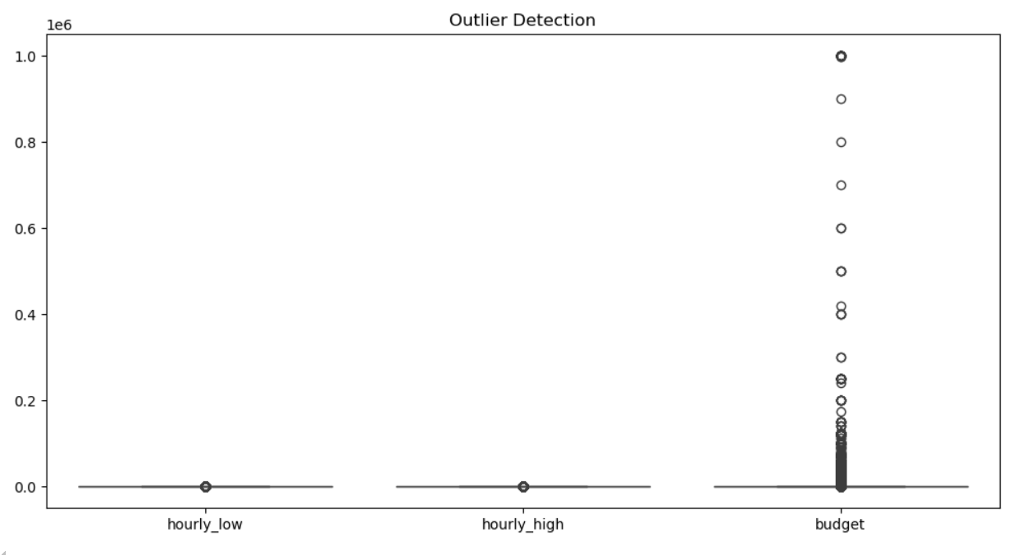

Slide 7
DATA CLEANING & PREPROCESSING
STEPS TAKEN
MISSING CATEGORICAL VALUES FILLED WITH 'UNKNOWN'.
Numerical columns imputed with median values.
Converted published_date to datetime format.
OUTCOME:
CLEANED DATASET READY FOR ANALYSIS WITH CONSISTENT FORMATTING AND REDUCED NULL VALUES.

Slide 8
INSIGHTS & ANALYTICS
TASK 1: TOP KEYWORDS IN JOB TITLES
METHODOLOGY: TOKENIZED JOB TITLES USING COUNTVECTORIZER AND APPLIED TRUNCATED SVD.
Findings:
Identified top keywords highlighting high-demand skills.

Slide 9
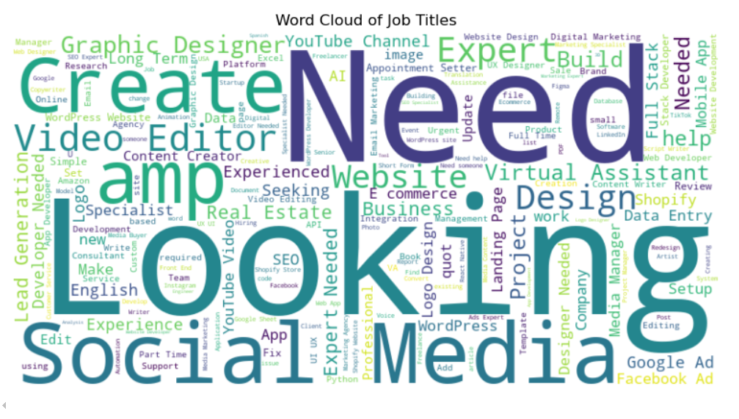

Slide 10
TASK 2: EMERGING JOB CATEGORIES
METHODOLOGY: ANALYZED GROWTH RATES OF JOB POSTINGS BY CATEGORY OVER TIME.
Findings:
TOP 10 EMERGING JOB CATEGORIES VISUALIZED WITH GROWTH TRENDS.

Slide 11
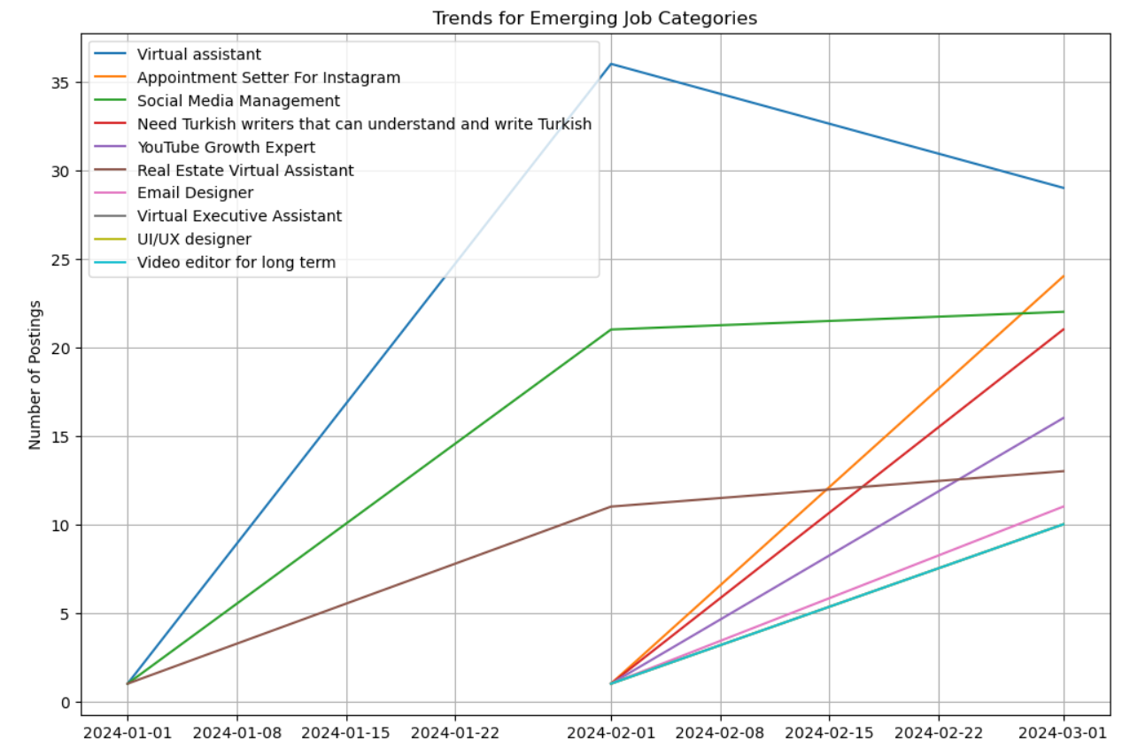

Slide 12
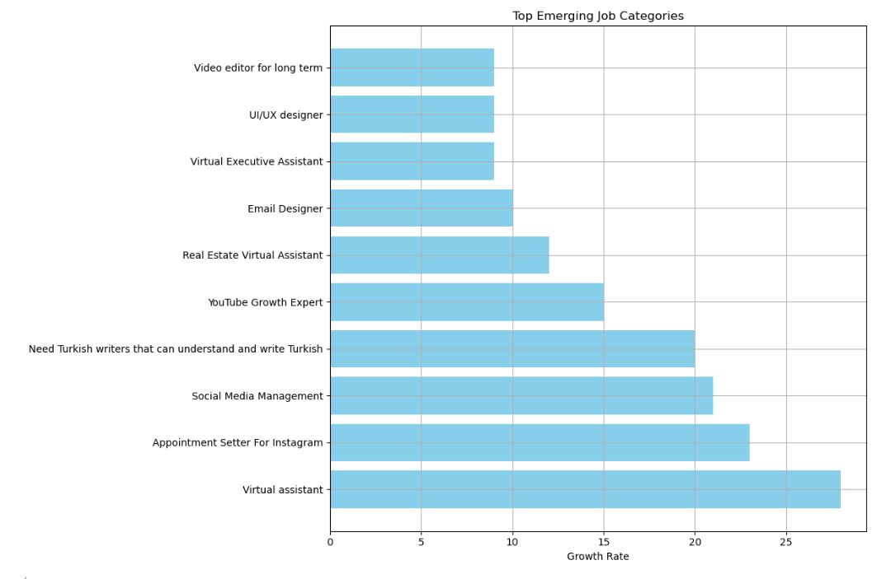

Slide 13
FORECASTING HIGH-DEMAND ROLES
APPROACH: Applied ARIMA modeling to forecast job postings for the next 12 months.
Results: Predicted growth trends for high-demand roles with RMSE evaluation.
Visualization:Line chart showcasing historical data and forecasted trends.

Slide 14
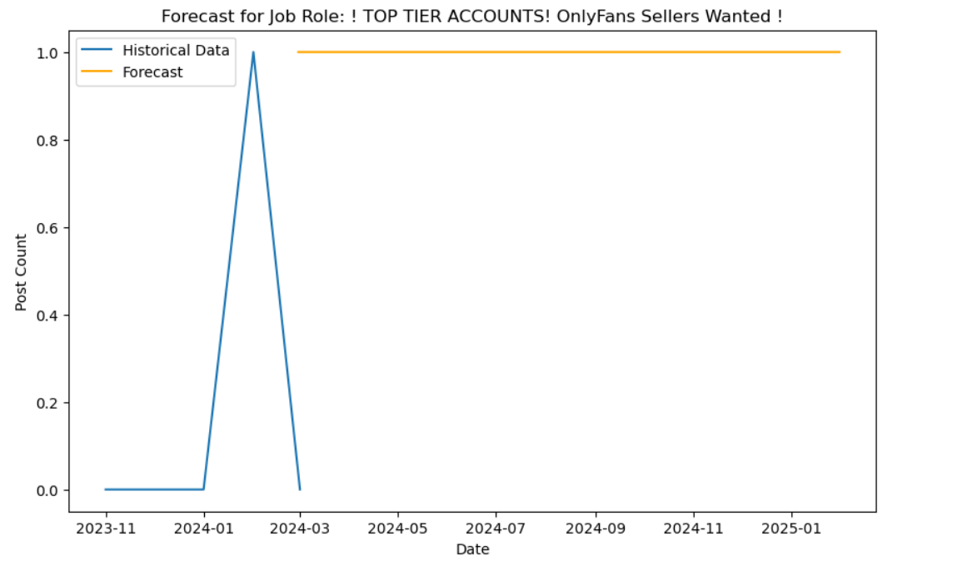

Slide 15
COMPARATIVE SALARY ANALYSIS BY REGION
APPROACH: Analyzed average salary (budget) by region using grouped data.
Findings: Variations in salary patterns across regions, with a choropleth map for interactive visualization.
Visualization: Bar chart comparing regional salary differences.

Slide 16
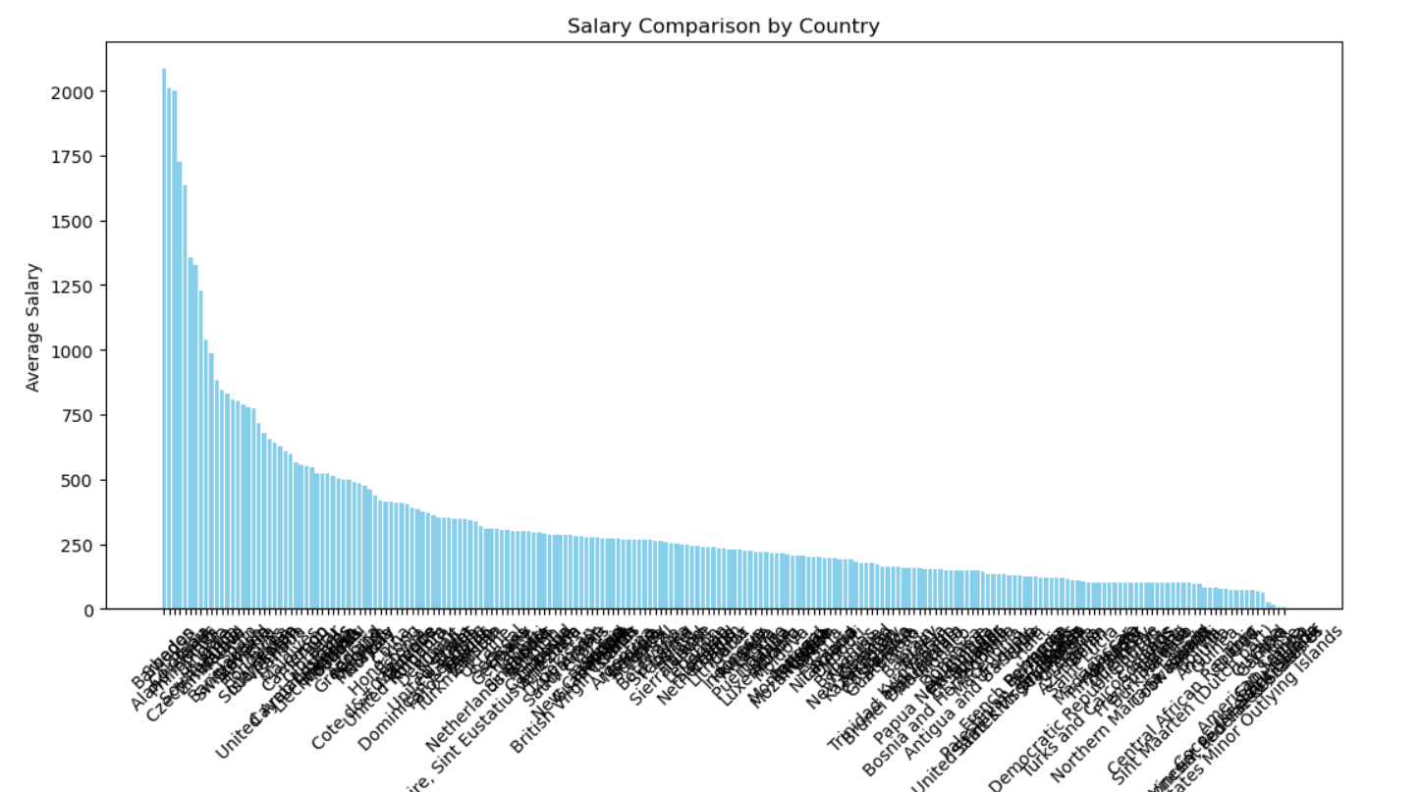

Slide 17
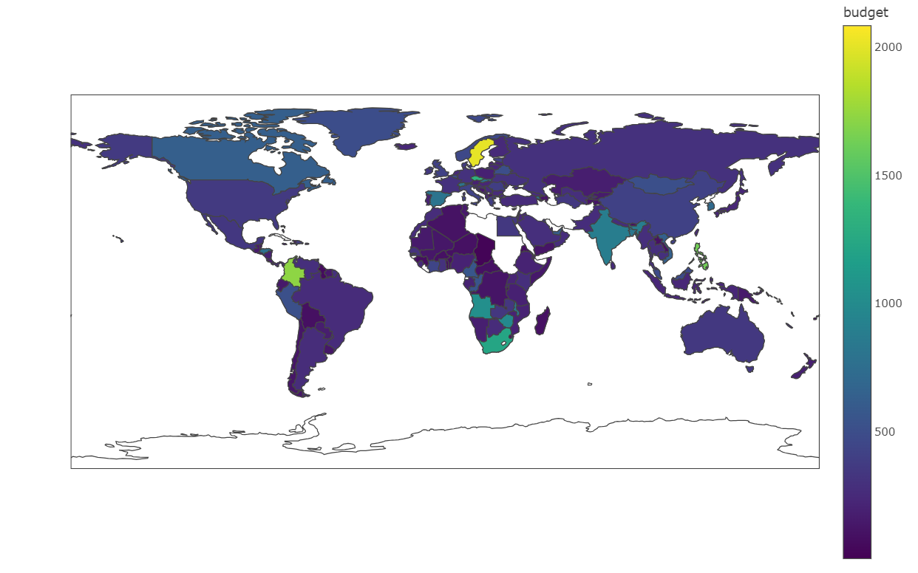

Slide 18
PERSONALIZED JOB RECOMMENDATION SYSTEM
METHODOLOGY: Built using TF-IDF for text features and cosine similarity. Integrated normalized salary as a scoring factor.
User Interaction: Input preferences for title, region, and budget to get tailored recommendations.
Output: Displayed recommendations as a table in a Streamlit dashboard.

Slide 19
MONITORING WORKFORCE DYNAMICS
MONTHLY INSIGHTS: Analyzed job category trends over time.
Remote Work Analysis: Filtered remote job postings and tracked their growth over time.
Visualization: Line chart showing remote job trends.

Slide 20
PREDICTING FUTURE WORKFORCE TRENDS
METHODOLOGY: Used linear regression to predict high-growth roles for the next 12 months.
Results: Visualization of predicted roles with growth rates by category.

Slide 21
CONCLUSION
KEY TAKEAWAYS:
Identified high-demand skills and emerging job categories.
Forecasted workforce trends and salary patterns.
Built a personalized recommendation engine for job seekers.

Slide 22
IMPACT:
EMPOWERS JOB SEEKERS TO ALIGN THEIR SKILLS WITH MARKET DEMAND.
Provides recruiters with data-driven insights for strategic hiring.

Slide 23


