Slide 1

📊 Equity Research News Tool
An AI-Powered Tool for Summarized News Analysis
Developed Using LangChain, NewsAPI, and Streamlit
By Deewankar Sharma

Slide 2
Introduction
• The Equity Research News Tool fetches and summarizes relevant news articles.
• It assists researchers and analysts in quickly understanding key market trends.
• Uses LangChain, NewsAPI, and Streamlit for AI-driven insights.

Slide 3
Technical Architecture
• NewsAPI: Fetches real-time articles based on user query.
• LangChain with Groq LLM: Generates summarized insights from news articles.
• Streamlit: Provides an interactive user interface with authentication.

Slide 4
Features & Functionalities
✔️ Fetches latest news articles using NewsAPI
✔️ Summarizes news using LangChain and Groq LLM
✔️ User authentication for secure access
✔️ Interactive UI built with Streamlit
✔️ Displays a structured summary

Slide 5
User Interface Design
• Elegant and intuitive UI for seamless interaction.
• Uses custom CSS for enhanced styling.
• Displays an image, input box, and summary results in a clean format.

Slide 6
Authentication System
• Implements a simple login system using Streamlit session state.
• Credentials stored securely for controlled access.
• Ensures only authorized users can use the tool.

Slide 7
How It Works?
1️⃣ User logs in with valid credentials.
2️⃣ Inputs a query (e.g., 'Impact of inflation on stock markets').
3️⃣ The tool fetches top 5 news articles from NewsAPI.
4️⃣ Summaries are generated using Groq LLM via LangChain.
5️⃣ A structured summary is displayed with key insights.

Slide 8
Benefits & Use Cases
✅ Saves time by summarizing news instantly.
✅ Helps equity researchers and analysts with quick insights.
✅ Supports financial decision-making based on news trends.
✅ Can be extended for other domains like healthcare, politics, and technology.

Slide 9

Future Enhancements
• Implement real-time alerts for breaking news.
• Integrate more LLM models for diversified analysis.
• Allow users to customize summaries with different tones.
• Add sentiment analysis for a deeper understanding of news impact.

Slide 10
Conclusion
• The Equity Research News Tool is a powerful solution for financial analysts.
• It leverages AI to extract valuable insights from news articles.
• Enhances decision-making and market trend analysis with quick summaries.

Slide 11
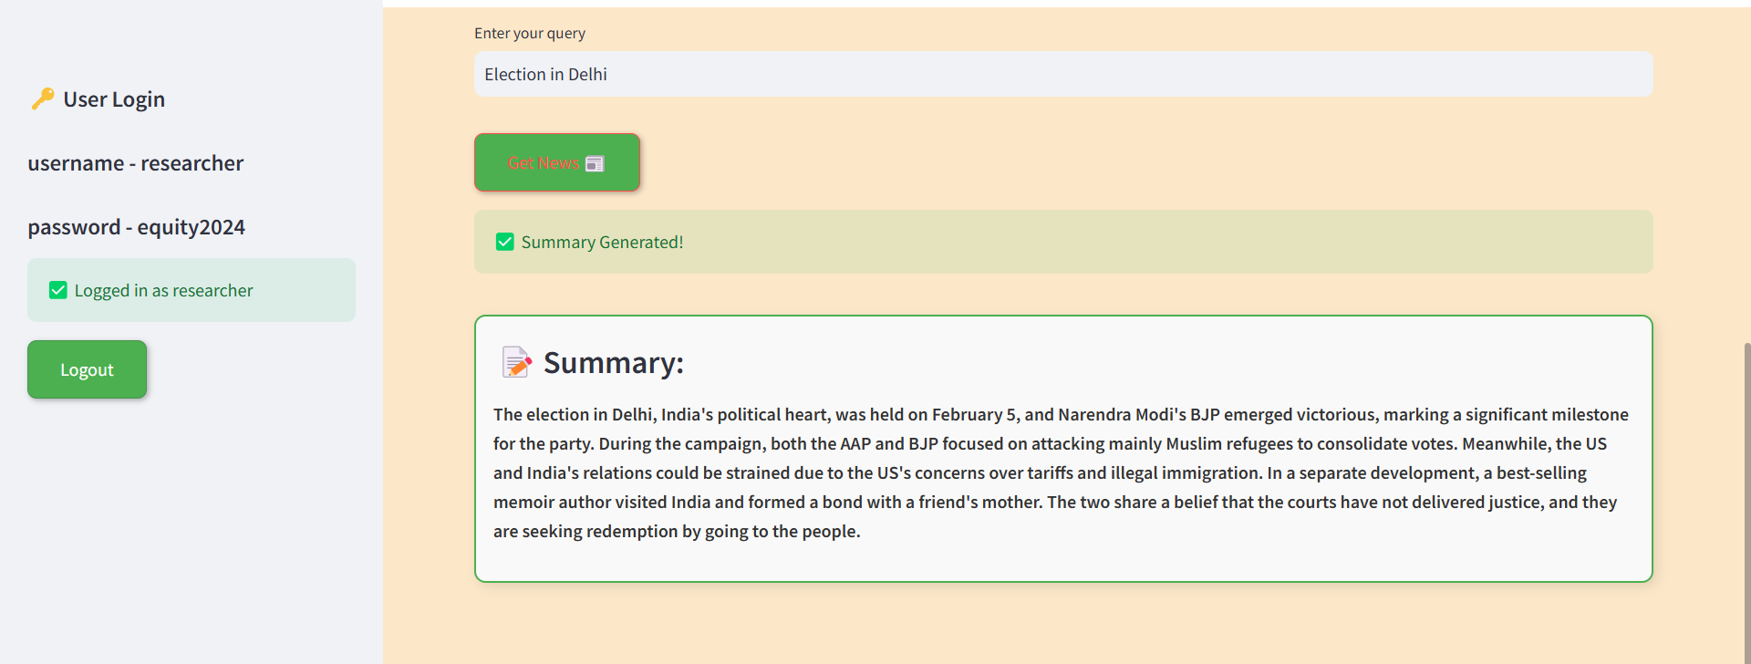
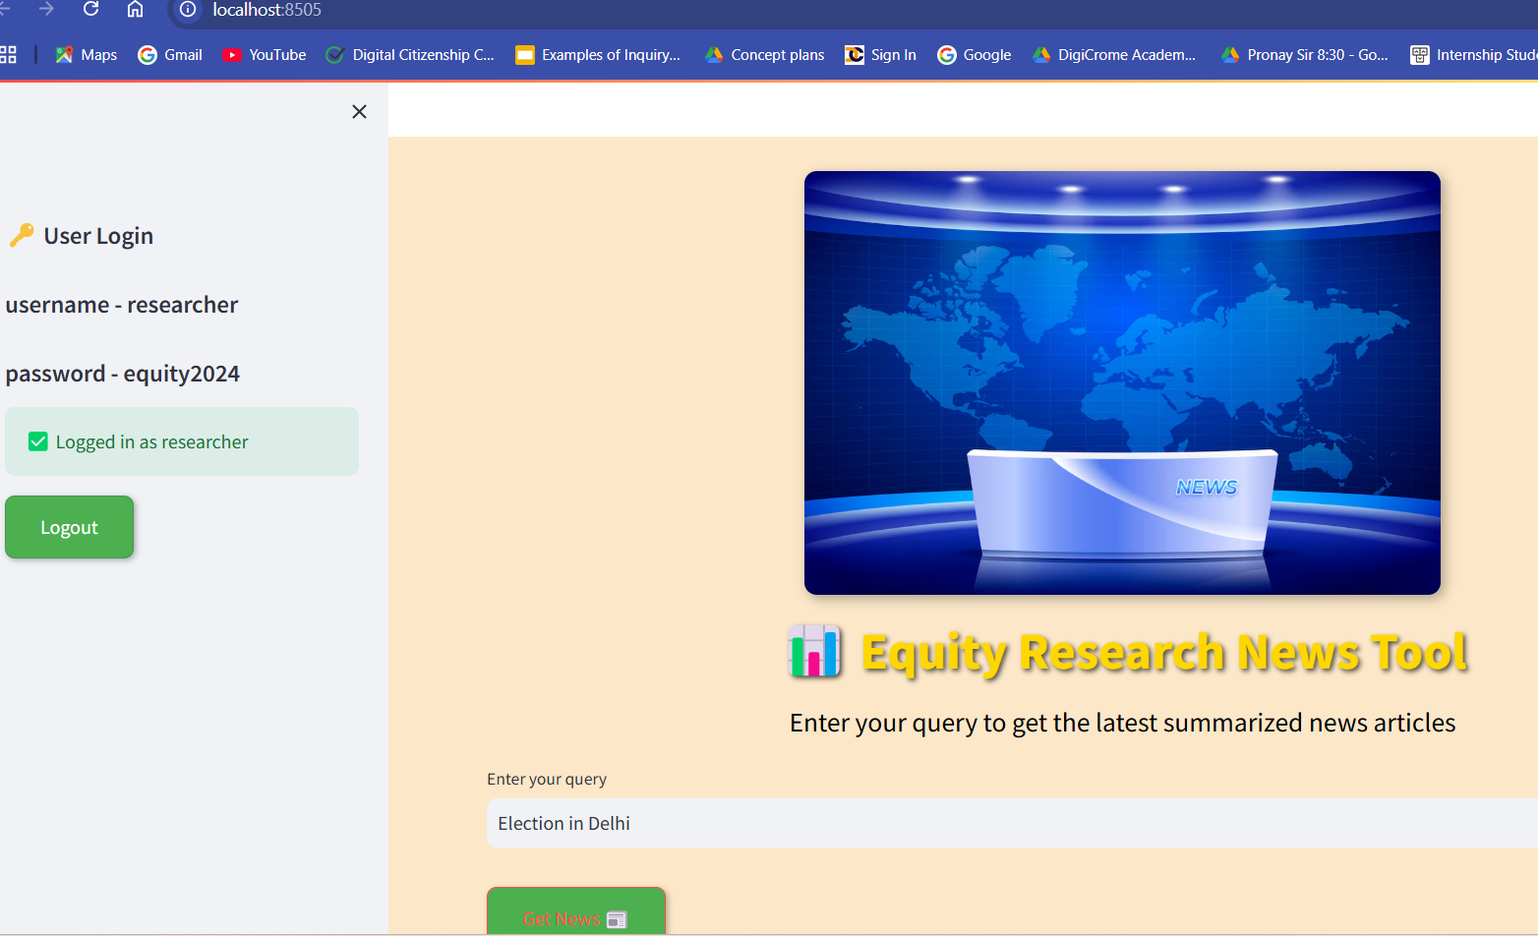
OUTPUT

Slide 12
THANKS

