Slide 1
Molecular Quantification and Tumor Reactivity Assessment of Tumor-infiltrating Lymphocytes Using Multiplexed Digital PCR
Fadi El Rami, Joe Yglesias, Kranthi Kunkalla, Joe Dean, Hequn Yin, Brian Gastman, Peter A Prieto, Rongsu Qi
Iovance Biotherapeutics, San Carlos, CA

Slide 2
Disclosures
FER, JY, KK, JD, HY, BG, PP, and RQ are employed by and own stock in Iovance Biotherapeutics.

Slide 3
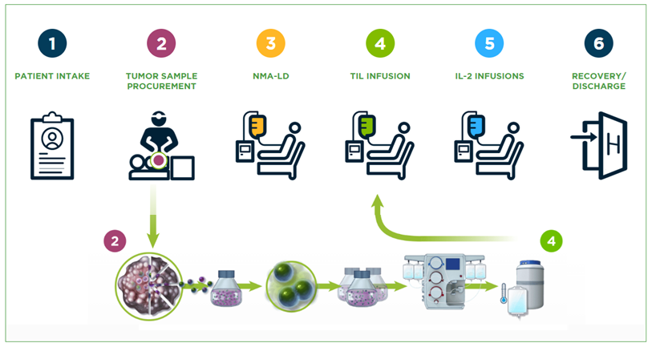
Surgical oncologists play a very important role in tumor sample procurement
1
2
3
4
5
6
PATIENT INTAKE
TUMOR SAMPLE PROCUREMENT
NMA-LD
LIFILEUCEL INFUSION
IL-2 INFUSIONS
RECOVERY/DISCHARGE
IL-2, interleukin-2; NMA-LD, nonmyeloablative lymphodepletion; TIL, tumor-infiltrating lymphocyte.
Notes:
TIL therapy revolutionized immunotherapy of solid tumors. This scheme demonstrates patient journey from TTP to infusion

Slide 4
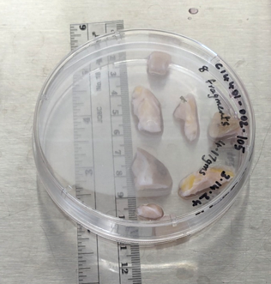
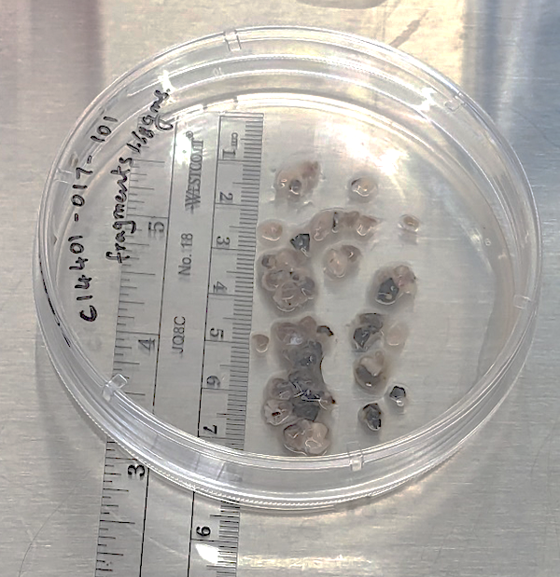
Tumor quality is crucial for successful TIL manufacturing and efficacy
Case 1: Melanoma Patient, Progressive Disease
Low T-cell infiltration
4.17 g tumor digested
Minimal number of T cells retained
Low manufactured dose: 4.14 billion cells
Case 2: Melanoma Patient, Partial Response
Good T-cell infiltration
1.68 g tumor digested
2.7 million T cells retained
Good manufactured dose: 35.4 billion cells
TIL, tumor-infiltrating lymphocyte.
Notes:
This material demonstrates that quality and quantity of starting material plays vital role in TIL manufacturing.

Slide 5
How can we detect region(s) with the most TIL infiltration from surgically resected tumors?
Notes:
PROBLEM statement

Slide 6
dPCR can discern tumor heterogeneity
Interpatient heterogeneity
(% T cells in 77 clinical tumors)
Intratumor heterogeneity
(% T cells in fragments dissected from same tumor)
100
50
90
80
40
70
30
60
50
20
TIL, %
T cell, %
40
30
10
20
0
10
0
–10
Tumor FFPE
(n=77)
1
2
3
4
5
6
7
8
9
10
MRC5
Tumor Fragments
dPCR, digital polymerase chain reaction; FFPE, formalin-fixed paraffin-embedded; TIL, tumor-infiltrating lymphocyte; TF, tumor fragment.
Notes:
dPCR detects TIL infiltration from patients’ formalin-fixed paraffin-embedded samples.
dPCR captures TIL infiltration among fragments from the same tumor (research tumor). Fragments are labeled based on spatial distribution.

Slide 7
Can dPCR assess reactivity of tumor fragments?
Tumor-reactivity profiling of tumor fragments dissected from the same tumor sample using dPCR
TRBC
CD200
CXCL13
1.5
1.0
Normalized Expression of Genes
0.5
0.0
1
2
3
4
5
7
8
9
10
Fragment
dPCR, digital polymerase chain reaction; TRBC, T-cell receptor beta chain.
Notes:
Tumor reactivity profiling of tumor fragments dissected from the same tumor sample using dPCR. Using genes whose expression is associated with tumor reactivity, dPCR can potentially assess quantity and quality of TIL for fragment selection. [TRBC= T cell receptor beta chain, marker for T cells; CXCL13= expressed by activated TIL, T follicular helper cells, and others in tertiary lymphoid structures (TLS); CD200= expressed on CD4 follicular helper T cells / FDC; CD19= marker of B cells, a major cellular component of TLS; RPP30= ribonuclease P subunit p30, used as reference gene marker for normalizing the expression of all genes in panel]. With work done to date, this signature remains to be validated. ADD DESCRIPTION OF MARKERS. CHANGE COLORS TO BE COLOR BLIND FRIENDLY

Slide 8
Conclusions
Surgical oncologists play an essential role in tumor tissue procurement
Qualitative features of tumor tissue procurement are essential for optimized manufacturing and clinical success
Digital PCR provides an accurate and time-efficient tool to quantify TIL infiltration and its potential tumor reactivity in tumor fragments with high cellular heterogeneity
This project is an ongoing partnership between surgical oncologists and researchers for improving selection of starting tumor material for TIL manufacturing
PCR, polymerase chain reaction; TIL, tumor-infiltrating lymphocyte.

Slide 9
Thank You

