Slide 1

InstructED
Kevin Cao, Andrew Jedlicka, Blake Miller, Shaun Trimm

Slide 2
What is InstructED?
Provide an online solution for teachers and students to organize and augment the learning experience
Serve as a centralized platform to target both the needs of the instructors and their pupils
Allow teachers can streamline their workflow and teaching plans, and support their students in their own individual way

Slide 3
Why Online Learning?
InstructED
In an increasingly digital and paperless world, institutions such as schools and universities need a simple and efficient way to provide students with a digital learning environment which will allow them to be successful in school, and prepare them for life beyond school.

Slide 4
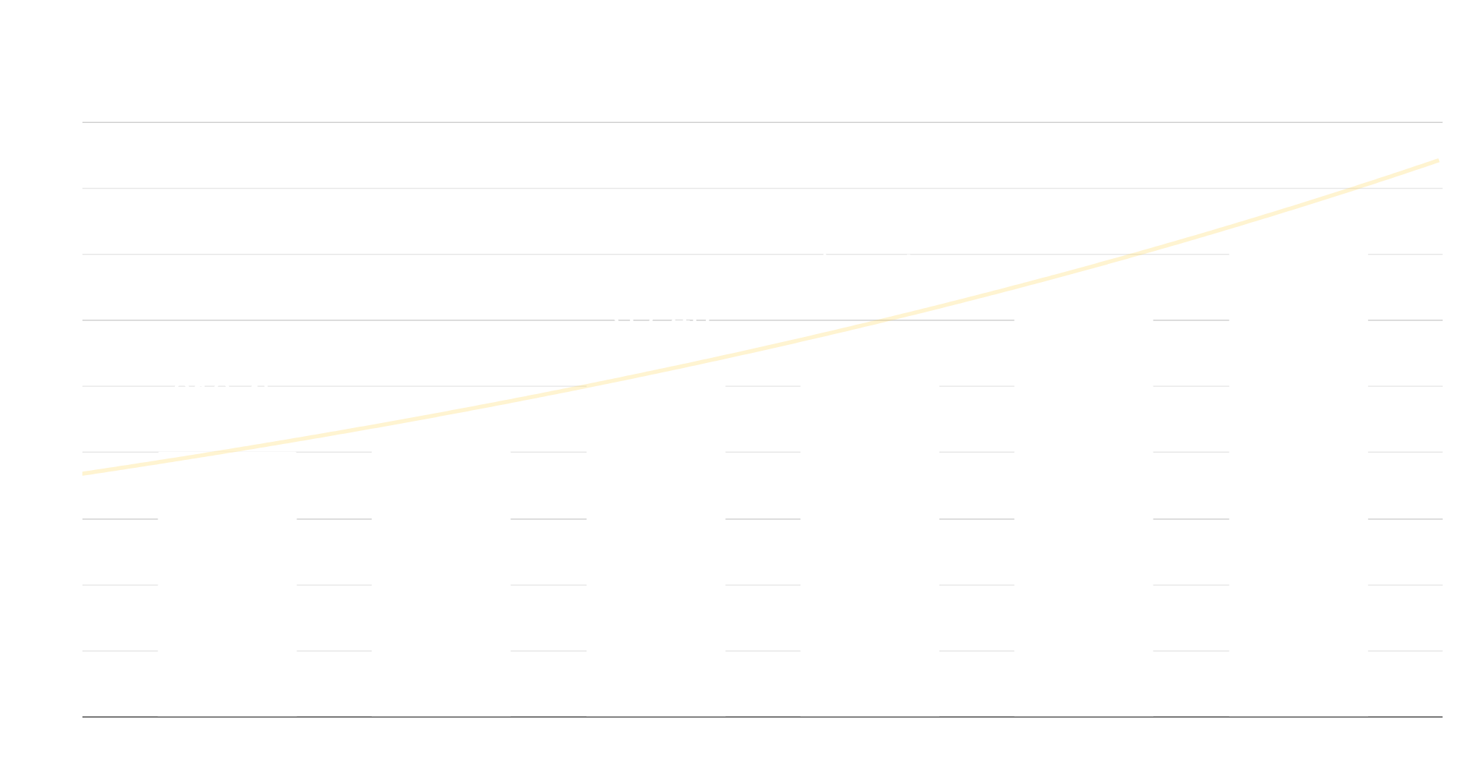
Market Trends
$13.4B
14%
$25.8B
5,300
50.8M
Industry Size in 2020
Compound Annual Growth Rate
Expected Size in 2025
Universities in United States
Students in Public Schools

Slide 5
COMPETITIVE ADVANTAGE
THEM
US
Large companies disconnected with the needs of the students and instructors
Current students and undergraduate instructors who have at least 3 years of experience using online learning software, and therefore understand what works well and what needs changed

Slide 6
CORE FEATURES
LOGIN & REGISTRATION
DASHBOARD
SUBMISSION & GRADING
SEARCH
CHAT
Secure login with unique ID, Duo authentication, and password recovery
View announcements and upcoming assignments with due dates
Find and sort assignments, announcements, and modules
Chat with students and instructors, both privately and in groups
File upload for students & instructors

Slide 7
TECHNOLOGY
FRONT-END
BACK-END
HTML/CSS, Bootstrap, JQuery
Node.js, SQL

Slide 8
OUR TEAM
KEVIN CAO
SHAUN T.
Computer Science BS,
Software Engineering
Computer Science BS,
Software Engineering
ANDREW J.
BLAKE M.
Computer Science BS,
Software Engineering
Back-end,
sprint manager
Computer Science BS/MS,
Game Development
Project manager,
back-end,
front-end
Front-end,
team scribe,
sprint manager
Back-end,
sprint manager

Slide 9
SPRINT SCHEDULE
 | Sprint 1 |  | Sprint 2 |  | Sprint 3 |  | Sprint 4 |  | Sprint 5
 | Wk 1 | Wk 2 | Wk 3 | Wk 4 | Wk 5 | Wk 6 | Wk 7 | Wk 8 | Wk 9 | Wk 10
Login & Registration
Dashboard
Submissions & Grading
Search
Chat
Extra Features
Testing
Mercury is the closest planet to the Sun

Slide 10
Thank you for listening!

