Slide 1
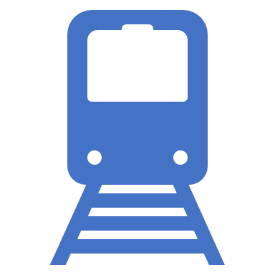
Optimizing Train Scheduling in Railway Networks: A Branch and Bound Approach
Enhancing Railway Operations: A Branch and Bound Algorithm for Real-Time Conflict-Free Train Scheduling with Implication Rules

Slide 2

Team Introduction
Abde Manaaf Ghadiali – G29583342
Gehna Ahuja – G35741419
Venkatesh Shanmugam – G27887303
Manikanta Allanki – G42549699

Slide 3

Problem Outline
Introduction to the Problem and Objective:
The research focuses on a train scheduling problem encountered by railway infrastructure managers during real-time traffic control. The primary goal is to address disruptions in train operations by re-computing a conflict-free timetable with feasible arrival and departure times (Emphasis is on minimizing deviations from the original timetable).
Problem, Graph and Algorithm Formulation:
The problem is framed as a large-scale job shop scheduling problem with no-store constraints. Time separation among trains is carefully estimated and considered in the model.
The scheduling problem is modeled using an alternative graph formulation. A branch and bound algorithm is developed for solving the scheduling problem. The algorithm incorporates implication rules to enhance computational efficiency. The implication rules are designed to speed up the computation process, making the algorithm more efficient.
Experimental Study:
An experimental study is conducted, focusing on a bottleneck area in the Dutch rail network. Results from the study indicate that a truncated version of the algorithm achieves proven optimal or near-optimal solutions within short time limits.

Slide 4

Why is this problem important?
The discussed problem of real-time conflict resolution in train scheduling is important for several reasons:
Dynamic Nature of Railway Operations: Railway operators plan train services well in advance, but unforeseen technical failures and disturbances can impact running times, causing primary delays. The dynamic nature of railway operations necessitates real-time adjustments to maintain operational efficiency.
Propagation of Delays: Delays in one part of the network can propagate as secondary delays to other trains due to interactions between them. Managing these secondary delays is crucial to prevent disruptions and maintain the overall integrity of the train network.
Need for Timely Solutions: The paper highlights that the process of rescheduling, termed train dispatching or conflict resolution, requires effective solutions within minutes. Timely resolution is essential to minimize disruptions and ensure the feasibility of the modified plan of operations.
Role of Human Dispatchers and Decision Support Systems: While human dispatchers play a role in conflict resolution, the paper acknowledges the limitations of existing systems and the need for more effective solutions. Decision Support Systems assist dispatchers, but there is a recognized need for improvements to address the complexity of real-time conflict resolution.
Utilizing Global Information: The paper argues for the development of conflict resolution systems that can leverage global information about the status of the entire network.
Historical Context and Growing Interest: The paper positions its contribution in the context of the increasing interest in train scheduling and timetabling problems since a pioneering paper, indicating the ongoing relevance and significance of the topic.

Slide 5
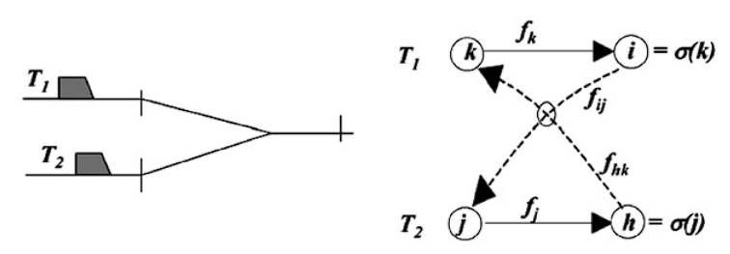
Solution and its Details
Formulation of Conflict Resolution Problem (CRP) Using Alternative Graph Model:
Nodes represent train operations - In the alternative graph model, each node represents a specific train operation, such as the passage of a train through a block section.
Arcs denote relationships between operations - Arcs connect nodes and represent relationships or dependencies between train operations. These relationships include both precedence constraints and alternative arcs, influencing the scheduling of trains through the network.
Constraints:
Precedence Constraints - Define the order in which train operations must occur. For instance, a train cannot enter a block section until the preceding section is clear. A selection is considered consistent if, when applied to the graph, it results in a conflict-free schedule, adhering to both precedence constraints and alternative arcs.
Alternative Arcs - Model conflicts and dependencies between incompatible operations. Pairs of alternative arcs represent choices that need to be made in the schedule. A selection in the alternative graph corresponds to choosing specific arcs while respecting the constraints.
Objective of AGM for CRP:
Minimize Deviation from Planned Schedule - The primary goal is to minimize the deviation from the originally planned schedule. Deviation can occur due to conflicts, delays, or changes in the real-time status of the network.
No Positive Length Cycles in the Alternative Graph - The absence of positive length cycles in the alternative graph is crucial to ensuring feasibility and avoiding conflicts. Positive length cycles would imply an operation preceding itself, which is infeasible in the context of train scheduling.
Notes:
The presence of a positive length cycle would imply an operation that precedes itself in the scheduling process. In practical terms, this would mean that a task or operation is scheduled to occur before it has even started, which is logically impossible and infeasible. In the specific context of train scheduling, having an operation precede itself is particularly problematic. Trains cannot start a task before the task has been initiated, and this violation of logical sequencing could lead to conflicts and render the schedule infeasible.

Slide 6
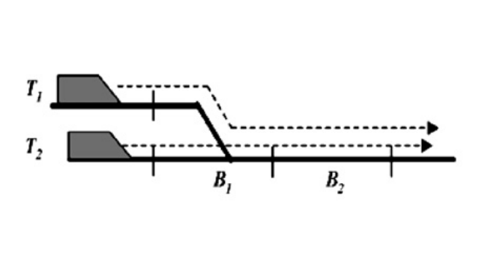
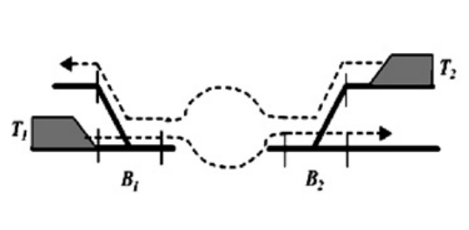
Solution and its Details
The Conflict Resolution Algorithms focus on effectively addressing conflicts in train scheduling through a combination of implication rules and the Branch and Bound algorithm.
Implication Rules:
Dynamic Implications (Propositions 1, 2): Rules that dynamically guide the algorithm by determining which arcs can be selected or forbidden based on real-time conditions and relationships between conflicting operations.
Static Implications (Propositions 3.3, 3.4): Establishes correspondence between selections of arcs from different alternative pairs. Pre-computed rules based on the physical track topology, offering efficient off-line guidance for the algorithm.
Branch and Bound Algorithm:
Building Extensions, Utilizing Implications: The algorithm constructs extensions of selections, respecting constraints and utilizing both dynamic and static implications to make informed decisions.
Jackson Preemptive Schedule for Lower Bounds: Utilizes the Jackson preemptive schedule to establish lower bounds on the length of paths in the alternative graph, aiding in assessing the quality of solutions.
Binary Branching Scheme based on AMCC Rule: Employs a binary branching scheme, where decisions are made based on the Alternative Maximum Concurrent Completion (AMCC) rule, prioritizing arcs that maximize the potential for conflict resolution.
Notes:
Static implications could refer to rules or relationships that are not dependent on real-time changes but are determined in advance.
The Jackson preemptive schedule is a scheduling technique used in the context of job shop scheduling. It involves the preemptive assignment of tasks to machines based on certain criteria. Preemptive scheduling allows for the interruption and resumption of tasks on machines.
In the context of an alternative graph, the term "path" typically refers to a sequence of edges (connections) between nodes (points) in the graph. Establishing lower bounds on the length of paths means determining the minimum possible length that a path can have.
A binary branching scheme involves making decisions at each step by choosing between two alternatives or options. In the context of optimization or decision problems, this approach simplifies the decision-making process.
The AMCC rule is a specific criterion or guideline used for decision-making. It likely involves evaluating alternative choices based on their potential impact on concurrent completion of tasks or activities.
In the binary branching scheme, decisions are made based on the AMCC rule. This means that at each decision point, the available alternatives are evaluated using the AMCC rule to determine the best course of action.

Slide 7

Solution and its Details
Now we delves into assessing the performance of different heuristics and their integration into the Branch and Bound algorithm for solving the Conflict Resolution Problem (CRP).
Preprocessing with Static Implications:
Static implications, computed offline in a preprocessing phase, significantly reduce computation time by associating each alternative arc with a set of statically implied arcs.
The algorithm builds extensions of selections, minimizing the longest path from 0 to n, using dynamic implications and the Jackson preemptive schedule for lower bounds.
Dispatching Rules and Heuristic Approaches:
First Come First Served (FCFS): Prioritizes trains based on their arrival time at a block section, a common practice in railway scheduling.
First Leave First Served (FLFS): Considers the time required for trains to exit a block section, combining the principles of prioritizing fast trains and those arriving first.
Alternative Maximum Concurrent Completion (AMCC): A greedy algorithm that forbids one alternative arc at a time, choosing the one causing the most significant delay. It considers only static implications, reducing computation time.
Branch and Bound Configuration:
Chosen Branching Scheme and Search Strategy: Specifies the binary branching scheme based on the AMCC rule, outlining the approach for exploring the enumeration tree. Upper Bound is set Based on Heuristic Results which sets the upper bound in the Branch and Bound algorithm using the best value obtained from the three heuristics (FCFS, FLFS, AMCC).

Slide 8
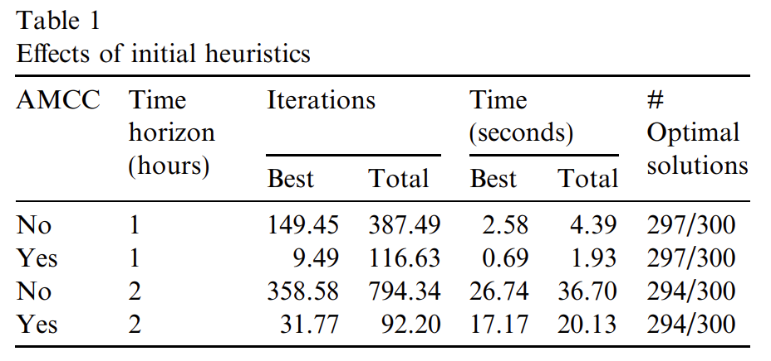
Empirical Results
Computational Setup:
The experiments use a C++ implementation on a laptop with a 1.6 GHz Pentium M processor.
The Schiphol rail network has four tracks, 86 block sections, 16 platforms, and two traffic directions.
A provisional timetable for 2007, with 54 trains circulating hourly, serves as the basis.
Perturbation schemes are created by introducing delays, with 60 instances divided into six groups.
Experimental Design:
Three initial heuristics (FCFS, FLFS, AMCC) and a branch and bound algorithm are evaluated.
Additional instances are generated to test the branch and bound algorithm under more challenging conditions.
Perturbations include random delays, varying distribution types, and modified timetables.
Results - Initial Heuristics:
FCFS and FLFS dispatching rules show negligible computation times.
The AMCC heuristic exhibits higher computation times but proves beneficial in subsequent branch and bound runs.

Slide 9
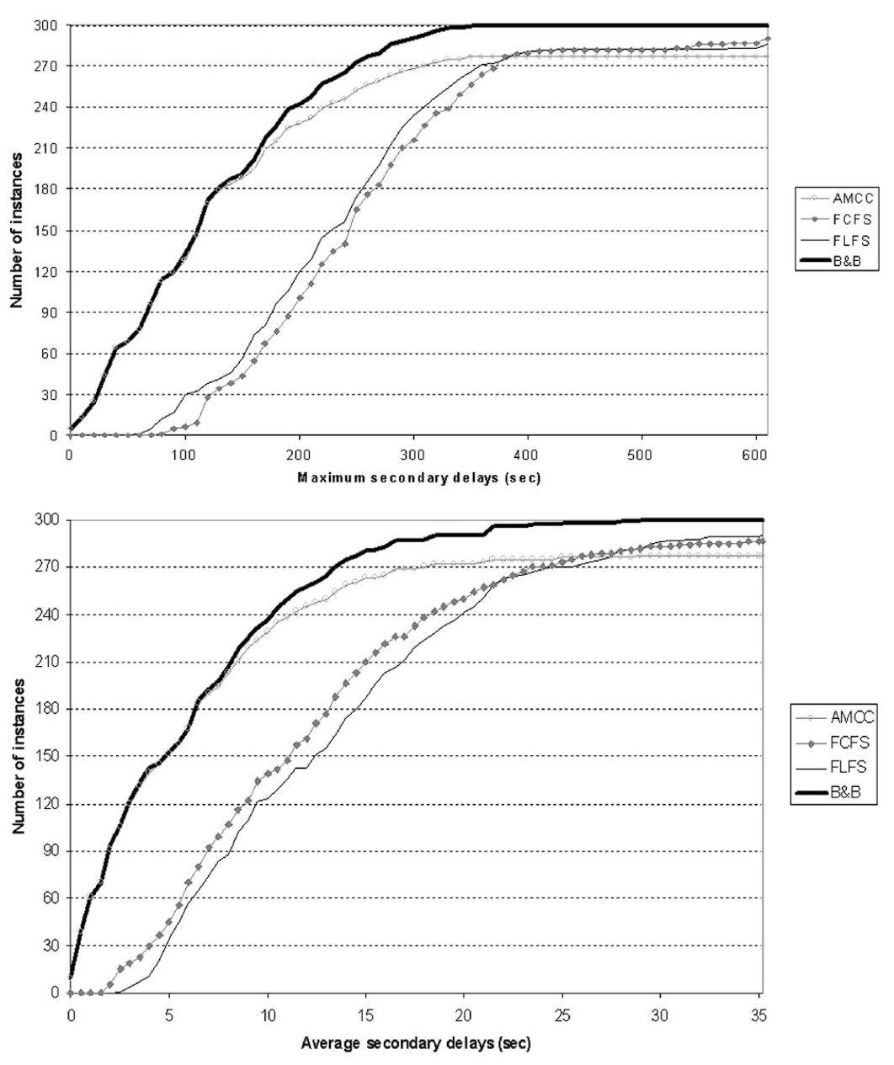
Empirical Results
Results - Branch and Bound Algorithm:
The use of AMCC reduces computation time by almost half for both one-hour and two-hour instances.
The branch and bound algorithm consistently outperforms heuristics, providing optimal or near-optimal solutions.
FCFS and FLFS rules, while simple, lead to poorer results, especially with significant secondary delays.
The branch and bound algorithm excels in reducing maximum and average secondary delays.
Evaluation of Experiments:
The branch and bound algorithm achieves proven optimal solutions in 297 out of 300 instances within a 120-second time limit.
Average computation time is 1.93 seconds, and the average number of nodes explored is 116.
The algorithm significantly improves solutions compared to heuristics, especially in challenging instances.
Effects of Static Implications:
Static implications in CRP prove effective in improving algorithm performance.
The algorithm consistently attains and proves optimality when static implications are used.
Without static implications, the algorithm struggles to find feasible solutions, especially in two-hour instances.
Hard Instances:
Most instances are easy to solve, with the branch and bound often closing the problem at root.
A few hard instances are identified, but the algorithm successfully handles them within reasonable time limits.
Longer computation times are observed for instances with two-hour timetables.

Slide 10

Conclusion
In conclusion, this paper addresses the intricate problem of real-time conflict resolution in the management of a complex rail network. Focused on railway infrastructure managers facing perturbations in train operations, the study formulates the issue as a substantial job shop scheduling problem with no-store constraints.
A branch and bound algorithm, incorporating implication rules to expedite computations, is developed to recompose a conflict-free timetable amid perturbations. The experimental study, centered around a bottleneck area in the Dutch rail network, demonstrates that the truncated algorithm efficiently delivers proven optimal or near-optimal solutions within stringent time limits.
The optimization model, grounded in discrete event optimization, adeptly handles the no-store aspect of the scheduling problem. The algorithm minimizes the maximum secondary delay for all trains at visited stations, showcasing its effectiveness.
The experiments reveal that algorithms leveraging global information outperform traditional dispatching rules, highlighting their potential for substantial improvements in railway service quality.
Overall, this research significantly contributes to advancing solutions for real-time conflict resolution in railway scheduling, offering practical insights and promising performance results.

Slide 11

References/Citations, Etc.
The references encompass a comprehensive array of contributions to the field of railway scheduling and operations. Together, these references cover a wide spectrum of topics, including optimization models, heuristic techniques, scheduling problems, and the application of technology in railway traffic control, contributing significantly to the broader field of railway scheduling and operations:
Adenso-Díaz et al. (1999) focus on online timetable rescheduling in regional train services, addressing dynamic changes in schedules.
Bra¨nnlund et al. (1998) provide insights into railway timetabling using Lagrangian relaxation, contributing to optimization techniques.
Caprara et al. (2002) discuss modeling and solving the train timetabling problem, offering significant insights into optimization models.
Carlier (1982, 1989, 1994) contributes to sequencing problems and job-shop scheduling, presenting algorithmic approaches.
Cordeau et al. (1998) conduct a survey of optimization models for train routing and scheduling, offering a comprehensive overview.
Dessouky et al. (2006) present an exact solution procedure for optimal dispatching times in complex rail networks.
Dorfman and Medanic (2004) address scheduling trains on a railway network using a discrete event model.
Fay (2000) introduces a fuzzy knowledge-based system for railway traffic control.
Hemelrijk et al. (2003) describe the Schiphol tunnel in 2007, forming the basis for experiments.
Higgins et al. (1996, 1997) contribute to optimal scheduling of trains on a single line track, offering heuristic techniques.
Jackson (1955) presents a classic paper on scheduling a production line to minimize maximum tardiness.
Jovanovic and Harker (1991) address tactical scheduling of train operations using the SCAN I system.
Kauppi et al. (2006) discuss future train traffic control through re-planning, exploring the evolution of control mechanisms.
Kraft (1987) presents a branch and bound procedure for optimal train dispatching.
Mascis and Pacciarelli (2002) discuss job shop scheduling with blocking and no-wait constraints.
Nie and Hansen (2005) conduct a system analysis of train operations and track occupancy at railway stations.
Oliveira and Smith (2000) present a job-shop scheduling model for the single-track railway scheduling problem.
Pachl (2002) discusses railway operation and control, offering comprehensive insights.
Ping et al. (2001) study intelligent train dispatching, emphasizing technological aspects.
Sahin (1999) addresses railway traffic control and train scheduling based on inter-train conflict management.
Schaafsma (2005) discusses dynamic traffic management as an innovative solution for the Schiphol bottleneck.
Szpigel (1973) contributes to discussions on optimal train scheduling on a single-track railway.

