Slide 1

DEF CON 21 CLOSING CEREMONIES
Stick a fork in us…we’re done!

Slide 2
What do we do?
Wired Network Infrastructure
Speakers (and special requests)
Vendors
Contests
Goons
Servers & more
Wireless Network
Attendees
DCTV

Slide 3
Timeline
SUN 7/28 | MON 7/29 | TUE 7/30 | WED 7/31 | THU 8/1 | FRI 8/2 | SAT 8/3 | SUN 8/4 | MON 8/5
ARRIVALS | SETUP | SETUP | SETUP | CONFERENCE | CONFERENCE | CONFERENCE | CONFERENCE | DEPARTURES
JAN | FEB | MAR | APR | MAY | JUN | JUL | AGO

Slide 4
Wired Infrastructure
120 Mbps uplink (6 Mbps - DC14)
FreeBSD Firewalls
10 managed switches
Not enough unmanaged switches

Slide 5
Wireless Stuff
Aruba 6000
47 Access Points
6 Air Monitors

Slide 6
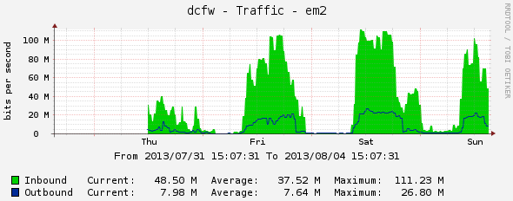
DC21 Network Stats
Internet Traffic

Slide 7
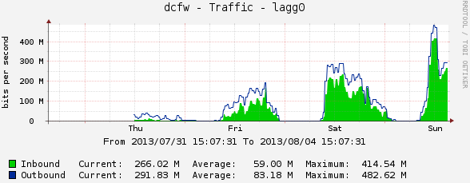
DC21 Network Stats
Local Traffic

Slide 8
WiFi Stats
3,950 Unique MAC addresses

Slide 9
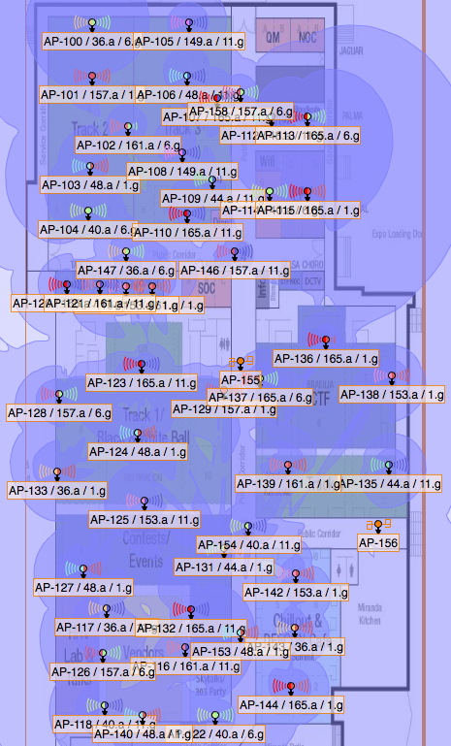
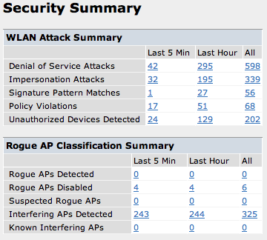
WiFi Stats

Slide 10
(unexpected) Issues
802.1x vs DefConSecure

Slide 11
The Unstoppable NOC Team
Infrastructure: Booger & Naifx
Wireless: Tabkur & Arhawk
DC TV: Videoman
Public Relations & More: #sparky
Social Media & More: T3ase
Master Planner: EFFFFN
Master On-Site Delivery: Mac
Retirement-Fail King: The Lockheed
Attempt-Retirement: Heather

Slide 12
Thanks!!
@DEFCON_NOC
www.defconnetworking.org
FEEDBACK: noc /AT/defconnetworking.org

