Slide 1
DEF CON 22 Network Operations Center

Slide 2

What do we do?
Wired Infrastructure
Speakers
Goons
Press
Contests
Vendors
DCTV
Those of you too drunk to roll your asses out of bed
Wireless Infrastructure
Those of you hangover that rolled your asses out of bed

Slide 3
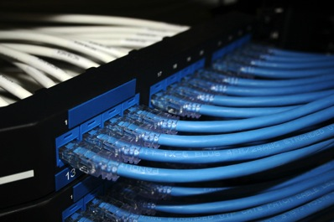
What changed? MOAR GOTGIGABITZ
DCTV
2 x HDTV video encoders
Firewall upgrade
2 x 10GE interfaces
10 x more powerful
Wireless Gear
2 x Aruba M3 sup cards
Media Server
2 x GE interfaces
10GE Core Switch

Slide 4
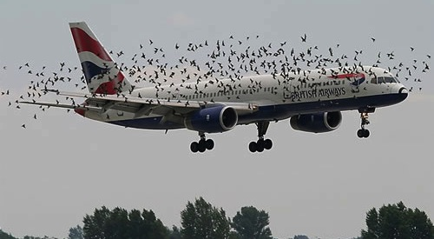
Network Topology
Notes:
On top of the upgrades mentioned in the last slide we had 51 Aruba Networks Access Points (Models AP-70 and AP-65), some configured as Access Points (providing access, duh) and some configured as Air Monitors.
Several switches providing layer 2 connectivity, some managed and some unmanaged.

Slide 5
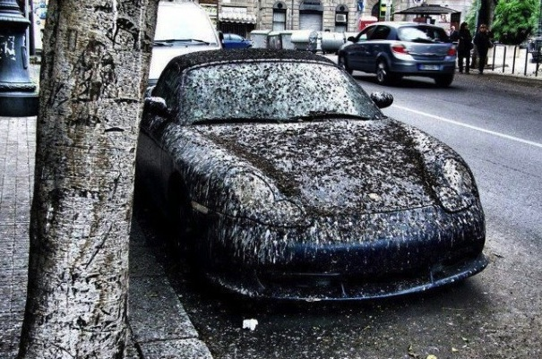
Notes:
It’s a hacker conference after all, but our mission is to provide reliable access to everyone.

Slide 6
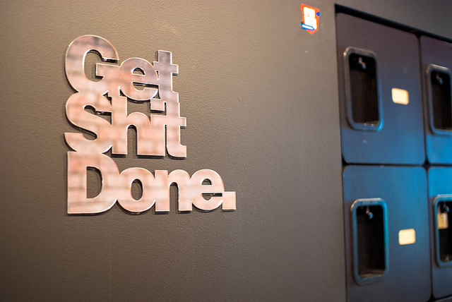
Challenges
PRE-CON
IOS + 802.1X + Certificates = f00bar
Some of the logistics
Not enough time
CON
Some devices not behaving as expected
Unplugged APs
People playing with the network (and attendees)
Notes:
It took us a while this year to bring the wifireg server up because once again the IOS devices were not behaving with the 802.1x certificates. After looking at different ways to provide that, we were able to create a mobile config package where then the IOS device would not complain about the cert. Still, since we don’t use an MDM solution (and you would not want us to manage your device either), the mobileconfig package couldn’t be “verified”.
We found a couple more kinks with the IOS devices, luckily ran into a fellow Apple employee during the cons and let’s see if something can be done.
Also, post conference, had a good talk with a known friend that likes to play with our network, and despite the allegations that he was able to MiTM the network, we still need to dig through the data he has since during our tests pre-con the IOS seemed to be sending the credentials to a rogue server (prompting the user for the password again), but the reality is that the device itself was sending a reject 802.1X packet to the server due to talking to the wrong cert. Let’s see.

Slide 7
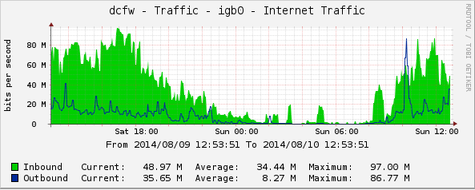
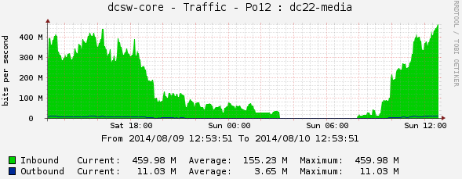
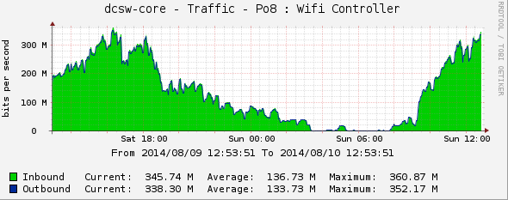
Stats (because math is hard)
As of Sun 12:30PM, transferred
- Internet: 1.11TB
- Media Server: 4.41TB
- WiFis: 3.97TB
DHCP Leases
- 4353 devices
Notes:
People like stats, here are some of them then:
We had a 120 Mbps uplink to the internetz, we did not peak it this year.
Internal traffic, especially to DTs new media server was really good and kept the internal network busy

Slide 8
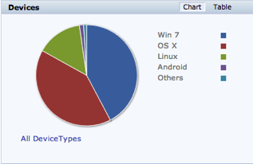
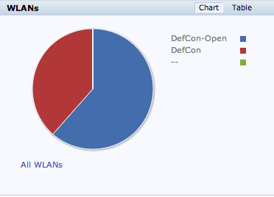
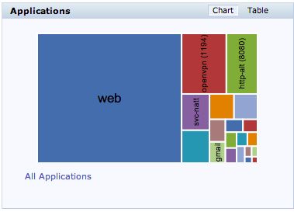
WiFi Stats
41 Access Points
10 Air Monitors
Average of users: 600 / hour
Average of attacks: 1904 /day
Notes:
We see more users on the DefCon unencrypted network for most of the time… that’s a fact…

Slide 9
DCTV
Broadcast to the 2500 Rio guest rooms!
Played the DEF CON documentary
We are looking for original content…
Notes:
DCTV is awesome… we will do our best to keep that for the new location.

Slide 10
NOC TEAM
Leads
@effffn
mac
Infra/ Systems
#sparky
t3ase
Booger
Naifx
DCTV
videoman
WiFi
rukbatgarten
arh@wk
N00bs
c0mmiebstrd
whop
CRV
serif
Notes:
As mentioned in the conference program, I have no words to thank the NOC team. Their “con week” starts on Monday, to make sure everything is up and running for contests, speakers, vendors and attendees by the time the conference opens on Thu morning. It is a challenge. And after that, monitoring, fixing and helping with ongoing requests throughout the conference days. If you ever get to know one of them, buy them a beer or 10.

Slide 11
Thanks!!
Dark Tangent
Will
Charel
Caesars Staff
Encore Staff
You!
The random guy who brings us snacks!
Those who offered constructive commentary
http://defconnetworking.org
@DEFCON_NOC
noc/at\defconnetworking.org

