Slide 1
DEF CON 23 NOC REVIEW

Slide 2

what do we do?
Wired Infrastructure
Speakers
Goons
Press
Contests
Vendors
Media Server
Workshops
rootz
DCTV
for the hangover people in their rooms
Wireless Infrastructure
for the the brave people

Slide 3

Planning
Early / even moar planning
The two venues major concerns
interconnectivity (MDFs/ IDFs/ etc)
ethernet drop availability (especially Bally’s & 26th floor)
wifi coverage
DCTV availability, number of channels and quality of the signal
getting all of the requirements on time

Slide 4


Slide 5
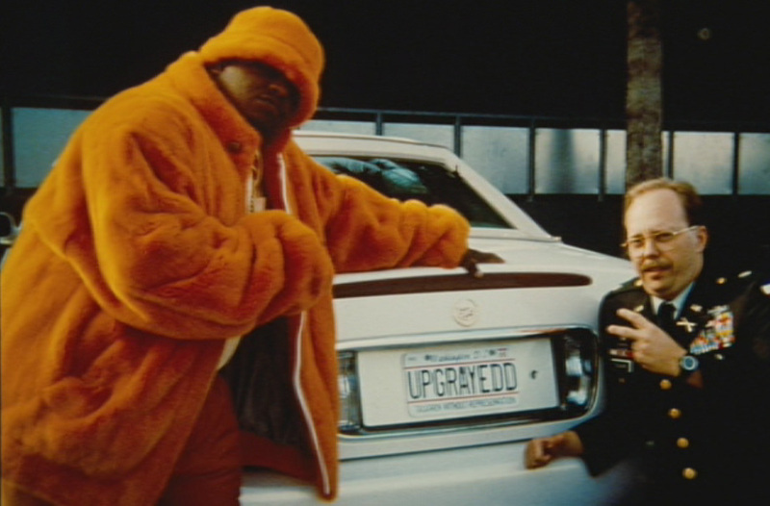
upgrayedd
Some newer Aruba APs
105
135
225
7210 Controller
new raspberry pis for DCTV
addition of slides to the DCTV streaming

Slide 6
Setting Up
moved remaining core
gear to MDF
NOC Setup
moar AP hanging
Internet
AP hanging start
patching patching
patching patching
MDF/IDF connections
Hotels Interconnect
CGClines up/ testing
AP hanging start
Android 802.1x fun
DCTV Staging
DCTV headend install
Network Management
Systems
WiFI Controller
Setup/ RADIUS Auth
testing
wifireg.defcon.org up!
Monday
Tuesday
Wednesday

Slide 7
Challenges
port mapping/ provisioning
All kinds of WiFi config instructions
getting requirements on time
last minute changes or new requests

Slide 8


Challenges

Slide 9
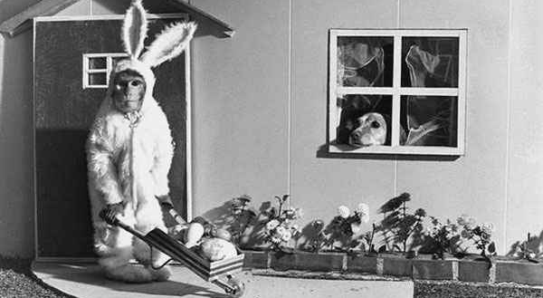
Issues
Notes:
port mapping
android

Slide 10
Numbers
10 gbps backbone
125 mbps internet uplink
Wired
Firewall
2 x Core routers
15 x edges
Media Server

Slide 11
Numbers
Wireless
7210 Aruba Controller
50 Access Points
DCTV
5 raspberry pis
5 channels Paris and Bally’s
Video Transcoder with 32G of memory

Slide 12
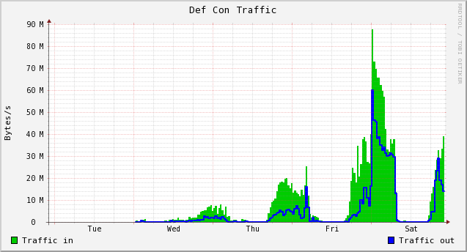
Numbers
Internet
1.5 Terabytes in
0.34 Terabytes out
Media Server
1.8 Terabytes
22k DHCP leases (all network, and yeah…)
5,300 different mac addresses (all network, and yeah… )
3,972 users registered on wifireg
117,467 valid authentications against the RADIUS server

Slide 13
# of Devices by Manufacturer
1883 Apple
782 Intel Corporate
239 Hon Hai Precision Ind. Co.,Ltd.
201 LG Electronics
196 Samsung Electro Mechanics co., LTD.
93 ASUSTek COMPUTER INC.
92 HTC Corporation
90 VMware, Inc.
90 Liteon Technology Corporation
86 Motorola Mobility LLC

Slide 14
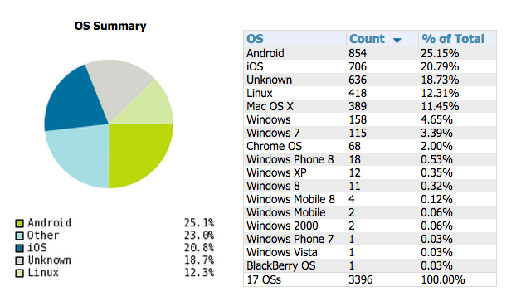
WiFi Graphs

Slide 15
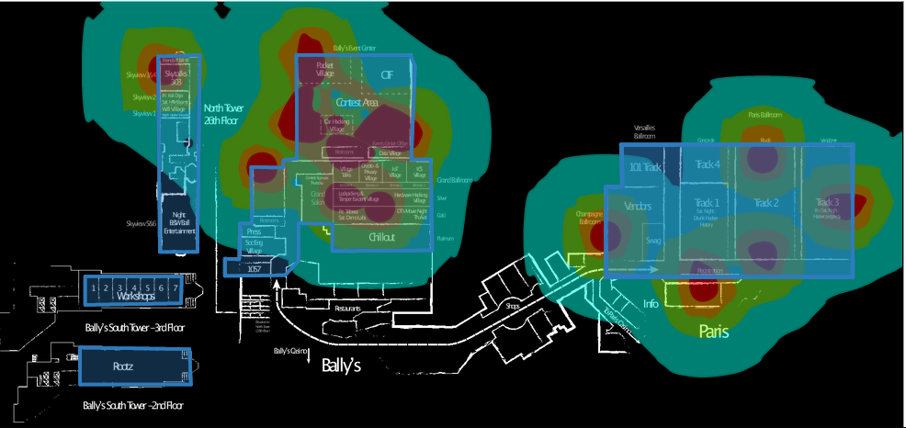
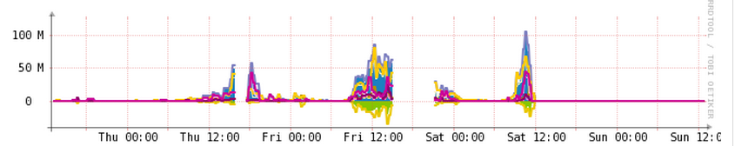
WiFi Graphs

Slide 16
effffn’s twelve
Leads
@effffn
mac
Infra/ Systems
#sparky
Naifx
Booger
char
commiebstrd
DCTV
videoman
serif
WiFi
rukbatgarten
arh@wk
CRV
N00b
planB

Slide 17
THANKS!
DT
Russ
Charel
Caesars Staff
Encore Staff
Dragorn
Source of Knowledge
The same random guy who brings us snacks!
You!
http://defconnetworking.org
@DEFCON_NOC
noc/at\defconnetworking.org

