Slide 1
DefCon 14
DefCon Network Team

Slide 2
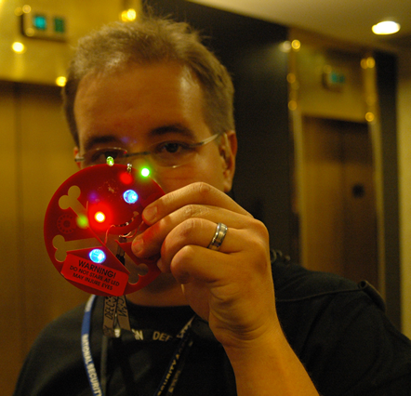
Do what?!
The Networks
  Public (wireless)
  Speakers
  Press
  Goons
  Public Servers
DefCon TV

Slide 3
DefCon TV
What we planned:
Ch26:
  The Geek Confessions
  DC PhotoBlog
  Movie Channel
Ch27:
  Information & updates

Slide 4
DCTV ☹
We got “new restrictions” last minute

Slide 5
DCTV ☹
We got “new restrictions” last minute
No PC’s could be used
  No dynamic content
  No physical access

Slide 6
DCTV ☹
We got “new restrictions” last minute
No PC’s could be used
  No dynamic content or physical access
So…
  We authored DVDs every few hours
  Hand delivered to Riviera staff to swap-out for DefCon Info Channel (in-room)

Slide 7
DCTV ☹
Thanks to DC801 for setting up their Movie Channel box
We’ll work with the hotel to make things better next year!
IDEAS: dctv@defconnetworking.org

Slide 8
DC14 Network
Our trusty Aruba Wireless kit
Our trusty OpenBSD firewalls
Lots of cable & gaffers tape.
6Mb Net Connection
Freaking awesome hotel AV/IT staff!

Slide 9

DC14 Network
Our trusty Aruba Wireless kit
Our trusty OpenBSD firewalls
Lots of cable & gaffers tape.
6Mb Net Connection
Freaking awesome hotel AV/IT staff!
And lots of homebrew!

Slide 10
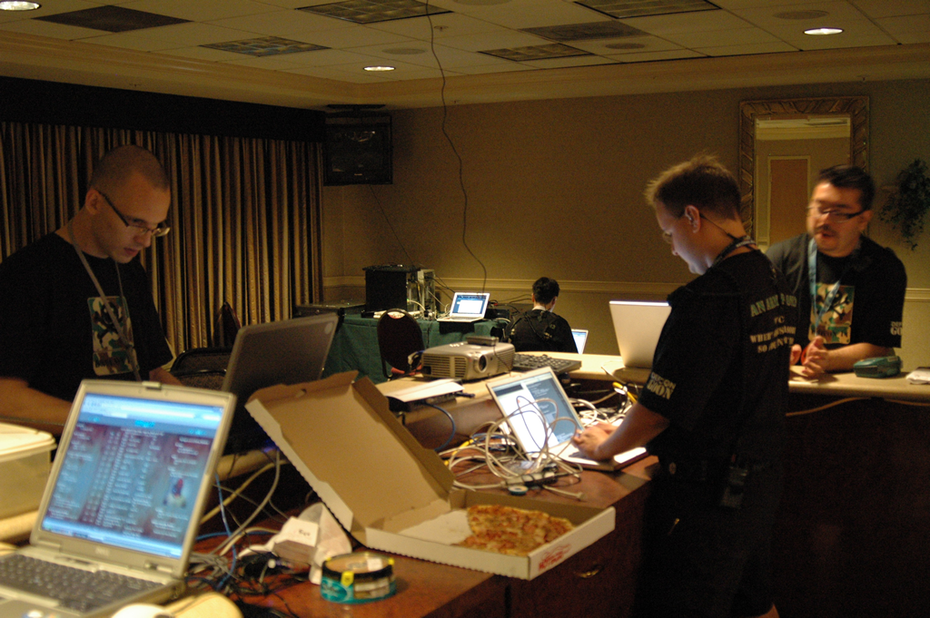

Slide 11
DC14 NetStats
Internet Traffic
SATURATED CONNECTION (6Mb)
173GB over 3 days

Slide 12
DC14 NetStats
DHCP: 2,355 leases
WiFi Stats:
  Average users on WiFi: 220 users
  Max number of users at the same time: 515 users
  Rogue (wired) APs: 2
  AP impersonation events: 25 (trying to be official-ish SSID)
  DoS Attacks ~2300
  MiTm Attacks ~ 2000
  Lots of adhoc networks
  WLAN Traffic:
    In 69,411,028,696 bytes
    Out 35,751,948,767 bytes
  Some people are STILL using airpwn to inject packets. there is no protection against this USE ENCRYPTION.

Slide 13
Tip Your Staff
Schwag your Goons!
MANY THANKS TO…!
  Infrastructure: Videoman & Heather
  WiFi: Sqweak & Effffn
  Resident BadMan™: Major Malfunction
  Political Advisor: Lockheed(me)
  DCTV: Rant Radio (Derek, James)

Slide 14
DefCon 15
CHEERS!

