Slide 1

Integration of Static Code Analysis in Continuous Integration Lifecycles
Brian Pfretzschner
Sebastian Funke
Hamza Zulfiqar
Source: http://povilasb.com/_images/code_analysis.jpeg

Slide 2
Why Static Code Analysis?
Static Code Analysis is your personal (security) code auditor!
Code
Auto Analysis
Code Review
Solid Software
Notes:
- gjg

Slide 3
Research questions
Where to apply static code analysis in software development processes?
How usable is the integration of popular Open Source static code analysers?
How usable are the reporting capabilities of popular Open Source static code analysers?
Notes:
- gjg

Slide 4
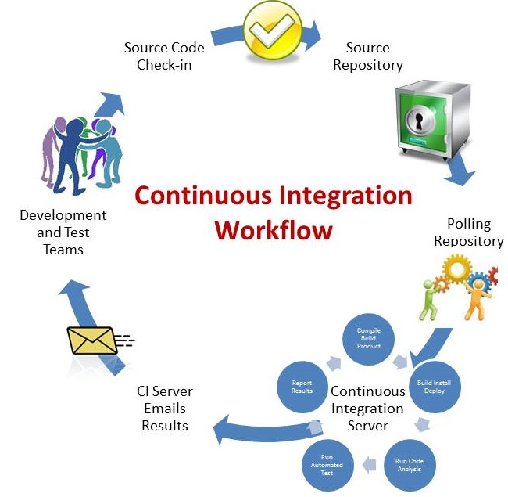
Where to apply static code analysis?
Directly in IDEs (e.g. Eclipse)
In Continous Integration (CI) systems (e.g. Jenkins)
External Code Quality Management (CQM) tools (e.g. SonarQube)
http://www.retrieverconsulting.com/cloud-solutions.html
Notes:
- We want to answer this question with the research for the other questions, how easy it is to integrate Static code analysis in those development processes and how usable is the reporting

Slide 5
Usability Evaluation of Static Code Analysis Integration
Evaluation Method: Cognitive Walkthough with usability inspection
Prepare Analysis
Run Analysis
Evaluate Analysis results
Manage results
Usability questions in every walkthrough stage

Slide 6




Evaluated Tools
IDE: Eclipse
CI: Jenkins
CI: TeamCity
CQM: SonarQube
https://raw.githubusercontent.com/yoshimov/chocolatey-packages/master/eclipse-java-juno/Eclipse_Icon_by_flosweb.png
https://wiki.jenkins-ci.org/display/JENKINS/Logo
http://citconf.com/archive/budapest2012/_Images/_Sponsors/team_city.png
http://www.sonarqube.org/wp-content/themes/sonarsource.org/images/sonar.png
Notes:
-

Slide 7
Comparison Results
Notes:
- gjg

Slide 8
Conclusion
Open Source analysers lack multi-language support
Analysers customization (Rules) hard to accomplish
Analysis in IDE not efficient, central, easy to manage
Analysis in CI tools hard to configure
Reporting capabilities of analysers in CI not usable
External Code Quality Management tools do the job
Good idea to use many analysers
BUT: many duplicate findings
Future approach: Tool to filter duplicates and false positives
Notes:
- gjg

Slide 9

Questions

