Slide 1
University Admission help tool
Created by rahat Rizvi Rahman(roll-37) & mustafizur Rahman(roll-22)

Slide 2
Outlines
About
Features
Resources
Work details
Flow Chart
Our experience

Slide 3
about
It’s an application to help the students to get the right and resourceful information about admission test
On the basis of user’s given information and result this application provides suggestion of universities

Slide 4
objectives
Reduces complexity of admission process
Reduces waste of time of searching varsity’s information
Improvement of student’s academic skill

Slide 5
Main features
Step by step profile building
Suggestion on the basis of current update
University information desk
University suggestion and important links

Slide 6
More features
User friendly interface
No complexity in account creating
Easy switching between the pages
Showing university information to all users

Slide 7
Resources
Intellij IDEA 2018.1
Java swing for graphical user interface
Online resources-> javapoint,java2s,tutorialspoint,youtube tutorials etc.

Slide 8
Oop concept
Different classes for different purposes
Use of polymorphism by constructor overloading
Partitioning the project in different modules

Slide 9
Graphical-io
For user input we used –JTextField , JComboBox , JCheckBox , Jlist ,JPasswordField etc.
For switching pages and selecting options we used-Jbutton
We used CardLayout , GridLayout , GridBagLayout for organizing components on the content pane.

Slide 10
Socket programming
Every account holder is a client and connected with server
Every account holder’s information is stored in server
Client and server communicate through socket
We used multithreading for handling multiple clients
Used Java.net package for communication between client and server

Slide 11
Work distrubution
We shared our thoughts and helped each other throughout the project
Student data collect and management part was done by Rahat Rizvi Rahman
Versity data collect and management part was done by Mustafizur Rahman
Networking and suggestion part was done by both of us

Slide 12
FILE i/o
Every account holder’s information is in different files
Every university’s information is in different files
Used Java.io package for retrieving data from files

Slide 13
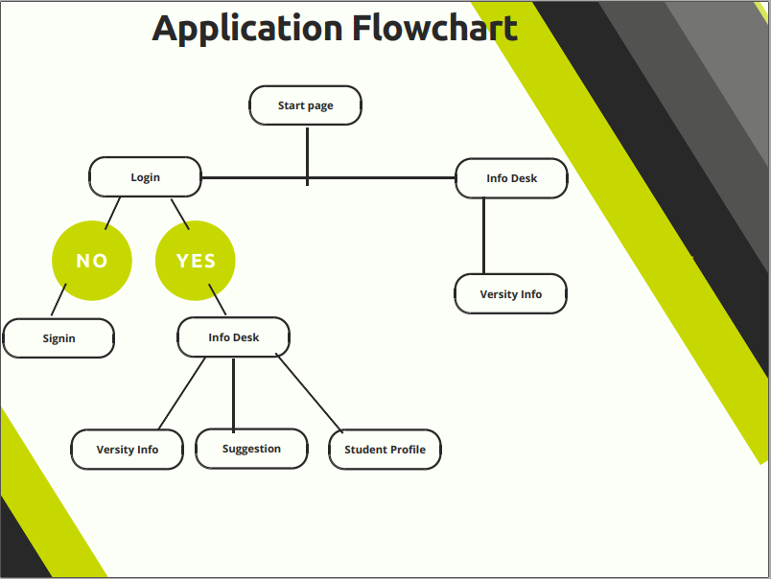

Slide 14
Our experience
Working in a project like making a tool like this was really very interesting and we gained much knowledge while building it. Most importantly we developed our object oriented programming knowledge and this was the first time we created a tool using java and really was very helpful.
We faced some problems regarding layout and network communication but we came out with solution by working hard and exploring online resources.
It was an exciting and fascinating experience.

Slide 15
Thank you

